Slide 1
Employee Benefits Summary
2022

Slide 2
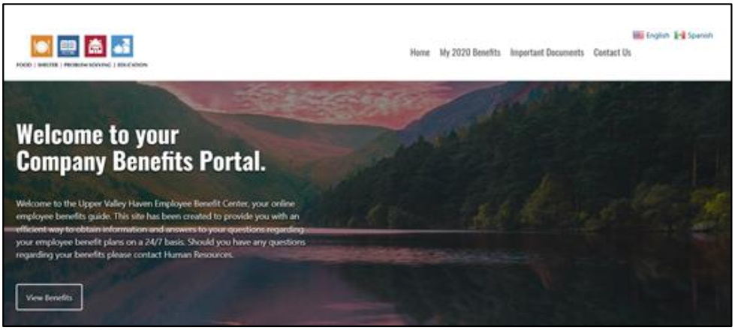
Benefit Eligibility
Benefit | Eligibility | Waiting Period
Medical, Dental & Vision Insurance | Minimum 20 hours/week | 1st of the month following date of hire
Group Life and AD&D | Minimum 24 hours/week | 1st of the month following 90 days after hire
Group Long-Term Disability | Minimum 24 hours/week | 1st of the month following 90 days after hire
Voluntary Short-Term Disability | Minimum 24 hours/week | 1st of the month following 90 days after hire
403(b) Retirement Plan | No minimum hours | Date of hire
Employee Assistance Program (EAP) | No minimum hours | Date of hire
Employee Benefit Center (EBC)
The Employee Benefits Center (EBC) is your online benefits resource. It is a one-stop resource which provides you with current benefits information, benefit summary documents, forms, and contact information for each carrier.
To log into the EBC, go to: uppervalleyhaven.trgportal.com
Username: uvh
Password: benefits
2 Medical | Dental | Vision | Life | Disability | Retirement

Slide 3
Plan Contact Information
MVP Healthcare
Medical Insurance
mvphealthcare.com / (888) 687-6277
Northeast Delta Dental
Dental Insurance
nedelta.com / (800) 832-5700
VSP
Vision Insurance
vsp.com / (800) 877-7195
Reliance Standard
Life/AD&D and Long-Term Disability
rsli.com / (800) 351-7500
Reliance Standard
Voluntary Short-Term Disability
rsli.com / (800) 351-7500
Vanguard Retirement
403(b) Retirement Plan
vanguard.com / (800) 962-5068
Magellan Healthcare
Employee Assistance Program
magellanhealthcare.com / (800) 450-1357
GradFin
Tuition Assistance
gradfin.com/trg.html
Medical | Dental | Vision | Life | Disability | Retirement 3xxxxxxxxxxxx

Slide 4
Medical Plans
 | VT Platinum | VT Plus Gold 3 HDHP | Reflective Silver 2 HDHP
Medical Deductible | $400 / $800 Embedded Deductible¹ | $3,200 / $6,400 Aggregate Deductible¹ | $5,100 / $10,200 Embedded Deductible¹
Medical OOPM | $1,400 / $2,800 | $3,200 / $6,400 | $5,100 / $10,200
Rx OOPM | $1,400 / $2,800 Med & Rx Separate | $1,400 / $2,800 Med & Rx Combined | $1,400 / $2,800 Med & Rx Combined
Preventive Care | Covered in Full | Covered in Full | Covered in Full
PCP & MH/BH Office Visit | $15 copay | Deductible, then 0% | Deductible, then 0%
Specialist Office Visit | $40 copay | Deductible, then 0% | Deductible, then 0%
Diagnostic Tests Labs / X-rays | Lab/Ofc: $15 copay Hosp: Ded, then 10% | Deductible, then 0% | Deductible, then 0%
Adv Radiology (MRI, CT, PET) | Deductible, then 10% | Deductible, then 0% | Deductible, then 0%
Urgent Care | $50 copay | Deductible, then 0% | Deductible, then 0%
Emergency Room | Deductible, then $100 | Deductible, then 0% | Deductible, then 0%
Inpatient Services | Deductible, then 10% | Deductible, then 0% | Deductible, then 0%
Outpatient Surgery | Deductible, then 10% | Deductible, then 0% | Deductible, then 0%
Chiropractic Office Visit | $20 copay | Deductible, then 0% | Deductible, then 0%
Outpatient PT/OT/ST (30 combined visits maximum) | Deductible, then 10% | Deductible, then 0% | Deductible, then 0%
Acupuncture | Not Covered | $500 allowance² | $500 allowance²
Prescriptions
Preventive Rx | Prev Rx process the same as any other prescription | Ded waived for Prev Rx Tier 1 $10 copay Tier 2 $15 copay Tier 3 5% coins | Ded waived for Prev Rx
Tier 1: Generic Rx | $10 copay (no Ded) | Deductible, then 0% | Deductible, then 0%
Tier 2: Preferred Brand Rx | $50 copay (no Ded) | Deductible, then 0% | Deductible, then 0%
Tier 3: Non-Preferred Brand Rx | 50% coins (No Ded) | Deductible, then 0% | Deductible, then 0%
Tier 4: Specialty Rx | 50% coins (No Ded) | Deductible, then 0% | Deductible, then 0%
¹ If your plan has a embedded deductible, the plan will begin to pay covered services for an individual member (enrolled in EE, ES,
EC, or Fam) once they have met the individual deductible. If your plan has an aggregate deductible, the entire family deductible
must be met before the plan begins to pay covered services for any member of the family.
² Members are reimbursed up to $500 for acupuncture services from a licensed provider. Once this allowance is met, no further
acupuncture services will be covered. This benefit is subject to the deductible and OOPM on high deductible plans. For those plans,
services will be reimbursed up to $500 in the same manner billed if the deductible has been met. If the deductible has been met, MVP
will apply the allowance to the deductible and OOPM until the deductible is met.
4 Medical | Dental | Vision | Life | Disability | Retirement
Medical | Dental | Vision | Life | Disability | HRA | FSA | Retirement 5

Slide 5
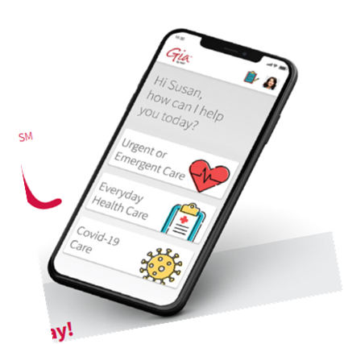
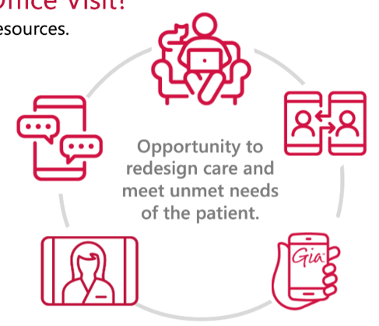
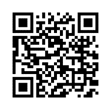
Welcome to a whole new world of care.
Easy access. Expert answers. Advice you can trust.
It’s all at your fingertips with Gia.
Gia can help you figure out if you need to see a doctor. And can help you find the right doctor…virtual care or in-person. Gia can also help with prescription refills, lab work, and more.
Health Questions? Gia has the answers.
Use Gia’s simple but powerful search tool, giving you helpful
and relevant health information you can trust.
Learn more:
GoAskGia.com or
download the Gia app today
Through Gia, you can access virtual care services¹
Gia can refer you to MVP’s virtual care services including:
24/7 Emergency Care
24/7 Urgent Care
Mental Health and Psychiatry
Primary Care
Lactation Consultants
Nutritionists and Dieticians
NEW! Virtual Physical Therapy!
myVisitNow
Schedule online appointment for psychiatry, behavioral health, nutrition, and lactation services. Have your appointments at home, on-the-go, or anywhere from your smartphone, tablet, or computer with a webcam.
Learn more: myVisitNow.com or
download the myVisitNow app
Virtual Physical Therapy
Treat and help prevent pain and injuries anytime, anywhere from your smartphone with virtual physical therapy.
Learn more: mvphealthcare.physera.com
Save time & money with virtual access
to care
Scan to learn more!
¹ Gia virtual care services and virtual physical therapy are $0 on all plans, except qualified
high-deductible health plans (QHDHPs) in 2022. The IRS now requires members enrolled
in QHDHPs to pay for virtual care services until their plan deductible is met. After the
deductible is met, virtual care services are $0. In-person or virtual care excluding Gia is
subject to co-pay/cost-share per plan details.
Medical | Dental | Vision | Life | Disability | Retirement 5xxxxxxxxxxxx

Slide 6
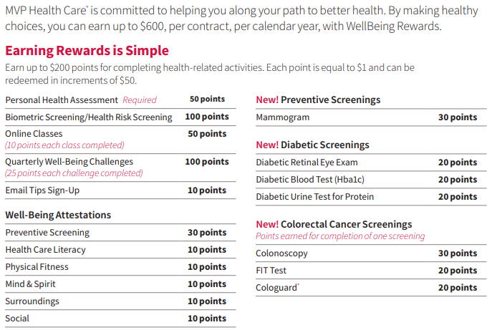
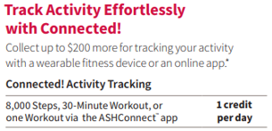
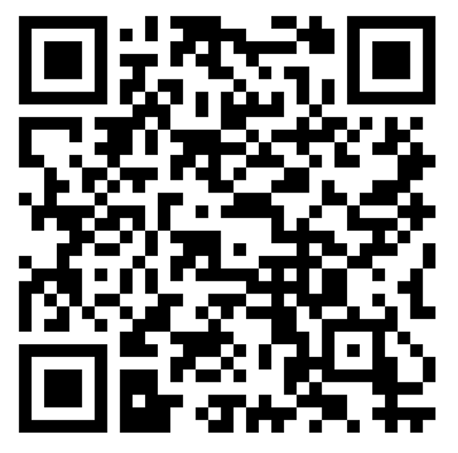
MVP WellBeing Rewards (for Silver & Bronze Plan participants)
You can earn up to $600 by:
Earn $200 by completing healthy activities—start with a personal health assessment & a biometric screening, then you can take online classes, compete in an online challenge, and participate in activity tracking programs.
Then get reimbursed up to $200 for activities that are great for your wellbeing—stress reduction apps, continuing education classes, healthy weight programs, gym memberships, yoga, massage, and more.
Finally earn another $200 for meeting activity goals—track your steps and log workouts to help create healthy habits.
Need an activity tracker or home exercise equipment? MVP offers discounts on these products—up to 55%.
Scan to learn more!
6 Medical | Dental | Vision | Life | Disability | Retirement

Slide 7
Dental Plan
Calendar Year Maximum: $2,000 per person (Coverage A, B and C combined) One-time Deductible: $100 / $300 Individual / Family (Coverage B & C combined)
DIAGNOSTIC / PREVENTIVE | BASIC RESTORATIVE | MAJOR RESTORATIVE
Covered at 100% No Waiting Period | Covered at 80% No Waiting Period | Covered at 50% After a 6-mo waiting period
DIAGNOSTIC: Oral evaluations twice in a 12-month period, this includes periodic, limited, problem focused, and comprehensive evaluations Bitewing x-rays once in a 12-month period X-rays of individual teeth as necessary Brush biopsy once in a 12-month period PREVENTIVE: Cleanings twice in a 12-month period Fluoride twice in a 12-month period to age 15 Sealant application to permanent molars, once in a life per tooth, for children to age 15 | RESTORATIVE: Amalgam (silver) fillings; Composite (white) fillings ORAL SURGERY: Routine extractions ENDODONTICS: Root canal therapy PERIODONTICS: Treatment of gum disease Periodontal Cleaning (Maintenance procedures) Note: Only two cleanings are covered in a 12-month period. These may be any combination of routine (Cov A) or periodontal (Cov B) Space maintainers to age 15 Full-mouth/panoramic x-rays once in a 5-year period EMERGENCY PALLIATIVE TREATMENT | PROSTHODONTICS: Removable and fixed partial dentures (bridge); complete dentures Rebase & reline (dentures) Crowns Onlays Implants DENTURE REPAIR: Repair of removable denture to its original condition ORAL SURGERY: Complex extractions and other surgical procedures CROWN LENGTHENING: Clinical crown lengthening once in a lifetime per site
Calendar Year Maximum: $2,000 per Person (up to $4,000 with Double-Up Max)
Medical | Dental | Vision | Life | Disability | Retirement 7xxxxxxxxxxxx

Slide 8
Dental Wellness
A healthy mouth is part of a healthy life, and Northeast Delta Dental’s innovative HOW
program works with your dental benefits to help you achieve and maintain better oral
wellness. HOW is all about you because it’s based on your specific oral health risk and
needs. Best of all, it’s secure and confidential.
Here’s how to get started:
1. Go to www.healththroughoralwellness.com and click on “Register Now”.
Know Your Score
After you register, please take the free oral health risk assessment by clicking on “Free Assessment”
in the Know Your Score section of the website.
Share Your Score With Your Dentist
The next step is to share your results with your dentist at your next dental visit. Your dentist can
discuss your results with you and perform a clinical version of the risk assessment
This Northeast Delta Dental Plan allows you to double your calendar year maximum by earning an additional $250 per year for use in future benefit periods.
Here is how it works:
To qualify for the carryover, you must have a claim paid for either an oral exam or a cleaning during a calendar year (a focus on prevention), and your total paid claims cannot exceed $500 during the same calendar year.
The carryover will accumulate for each year of qualification up to an amount equal to the plan’s original calendar year maximum. If, for example, the calendar year maximum is $2,000, enrollees can ultimately achieve an annual maximum of $4,000.
Great Savings—Up to 35% oﬀ eyewear
Choose from any available frame including quality name-brand products such as Brooks Brothers®, Ann Klein®, Vogue® and more at provider locations. With EyeMed Vision Care, Northeast Delta Dental members have access to over 71,000 vision care providers nationwide at 27,000 locations including optometrists, ophthalmologists, opticians, and the nation’s leading optical retailers.
It’s easy! To request your discount, simply present your Delta Dental member ID card or this ﬂyer when you arrive at the provider office or location. Your EyeMed provider will take care of the rest! To learn more about the EyeMed Vision Care Discount Plan, please visit our website at www.nedelta.com
8 Medical | Dental | Vision | Life | Disability | Retirement

Slide 9
VSP Vision
Benefit |  | Description | Copay |  | Frequency
Your Coverage with a VSP Provider
WellVision Exam | Focuses on your eyes and overall wellness | Focuses on your eyes and overall wellness | $20 for exam and glasses | $20 for exam and glasses | Every calendar year
Prescription Glasses
Frame | $150 allowance for a wide selection of frames $170 allowance for featured frame brands 20% savings on the amount over your allowance | $150 allowance for a wide selection of frames $170 allowance for featured frame brands 20% savings on the amount over your allowance | Combined with exam | $20 copay | Every other calendar year
Lenses | Single vision, lined bifocal, and lined trifocal lenses Polycarbonate lenses for dependent children | Single vision, lined bifocal, and lined trifocal lenses Polycarbonate lenses for dependent children | Combined with exam |  | Every calendar year
Lens Enhancements | Progressive lenses Anti-reflective coating Tints/Photochromic adaptive lenses Scratch Resistant Coating Average savings of 35-40% on other lens enhancements | Progressive lenses Scratch Resistant Coating Average savings of 35-40% on other lens enhancements | $0 $0 | $0 $0 $0 $0 | Every calendar year
Contacts (instead of glasses) | $150 allowance for contacts; copay does not apply Contact lens exam (fitting and evaluation) | $130 allowance for contacts; copay does not apply Contact lens exam (fitting and evaluation) | Up to $60 | Up to $60 | Every calendar year
Extra Savings | Glasses and Sunglasses Extra $20 to spend on featured frame brands. Go to vsp.com/special offers for details 30% savings on additional glasses and sunglasses, including lens enhancements, from the same VSP provider on the same day as your WellVision Exam. Or get 20% from any VSP provider within 12 months of our last WellVision Exam. | Glasses and Sunglasses Extra $20 to spend on featured frame brands. Go to vsp.com/special offers for details 30% savings on additional glasses and sunglasses, including lens enhancements, from the same VSP provider on the same day as your WellVision Exam. Or get 20% from any VSP provider within 12 months of our last WellVision Exam.
 | Retinal Screening No more than $39 copay on routine retinal screenings as an enhancement to a WellVision Exam | Retinal Screening No more than $39 copay on routine retinal screenings as an enhancement to a WellVision Exam
 | Laser Vision Correction Average 15% off the regular price or 5% off the promotional price; discounts only available from contracted facilities | Laser Vision Correction Average 15% off the regular price or 5% off the promotional price; discounts only available from contracted facilities
TruHearing is making hearing aids affordable by providing exclusive savings to all VSP members. You can save up to 60% on a pair of hearing aid with TruHearing pricing. What’s more, your dependents and even extended family members are eligible.
In addition to great pricing, TruHearing provides you with:
Three provider visits for fitting, adjustments, and cleanings
A 45-day money back guarantee
Three-year manufacturer’s warranty for repairs and one-tine loss & damage
48 free batteries per hearing aid
Learn more about this VSP Exclusive Member Extra at www.vsptruhearing.com
Medical | Dental | Vision | Life | Disability | Retirement 9xxxxxxxxxxxx

Slide 10
Contributions & Rates
Upper Valley Haven Contribution
For each full-time (32+ hours) employee: $8,726, an average of $727.16 per month
For each part-time (20-31 hours) employee: $4,363, an average of $363.58 per month
Medical
 | Platinum | Gold CDHP | Silver CDHP
Employee | $810.54 | $683.24 | $593.43
Employee + Spouse | $1.621.08 | $1,366.48 | $1,186.86
Employee + Child(ren) | $1,564.34 | $1,318.65 | $1,145.32
Employee + Family | $2,277.62 | $1,919.90 | $1,667.54
Delta Dental
Employee | $43.81
Employee + 1 | $79.86
Employee + Family | $134.78
VSP Vision
Employee | $11.92
Employee + Spouse | $19.07
Employee + Child(ren) | $19.46
Employee + Family | $31.38
10 Medical | Dental | Vision | Life | Disability | Retirement

Slide 11
Life & Disability Insurance
Employer-Paid
Life/AD&D and Long-Term Disability
Basic Life and Accidental Death & Dismemberment Insurance
100% Employer Paid | $25,000 Basic Life Insurance $25,000 Accidental Death & Dismemberment
 | Benefit reduces by 50% at age 70 (reduction from pre-age 65 amount)
Long-Term Disability Insurance
100% Employer Paid | Benefits begin after a 180 consecutive days of total disability
 | Benefit is 60% of monthly earnings up to a maximum of $6,000 per month Minimum monthly benefit is $50 Maximum benefit period to age 65 or SSNRA
Employee-Paid
Voluntary Short-Term Disability
Voluntary Short-Term Disability Insurance
100% Employee Paid | Each employee may elect an amount of insurance in increments of $25 from a minimum of $100 per week to a maximum of $1,500 per week, not to exceed 60% of covered earnings. There is a 30 day sickness/injury elimination period
Medical | Dental | Vision | Life | Disability | Retirement 11xxxxxxxxxxx

Slide 12
403(b) Retirement Plan
All employees are eligible to participate in the Upper Valley Haven 403(b) retirement plan through the Vanguard on their first day of employment.
To contribute to your plan, you will be asked to complete a salary deferral agreement to indicate how much of your income you wish to defer to your plan. Contributions will be deducted from your paycheck on a pre-tax basis.
Your contribution to your 403(b) plan may not exceed $20,500 for the 2022 calendar year. Annual limitations are set by the IRS and are subject to change. If you are at least 50 years old, you may make an additional catch-up contribution of $6,500.
Employee Assistance Program (EAP)
The Employee Assistance Program (EAP) is a confidential referral service available to all employees and their immediate household members through Principal, in partnership with Magellan Health. The program is designed to help those experiencing difficulties which may interfere with personal health, family relationships, or job responsibilities.
Licensed professionals provide confidential support and guidance by phone or online, to assist with concerns, such as:
Family, relationship, and parenting issues
Basic child and elder care needs
Emotional and stress-related issues
Conflicts at work or home
Alcohol and drug dependencies
Personal development and general wellness
Available 24/7 by phone or online:
800-450-1327
www.magellanhealth.com/member
12 Medical | Dental | Vision | Life | Disability | Retirement

Slide 13
GradFin
The Upper Valley Haven offers a tuition assistance program designed to help employees repay student loan debit and improve their financial wellbeing through consultation services with GradFin. GradFin is a benefit program that is revolutionizing the way employees can reduce their student loan debt. This program is available to you at no cost.
Through GradFin you receive:
One-on-one education consultations with a GradFin Consultant to review your current loan status and discuss the best payoff option available to you.
GradFin will analyze your loans and provide payment and refinancing options for your federal and/or private loans.
GradFin will consult with you by phone to determine which loans to refinance and to make recommendations on the best payoff strategies for your remaining loans.
GradFin assists in cutting monthly student loan payments to help you put your hard-earned money toward other financial goals.
GradFin will work to offer a competitive interest rate reduction when you refinance your loans.
GradFin will provide up to a $300 bonus to you when you refinance. The bonus will be applied to the principal of your closed loan.
GradFin will offer the lowest interest rates in the industry through their lending platform which is made up of ten lenders to maximize the chances that you will be approved for a new loan.
For more information or to schedule your consultation:
www.gradfin.com/trg.html
Eligibility:
To participate in the benefit, you must be an employee of Upper Valley Haven and must be at least 21 years old. Student loans held by an employee’s dependent are not eligible for GradFin services unless the employee is also a co-signer of the loan.
Medical | Dental | Vision | Life | Disability | Retirement 13xxxxxxxxxxx

Slide 14
Additional Information and Notices
COBRA Information:
COBRA continuation coverage is a temporary extension of coverage under the group health plan. The right to COBRA continuation coverage was created by a federal law, the Consolidated Omnibus Budget Reconciliation Act of 1985 (COBRA). COBRA continuation cover age can become available to you when you would otherwise lose your group health coverage. It can also become available to other members of your family who are covered under the Plan when they would otherwise lose their group health coverage. For additional information about your rights and obligations under the Plan and under federal law, you should review the Plan’s Summary Plan Description or contact the Benefits Coordinator in Human Resources.
Health Insurance Marketplace:
You may have other options available to you when you lose group health coverage. You may be eligible to buy an individual plan through the Health Insurance Marketplace (www.healthcare.gov). By enrolling in coverage through the Marketplace, you may qualify for lower costs on your monthly premiums and lower out-of-pocket costs. Additionally, you may qualify for a 30- day special enrollment period for another group health plan for which you are eligible (such as a spouse’s plan), even if that plan generally doesn’t accept late enrollees.
HIPAA Information:
Special Enrollment Right Mandated by the Health Insurance Portability and Accountability Act of 1996
Group health plans and health insurance insurers are required to provide special enrollment periods during which individuals who previously declined coverage for themselves and their dependents may be allowed to enroll without having to wait for the plan’s next open enrollment period. A special enrollment period can occur if a person with other health coverage loses that coverage or if a person becomes a new dependent through marriage, birth, adoption or placement for adoption. If you refuse enrollment for yourself or your dependents for medical coverage, you may later enroll within 30 days of a change in family status or loss of health coverage.
Individuals may not be denied eligibility or continued eligibility to enroll for benefits under the terms of the plan based on specified health factors. In addition, an individual may not be charged more for coverage than similarly situated individuals based on these specific health factors.
Effective April 1, 2009, the Children’s Health Insurance Reauthorization Act of 2009 (CHIPRA) created a new 60-day special enrollment peri od for eligible employees and dependents to immediately enroll in the plan if they become ineligible for Medicaid or any state’s Children’s Health Insurance Program (CHIP) and lose coverage or become eligible for that state’s premium assistance program. The employee must request coverage within 60 days after the termination of coverage or the determination of subsidy eligibility.
Women’s Health and Cancer Rights Act of 1998 (WHCRA):
WHCRA requires a group health plan to notify you, as a participant or a beneficiary, of your potential rights related to coverage in connection with a mastectomy. Your plan may provide medical and surgical benefits in connection with a mastectomy and reconstructive surgery. If it does, coverage will be provided in a manner determined in consultation with your attending physician and the patient for a) all stages of reconstruction on the breast on which the mastectomy was performed; b) surgery and reconstruction of the other breast to produce a symmetrical appearance; c) prostheses; and d) treatment of physical complications of the mastectomy, including lymphedema. The cover age, if available under your group health plan, is subject to the same deductible and coinsurance applicable to other medical and surgical benefits provided under the plan. For specific information, please refer to your summary plan description or benefits booklet, or contact Human Resources.
This is only a Summary, not a Certificate of Insurance
The information contained in this Employee Benefits Summary is presented for illustrative purposes only and is based on information provided by the employer and in certificates of insurance supplied by the insurance carrier. The Richards Group, your company’s insurance broker, has prepared this Summary to assist employees in understanding their company’s benefits plan. While every effort has been made to describe these benefits accurately, discrepancies or errors are possible. You should also read the actual plan documents in their entirety. If there is a discrepancy between the Employee Benefits Summary and the actual plan documents, the plan documents will prevail. If you have any questions about the Employee Benefits Summary, please contact Human Resources.
14 Medical | Dental | Vision | Life | Disability | Retirement

Slide 15
Notes
Medical | Dental | Vision | Life | Disability | Retirement 15xxxxxxxxxxx

