Slide 1
Understanding Your Health Plan
Open Enrollment Presentation for Brattleboro Retreat

Slide 2
Health Plans, Inc. (HPI)
We’re glad you’re here.
HPI will continue to be your health benefits administrator.
We’ve been helping members make the most of their health benefits for more than 38 years.
Our member services team is specially trained to answer any of your health benefit questions and quickly get you the information you need.

Slide 3
Nationwide healthcare coverage
Access to in-network care with the Harvard Pilgrim provider network
In New England: over 80,000 doctors and clinicians and 183 hospitals
Outside New England: coverage through the UnitedHealthcare Options PPO network
Save money when you stay in-network
No need to choose a primary care provider (PCP) or get referrals to see a specialist
Preventive care is covered 100% in-network

Slide 4
Plan Benefit Highlights: Gold Plan - HRA
Category | Tier 1 Dartmouth Hitchcock Facility Services | Tier 2 HPHC In-Network | Tier 3 Non-Network
Plan Year Deductible* | $4,500 / $9,000 | $5,000 / $10,000 | $10,000 / 20,000
Routine Physical Exam | 100%, deductible waived | 100%, deductible waived | 100% allowed after deductible
Primary Care Office Visit | 100% after deductible | 100% after deductible | 100% allowed after deductible
MRI, PET, CT | 100% after deductible | 100% after deductible | 100% allowed after deductible
Emergency Room (Deductible waived) | 100% after deductible | 100% after deductible | 100% allowed after deductible
Inpatient Hospitalization | 100% after deductible | 100% after deductible | 100% allowed after deductible
Day Surgery | 100% after deductible | 100% after deductible | 100% allowed after deductible
Out-of-Pocket Max | $4,500 / $9,000 | $5,000 / $10,000 | $10,000 / $20,000
Retail Prescriptions: Optum / RxBenefits | $5 / $45 / $90 (30-day supply)
Mail Order Prescriptions: Optum Rx. (new prescription needed for mail order) | $10 / $90 / $180 (90-day supply)
*Deductibles and out-of-pocket maximums are not combined This is a high-level summary for illustrative purposes. Contact HPI to confirm all benefits.

Slide 5
Plan Benefit Highlights: Silver Plan
Category | Tier 1: Dartmouth Hitchcock Facility Services | Tier 2 HPHC In-Network | Tier 3 Non-Network
Plan Year Deductible* | $2,500 / $5,000 | $3,000 / $6,000 | $6,000 / $12,000
Routine Physical Exam | 100%, deductible waived | 100%, deductible waived | 70% allowed after deductible
Primary Care Office Visit | $25 copay | $25 copay | 70% allowed after deductible
MRI, PET, CT | 80% after deductible | 80% after deductible | 70% allowed after deductible
Emergency Room (Deductible waived) | $150 copay | $150 copay | $150 copay then 100% allowed
Inpatient Hospitalization | 90% after deductible | 80% after deductible | 70% allowed after deductible
Day Surgery | 90% after deductible | 80% after deductible | 70% allowed after deductible
Out-of-Pocket Max | $4,500 / $9,000 | $5,000 / $10,000 | $10,000 / $20,000
Retail Prescriptions: Optum / RxBenefits | $5 / $30 / $50 (30-day supply)
Mail Order Prescriptions: Optum Rx. (new prescription needed for mail order) | $10 / $60 / $100 (90-day supply)
*Deductibles and out-of-pocket maximums are not combined This is a high-level summary for illustrative purposes. Contact HPI to confirm all benefits.

Slide 6
Plan Benefit Highlights: Basic Plan
Category | Tier 1 Dartmouth Hitchcock Facility Services | Tier 2 HPHC In-Network | Tier 3 Non-Network
Plan Year Deductible* | $5,000 / $10,000 | $6,000 / $12,000 | $12,000 / $24,000
Routine Physical Exam | 100%, deductible waived | 100%, deductible waived | 70% allowed after deductible
Primary Care Office Visit | $40 copay | $40 copay | 70% allowed after deductible
MRI, PET, CT | 100% after deductible | 100% after deductible | 70% allowed after deductible
Emergency Room (Deductible waived) | $300 copay | $300 copay | $300 copay then 100% allowed
Inpatient Hospitalization | 100% after deductible | 100% after deductible | 70% allowed after deductible
Day Surgery | 100% after deductible | 100% after deductible | 70% allowed after deductible
Out-of-Pocket Max | $5,000 / $10,000 | $6,000 / $12,000 | $15,000 / $30,000
Retail Prescriptions: Optum / RxBenefits | $10 / $30 / $50 (30-day supply)
Mail Order Prescriptions: Optum Rx. (new prescription needed for mail order) | $20 / $60 / $100 (90-day supply)
*Deductibles and out-of-pocket maximums are not combined This is a high-level summary for illustrative purposes. Contact HPI to confirm all benefits.

Slide 7
Plan Benefit Highlights: Bronze Plan HDHP - HSA
Category | Tier1 Dartmouth Hitchcock Facility Services | Tier 2 HPHC In-Network | Tier 3 Non-Network
Plan Year Deductible* | $2,500 / $5,000 | $3,000 / $6,000 | $3,000/ $6,000
Routine Physical Exam | 100%, deductible waived | 100%, deductible waived | 100% allowed deductible waived
Primary Care Office Visit | 80% after deductible | 80% after deductible | 80% allowed after deductible
MRI, PET, CT | 80% after deductible | 80% after deductible | 80% allowed after deductible
Emergency Room (Deductible waived) | 90% after deductible | 90% after deductible | 90% allowed after deductible
Inpatient Hospitalization | 90% after deductible | 80% after deductible | 80% allowed after deductible
Day Surgery | 90% after deductible | 80% after deductible | 80% allowed after deductible
Out-of-Pocket Max** | $3,500 / $7,000 | $4,000/ $8,000 | $4,000 / $8,000
Prescriptions: In network, Optum Rx/RxBenefits | $10 / $30 / $50 (30-day supply)
Prescriptions: Optum rx: Mail Order (new prescription needed for mail order) | $20 / $60 / $100 (90-day supply)
*Deductibles are combined. **Out-of-pocket maximums are not combined. This is a high-level summary for illustrative purposes. Contact HPI to confirm all benefits.

Slide 8
Comparing Plans
How the plans are the same
No pre-existing condition limitations
Unlimited Lifetime Maximum
No referrals required for care
Preventative care covered at 100%
Same HPI nationwide provider network
Same services covered by each plan

Slide 9
Comparing Plans
How the plans are different
Who pays when (when does a copay, deductible, or coinsurance apply?)
Out of Pocket Maximum (maximum exposure)
Out of pocket vs. out of paycheck
The Gold plan has a Health Reimbursement Account (HRA)
The Bronze plan is Health Savings Account (HSA)- eligible

Slide 10
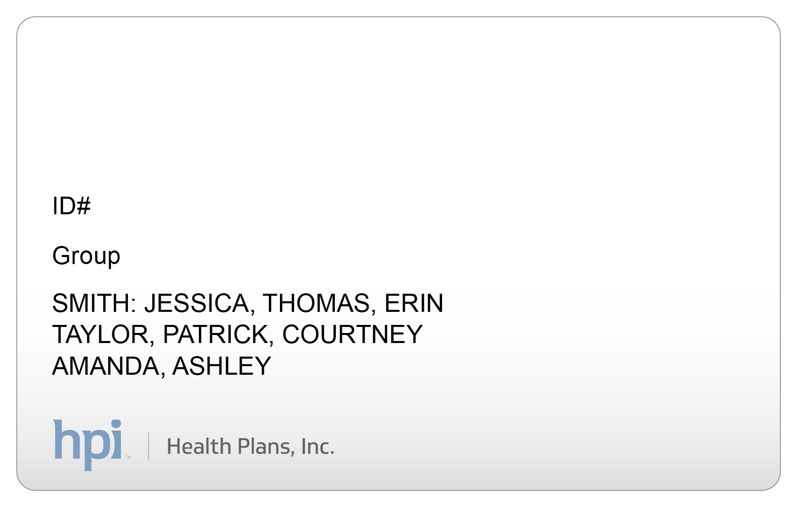
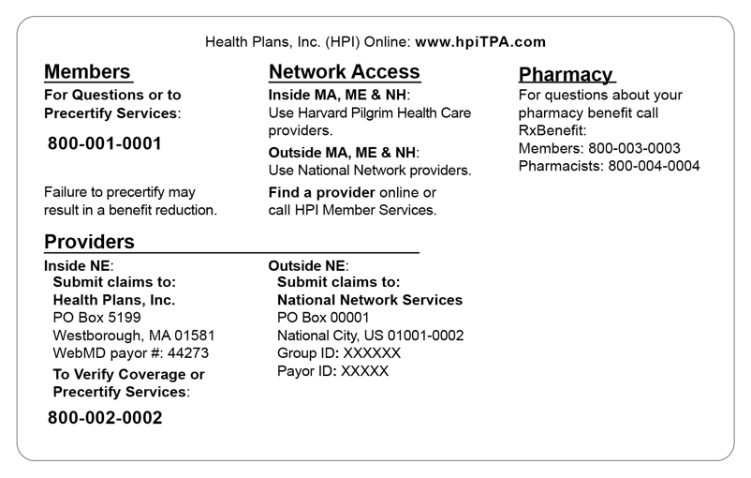
One Member ID Card for Medical and Prescription Services
Watch the mail for your Member ID Card if you are a new employee or new plan participant
Includes copay amounts and your healthcare provider network, Harvard Pilgrim Health Care
Tells your provider how to bill for services
Lists the customer service phone numbers and our website
Always keep your card with you for when you need care
ABC COMPANY
HHZ010000
Medical Copays
Z01
Preventive
Office Visit
Specialist
$0
$20
$20

Slide 11
Programs for Your Health
Manage diabetes, heart, lung or other chronic conditions
Enroll in our condition management program to work with a dedicated nurse who can help you improve well being.
Breathe easier
Get help managing your asthma and avoiding your triggers to reduce missed days at work or school.
You don’t have to face serious illness alone
You and your family will get personal support from an experienced nurse care manager to help you get the right care at the right time.
Call us at the number on the back of your ID card for more information
Notes:
Disease/Condition Management

Slide 12
Get Help with Your Complex Condition
Get help managing specific complex chronic conditions
Enroll in our complex condition management program to work with a dedicated nurse who can help you self-manage your condition and feel as good as possible.
One-on-one support so you don’t have to face serious illness alone
Get personal support from an experienced nurse care manager to help you get the right care at the right time and develop ways to stay motivated and on track with your medications and treatment.
Call us at the number on the back of your ID card for more information
Notes:
Complex Condition Management

Slide 13
Your Doctor On Demand Benefit
Quality medical and behavioral health services any time you need them —right from home.
You can see a doctor right away from your smart phone, tablet or computer
Available to you and your covered dependents
Saves you the time and cost of traveling to the ER or Urgent Care
Treatment for urgent care, behavioral health and everyday care, including:
Cold & flu
Sinus infections
Skin conditions
Allergies
Anxiety & depression
Download the app free from the Apple Store or Google Play, or visit doctorondemand.com/health-plans-inc from a Google Chrome browser

Slide 14
Exclusive Discounts on Health-Related Products and Services
As an HPI member, you are entitled to special savings on many health-related products and services.
Fitness Discounts
Wellness and Healthy Product Discounts
Vision and Hearing Care
Safety and Comfort Care
Nutrition
For a list of available member discounts go to hpiTPA.com

Slide 15
COVID-19 Information
Who can I call at HPI if I have COVID-19 benefit and coverage questions?
Give us a call at the phone number listed on the back of your Member ID card, or call 800-532-7575, Monday through Friday, 8am to 6pm (ET).
Where can I get up-to-date information on COVID-19?
Visit the Centers for Disease Control and Prevention (CDC) website at cdc.gov.
Does HPI have information about COVID-19 on its website?
For information about COVID-19 and your health plan coverage, visit healthplansinc.com/COVID-19

Slide 16
Online Tools and Resources
HPI Online: hpiTPA.com

Slide 17
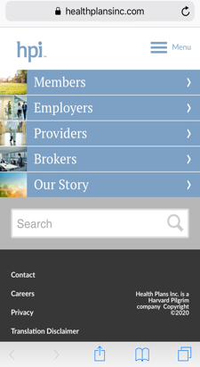
Manage Your Plan at Home or On the Go with My Plan
Use your Member ID number to register for instant secure access to your plan information:
Find doctors and hospitals in your network
Check the status of a claim
Review your benefits
Access your prescription drug plan
Print a claims history summary report
Submit a request for claims reimbursement
Print or submit forms
View, print, or order your member ID card
Watch our video tour to see what you can do.

Slide 18
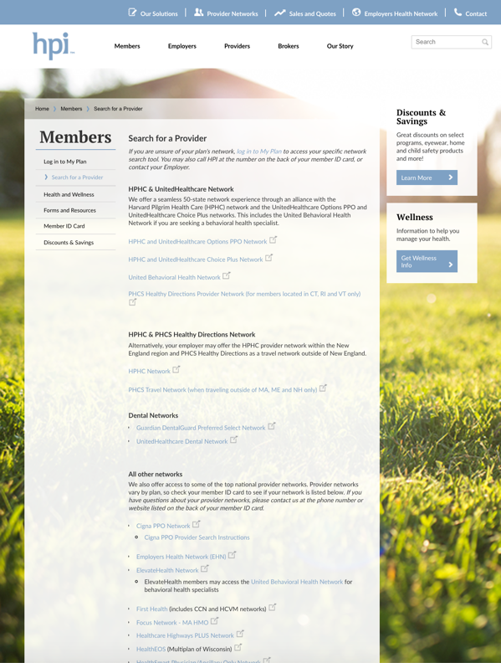
Find Providers in Your Network
To find providers in your network, go to hpiTPA.com:
1
Log in to My Plan
2
Click on your network under My Provider Networks
or
1
Visit our Find a Provider page
2
Select Harvard Pilgrim Health Care and UnitedHealthcare Options PPO network to begin your search

Slide 19
Access Helpful Health and Wellness Resources
Your Health Resources
Educational library
Health quizzes and interactive tools
Healthy pregnancy
Kick the habit
Lots more
Mindfulness
Stream or download free guided meditations
Explore free learning and practice videos

Slide 20
Thank You
Questions?
hpiTPA.com
800-532-7575
Weekdays 8am–6pm (ET)

