Slide 1
Prepared for

Slide 2
Health Plans, Inc.
We’re glad you’re here.
Health Plans, Inc., (HPI) will continue to be your health benefits administrator.
We’ve been helping members make the most of their health benefits for more than 35 years.
We’ll ensure that your medical claims are paid quickly and accurately so that your costs can be kept to a minimum.
Our member services team is specially trained to answer any of your health benefit questions and promptly get you the information you need.

Slide 3
Nationwide healthcare coverage
Access to in-network care with the Harvard Pilgrim provider network.
In New England: over 53,000 doctors and clinicians and 170 hospitals
Outside New England: coverage through the UnitedHealthcare Options PPO network
No need to choose a primary care provider (PCP) or get referrals to see a specialist
Preventive care is covered at 100%
Notes:
Edit slide to select Options PPO or Choice Plus for the UnitedHealthcare network

Slide 4
About your plan benefits

Slide 5
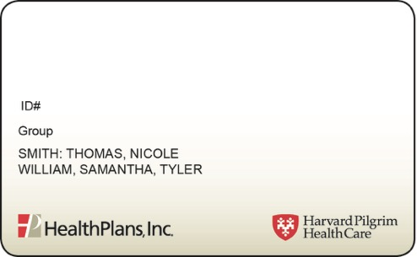
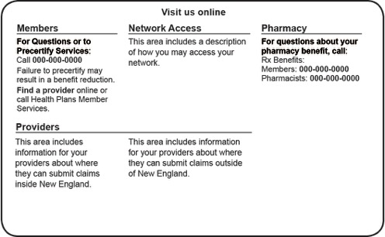
One Member ID Card for Medical and Prescription Services
Watch the mail for your member ID card if you are either a new employee or new participant
Informs you of copay amounts and your healthcare provider network, Harvard Pilgrim Health Care
Includes pertinent information that tells your provider how to properly bill for services
Lists the customer service phone numbers and URLs for you to contact with questions
Always keep your card with you for when you need care
ABC COMPANY
HHZ010000
Medical Copays
Z01
Preventive
Office Visit
Specialist
$0
$20
$20
Notes:
HPHC Primary

Slide 6
Online tools and resources at healthplansinc.com

Slide 7
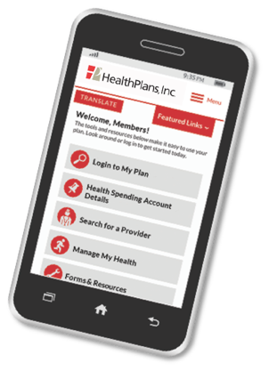
Manage Your Plan at Home or On the Go with My Plan
Use your member ID number to register for instant secure access to your plan information:
Find doctors and hospitals in your network
Check the status of a claim
Review your benefits
Access your prescription drug plan
Print a claims history summary report
Submit a request for claims reimbursement
Print or submit forms
View, print, or order your member ID card
Helpful benefit plan tools available in standard and mobile-friendly formats

Slide 8
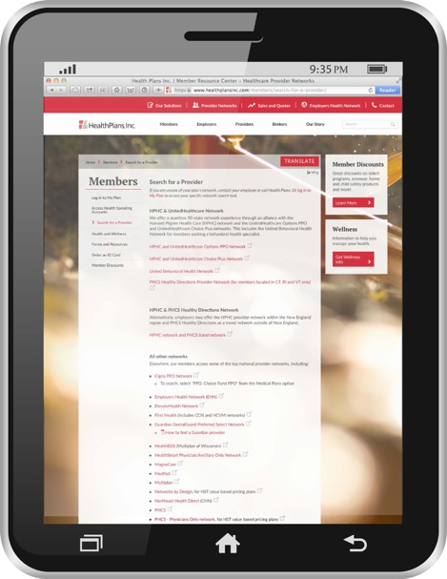
Find Providers in Your Network
To find providers in your network, go to healthplansinc.com/members:
Log in to My Plan
1
Click on your network under My Provider Networks
2
or
Click Search for a Provider
1
Select Harvard Pilgrim Health Care and UnitedHealthcare Options PPO
network to begin your search
2
Notes:
Edit the slide to select Options PPO or Choice Plus for the UnitedHealthcare network

Slide 9
Health Plans Inc. Portal Tour

Slide 10
Search For A Provider

Slide 11
Find A HPHC Provider

Slide 12
Print A Temporary ID Card

Slide 13
Additional Services From HPI

Slide 14
COVID-19 Information
Who can I call if I’m not feeling well?
If you are not feeling well, please contact your primary care provider to discuss active symptoms.
To help you make decisions about seeking appropriate care, try the CDC’s symptom checker at cdc.gov/coronavirus.
Where can I get the latest information about COVID-19?
For the best source for up-to-date information, visit the Centers for Disease Control and Prevention (CDC) website at cdc.gov. The outbreak is evolving quickly, and the CDC and health departments in each state are working on public health policies to help prevent the spread of the illness.
Who can I call at HPI with questions?
Benefits and coverage questions:
Contact the phone number listed on the back of your Member ID card, or call 800-532-7575, Monday through Friday, 8am to 5pm (ET).
COVID-19 specific questions:
Call 877-213-5225, Monday through Friday, 8am to 5pm (ET).
For more information about COVID-19 and your health plan coverage, visit healthplansinc.com/COVID-19.

Slide 15
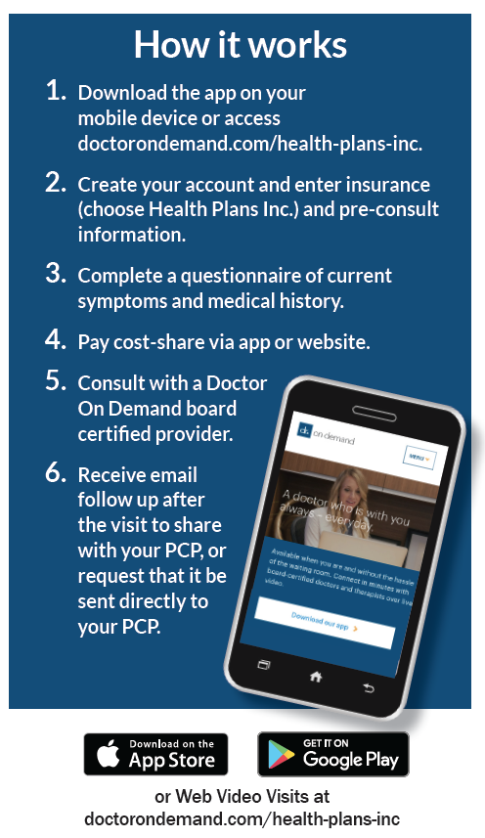
Doctor On Demand
Doctor On Demand gives you virtual video visits with licensed doctors, psychologists and psychiatrists from your phone tablet or computer.
Fast and Easy
Connect with a physician in minutes
Pay only your office visit/PCP-level cost share
Referrals are not required
Prescriptions sent directly to your pharmacy
Medical Urgent Care Visits
Coughs/Colds/Flu
Pediatric issues
Sinus and allergies
Nausea/diarrhea
Rashes and skin issues
Women’s health
Sports injuries
Behavioral Health Visits
Psychologists support you using talk therapy, while psychiatrists will also look for biological imbalances and can prescribe medicine as a part of a treatment plan.

Slide 16
What We Treat
Urgent Care
Behavioral Health
Everyday Care
Cold & Flu
Sinus infections
Bronchitis & Pneumonia
Urinary Tract Infections
Vomiting & Diarrhea
Conjunctivitis
Vaginal & Yeast Infections
Cellulitis & Skin Conditions
Anxiety & Depression
Stress
Postpartum
Trauma & Loss
Post Traumatic Stress Disorder
Behavioral Therapy
Social Anxiety
Insomnia
Substance Use Disorder
Women’s Health
Men’s Health
Labs & Screenings
Allergies
Allergic Asthma
High Cholesterol
High Blood Pressure
Weight Management
Notes:
Here are some of the top conditions we treat with UC, BH and everyday care

Slide 17
Doctor On Demand – How do I access Medical and Behavioral Health services?
Download the free Doctor On Demand app on your mobile device through
Go to www.doctorondemand.com/health-plans-inc from a Google Chrome browser to register
Notes:
How do you access DOD? There are several ways to access our services. First we ask that you register by creating an account, then you are ready to see a provider when you need them. You can download the DOD app free on your mobile device through the App Store or Google Play. Using Google Chrome, you can also access Health Plan, Inc’s landing page noted here to both register for an account and see a doctor.

Slide 18
Programs for Your Health
Manage diabetes, heart, lung or other chronic conditions
Enroll in our condition management program to work with a dedicated nurse who can help you improve well being.
Breathe easier
Get help managing your asthma and avoiding your triggers to reduce missed days at work or school.
You don’t have to face serious illness alone.
You and your family will get personal support from an experienced nurse care manager to help you get the right care at the right time.
Call us at the number on the back of your ID card for more information

Slide 19
Get Help with Your Complex Condition
Get help managing specific complex chronic conditions.
Enroll in our complex condition management program to work with a dedicated nurse who can help you self-manage your condition and feel as good as possible.
One-on-one support so you don’t have to face serious illness alone.
Get personal support from an experienced nurse care manager to help you get the right care at the right time and develop ways to stay motivated and on track with your medications and treatment.

Slide 20
Exclusive Discounts on Health-Related Products and Services
As a Health Plans member, you are entitled to special savings on many health-related products and services.
Fitness Discounts
Wellness and Healthy Product Discounts
Vision and Hearing Care
Safety and Comfort Care
Nutrition

Slide 21
Thank you. Questions?
healthplansinc.com
800-532-7575
weekdays 8am – 5pm (ET)
Habla Español? Podemos ayudar.

