Slide 1

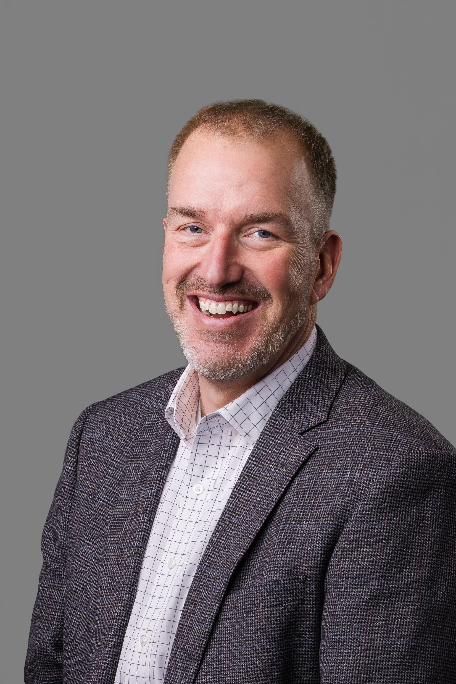
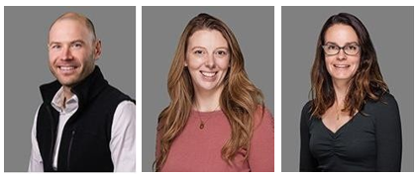
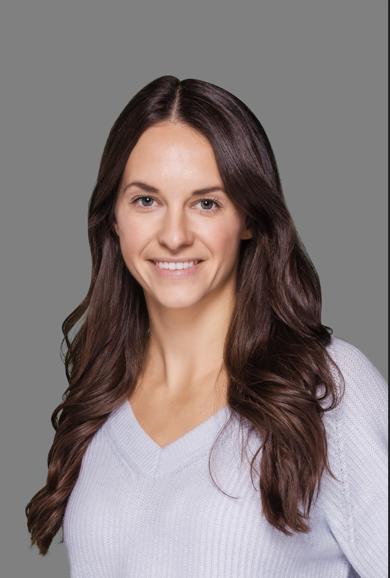
The Richards Group
Contact List 2023
Name | Title | Phone | Email | Resource
John Round | Principal | O: (802) 251-1879 x1524 | jround@therichardsgrp.com | Strategy & Underwriting
Drew Bryenton | Account Executive | O: (802) 251-1821 x1530 | dbryenton@therichardsgrp.com | Total Rewards, Overall Account Management
Katie Andrews | Sr. Account Manager | O: (802) 251-1868 x2224 | kandrews@therichardgrp.com | Total Rewards, Day to Day Service
Jennifer Susmann | Account Manager | O: (802) 251-3850 x1045 | jsusmann@therichardsgrp.com | Total Rewards, Day to Day Service
Mari Walsh | Director of Well - Being | O: (802) 251-1858 x1827 | mwalsh@therichardsgrp.com | Total Rewards, Organizational Wellness Lead

