Slide 1
*Voluntary Critical Illness Insurance
*Voluntary Accident Insurance
*New Election Options- Effective 1/1/2024

Slide 2
Voluntary Specified Disease/ Critical Illness Insurance
Provides a lump-sum cash benefit upon diagnosis of a critical illness such as:
Heart attack
Stroke
Coronary artery bypass
Organ failure
Cancer
Acute Respiratory Distress Syndrome (ARDS)
Guarantee Issue in $10,000 increments to $30,000 for Employee and Spouse.

Slide 3
Voluntary Critical Illness Coverage Amounts Coverage is available with NO HEALTH QUESTIONS or PHYSICAL EXAMS, up to the Guaranteed Issue Amount during this open enrollment only
Coverage Guidelines | Minimum | Maximum | Guarantee Issue
For You Elect in $10,000 Increments | $10,000 | $50,000 | $30,000
Spouse Elect in $10,000 Increments | $10,000 | 100% of employee’s CI Principal Sum, up to $50,000 | $30,000
Child(ren) *benefit for each child | 25% of Employee’s CI Principal Sum, up to $10,000 | 50% of employee’s benefit, up to $50,000 | No cost for coverage
Pre-existing condition limitation - any condition you receive medical attention for in the 12 months prior to your effective date of coverage that results in a claim during the first 12 months of coverage, would not be payable

Slide 4
Critical Illness Benefit Categories
Benefit Category | Condition | % of CI Principal Sum
Heart/Circulatory/Motor Function | Heart Attack, Heart Transplant, Stroke, ALS(Lou Gehrig’s), Advanced Alzheimer’s, Advance Parkinson’s Heart Valve Surgery, Coronary Artery Bypass, Aortic Surgery | 100% 25%
Organs | Major Organ Transplant/Placement on UNOS List, End-Stage renal Failure Acute Respiratory Distress Syndrome (ARDS) | 100% 25%
Childhood/Developmental | Cerebral Palsy, Structural Congenital Defects, Genetic Disorders, Congenital Metabolic Disorders, Type 1 Diabetes | 100%
Cancer | Cancer (Invasive) Bone Marrow Transplant Carcinoma in Situ, Benign Brain Tumor | 100% 50% 25%
Payment of a partial benefit reduces the remaining amount payable in a category.

Slide 5
$10,000 Benefit for Employee
Employee’s Elected $10,000 Coverage | Are Medical Questions Required? | Weekly Amount Deducted Per Pay (52/Year)
Age 30 | No | $ 1.43
Age 40 | No | $ 2.95
Age 50 | No | $ 6.69
The maximum payout amount is 400% of the Principal Sum for each insured person.
Health Screening Benefit of $75 paid once per calendar year per adult insured family member
Yearly Cost for $10,000 coverage with Health Screening Benefit
Age 30- $ 74.36 per year with screening = Free
Age 40- $ 153.40 per year with screening = $78.40
Age 50- $ 347.88 per year with screening = $272.88

Slide 6
Voluntary Accident Insurance
Initial Care & Emergency- Off-job
Emergency room- $200
Urgent care center- $125
Initial physician’s office visit- $100
Specified Injuries
Fractures, dislocations, lacerations, burns and dental
Hospital, Surgical & Diagnostic
Admission- $1500
Fractures (Surgical/Non-surgical)- Up to $6,000/Up to $3,000
Dislocations (Surgical/Non-surgical)- Up to $9,000/Up to $4,500
Follow-up Care
Physician follow-up office visit, therapy services, medical devices and prosthetic devices.
Health Screening Benefit of $75 paid once per calendar year per insured family member

Slide 7
Accident Benefit Premiums
The amounts shown below are Weekly (52 pays). You may elect insurance for you only, or for your family.
Coverage Tier | Premium Amount
Employee/Member | $ 3.41
Employee/Member + Spouse | $ 5.48
Employee/Member + Child(ren) | $ 7.46
Employee/Member + Family | $ 10.18
Health Screening Benefit of $75 paid once per calendar year per insured family member
Yearly Cost for coverage by taking advantage of $75 Health Screening Benefit
Employee Only =$ 177.32 with $75 HSB = $102.32 per year
Employee + Spouse- = $ 284.96 with$150 HSB = $134.96 per year
Employee + Children=$ 387.92 with HSB = SAVINGS
Employee + Family= $ 529.36 with HSB = SAVINGS

Slide 8
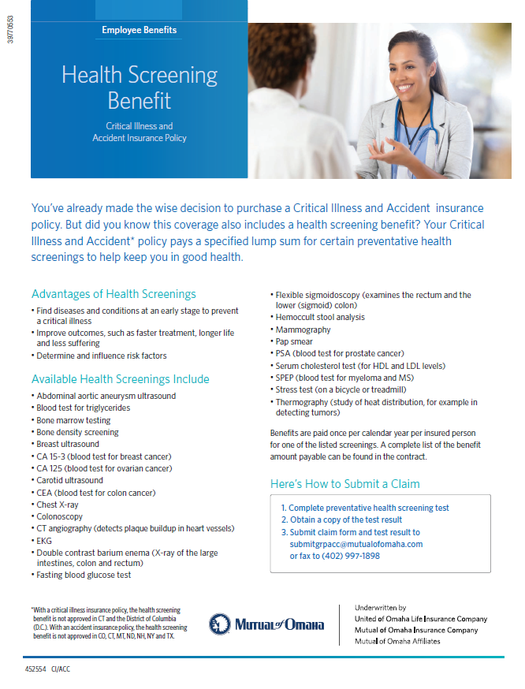
Health Screening Benefit
Critical Illness and Accident coverage each include a $75 benefit for certain health screening tests, payable once per calendar year, per covered member when proof of procedure is provided.
Members enrolled in both plans can claim this benefit 2 times using just one claim form for a combined $150 benefit.
.
Qualifying Health Screenings
Abdominal aortic aneurysm ultrasound
Blood test for triglycerides
Bone marrow testing
Bone density screening
Breast ultrasound
CA 15-3 (blood test for breast cancer)
CA 125 (blood test for ovarian cancer)
Carotid ultrasound
CEA (blood test for colon cancer)
Chest X-ray
Colonoscopy
CT angiography
EKG
Double contrast barium enema
Fasting blood glucose test
Flexible sigmoidoscopy
Hemoccult stool analysis
Mammography
Pap smear
PSA (blood test for prostate cancer)
Serum cholesterol test
SPEP (blood test for myeloma and MS)
Stress test (on a bicycle or treadmill)
Thermography

Slide 9
Voluntary Critical Illness Insurance- $10k Benefit
Age 30- $1.43 per pay period
Age 40- $ 2.95 per pay period
Age 50- $ 6.69 per pay period
Voluntary Accident Insurance
Employee Only- $ 3.41 per pay period
Employee + Spouse- $ 5.48 per pay period
Employee + Children- $ 7.46 per pay period
Employee + Family- $ 10.18 per pay period
You must complete and submit an Evidence of Insurability application if you and your spouse are enrolling for Voluntary Critical Illness coverage in excess of $30,000, up to $50,000 of coverage.
Application can be submitted online at www.mutualofomaha.com/eoi Group# B9VJ
Questions? Please contact me Pamela.Eisenberg@mutualofomaha.com or 617-716-9920
New Enrollment Options for 2024

Slide 10
Underwritten by:
Mutual of Omaha Insurance Company
United of Omaha Life Insurance Company
3300 Mutual of Omaha Plaza
Omaha, NE 68175
Accident insurance underwritten by United of Omaha Life Insurance Company, 3300 Mutual of Omaha Plaza, Omaha, NE 68175. Policy form number 7000GM-U-EZ 2010 or state equivalent (7000GM-U-EZ 2010 NC). United of Omaha Life Insurance Company is licensed nationwide, except in New York.
Critical illness insurance underwritten by United of Omaha Life Insurance Company, 3300 Mutual of Omaha Plaza, Omaha, NE 68175. Policy form number 7000GM-U-EZ 2010 or state equivalent (7000GM-U-EZ 2010 NC). United of Omaha Life Insurance Company is licensed nationwide, except in New York.
Disability income insurance underwritten by United of Omaha Life Insurance Company, 3300 Mutual of Omaha Plaza, Omaha, NE 68175. Policy form number: 7000GM-U-EZ 2010 or state equivalent (7000GM-U-EZ 2010 NC ). United of Omaha Life Insurance Company is licensed nationwide, except in New York.
Life insurance is underwritten by United of Omaha Life Insurance Company, 3300 Mutual of Omaha Plaza, Omaha, NE 68175. Policy form number 7000GM-U-EZ 2010 or state equivalent (7000GM-U-EZ 2010 NC). United of Omaha Life Insurance Company is licensed nationwide, except in New York.
Dental insurance is underwritten by United of Omaha Life Insurance Company, 3300 Mutual of Omaha Plaza, Omaha, NE 68175. Policy form number 7000GM-U-EZ 2010 or state equivalent (In NC: 7000GM-U-EZ 2010 NC). United of Omaha Life Insurance Company is licensed nationwide except in New York.
Accidental Death and Dismemberment (AD&D) insurance is underwritten by Mutual of Omaha Insurance Company, 3300 Mutual of Omaha Plaza, Omaha, NE 68175. Policy form number 7000GM-M-EZ 2010. Mutual of Omaha Insurance Company is licensed nationwide.
Some exclusions, limitations and reductions may apply. Please contact Mutual of Omaha and/or United of Omaha for specific product details and policy provisions.
Each company is responsible for its own contractual and financial obligations.

