Slide 1


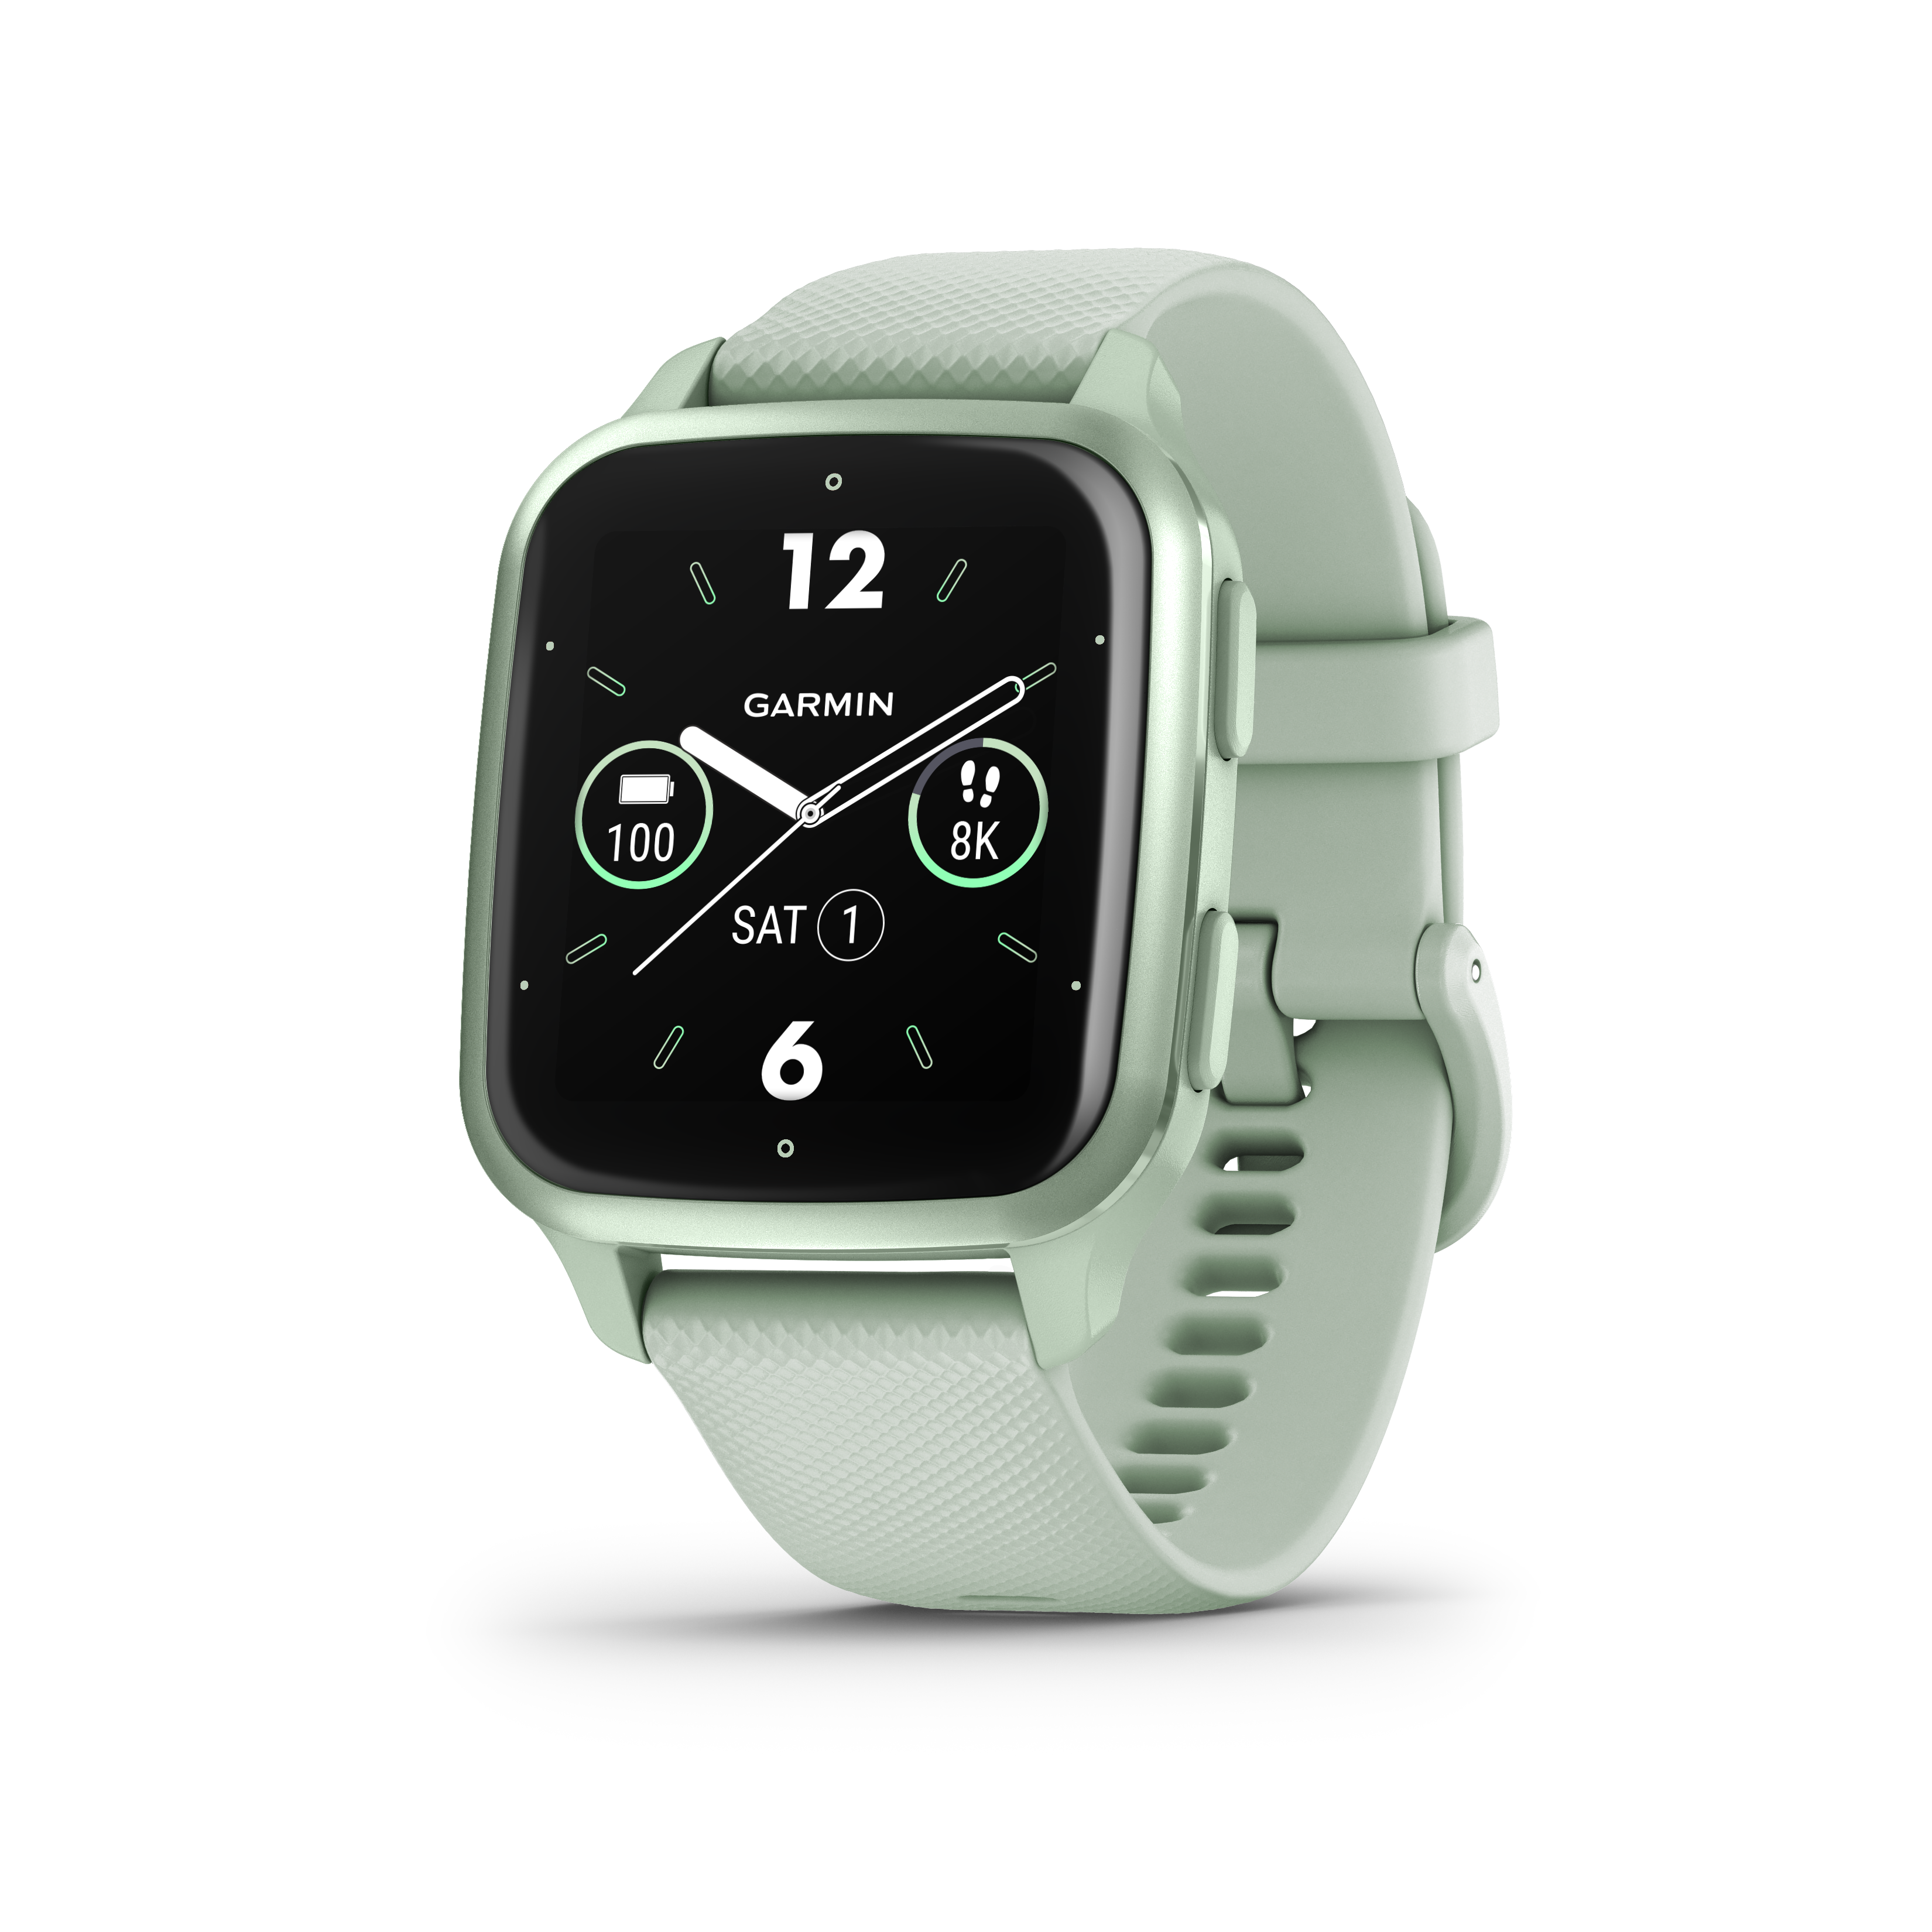

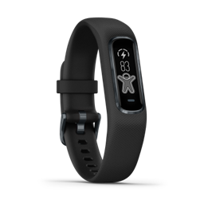
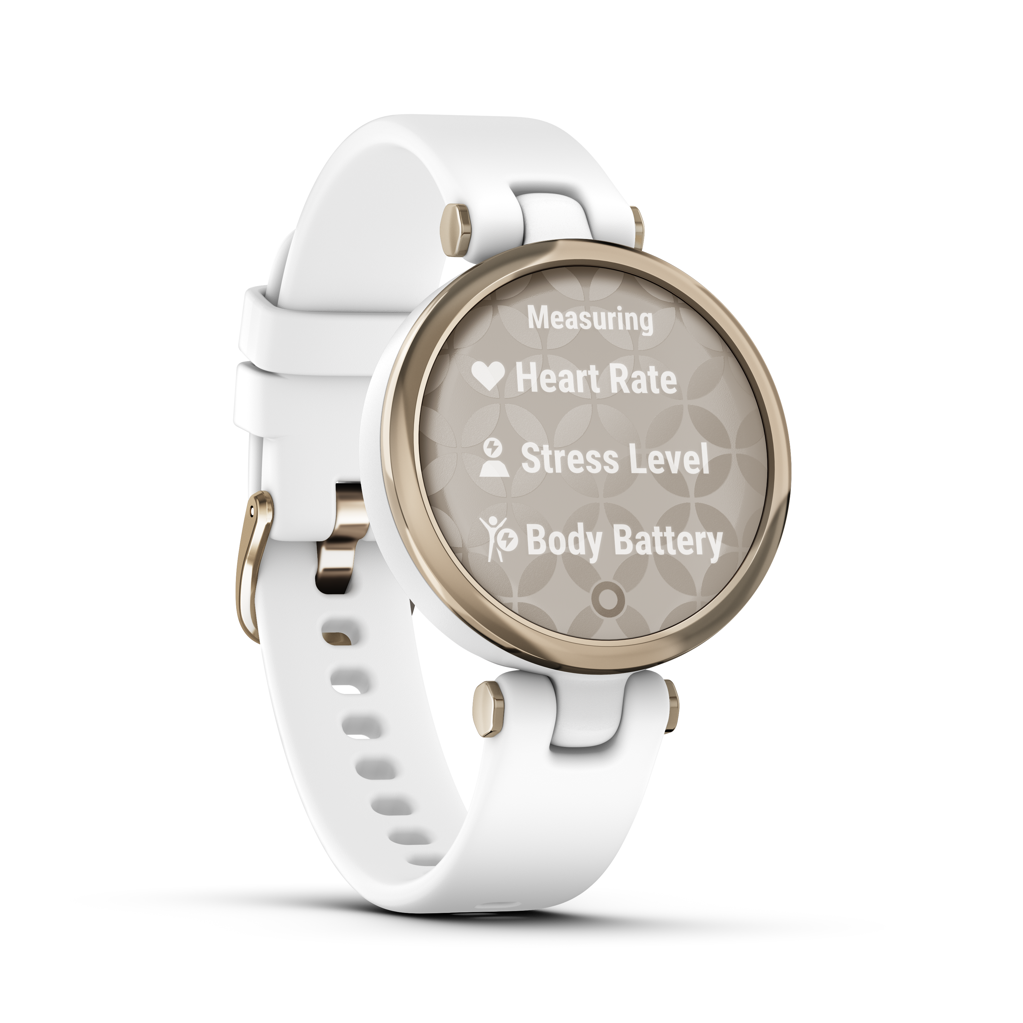

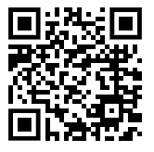
Shop for the latest Fitbit & Garmin devices at great low rates!
Find the motivation to reach your health & fitness goals!
Wearable activity trackers are a great way to track your activity levels and inspire action.
The Wellness Outlet offers discounted pricing on the latest Fitbit & Garmin devices. PLUS, get FREE shipping on all orders! Choose from the latest smart technology with GPS, heart rate, smart phone notifications and more.
Create your Wellness Outlet account today:
Step 1: Go to www.thewellnessoutlet.com
Step 2: Click on "Activate Account"
Step 3: Use the group code: RICHARDSGRP
(it IS case sensitive) to create an account
Step 4: Login to your account to access discounted devices.
Questions? support@motionconnected.com | 920.593.8868

