Slide 1
US Benefit Plan Review & Open Enrollment - 2023
Notes:
Welcome to New Chapter’s Open Enrollment Information Session for the 2023 Benefit Plan Year. The benefits we’ll be discussing today go into effect January 1st. As a reminder, ALL US employees must go through the Open Enrollment process even if you are not making changes.

Slide 2
It is important that you understand your benefits
Health Insurance
Health Savings Account w/ Employer Match
Flexible Spending Account
Dependent Care Flexible Spending Account
Dental Insurance
Vision Insurance
New Chapter paid
Employee paid
401(k) w/ Employer Match
Short Term/ Long Term Disability
Company Paid Life Insurance / AD&D
Voluntary Legal Services
Voluntary Life Insurance
Voluntary Critical Illness
Voluntary Accident
Voluntary Identity Theft
Tuition Assistance & Reimbursement
Cigna Telehealth Services
Employee Assistance Program (EAP)
Wellness Rewards and Incentives
Retirement Gift Program
Maternity/Parental
Paid Time Off
Company Trip
And More…
Notes:
In order to do that, it is important that you understand your benefits. There are a variety of options available, so we’ll spend a little bit of time going through each of them. If you have questions, Tamara and I are happy to help.

Slide 3
Enrollment Eligibility
Open Enrollment is held annually in November for a January 1 effective date. All employees must enroll in and/or waive benefits each November.
Please enroll no later than Tuesday, November 22
All Regular Full Time Employees who work at least 30-hours per week, and Regular Part Time Employees who work at least 16-hours per week are eligible for benefits
You may also enroll mid-year if you experience a life event (loss of insurance, marriage, divorce, newborn child, adoption of child).
If your employment ends, your insurance will terminate on the last day of the month of your termination.
Notes:
Open Enrollment is held annually each November. ALL eligible employees must go through the Open Enrollment Process. The last day to enroll is Tuesday, November 22.
You may also go through the enrollment process if you experience a qualifying life event.

Slide 4
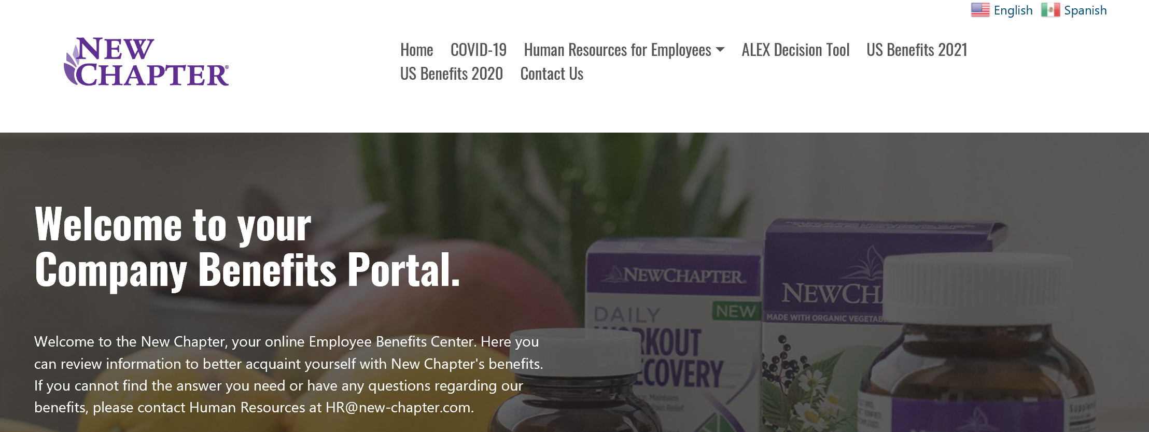
Employee Benefit Center (EBC)
To view benefit options, log on to the Employee Benefit Center (EBC)
http://newchapter.trgportal.com/
Username: newchapter
Password: benefits
Notes:
Hopefully, you have visited our Employee Benefits Center. The EBC has lots of great information regarding benefits. If you have questions after you login, please be sure to see Tiffany or Tamara. The EBC also houses other HR resources like our employee handbook.

Slide 5
Employee Benefit Center (EBC)
All our benefit plan information is available on the EBC. It is an excellent resource to assist you with making educated benefit decisions for you and your family.
ALEX is an interactive tool to help with the decision-making process.
ALEX can help guide you through your benefit elections, but it is important to remember that he is simply a guide.
Notes:
Also, housed on the EBC is a great tool called ALEX. Alex is an interactive tool intended to help guide you through the decision-making process. You tell him your information, and he makes suggestions on benefit elections. He’s simply a guide, but it’s always a good idea to check this out to make sure you’re in the right plans for you and your family.

Slide 6
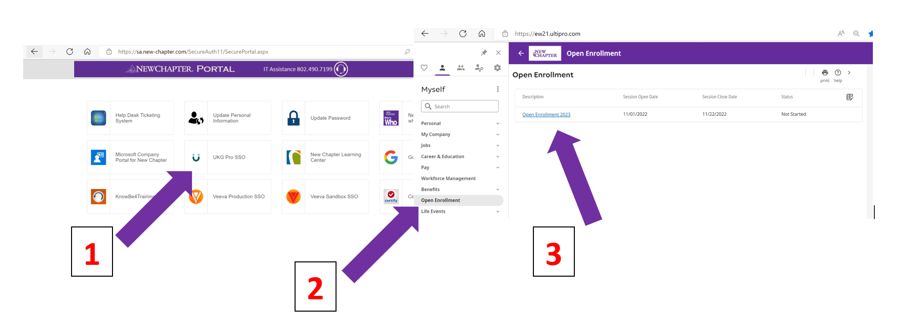
Benefits Enrollment - UKG
Notes:
We’ll be using UKG for Open Enrollment this year. Login through the New Chapter portal using the UKG SSO link. Choose Open Enrollment from the menu on the left, then choose Open Enrollment 2023

Slide 7
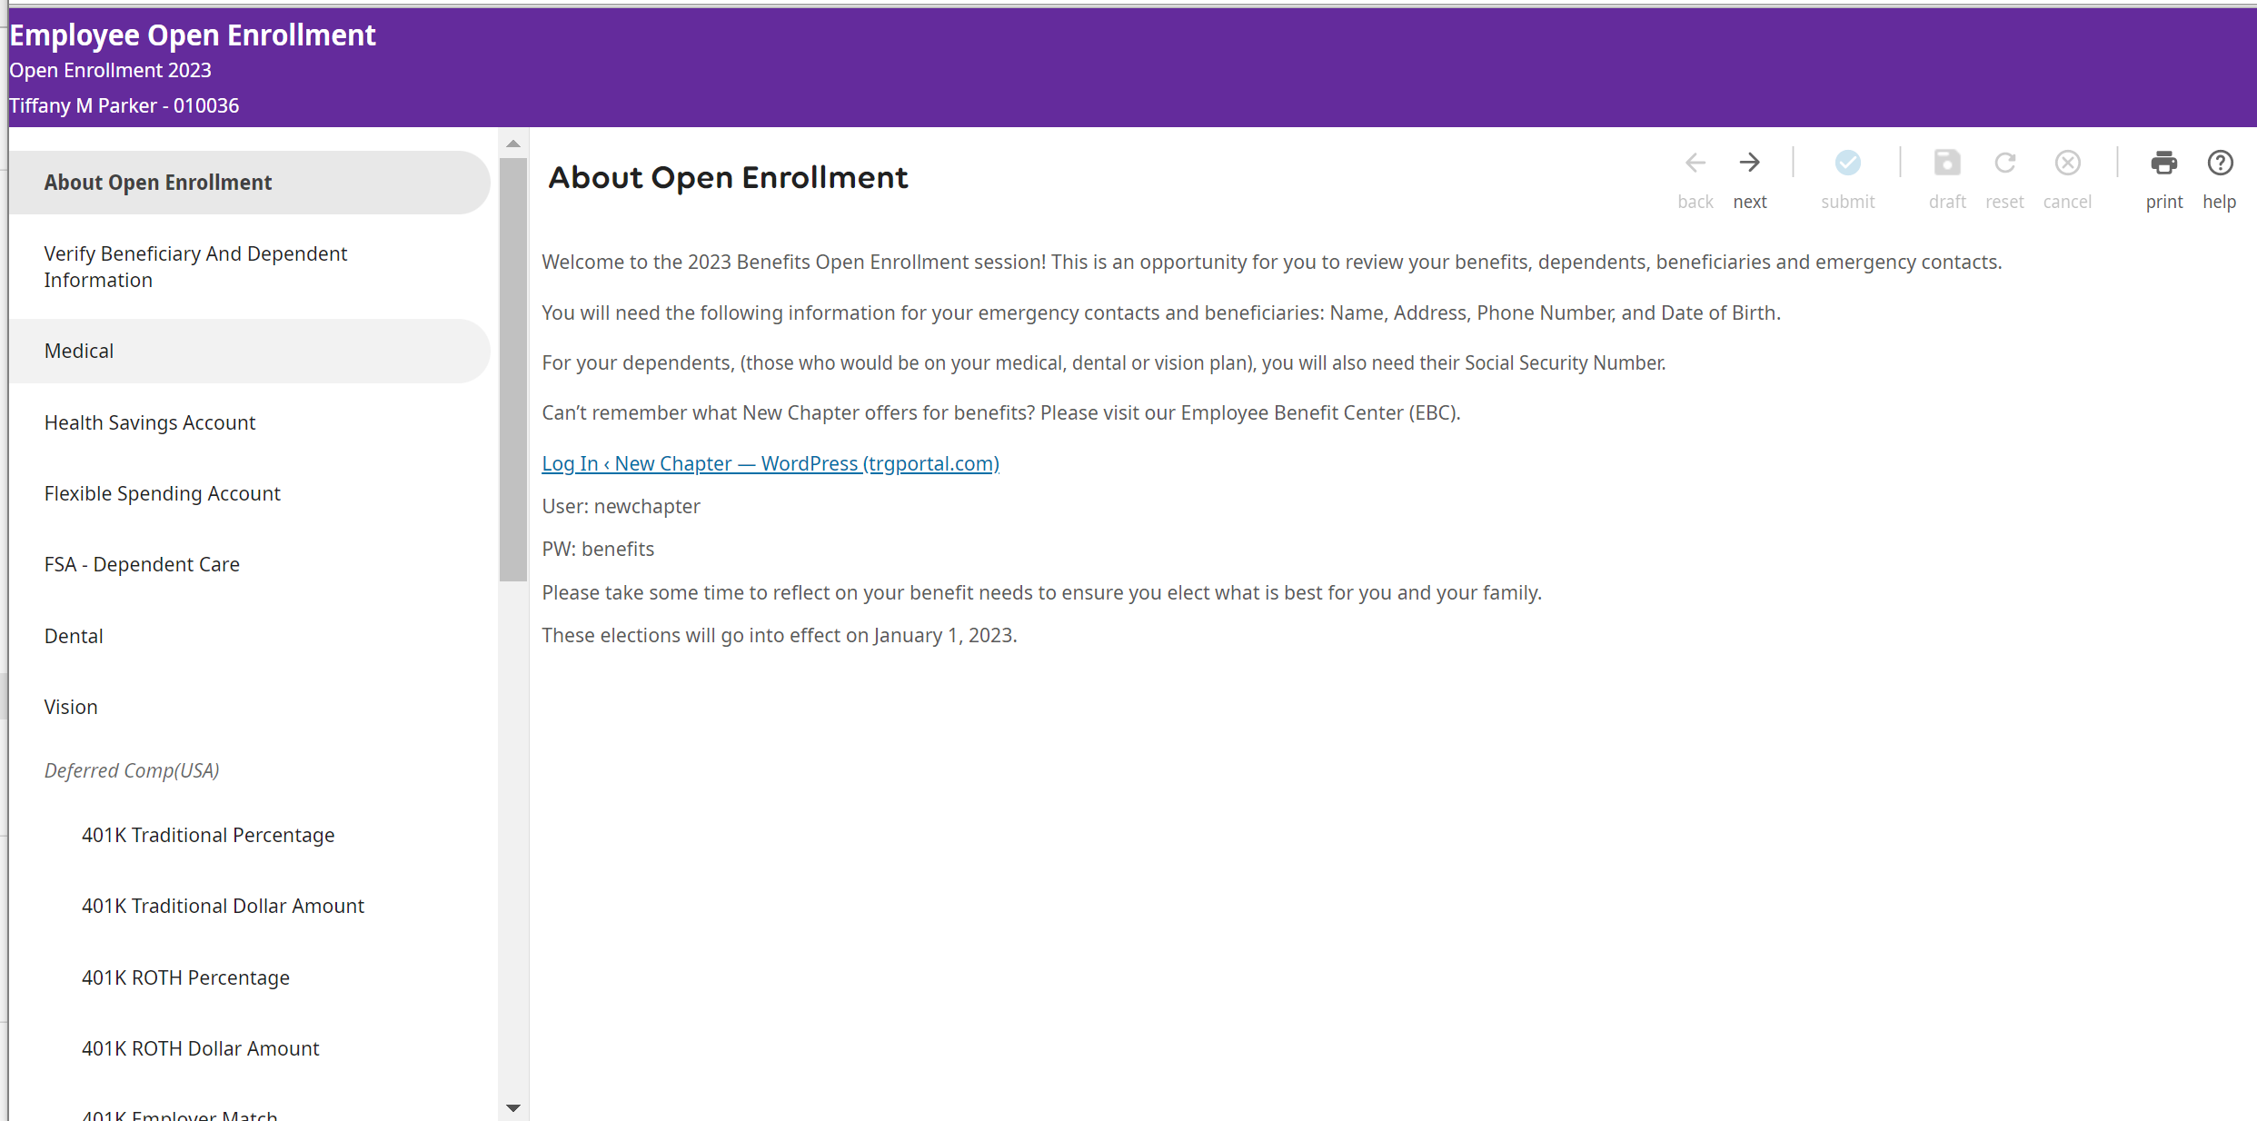
Benefits Enrollment - UKG
Notes:
Please read the information on each screen for details on your options and requirements to move forward. For example, you will need social security numbers and date of birth for your dependents.
You can navigate using the Next button, or you can jump around by selecting a benefit from the left.

Slide 8
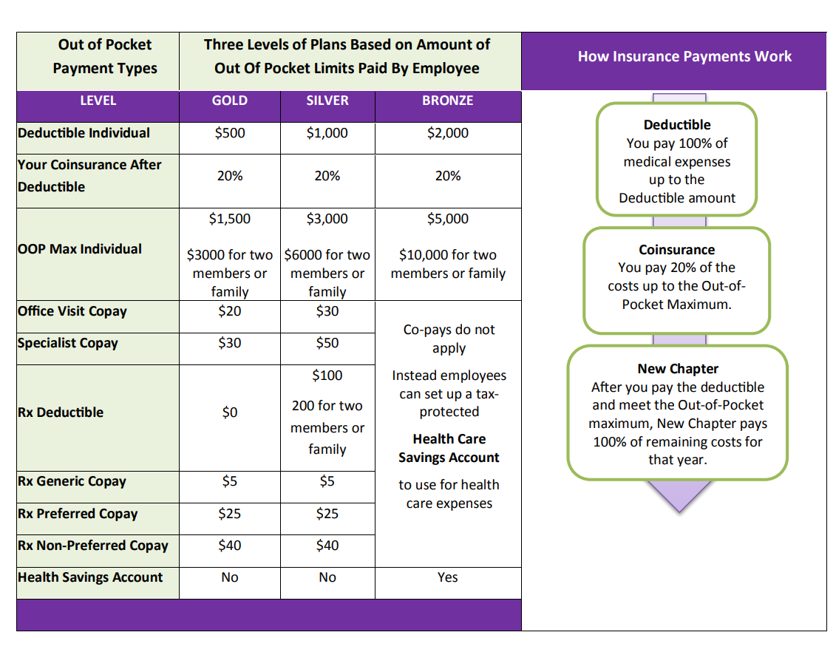
Medical Benefits
Three Health Insurance plan levels are designed to meet the needs of you and your family
Bronze – high deductible plan with an HSA (Health Savings Account)
Silver – your middle of the road plan
Gold – the plan with the lowest copays, deductibles, and out of pocket maximum, but the highest bi-weekly deduction
Notes:
New Chapter offers 3 health insurance plan levels. No one plan could be right for everyone, so we want to provide you with options. The Bronze Plan is a high deductible plan with low premiums. The Gold Plan is a lower copay, deductible and out-of-pocket-max, plan, but has the highest premiums. You can think of the Silver Plan as somewhere in the middle. It is important to understand these benefits in order to find the best plan for you and your family. More information can be found in the Medical benefit tab on the EBC.

Slide 9
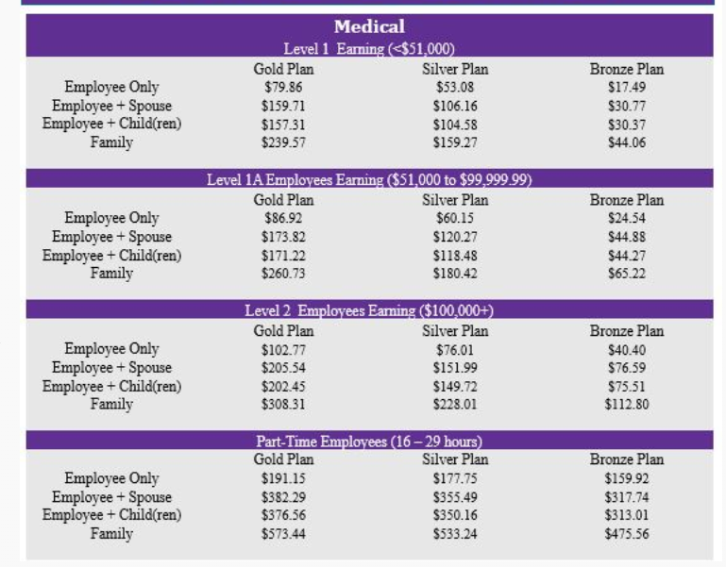
Medical Bi-Weekly Contributions
Notes:
Medical costs increased this year. New Chapter has absorbed the majority of the increase however we are passing along an average of 3% increase. Your bi-weekly premium is based on your current salary level. This rate chart is located on the EBC. The UKG system will also show rates and current enrollment election when you are making your selections.

Slide 10
Employee Health Care Spousal Surcharge
A $200 monthly ($92.31 bi-weekly) surcharge will be added to your premium, if you have elected coverage for your spouse AND your spouse is eligible for coverage through their employer but elects not to enroll.
If your spouse is not eligible for coverage as an employee, the spousal surcharge is waived.
If you choose coverage for your spouse, you will be required to complete a Spousal Surcharge Form.
Notes:
If your spouse is eligible for coverage, and you elect spousal coverage through New Chapter, a $200 per month surcharge will be added to your premium. If you’re spouse isn’t eligible for coverage or you aren’t electing coverage for your spouse, the surcharge will be waived. If this applies to you, choose one of the Spousal Surcharge plans when enrolling in UKG.

Slide 11
Health Savings Account (HSA)
A health savings account (HSA) is a tax-advantaged medical savings account for those enrolled in the Bronze Plan.
The funds contributed to an account are not subject to federal income tax at the time of deposit.
HSA funds roll over and accumulate year to year if not spent.
Eligibility Requirements
You must be enrolled in the Bronze Plan
You must not have health coverage elsewhere
You must not be claimed as a dependent on another person’s tax return
You must not be enrolled in Medicare (part A or B)
Notes:
If you decide that the Bronze plan is right for you, you’ll want to consider contributing to an HSA. You decide how much to contribute, and the funds are deducted bi-weekly from your paycheck…tax free. The funds can be used to pay for qualified medical, dental, and vision expenses …the IRS has the guidelines for what qualifies and there are some eligibility requirements.

Slide 12
HSA Advantages
Employees decide how much money to set aside for health care costs via payroll deduction
Employees control how their HSA money is spent
Employees own the account, and the money is theirs even if they change jobs
It’s simple to use – no claims review, just keep your receipts
Any unused money at the end of the year rolls over (stays in employee’s account)
Employees don’t pay taxes on the money going into their HSA
Lower insurance premiums while maintaining the security of quality major medical coverage
Notes:
Advantages of an HSA…you control how the money is spent and the account is yours, meaning you take it with you if you change jobs. Any unused money rolls over into the next year, and you pay no taxes on the funds going into the account. You also enjoy the lower bi-weekly premium rates on the Bronze plan.

Slide 13
HSA Disadvantages
Illnesses/Accidents can be unpredictable
It can be challenging to set aside money to put into the HSA
Pressure to save the money in and HSA might lead individuals to avoid seeking medical care when needed
If funds are taken out of an HSA for nonmedical expenses, those funds are no longer tax exempt.
Parents can not use funds from an HSA to pay for their child’s care after age 24
Notes:
Disadvantages of an HSA…Illnesses and accidents can be unpredictable. You never know when you might suffer an injury or serious illness. You also may feel pressure to save the money you’ve built up in the account, and that could lead you to not seek care when you really need it. Additionally, if you take out funds for nonmedical expenses, those funds are no longer tax exempt.

Slide 14
Additional HSA Details
2023 Contribution Limits
Single Plan: $3,850
Family Plan: $7,750 (Family Plan is defined as 2 or more)
HSA catch-up Contribution Limits
For participants age 55 or older: $1,000
Employer Contributions
New Chapter will match employee HSA contributions, dollar-for-dollar per pay period up to $520 per calendar year.
Notes:
If after considering the advantages and disadvantages, you decide that the Bronze Plan with HSA is right for you, New Chapter will match your contribution dollar for dollar up to $520 this year.

Slide 15
Flexible Spending Account (FSA)
Employees choose to set aside pre-tax dollars into an FSA to help pay for qualified expenses that occur during the calendar year
Contributions made to your account that are used to pay for qualified medical, dental and vision expenses are tax free. Contribution Limit: $3,050/year
The full contribution amount is available on the first day of coverage
$610/year rollover
Anything over $610 is forfeited
Once enrolled, the election amount cannot change
Notes:
There are a variety of Flexible Spending account options. This FSA is available to you if you choose the Silver or Gold plans or Waive Benefits. The funds can be used to pay for qualified medical, dental, and vision expenses. As with the HSA, you decide how much to contribute and the funds are deducted pre-tax, from your bi-weekly paycheck. Carefully consider the amount however, because once you’ve made your election, it cannot be changed. Any unused funds in excess of $610 ($570 for 2022) are forfeited at the end of the year. The full amount you elect is available to you at the start of the year.

Slide 16
Flexible Spending Account – Limited Purpose
Like an FSA, but typically offered in combination with an HSA. Can only be used for qualified dental and vision expenses
Contributions you make to your account that are used to pay for qualified dental or vision expenses are tax free. Contribution Limit: $3,050/year
The full contribution amount is available on the first day of coverage
$610/year rollover
Anything over $610 is forfeited
Once enrolled, the election amount cannot change
Notes:
Limited Purpose FSA is for those on the Bronze Plan. Very similar to the FSA however these funds can only be used for dental and vision expenses. Again, carefully consider the amount because funds in excess of $610, ($570 for 2022) are forfeited at the end of the year. If you do have unused funds that you’re unsure how to spend, FSASTORE.com is an excellent resource. They list ideas for what things you can spend your money on, and you can even order from their site. Band-Aids, ice packs, cold medication…

Slide 17
Flexible Spending Account – Dependent Care
A Dependent Care Flexible Spending Account uses your Pre-tax Contributions to cover Dependent Care (usually childcare) expenses. Eligible Dependents include children under 13 years of age, and a Spouse or other Dependent that is physically or mentally incapable of caring for himself/herself.
Contributions you make to your account used to pay for qualified dependent care expenses are tax free. Contribution Limit: $5,000/year ($2,500 if married filing separately; $5,000 total max per family)
Funds are available as soon as contributions are deposited into your account throughout the year
No rollover
In order for claims to be paid back from your DCFSA, Cigna must receive claims within 90 days of the date your DCFSA ends; anything left over is forfeited
Once enrolled, the election amount cannot change
Notes:
You are eligible for the Dependent Care FSA Eligible on any of our plan levels and even if you do not have medical coverage through New Chapter. Again, this uses pre-tax dollars to pay for dependent care; typically, childcare expenses. The funds are deducted from your bi-weekly paycheck and are available to you as you contribute. Because the funds are not available all at once, often employees will pay upfront, and then submit claims for reimbursement. So, if you know you’ll have child or adult care expenses this year, this is a way to pay for that pre-tax. There is no roll-over with this type of account so just make sure you’ve carefully considered the election amount.

Slide 18
HSA & FSA
Please be sure to go to Cigna.com/expenses for the following:
What FSA expenses & HSA expenses can be reimbursed?
Whose expenses can be reimbursed?
Alphabetical List of Covered and Not-Covered Items
Ineligible Expenses
Ineligible Receipts
Dependent Day Care Expenses
Notes:
Additional information on eligible HSA and FSA expenses can be found on the EBC, and on the Cigna website.

Slide 19
Dental Benefits
Outline of Benefits:
New Chapter offers a dental plan option with a $50 per person, per year deductible; or a $150 per family, per calendar year deductible (applies to Basic & Major benefits only)
No Office Visit Copayments
Includes oral evaluations and cleanings twice in a 12-month period
Dependent children are covered up to age 26
Medical enrollment is not required to enroll in the dental plan
Please review EBC for additional coverage details
Notes:
We get our Dental benefits through Delta Dental. An outline of benefits is listed but please visit the EBC for detailed information and specifics. Benefits include cleanings twice in a 12-month period.
New for 2023, we’ve increased the annual benefit maximum from $1,750 to $2,000 and increased the annual Ortho benefit maximum from $1,500 to $2,000
Healthy Oral Wellness (HOW) available through our Dental Plan. There’s an assessment to go through to see if you might be eligible for additional cleanings. It may allow you to get additional services for no cost depending on the condition of your mouth. Check with your dentist’s office to get things started.

Slide 20
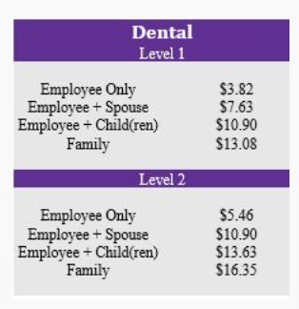
Dental Bi-Weekly Contributions
Notes:
Dental premiums will also increase an average of 3% this year. Your bi-weekly premium is based on your current salary level. This rate chart is located on the EBC. The UKG system will also show rates and current election when you are making your selections.

Slide 21
Base Vision Benefits
This standard benefit is 100% paid for by New Chapter
Focuses on your eyes and overall wellness
1 Exam every 12 months
$130 allowance every 2 years in frame or contacts without coating, progressive lenses, and scratch resistant coating to lenses.
Please review EBC for coverage limits.
Website: https://www.vsp.com
There is no ID card for VSP
Notes:
New Chapter offers two Vision Plan options through VSP. The first is a 100% employer paid plan. This plan includes one exam every 12-months and is available at no cost to you.

Slide 22
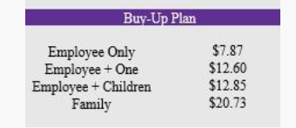
Buy-Up Vision Plan
New Chapter also offers a Premium Vision Plan with VSP. This optional benefit is paid for by the employee
1 Exam every 12 months
$180 allowance each year in frame or contacts; also adds anti-reflective coating, progressive lenses, scratch resistant coating to lenses.
Please review EBC for coverage limits.
Website: https://www.vsp.com
There is no ID card for VSP
Notes:
The other is a Premium Plan. This is an optional plan paid for by you. This plan includes an additional $50 allowance in frames or contacts, and includes coverage for anti-reflective coating, progressive lenses and scratch resistant coating. Listed here are the bi-weekly premium rates. These rates are available on the EBC and in UKG.

Slide 23
Vision Benefits
Visit eyeconic.com to choose from a large selection of contact lenses and designer frames using a virtual try-on feature.
Eyeconic offers free shipping and returns
If you find the same merchandise at a lower price, they will refund the difference
Your benefits will go further when you see an In-Network provider, however, if you prefer to see an Out-Of-Network provider, you can submit a claim at vsp.com. You will be reimbursed at VSP’s standard reimbursement rate.
Please review EBC for additional coverage details
Notes:
Your Vision benefits will go further if you see an in-network provider, however if you choose to see an out-of-network provider, you can submit your claim for reimbursement to VSP. Additionally, visit eyeconic.com to purchase contact lenses or frames. Visit the EBC for additional details.

Slide 24
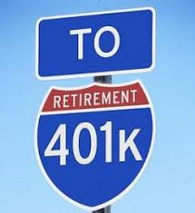
Retirement Benefits - 401(k)
Employer matching 100% of the first 3% AND 50% of the next 2% employee contribution
Immediate vesting
All Regular Full and Part Time employees are eligible to participate if they are age 21 or older
Loans/Hardship withdrawals
Group and 1:1 financial wellness sessions offered periodically.
You may make changes to your 401(k) election at any time
2023 contribution limit: $22,500
For participants age 50 or older: $30,000
Notes:
The company will match 100% of the first 3% and 50% of the next 2% employee contribution. Think of this as FREE money to save for your retirement. Additionally, contributed funds are vested immediately. As you go through Open Enrollment, consider enrolling, or increasing your 401k contribution.

Slide 25
Retirement Gift Benefit
The Retirement Gift program awards retirees a monetary gift upon retirement and the continuation of their New Chapter product discount. Additionally, New Chapter will fund a Health Reimbursement Account with tax-free funds to be used toward qualified healthcare expenses. HRA funds rollover year-over-year and expire if not used after 5 years.
Full Retirement: Employees 55+ with a minimum of 5 years of service are rewarded with $100 per year of service.
Early Retirement: (Rule of 60; age plus length of service equals 60) for employees age 50 or above with a minimum of 5 years of service are rewarded with $50 per year of service.
Notes:
In addition to the continuation of the New Chapter product discount, and a monetary gift based on years of service, Retirees are enrolled in a Retiree Health Reimbursement Arrangement. New Chapter will fund HRA accounts with tax-free funds to be used for qualified healthcare expenses. Funds will rollover year-over-year and will expire if not used within 5 years.

Slide 26
Voluntary Life Insurance
100% employee paid
Optional up to $500K for employee and spouse – must go through medical underwriting
Option for coverage for Child(ren)
Portable
Review any paperwork from Reliance as they may need assistance in contacting your provider(s)
Refer to EBC for guaranteed issue amounts
Notes:
New Chapter also offers voluntary benefits through Reliance Standard. See the EBC for additional details and guarantee issue amounts for Voluntary Life.

Slide 27
Voluntary Critical Illness Insurance
100% employee paid
Provides a fixed, lump-sum benefit upon diagnosis of a critical illness, which can include heart attack, stroke, paralysis, etc.
Paid directly to the insured and may be used for any reason. Some include deductibles, prescriptions, transportation and childcare.
Refer to EBC for guaranteed issue amounts
Notes:
Voluntary Critical Illness provides a fixed, lump-sum benefit upon diagnosis of a critical illness. Refer to the EBC for guaranteed issue amounts. There are limitations to what is covered so be sure do read the fine print there.

Slide 28
Voluntary Accident Insurance
100% employee paid.
Accident insurance provides a range of fixed, lump-sum benefits to help offset the costs associated with a covered accident.
Paid directly to you and may be used for any purpose, such as deductibles, prescriptions, transportation, childcare, etc.
The amount you receive varies by type of accident incurred.
Refer to EBC for further details.
Notes:
Voluntary Accident Insurance provides a range of fixed, lump-sum benefits to help offset the costs associated with a covered accident. Refer to the EBC for additional details and rates.

Slide 29
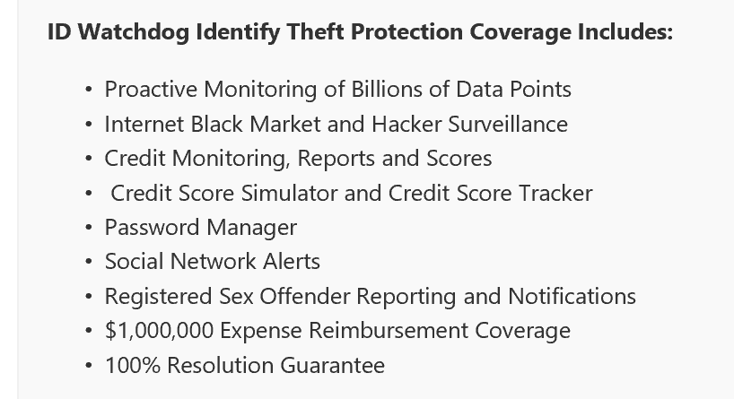
Identity Theft
Employee Contribution
Election | Bi-Weekly
Employee only | $ 4.38
Family | $ 7.80
Voluntary Identity Theft
Identity theft occurs when someone steals your personal information —such as your name, Social Security number, and date of birth
100% employee paid
Portable
Refer to EBC for further details
Notes:
A voluntary benefit for Identity Theft protection in partnership with ID Watchdog. An easy and affordable way to help better protect and monitor the identities of you and your family. You’ll be alerted to potentially suspicious activity and enjoy the peace of mind that comes with the support of dedicated identity resolution specialists.

Slide 30
Legal Services Voluntary Benefit (employee paid)
A legal insurance plan that provides support and protection for unexpected legal issues.
What you get:
An attorney with expertise specific to your personal legal matter.
Access to a national network of attorneys with exceptional experience that are matched to best meet your needs.
Assistance navigating common individual of family legal issues.
Includes coverage for employee, spouse and unmarried dependent children up to age 26
100% employee paid, portable voluntary benefit and is portable upon termination
Notes:
Home buying, selling, refinancing, landlord/tenant disputes
Financial: debt, collections, contracts, student loans refinancing
Family, divorce, adoption, child support, custody domestic violence
Estate planning and wills
Legal services benefit cost is $8.18 bi-weekly. This covers the employee, spouse and unmarried dependents age 26 and under

Slide 31
Life Insurance, AD&D, Short Term Disability & Long-Term Disability
Life & AD&D Insurances:
This benefit is paid at 1 x your annual base earnings
Short & Long Term Disability
Short Term – Day 15 to 6 months
There is a 14-day waiting period for Disability Insurance. This means you will start to be paid via Reliance on the 15th day of Disability or Illness.
Long Term – 6 months to retirement age
Notes:
As a reminder, New Chapter offers Life Insurance, Accidental Death and Dismemberment Insurance, Short- and Long-Term Disability. These are employer paid benefits through Reliance Standard.

Slide 32
Cigna Telehealth Connection
Cigna Telehealth Connection is a benefit provided by MDLIVE accessed via the mycigna.com website.
You can access a doctor from your home, office, or on the go - 24 hours a day, 7 days a week, 365 days a year!
U.S. Board Certified doctors can visit with you via phone or secure video to help treat non-emergency medical conditions.
Simply pay the applicable in-network copay, deductible or coinsurance.
Common conditions include sore throat, headache, stomachache, fever, cold and flu, allergies, rash, UTIs, and more…
Notes:
You’ve probably experienced a time where you were away from home, or at work and unable to see your doctor. With Cigna Telehealth, you can visit with certified doctors over the phone or video for non-emergency medical conditions. This is a benefit available to you through your coverage. Consider utilizing this benefit if you are contemplating an ER or Urgent Care visit for a non-emergent issue.

Slide 33
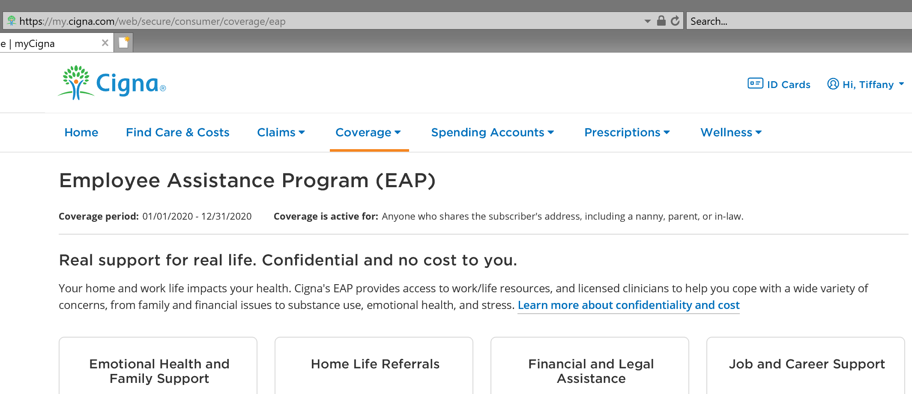
Employee Assistance Program (EAP)
This benefit is 100% employer paid
It is free to everyone in your household
Available 24 hours a day / 7 days a week
It is a confidential resource for various kinds of personal matters:
Child Care, Financial Service, Identity Theft, Legal Consulting*, Pet Care, Senior Care
www.cignabehavioral.com
Employer ID: newchapter
Or
888.371.1125
*Restrictions do apply*
Notes:
Another benefit available to you through Cigna is the Employee Assistance Program. It is a confidential resource for various kinds of personal matters. It is free to everyone in your household and is available 24 hours a day / 7 days a week. You will be asked to provide the Employer ID: newchapter when calling. EAP is also available via Live Chat on CignaBehavioral.com

Slide 34
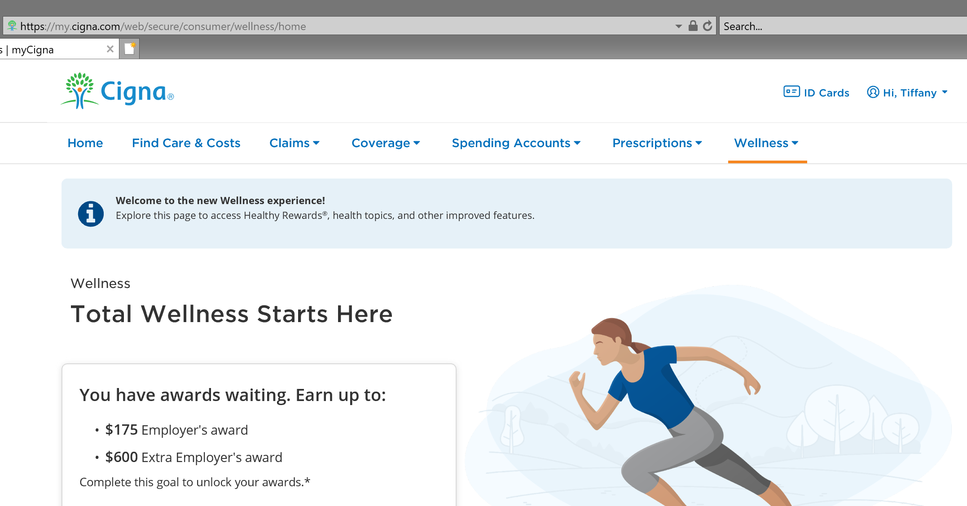
Wellness Rewards
Up to $200 per calendar year
$50 for the Health Assessment
$50 for Annual Exam/Physical
$100 for gym memberships, fitness classes, exercise equipment, activity log, etc.
You cannot access the $100 for gym memberships, etc. without participating in the health assessment!
Healthy Pregnancies, Healthy Babies® program:
Enroll in this program designed to help you and your baby stay healthy during your pregnancy and in the days and weeks following birth. Take part in the Cigna Healthy Pregnancies, Healthy Babies® program and earn an incentive.
Notes:
New Chapter encourages and rewards wellness activities. You can earn up to $200 in wellness incentives. Simply complete the heath assessment at mycigna.com and earn $50. An additional $50 can be earned when you have an annual physical exam. An additional $100 can be earned for reimbursement of gym memberships, exercise equipment and fitness classes. Visit the EBC or mycigna.com for additional details.

Slide 35
Tuition Reimbursement
Encourages professional growth and development through continued education.
Employees who are furthering their education through courses related to their current job or future career opportunities at New Chapter are eligible for up to $4,000 tuition reimbursement in a calendar year.
See Employee Benefit Center (EBC) for pre-approval forms and guidelines.
Notes:
We also offer a Tuition Reimbursement program. Employees who are furthering their education through courses related to their current job or future career opportunities at New Chapter are eligible for up to $4,000 in a calendar year. The EBC has detailed program guidelines and the pre-approval forms.

Slide 36
GradFin – Tuition Assistance
The GradFin tuition assistance program is designed to help New Chapter employees pay back student loan debt and improve their financial well-being.
GradFIN will provide:
One-on-one education consultations. Consultation Experts review your current loan status and discuss personalized payoff options to save on your loans.
Competitive interest rate reduction when you refinance your loans.
Up to a $300 bonus to you when you refinance your loans with GradFin. (The bonus will be applied to the principal balance of the closed loan).
The lowest interest rates in the industry through their lending platform which is made up of ten lenders to maximize the chances that you will be approved for a new loan.
Utilizing New Chapter's relationship with The Richards Group, consultation services through GradFin are provided free of charge.
For more information or to schedule a one-on-one consultation visit:
www.gradfin.com/trg.html
Notes:
New Chapter, in partnership with The Richard’s Group offers tuition assistance through GradFin. GradFin helps you pay off student loan debt. They offer one-on-one consultations, competitive interest rate reduction, and the lowest rates in the industry. All the information is located on the EBC or at gradfin.com

Slide 37
Company Trip - Alaska
Re-introduce the company trip to Alaska for Summer 2023!
Notes:
The trip was put on hold due to Covid travel and safety restrictions.
Employees become eligible after 5-years of service. We can take about 7 employees each year. Invitations will go out in January.

Slide 38
Paid Time Off – Civic Duty
New for 2023!
8 hours of Civic Activity Paid Time Off to support civic engagement.
You are welcome to support the cause(s) of your choice, volunteer, walk in marches, participate in educational events, inform yourself on the issues, communicate your views to elected representatives and cast your ballots knowledgeably
Notes:
New for 2023, Civic Duty PTO
8 hours, use it or lose it, to support civic engagement

Slide 39
Maternity and Parental Benefit
Parental Leave (for fathers and adoptive parents)
Up to 4-weeks
Paid at 100% of base salary following the birth or adoption of a child.
This time does not need to be taken immediately or consecutively; however, it must be taken within the 6-months of the birth or adoption.
Maternity Leave: 14 weeks
Week 1-2 –100% of base salary paid by New Chapter
Week 3-6 –40% of base salary paid by New Chapter and 60% of base salary paid by Reliance STD
Week 7-14 – 100% of base salary paid by New Chapter
Notes:
The Parental Leave benefit, for fathers and adoptive parents, has increased from 15-20 days. This time does not need to be taken immediately or consecutively but must be taken within 6-months of the birth or adoption.
The Maternity Leave benefit Has increased from 12 to 14 weeks for natural birth and 16 weeks for C-Section.

Slide 40
Essential Worker and Home Office Stipend
New for 2023!
$100 one-time taxable stipend:
To offset home office expense and support ergonomic safety
To offset essential worker expenses
Payment will be made through Payroll in January
Notes:
$100 one-time taxable stipend to be used to offset home office equipment expenses and essential worker travel expenses.
Payment will be made through payroll in January.

Slide 41
Employee Product Purchasing Program
Employee store is located at www.newchapter.com, our DTC site
85% discount off MSRP and $35 monthly subsidy
Create your account and notify Tiffany in HR to get your account set up with the discount/subsidy
The subsidy will be applied to the first order each month. If the full subsidy is not used, it will be applied to each order thereafter until the full amount has been used.
Use the full Brattleboro zip code 05301-9180 in the shipping address to have your order picked up at 90 Tech, and the $5 shipping charge will be waived
Orders are typically processed within 3-5 business days, secondary to regular consumer orders. Once your order ships you will receive an e-mail with the tracking #.
Notes:
This is an extremely popular and highly valued benefit. It gives employees heavily discounted access to New Chapter products. 85% discount and $35 monthly subsidy.

Slide 42
Q&A
Notes:
Your benefits represent a large part of your total rewards package at New Chapter. Understanding your plans and how they can work for you and your family is important to your overall health, wellness, and financial security. If you have questions regarding the Open Enrollment process, benefit plans, or coverage details, please visit the EBC or contact Tiffany or Tamara in Human Resources. Thank you for taking the time to review our 2023 benefit offerings.

