Slide 1



2026
Mansfield Housing Group
BENEFITS SUMMARY
Exempt Employees
Notes:
Updated for 2026

Slide 2





Table of Contents & Contact Information
Contact Information 2
Eligibility & Helpful Terms 4
Medical Coverage 5
Flexible Spending Account 6
Dental Coverage 7-8
Vision Coverage 9
Rates 10
Life & Disability Insurance 11
Medicare Navigation 12
Reminder: Always notify Human Resources if you have a change of address, phone number or would like to update your emergency contacts.
 | MVP Healthcare: Medical Insurance 800-852-7826 www.mvphealthcare.com |  |  | VSP: Vision Insurance 800-877-7195 www.vsp.com
 | Northeast Delta Dental: Dental Insurance 800-832-5700 www.nedelta.com |  |  | Mutual of Omaha Life/AD&D, Voluntary Life/AD&D, Voluntary Short-Term Disability 800-228-7104 www.mutualofomaha.com
 |  | MEDICARE NAVIGATION SERVICES SmartConnect 1-833-502-2747| TTY: 711 https://gps.smartmatch.com/therichardsgroup |  | We make connecting to Medicare easy by doing all the hard work for you. SmartConnect is your concierge service to explore the benefits and savings of Medicare coverage. Exclusively brought to you by The Richards Group.
Should you have any questions regarding your benefits or any other component of your employment with us, we invite you to contact our Human Resource Department:
Notes:
No changes

Slide 3




Our Employees Are Our Most Valuable Asset
Your health and wellbeing are important to us, therefore we strive to ensure a competitive and comprehensive benefits package for you and your family.
During Open Enrollment, we encourage you to review all the benefits that are offered to you to determine the best options for you and your family. It is important that you have a comprehensive understanding of your benefit plan options. You are encouraged to review this booklet carefully and, in its entirety, as it provides some important information regarding all benefits available to you. Remember, as always, your friendly and knowledgeable HR team is here to help.
Please take this opportunity to compare coverages, ask questions, and most of all make sure you are getting the most out of your benefits. Please find the appropriate Human Resource contact on the Contact Information Page.
This handbook is for illustrative purposes only. Please refer to your Certificate of Coverage for details
Notes:
Updated

Slide 4
Eligibility & Helpful Terms
BENEFIT ELIGIBILITY
Our benefit package is designed specifically with our employment classifications in mind. Please refer to each coverage section to determine your eligibility based upon your employment classification.
Benefit | Eligibility | Waiting Period
Medical Insurance | Minimum 30 hours/week | 1st of the month following date of hire
Dental Insurance | Minimum 30 hours/week | 1st of the month following date of hire
Vision Insurance | Minimum 30 hours/week | 1st of the month following date of hire
Flexible Spending Account | Minimum 30 hours/week | 1st of the month following date of hire
Employer Paid Life/AD&D | Minimum 30 hours/week | 1st of the month following date of hire
Voluntary Life Insurance/AD&D | Minimum 30 hours/week | 1st of the month following date of hire
Voluntary Short-Term Disability | Minimum 30 hours/week | 1st of the month following date of hire
Insurance Terms
Copay
A defined flat dollar amount that an individual must pay when s/he receives a covered medical service. For example, an individual may have to pay $20 for each covered primary care visit. The cost of the copay depends on the service and plan.
Coinsurance
A type of cost sharing where an individual pays a percentage of the cost of the medical services s/he receives. For example, health insurance may cover 80% of the charges for a covered hospitalization, leaving the individual responsible for the other 20%. The percentage covered depends on the service and the health plan. Coinsurance is typically stated as the percent of member responsibility (e.g., 20%).
Deductible
The amount an individual must pay for covered care before health insurance begins to pay for services. It is common for the deductible to be waived for preventive services.
OOPM (Out-of-Pocket Maximum)
The annual maximum amount an individual will have to pay out-of-pocket for covered services. Generally, this includes the deductible, Coinsurance, and copays.
Embedded Deductible
A type of family deductible that allows for multiple layers of deductibles for individual family members. All individuals in a family contribute to the same family deductible, but if a person meets the plan’s individual deductible, they no longer pay toward the family deductible and cost sharing (copays and Coinsurance) will be in effect.
Notes:
No changes

Slide 5



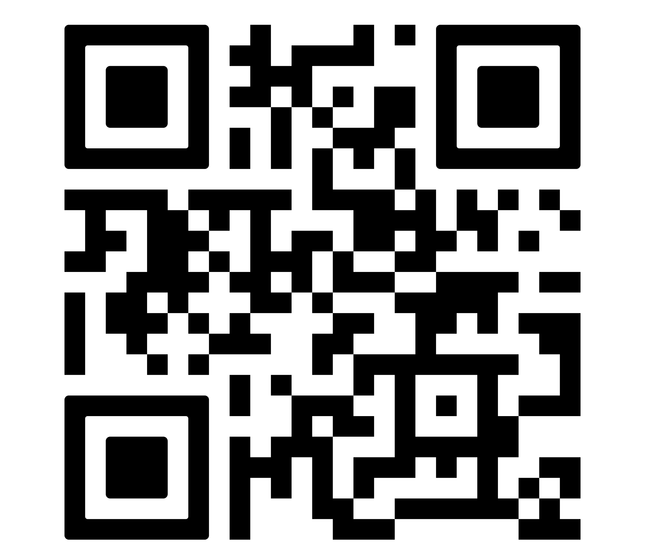
Employee Benefits Center
The EBC is your online employee benefits center. The EBC is a one-stop resource which provides you with up-to-date benefit information, benefit summary plan documents, forms and contact information for each carrier. This site is available to you 24/7 all year round.
mansfield.trgportal.com
mansfield
benefits
Scan to view online

Slide 6
Medical Coverage
Type of Service | VT Gold 1 | Reflective Silver 3
Preventative Care | Covered in full | Covered in full
Medical Deductible Single Family | $1,500 $3,000 | $3,500 $7,000
Prescription Deductible Single Family | $250 $500 | $500 $1,000
Coinsurance | 30% after deductible | 50% after deductible
Medical Out of Pocket Max Single Family | $5,700 $11,400 | $10,150 $20,300
Prescription Out of Pocket Max Single Family | $1,650 $3,300 | $1,650 $3,300
Office Visit- Primary Care/Specialist | $20 copay / $55 copay | $40 copay / $90 copay
Lab/X-ray/MRI Services | Lab & X-ray Office: $20 copay Lab & X-ray Facility: 30% after deductible MRI: 30% after deductible | Lab & X-ray Office: $40 copay Lab & X-ray Facility: 50% after deductible MRI: 50% after deductible
Chiropractic Care & Physical therapy | $35 copay | $50 copay
Urgent Care | $65 copay | $100 copay
Emergency Room | $150 copay after deductible | $250 copay after deductible
Inpatient & Outpatient Facility | 30% after deductible | 50% after deductible
Prescription Drug Retail, per 30 day supply Mail order, 90 day supply | $15 / $60 after deductible / 50% after deductible $37.50 / $150 / 50% after deductible | $15 / $70 after deductible / 50% after deductible $37.50 / $175 / 50% after deductible
Sign in or create an online account to:
View, print, or order ID cards
Make a payment
Check the status of a claim, and more!
Register or sign in to your
account by going to myaccount.mvphealthcare.com
Notes:
Updated for 2026

Slide 7
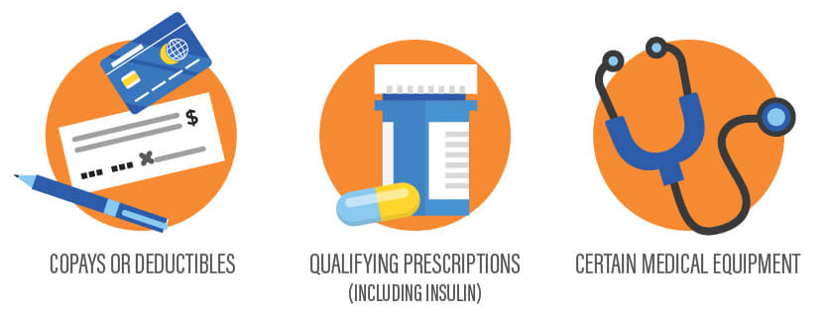

Flexible Spending Account
Flexible Spending Accounts can help you pay health care and dependent care expenses on a pre-tax basis. By anticipating your family’s health care and dependent care expenses for the next year and setting aside money, you can actually lower your taxable income.
Healthcare Reimbursement (FSA)
Annual Max & Utilization: The annual maximum amount you may contribute to this FSA is $2,800 per calendar year. This program allows employees to use pre-tax dollars for certain IRS-approved expenses. Any unused FSA dollars will be forfeited on March 15th, following the end of the plan year. *Over-the-counter medications are not reimbursable through the FSA unless you have a prescription from your physician.
Some examples include:
Hearing services, including hearing aids and batteries
Vision services, including contact lenses, contact lens solution and eyeglasses
Dental services and orthodontia
Medical and Rx deductibles; Co-payments and Co-insurance
For a full list of eligible items, please visit https://fsastore.com/fsa-eligibility-list
How to access your FSA funds
Request Reimbursement
Submit an FSA claim to access funds
Claim requests can be submitted many ways for your convenience:
Log into the Consumer Portal, enter the claim details, and upload scanned supporting documentation to us.
Log into the mobile app on your smartphone, enter the claim details and snap photos of supporting documentation to submit them to us.
Complete a claim form, attach copies of supporting documentation and send them by mail, fax or email to us.
You can track all your claims through the Consumer Portal on our website or the mobile app.
Note: You do not need to show proof of payment to receive reimbursement, only that the service(s) were rendered. Complete the claim form and submit the detailed documentation for the eligible product or service. If the product or services is eligible, payment will be sent directly to you.
Secure Consumer Portal available to access your account 24/7/365 at www.csONE.com.
Customer Service Number: 1-888-227-9745 Fax: 603-224-0230 PO Box 1320, Concord, NH 03302-1320
Notes:
No increases for FSA, page done.

Slide 8

Dental Coverage
For 2026, Mansfield Housing Group will offer a comprehensive dental plan administered by Northeast Delta Dental
Outline of Covered Services |  | PPO Plus
Coverage A Diagnostic/Preventative | Diagnostic: Evaluations: 2 in a 12‐month period, Includes: periodic, limited, problem‐Focused & comprehensive evaluations. X‐rays: Bitewing X‐rays once in a 12-month period, X‐rays of individual teeth as needed Brush biopsy once in a 12‐month period Preventative: Cleanings: 2 in a 12‐month period Fluoride treatment: once in a 12‐month period to age 15 Sealant application to permanent molars, once in a lifetime per tooth, for children to age 15 | 100%
Coverage B Basic | Restorative: Amalgam (silver) fillings, Composite (white) fillings Oral Surgery: Routine extractions Endodontics: Root canal therapy Periodontics: Periodontal Maintenance (Cleaning) – 2 in a 12‐month period Space maintainers to age 15 Full-mouth/panoramic X-rays once in a 5-year period Emergency Palliative Treatment | 80%
Coverage C Major | Prosthodontics: Removable and fixed partial dentures (bridge); complete dentures, Rebase and reline (dentures) Crowns- Onlays- Implants Denture repair: Repair of a removable denture to its original condition Oral Surgery: Complex extractions and other surgical procedures Crown Lengthening: Clinical crown lengthening once in a lifetime per site | 50%
Coverage D | Orthodontics: Correction of crooked teeth for children & adults | 50%
 | Orthodontic Lifetime Maximum (per person) | $1,500
Annual Max For services covered under A, B and C |  | $2,000
Calendar Year Deductible per Person/Family (Coverage B and C only) |  | $100/$300
Notes:
No changes

Slide 9



Delta Dental Perks
A healthy mouth is part of a healthy life and Northeast Delta Dental’s innovative HOW program works with your dental benefits to help you achieve and maintain better oral wellness. HOW is all about you because it’s based on your specific oral health risk and needs. Best of all, it’s secure and confidential.
Here’s how to get started:
1. Go to www.healththroughoralwellness.com and click on “Register Now”.
Know Your Score
After you register, please take the free oral health risk assessment by clicking on “Free Assessment”
in the Know Your Score section of the website.
Share Your Score With Your Dentist
The next step is to share your results with your dentist at your next dental visit. Your dentist can
discuss your results with you and perform a clinical version of the risk assessment.
The Northeast Delta Dental Plan allows you to double your calendar year maximum by earning an additional $250 per year for use in future benefit periods.
Here’s how it works:
To qualify for the carryover, you must have a claim paid for either an oral exam or a cleaning during a calendar year (a focus on prevention), and your total paid claims cannot exceed $500 during the same calendar year.
The carryover will accumulate for each year of qualification up to an amount equal to the plan’s original calendar year maximum. If, for example, the calendar year maximum is $1,500, enrollees can ultimately achieve an annual maximum of $3,000.
Great Savings—Up to 35% off eyewear
Choose from any available frame including quality name-brand products such as Brooks Brothers®, Ann Klein®, Vogue®, and more at provider locations. With EyeMed Vision Care, Northeast Delta Dental members have access to over 71,000 vision care providers nationwide at 27,000 locations, including optometrists, ophthalmologists, opticians, and the nation’s leading optical retailers.
It’s easy! To request your discount, simply present your Delta Dental member ID card or this ﬂyer when you arrive at the provider office or location. Your EyeMed provider will take care of the rest! To learn more about the EyeMed Vision Care Discount Plan, please visit our website at www.nedelta.com.
This is a discount program only and is separate from vision coverage. Vision coverage is offered through VSP.
Notes:
No changes

Slide 10

Vision Coverage
Mansfield Housing Group is pleased to offer a comprehensive vision plan for employees. Eligible employees may enroll in the vision coverage during the initial eligibility waiting period & during Open Enrollment. See the Benefits Summary on the EBC for a complete outline of coverage.
Benefit | VSP Plan Description | Frequency | Copay
WellVision Exam | Focuses on your eyes and overall wellness Routine retinal screening | Every calendar year | $10 Up to $39
Prescription Glasses | Frame: $160 allowance for a wide selection of frames Extra $50 allowance for featured frame brands 20% savings on the amount over your allowance $70 Costco/Walmart frame allowance | Every other calendar year | Included in Prescription Glasses
 | Lenses: Single vision, lined bifocal, and lined trifocal lenses Impact-resistant lenses for dependent children | Every calendar year | Included in Prescription Glasses
 | Lens Enhancements: Progressive lenses Anti-glare coating Average savings of 30% on other lens enhancements | Every calendar year | $0
Contacts (instead of glasses) | $130 allowance for contacts; copay does not apply Contact lens exam (fitting and evaluation) | Every calendar year | Up to $60
Additional Savings | Standard & Premium Glasses and Sunglasses Discover all current eyewear offers and savings at vsp.com/offers 20% savings on unlimited additional pairs of glasses/sunglasses Laser Vision Correction Average of 15% off the regular price; discounts available at contracted facilities After surgery, use your frame allowance for sunglasses from any VSP doctor
Notes:
Updated to Enhanced

Slide 11
Rates
Medical Plan Bi-Weekly Premiums
MVP | VT Gold 1 | Reflective Silver 3
Employee Only | $89 | $0
Employee + Spouse | $559 | $382
Employee + Child(ren) | $527 | $355
Employee + Family | $941 | $691
Dental Plan Bi-Weekly Premiums
Dental – Premium Plus | Bi-Weekly Contribution
Employee Only | $11.17
Employee + One | $29.74
Employee + Family | $60.31
Vision Plan Bi-Weekly Premiums
Vision – VSP | Bi-Weekly Contributions
Employee Only | $6.92
Employee + Spouse | $11.07
Employee + Child(ren) | $11.30
Employee + Family | $18.21
Notes:
Updated to 2026

Slide 12


Life & Disability Insurance
Employer Paid Life and AD&D Insurance
Life insurance offers you and your family important financial protection. Mansfield Housing Group provides benefits eligible employees with Life Insurance and AD&D in the amount of $10,000. Mansfield Housing Group pays the full cost of these benefits. The benefits reduce to 65% upon reaching age 65 and 50% upon reaching age 70.
Voluntary Life Insurance & AD&D
Employees who would like to supplement their employer paid life insurance benefits may purchase additional coverage. Choose up to a maximum of $300,000 in $10,000 increments, not to exceed five (5) times the annual salary. The benefits reduce to 65% upon reaching age 65 and 50% upon reaching age 70.
Voluntary Dependent Life Insurance & AD&D
Employees may purchase life insurance benefits for their dependents.
Spousal Life Insurance & AD&D : You may elect up to $250,000 of coverage, in $5,000 increments. Coverage may not exceed the employee’s elected coverage.
Child Life Insurance & AD&D:
You may elect up to $10,000 of coverage per child, in $1,000 increments. Coverage may not exceed the employee’s elected coverage.
Evidence of Insurability
You will be required to give satisfactory evidence of insurability for supplemental life and AD&D amounts outside guaranteed issue (GI). GI for Employee Life is $100,000. GI for Spousal Life insurance is $25,000. All child amounts are guaranteed issue.
Voluntary Short-Term Disability Insurance
Employees may purchase Short-Term Disability insurance administered by Mutual of Omaha. Disability income protection insurance provides a benefit for “short term” disability resulting from a covered injury or sickness.
Benefit of 66.67% of base earnings to a maximum of $1,500 per week
Payment of benefits begin on the 8th consecutive day of your qualified disability or illness.
The maximum benefit period is 25 weeks per eligible disability
For rates and plan details, please visit the EBC

Slide 13
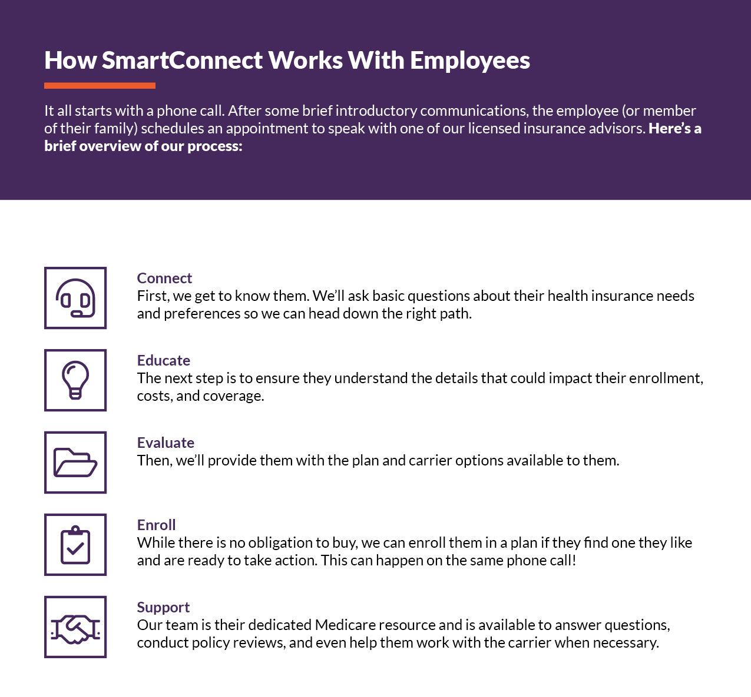
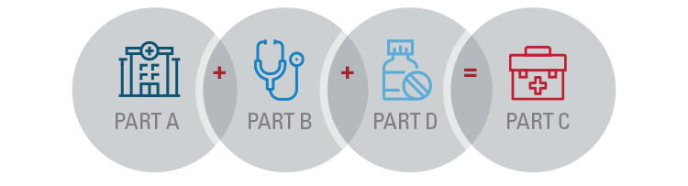

Medicare Navigation
Medicare Navigation (SmartConnect through The Richards Group)
Medicare is very complex, and it is important that you have an advocate who can provide you the proper Medicare education and guidance.
There are different paths you can choose in Medicare plans, and it can be very time consuming and difficult to filter through these options yourself. It is important that you find the appropriate plan in your area that best fits your medical needs and is within your financial budget.
The Richards Group has partnered with SmartConnect™, an exclusive, no-cost program created specifically to connect Medicare-eligible working adults to the world of Medicare benefits. Whether an employee plans to continue working or is transitioning to retirement, we tailor solutions designed around their needs. Our agents provide an unfiltered view of the entire range of options and prices available to the employee.
SmartConnect
1-833-502-2747 | TTY: 711
https://gps.smartmatch.com/therichardsgroup

Slide 14
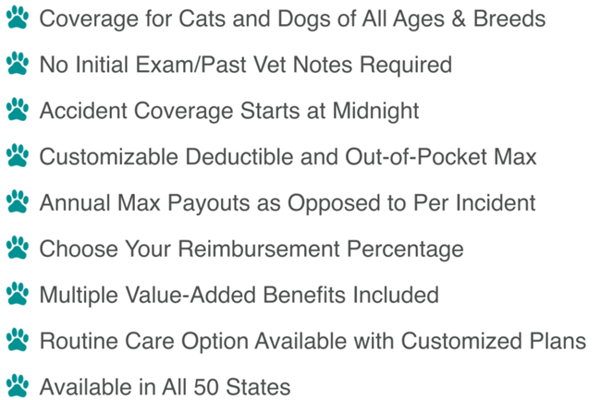



Pet Insurance
How Do I Enroll?
To enroll, visit: www.PinPaws.com/mansfield and follow the steps.
Monthly premiums will vary depending on the age and breed of your dog or cat, as well as which plan or customizations you choose. Monthly premiums will be paid by credit card.
Enrollment is not limited to Open Enrollment window or new hire eligibility.
Travel Assistance – Sun Life Financial
How Does Pet Insurance Work?
For more information, visit https://pinpaws.com/mansfield or call 844-746-7297.

Slide 15
Additional Information & Notices
COBRA Information:
COBRA continuation coverage is a temporary extension of coverage under the group health plan. The right to COBRA continuation coverage was created by a federal law, the Consolidated Omnibus Budget Reconciliation Act of 1985 (COBRA). COBRA continuation cover age can become available to you when you would otherwise lose your group health coverage. It can also become available to other members of your family who are covered under the Plan when they would otherwise lose their group health coverage. For additional information about your rights and obligations under the Plan and under federal law, you should review the Plan’s Summary Plan Description or contact the Benefits Coordinator in Human Resources.
Health Insurance Marketplace:
You may have other options available to you when you lose group health coverage. You may be eligible to buy an individual plan through the Health Insurance Marketplace (www.healthcare.gov). By enrolling in coverage through the Marketplace, you may qualify for lower costs on your monthly premiums and lower out-of-pocket costs. Additionally, you may qualify for a 30- day special enrollment period for another group health plan for which you are eligible (such as a spouse’s plan), even if that plan generally doesn’t accept late enrollees.
HIPAA Information:
Special Enrollment Right Mandated by the Health Insurance Portability and Accountability Act of 1996
Group health plans and health insurance insurers are required to provide special enrollment periods during which individuals who previously declined coverage for themselves and their dependents may be allowed to enroll without having to wait for the plan’s next open enrollment period. A special enrollment period can occur if a person with other health coverage loses that coverage or if a person becomes a new dependent through marriage, birth, adoption or placement for adoption. If you refuse enrollment for yourself or your dependents for medical coverage, you may later enroll within 30 days of a change in family status or loss of health coverage.
Individuals may not be denied eligibility or continued eligibility to enroll for benefits under the terms of the plan based on specified health factors. In addition, an individual may not be charged more for coverage than similarly situated individuals based on these specific health factors.
Effective April 1, 2009, the Children’s Health Insurance Reauthorization Act of 2009 (CHIPRA) created a new 60-day special enrollment peri od for eligible employees and dependents to immediately enroll in the plan if they become ineligible for Medicaid or any state’s Children’s Health Insurance Program (CHIP) and lose coverage or become eligible for that state’s premium assistance program. The employee must request coverage within 60 days after the termination of coverage or the determination of subsidy eligibility.
Women’s Health and Cancer Rights Act of 1998 (WHCRA):
WHCRA requires a group health plan to notify you, as a participant or a beneficiary, of your potential rights related to coverage in connection with a mastectomy. Your plan may provide medical and surgical benefits in connection with a mastectomy and reconstructive surgery. If it does, coverage will be provided in a manner determined in consultation with your attending physician and the patient for a) all stages of reconstruction on the breast on which the mastectomy was performed; b) surgery and reconstruction of the other breast to produce a symmetrical appearance; c) prostheses; and d) treatment of physical complications of the mastectomy, including lymphedema. The cover age, if available under your group health plan, is subject to the same deductible and coinsurance applicable to other medical and surgical benefits provided under the plan. For specific information, please refer to your summary plan description or benefits booklet, or contact Human Resources.
THIS IS ONLY A SUMMARY, NOT A CERTIFICATE OF INSURANCE
The information contained in this Employee Benefits Summary is presented for illustrative purposes only and is based on information provided by the employer and in certificates of insurance supplied by the insurance carrier. The Richards Group, your company’s insurance broker, has prepared this Summary to assist employees in understanding their company’s benefits plan. While every effort has been made to describe these benefits accurately, discrepancies or errors are possible. You should also read the actual plan documents in their entirety. If there is a discrepancy between the Employee Benefits Summary and the actual plan documents, the plan documents will prevail. If you have any questions about the Employee Benefits Summary, please contact Human Resources.
All content of this summary and additional information can be found on the EBC.
Paper notices are available upon request to Human Resources.

Slide 16



