Slide 1
Shop for care
Use the preventive care portion of your plan
Minute clinic or retail clinics
Online doctor visits
Use Generics
Inform your doctor/provider that you are on a HDHP
Shop for medical value – compare charges
Evaluate different pharmacies
Look up manufacturer discounts on prescriptions
Use your health plan tools and resources

Slide 2
Pairing with an HSA
If you or your spouse contribute to an HSA, your FSA needs to be limited to vision and dental
This allows the HSA to not be tapped for these costs
The maximum contribution for an HSA in 2023 is $3,850 for Single, and $7,750 for Family
Pair accounts with an HSA
Pairing with a Dependent Care FSA
An HSA does not affect your opportunity to utilize a Dependent Care FSA to set pre-tax money aside to pay for eligible dependent day care expenses
The maximum contribution for a Dependent Care FSA is $5,000 ($2,500 if married and filing separate

Slide 3
Delay reimbursements and save receipts
Opt out of the crossover feature
Any expense you incur after you’ve established your HSA and paid out-of-pocket creates an opportunity for a tax-free withdrawal
There is NO time limit to turn in receipts once the HSA is established
You retain a higher HSA balance now to earn interest or invest increasing the potential for growth
You can stop and continue this strategy as you see fit, or as major life events come up such as an interruption or reduction to income
At age 65 you can make distributions from your HSA for non-eligible expenses with no penalty, just pay your income taxes

Slide 4
HSA Scenario: OPTION 1 Meet Marie Single professional, no children
Annual salary | $48,000
HSA contribution | $3,000
Taxable income | $45,000
Estimated tax rate¹ | 30%
1 Assumes Marie pays 30% of her income in federal, State and social security taxes. Actual tax savings will depend on your HSA contributions, applicable State tax rates and your personal tax situation. Please consult your tax adviser for details.
Marie’s story is a hypothetical example for purposes of illustration only.
Notes:
HSA Case 3: Meet the Robinsons.
Isiah and Michelle have a growing family with two school-age children. Isiah works for a large manufacturing company as a manager making $56,000. Michelle runs her own catering business from home and makes $38,000. Isiah’s employer offered an HSA-qualified health plan this year that allows him to set aside up to $6,900 tax-free to pay for annual deductibles, save for dental and vision expenses and be prepared for any unplanned medical costs that may come up. The Robinsons decide to contribute $5,000 because they know any amount contributed and any interest it may earn is tax-free and remains theirs from year-to-year for qualified expenses. And, because their balance is above $1000, they take advantage of the more than 30 investment options available through Charles Schwab, anticipating their balance will increase each year.
Income $94,000
HSA Contribution $7,100 (pre-tax contribution – the max for 2020)
Net Taxable Income $86,900
Tax @ 25% $21,725 (vs. 23,500 on $94K)
Tax Savings $1,775.00
Medical expenses $1,850 (paid out of the HSA)
HSA Balance $3,150

Slide 5
Meet Sandra
Annual salary | $58,000
HSA contribution | $2,600
Taxable income | $55,400
Estimated tax rate¹ | 25%
Estimated tax savings | $650
1 Assumes Sandra pays 25% of her income in federal, State and social security taxes. Actual tax savings will depend on your HSA contributions, applicable State tax rates and your personal tax situation. Please consult your tax adviser for details.
When Sandra incurs a $650 health care bill, it actually costs her nothing when factoring in the tax savings!
This story is a hypothetical example for purposes of illustration only.
Notes:
HSA Case 2: Meet the Martinez’s
Maria is 41 and a manager at a small manufacturing business earning $68,000 per year. Her son, Antonio, is very involved in sports at his middle school. As a single parent, Maria is always looking for ways to save on health care costs and be ready for any unexpected costs that may not be covered by their health plan. As a way to curb rising health care premiums her employer only offers plans with high deductibles. Maria sees an HSA as a flexible way to help her manage their health care costs and save for medical expenses as Antonio enters high school.
Income $68,000
HSA Contribution $5,000 (pre-tax contribution)
Net Taxable Income $63,000
Tax @ 25% $15,750 (vs. $17,000 on $68K)
Tax Savings $1,250
Medical expense $2,450 (paid out of the HSA)
HSA Balance $2,550 (always carries over year after year)

Slide 6
In summary - Five ways an HSA can help you save for your future
1 - Money is not taxed. Money goes into your HSA without paying state or federal taxes. That brings down your taxable income and saves you as much as 28 to 40 percent on medical expenses, depending on your tax bracket.
2 - No “use it or lose it” rule. Money in your HSA belongs to you, even if you change jobs or health plans, or retire.
3 - Invest and grow your money. Your money can earn interest, tax-free, from day one. When your Base Balance reaches $1,000, you can activate your self-directed account.
4 - More flexibility and choice. You can use your HSA dollars for certain health care expenses beyond what your plan covers, allowing you to purchase these services tax-free even if they aren’t covered.
5 - Even out medical expense highs and lows. Since you manage your funds, you can save HSA money when you’re healthy so it’s ready when you need it.

Slide 7
Enrolled in Medicare Part A or Part B
HSA and Medicare
Remaining on Employer’s medical plan and delaying Medicare
No penalty for being enrolled in a HDHP
HSA money can be withdrawn without penalty
HSA contributions (including employer portion) should cease
HSA money can be used to pay for Medicare premiums
Make sure you are enrolled in an employer plan with creditable drug coverage:
[INSERT PLAN INFO HERE]
If both Medicare Part A & B are delayed, contributing to HSA after age-65 is allowed
It is recommended that if enrolling in Medicare post age-65, you cease HSA contributions six (6) months prior to enrolling in Medicare

Slide 8
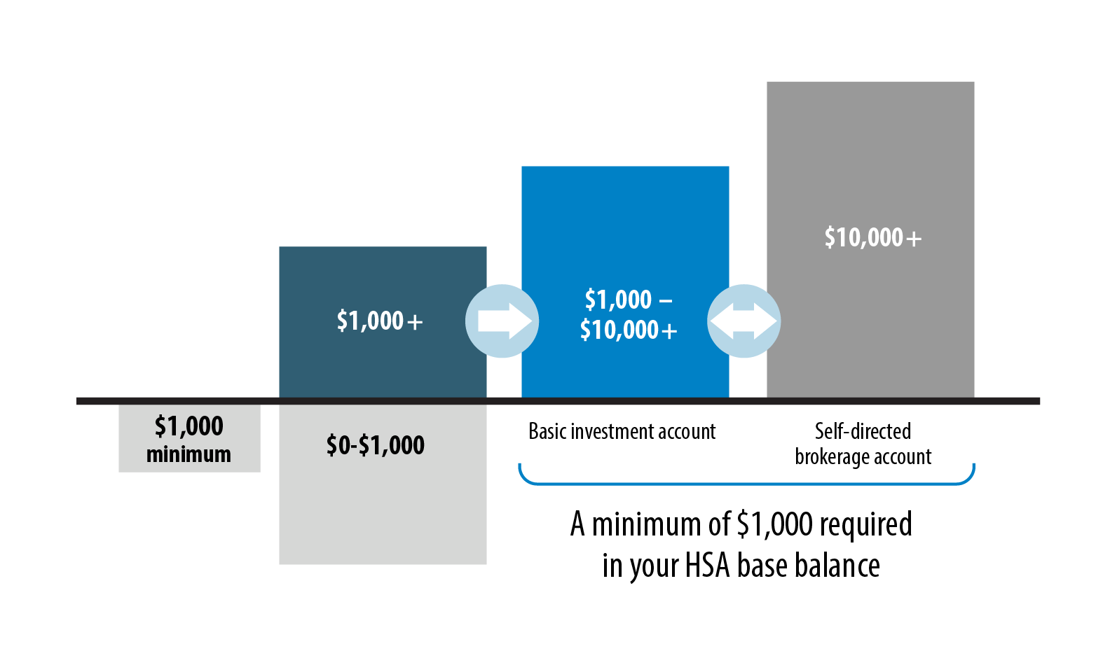
Investment options

Slide 9
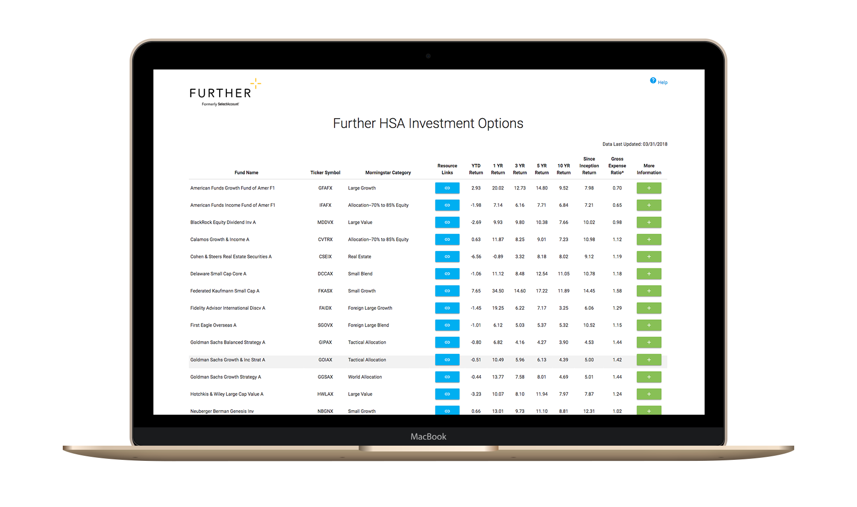
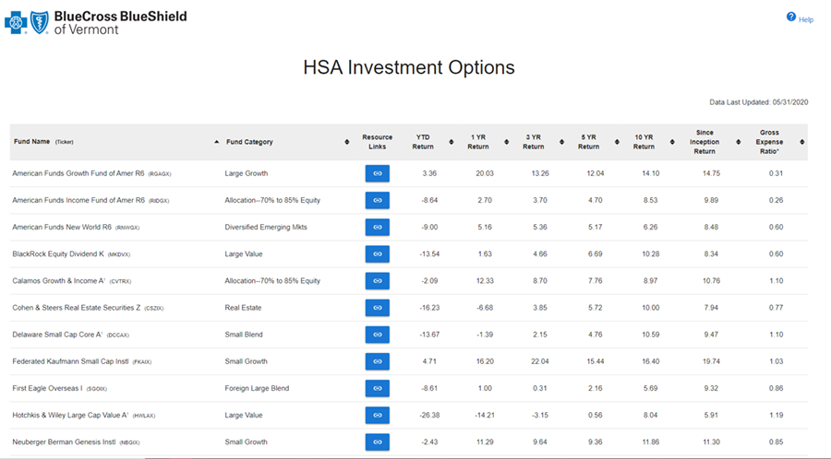
More than 30 mutual funds offered

Slide 10
Quarterly investment statements
Review activity
Manage asset allocation
View fund performance

Slide 11
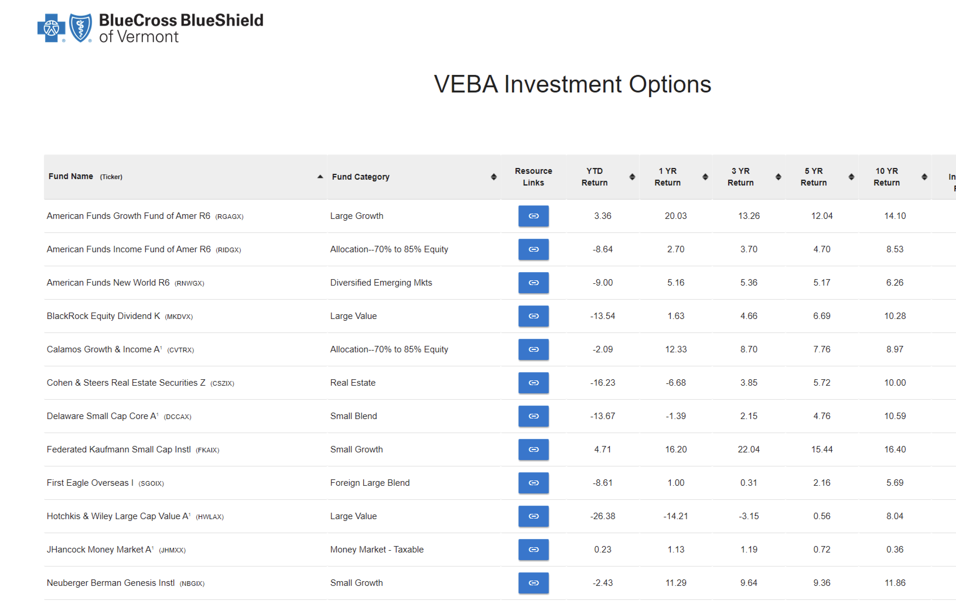
Getting started
Your Spending Account ID sent in your Welcome Kit
Register your account and access your online portal to manage funds

Slide 12
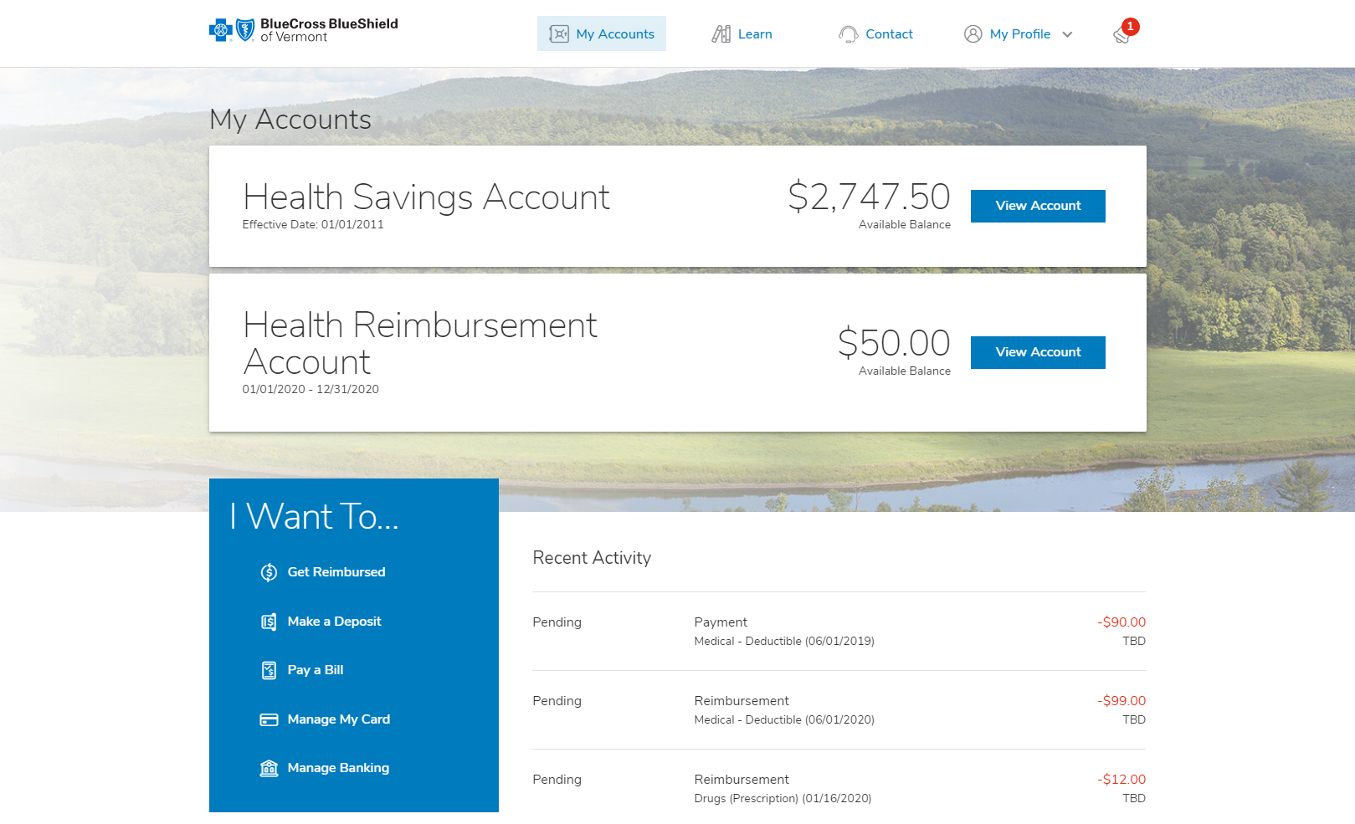
Self-managed through member portal
Basic Investment account:
Available when HSA Base Balance exceeds $1,000
$1.50 monthly fee
More than 30 mutual funds available
Brokerage account:
Available when available balance exceeds $10,000
$1.50 monthly fee
Managed through Charles Schwab
Access to full Schwab brokerage investments

Slide 13
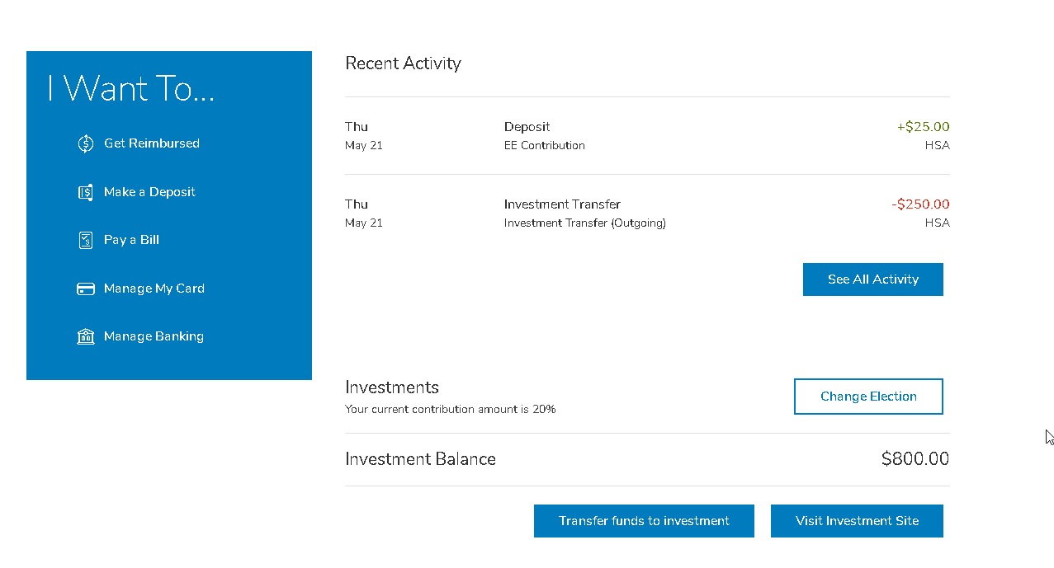
Transferring funds
Select ‘Transfer funds to investment’ button and proceed

Slide 14
Selecting the amount
Review ‘Amount Available to Transfer’. This reflects the available balance >$1,000.
Enter amount into ‘Amount to invest’.
Click the check box next to ‘I understand funds…’
Select Submit
Note: Please allow three business days for your changes to be reflected on your account.

Slide 15
Realign Investments
Realignment:
Step 1 - Review current % by investment
Step 2 - Choose investment(s) and new %. Add as many as you wish until 100% allocated.
Step 3 - Select realignment
Future investments:
Step 1 - Review current % by investment
Step 2 - Choose investment(s) and new %. Add as many as you wish until 100% allocated
Step 3 - Select investment elections

Slide 16
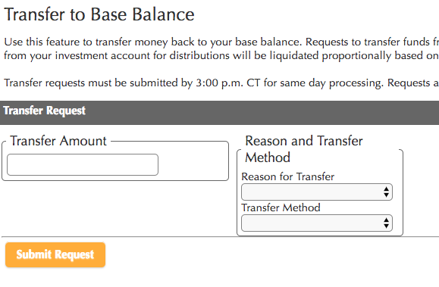
Transfer to Base Balance
Hover over ‘Move Money’ and select ‘Transfer Back to Base Balance’
Step 1 - Enter Transfer Amount
Step 2 – Change Reason and Transfer Method to ‘Transfer to Base Account’
Step 3 - Select Submit Request
Review and select ‘I accept’

Slide 17
Transfer funds between two or more mutual funds
Transfer tips
Transfer funds out when you need them
Allows for $ to $, $ to % or % to % transfers
No minimum balance transfer request
Transfer occurs in 2-3 business days
When you want to:
Pay health care expenses
No longer invest in Funds
No Service Fees to transfer
No minimum balance transfer request
Funds arrive within 2-3 business days

