Slide 1
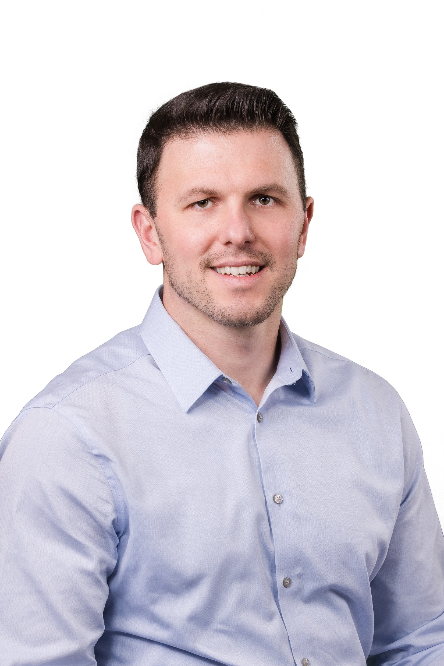
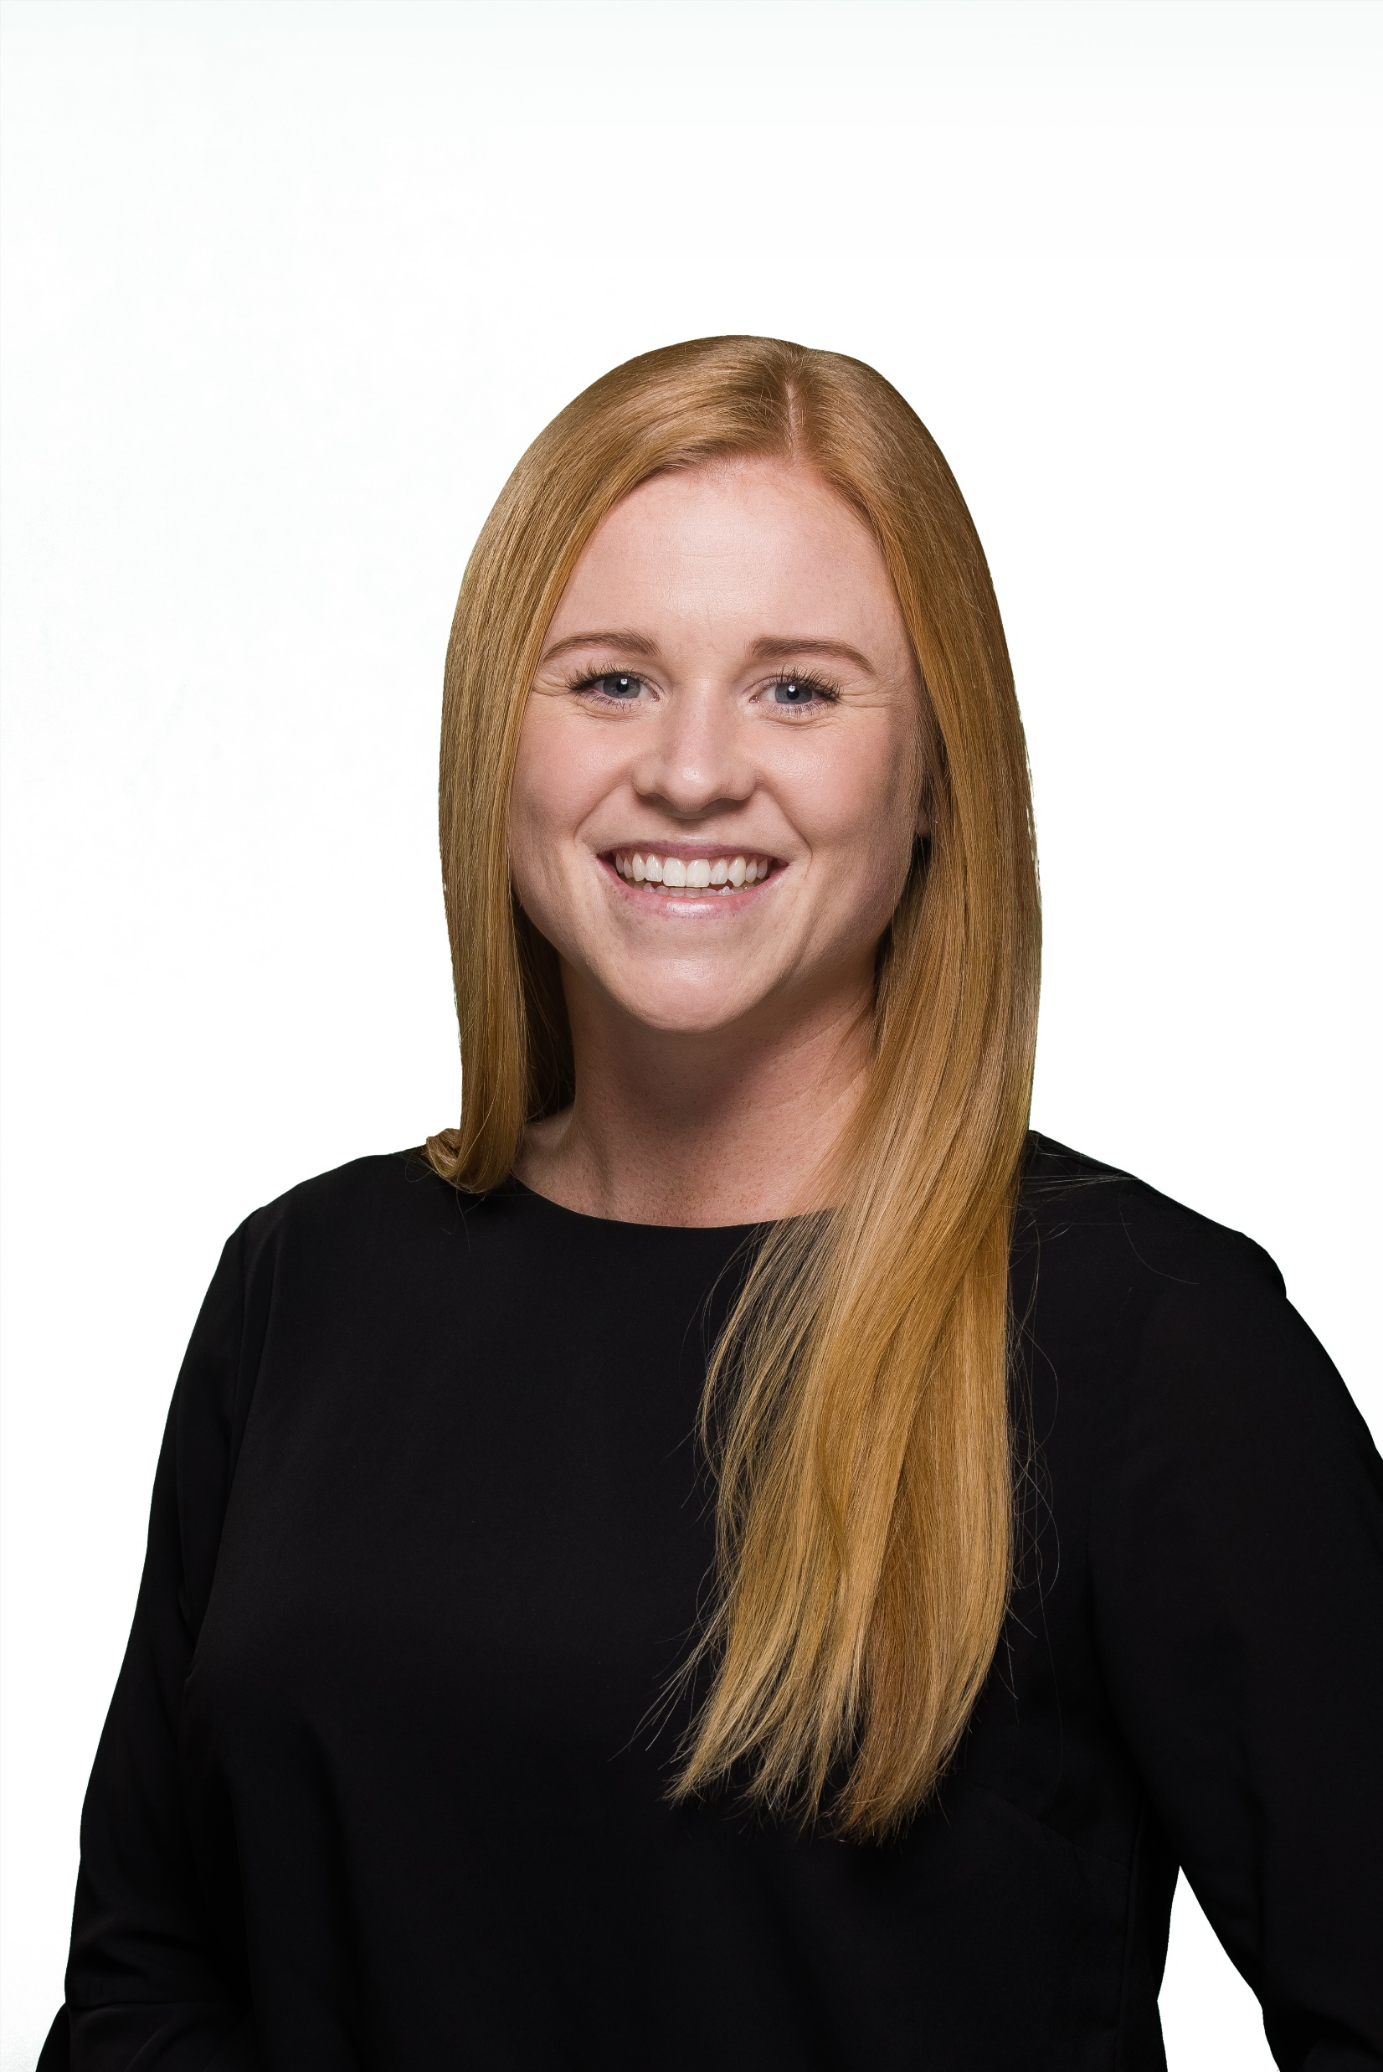
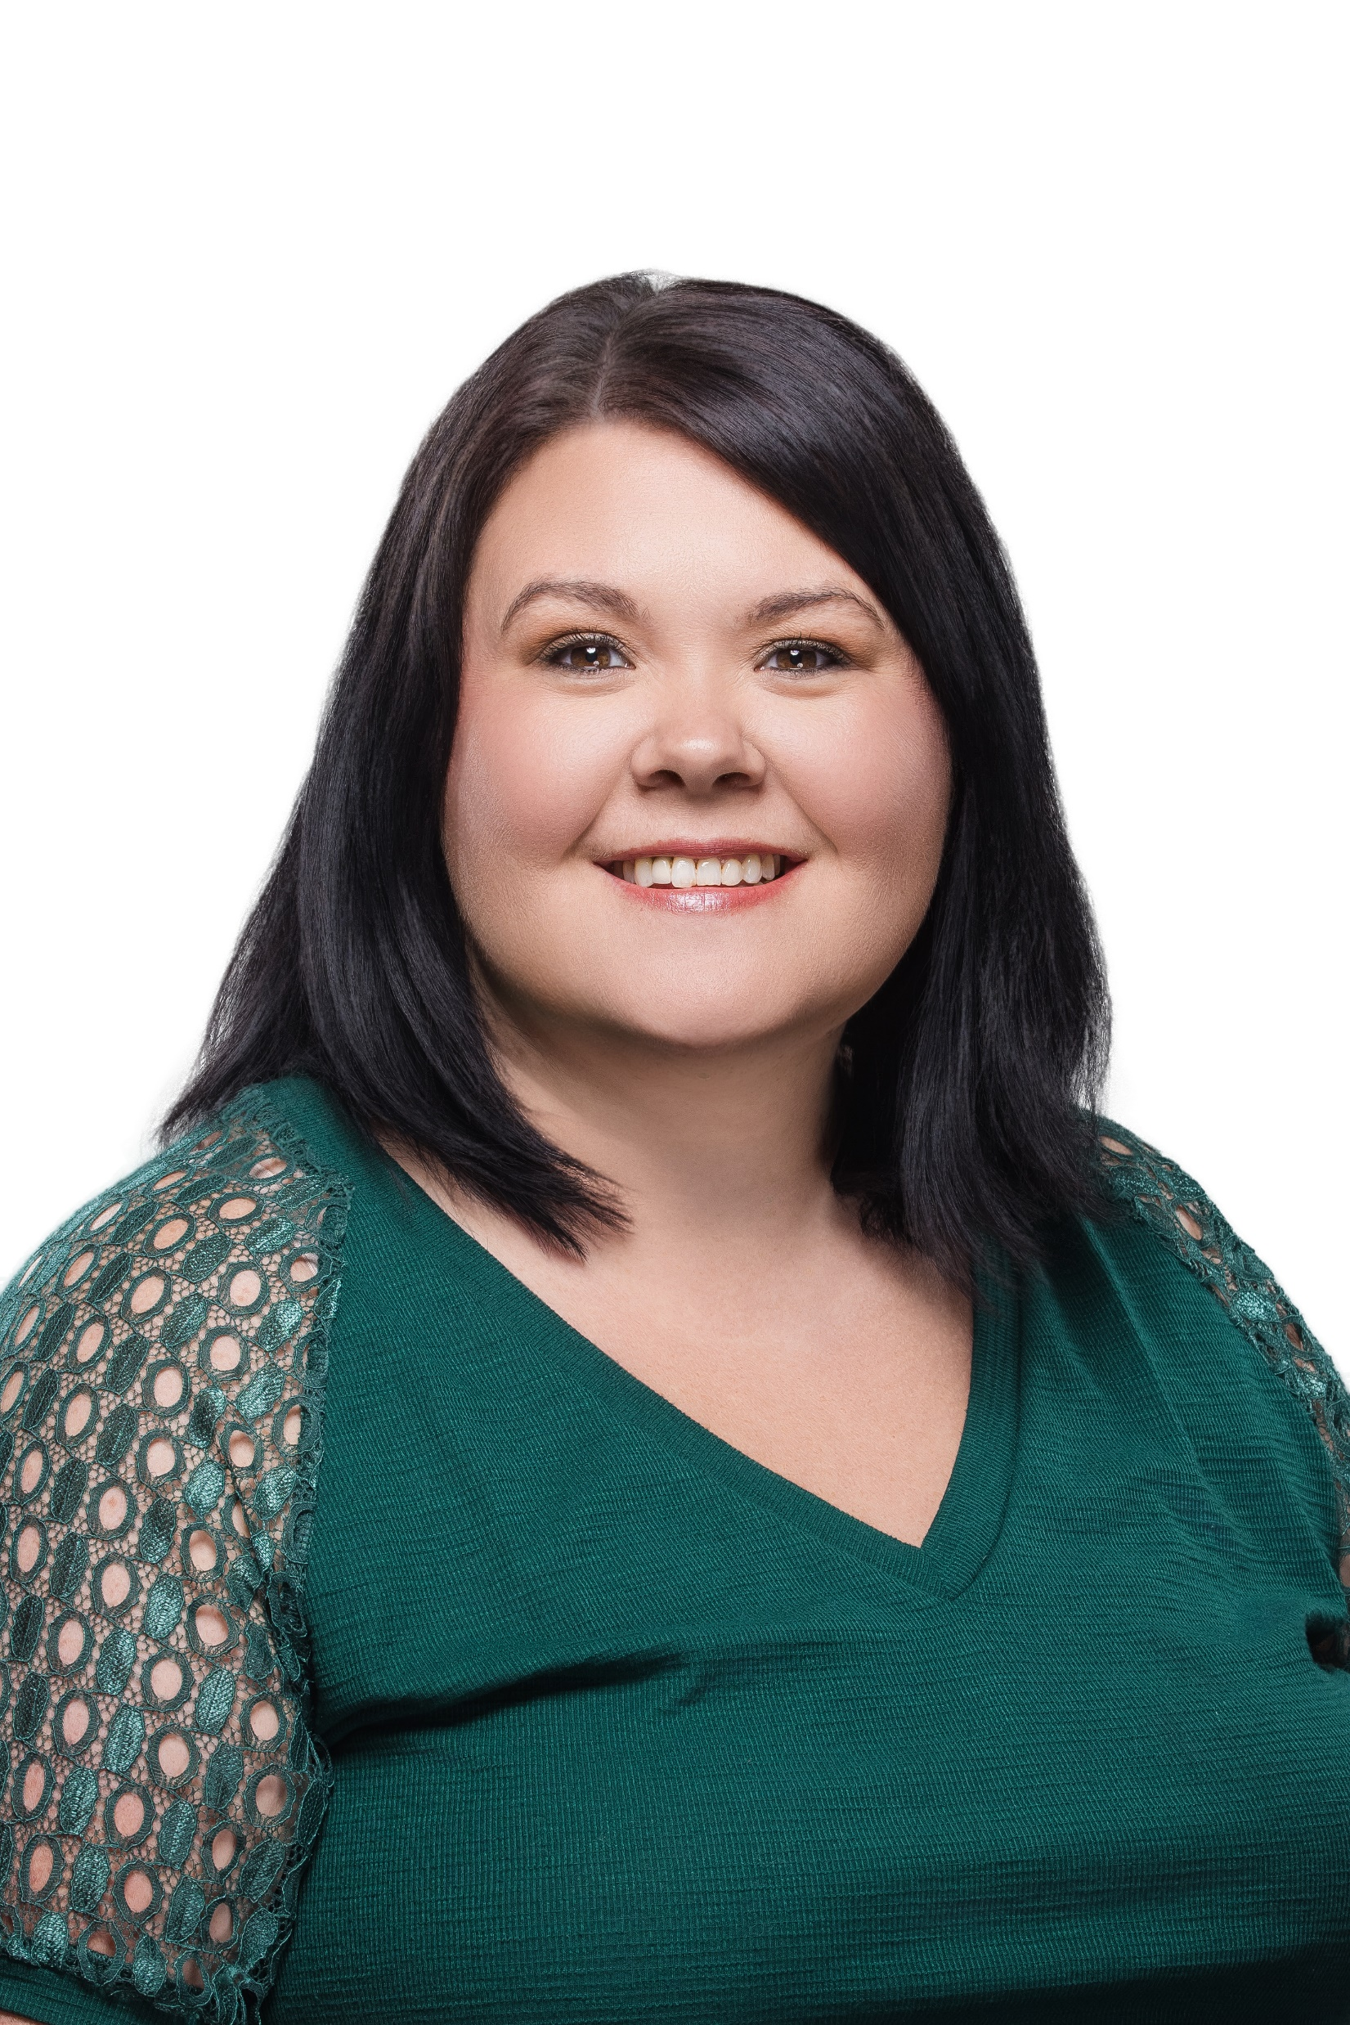
Ryan Cronan
Account Executive
rcronan@therichardsgrp.com
Cassie Westenfeld
Account Director
cwestenfeld@therichardsgrp.com
Katie Wilder
Senior Account Manager
kwilder@therichardsgrp.com
Contact Me Regarding:
Financials
Renewals
Strategy
Contact Me Regarding:
Day to Day service
Billing
Benefits Enrollment systems
Implementations
Contact Me Regarding:
Employee Education
Open Enrollment Meetings
BAAG and EBC Management
Compliance

Slide 2
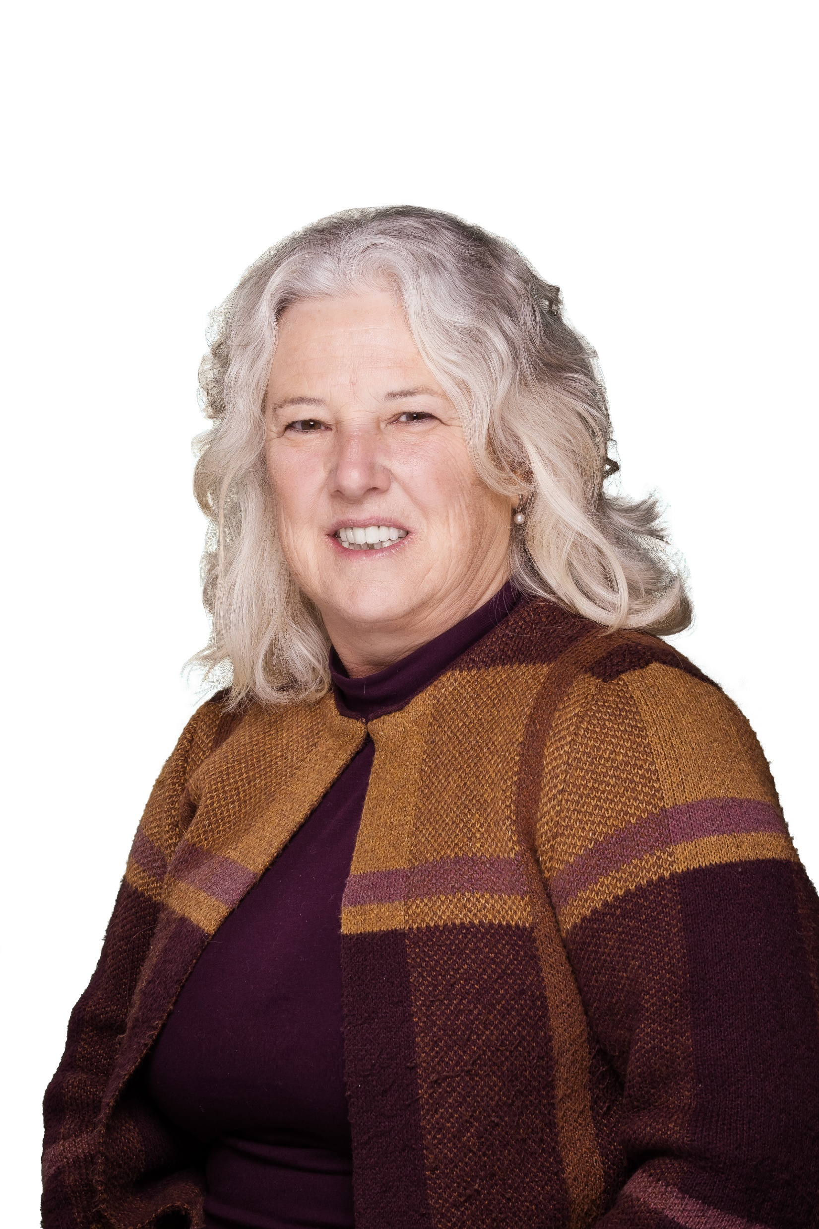
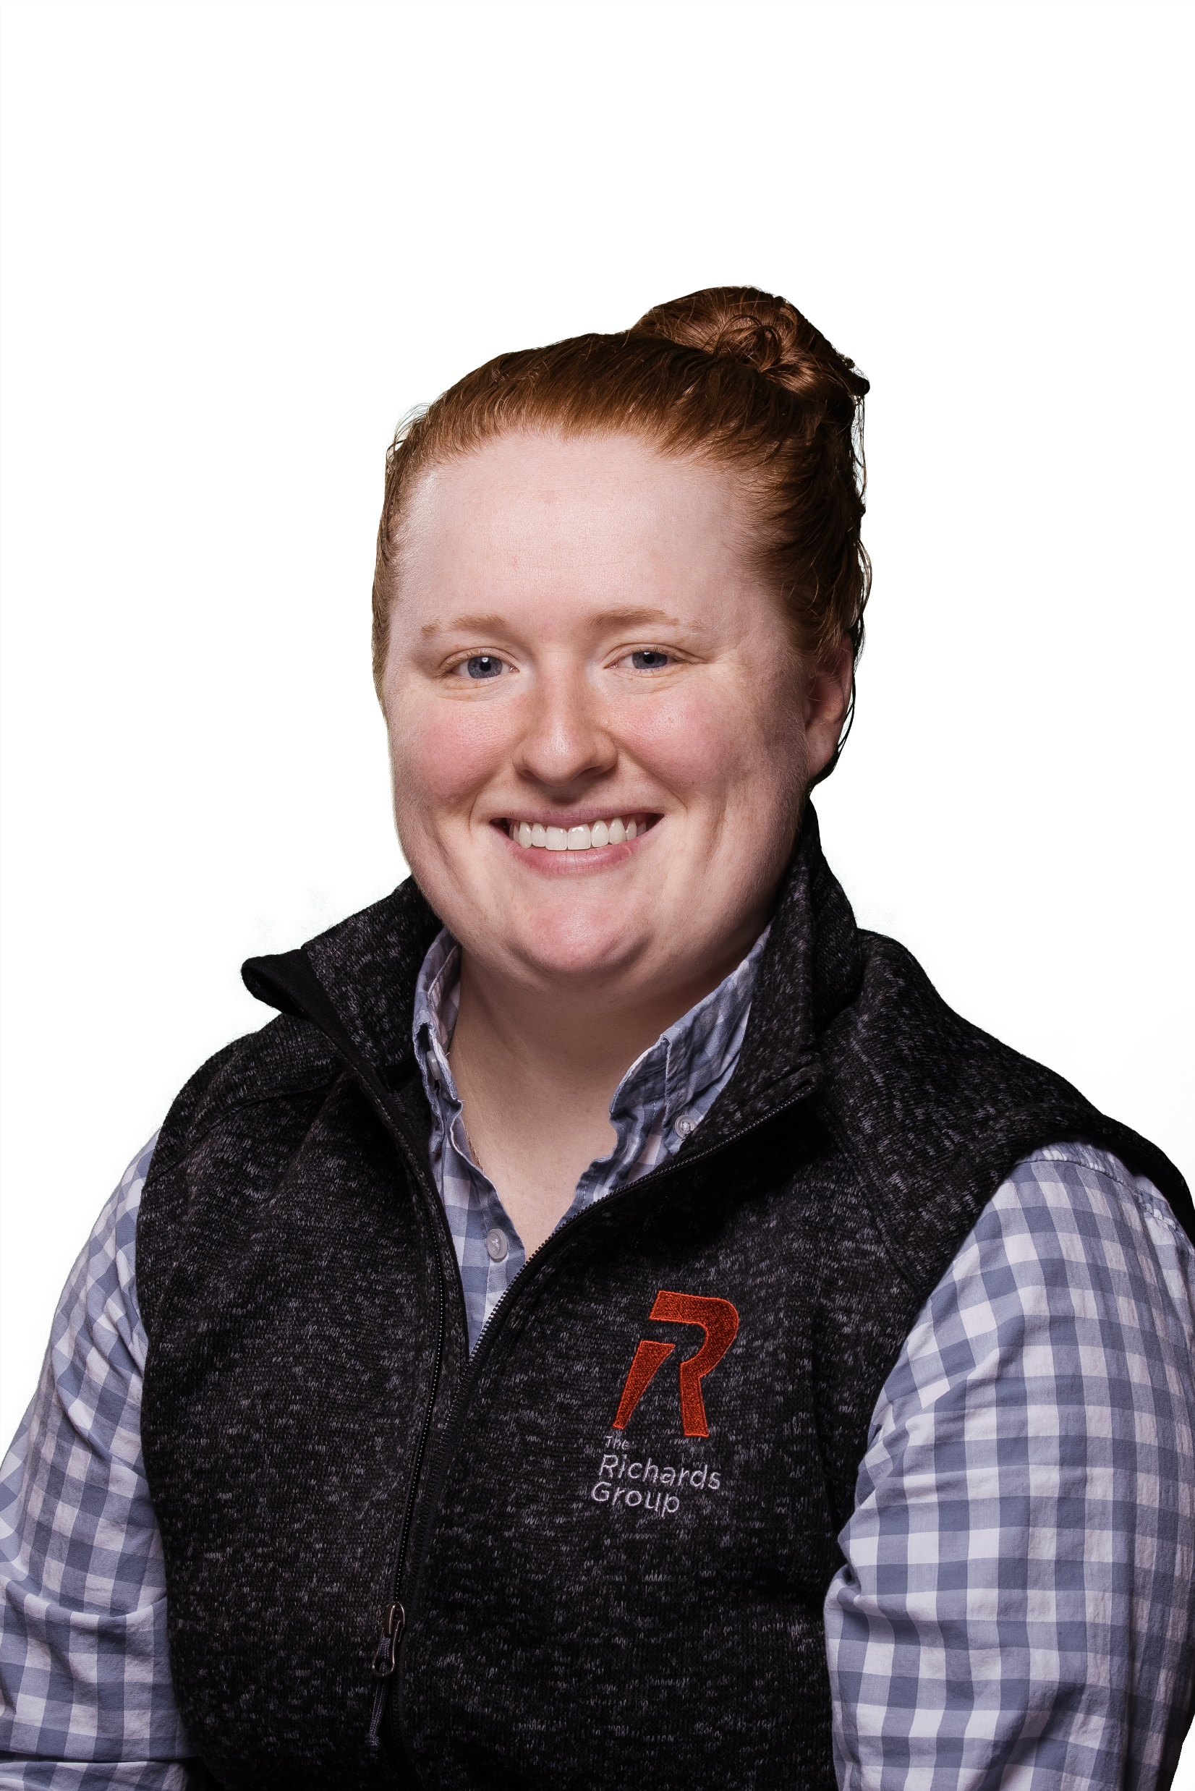
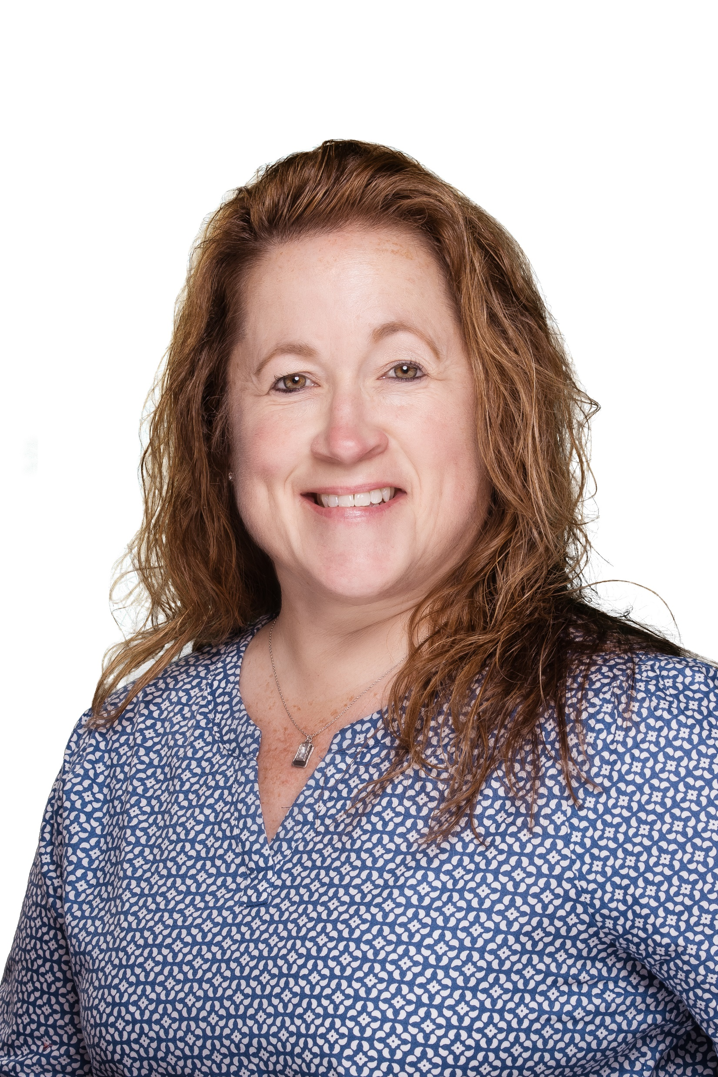
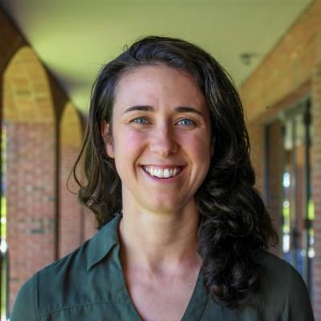
Patti Pileggi
Senior Account Executive
ppileggi@therichardsgrp.com
Kelley Knight
Account Executive
kknight@therichardsgrp.com
Katherine Pate
Senior Account Manager
kpate@therichardsgrp.com
Bethany Kelly
Senior Account Manager
bkelly@therichardsgrp.com
Contact Me Regarding:
Financials
Renewals
Plan Designs
Contact Me Regarding:
Financials
Renewals
Plan Designs
Contact Me Regarding:
Day to Day Questions
Reporting
Proposal Requests
Contact Me Regarding:
Benefits at a Glance (BAAG)
Employee Benefit Center (EBC)
Other Employee Facing Deliverables

Slide 3

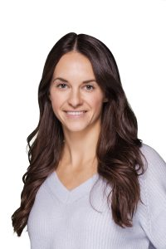
Patti Pileggi
Senior Account Executive
ppileggi@therichardsgrp.com
Kelley Knight
Account Executive
kknight@therichardsgrp.com
Katherine Pate
Senior Account Manager
kpate@therichardsgrp.com
Bethany Kelly
Senior Account Manager
bkelly@therichardsgrp.com
Mari Walsh
Director of Well-being
mwalsh@therichardsgrp.com
Contact Me Regarding:
Financials
Renewals
Plan Designs
Contact Me Regarding:
Financials
Renewals
Plan Designs
Contact Me Regarding:
Day to Day Questions
Reporting
Proposal Requests
Contact Me Regarding:
Benefits at a Glance (BAAG)
Employee Benefit Center (EBC)
Other Employee Facing Deliverables
Contact Me Regarding:
Wellness Initiatives

Slide 4

Patti Pileggi
Senior Account Executive
ppileggi@therichardsgrp.com
Kelley Knight
Account Executive
kknight@therichardsgrp.com
Katherine Pate
Senior Account Manager
kpate@therichardsgrp.com
Bethany Kelly
Senior Account Manager
bkelly@therichardsgrp.com
Mari Walsh
Director of Well-being
mwalsh@therichardsgrp.com
Contact Me Regarding:
Financials
Renewals
Plan Designs
Contact Me Regarding:
Financials
Renewals
Plan Designs
Contact Me Regarding:
Day to Day Questions
Reporting
Proposal Requests
Contact Me Regarding:
Benefits at a Glance (BAAG)
Employee Benefit Center (EBC)
Other Employee Facing Deliverables
Contact Me Regarding:
Wellness Initiatives

Slide 5
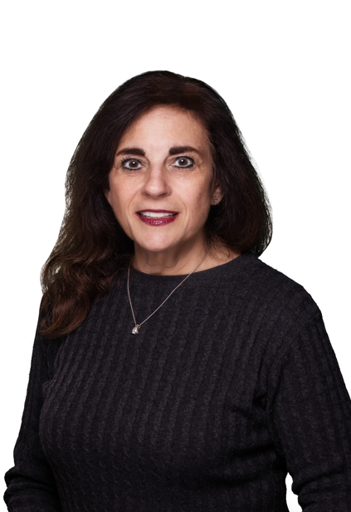
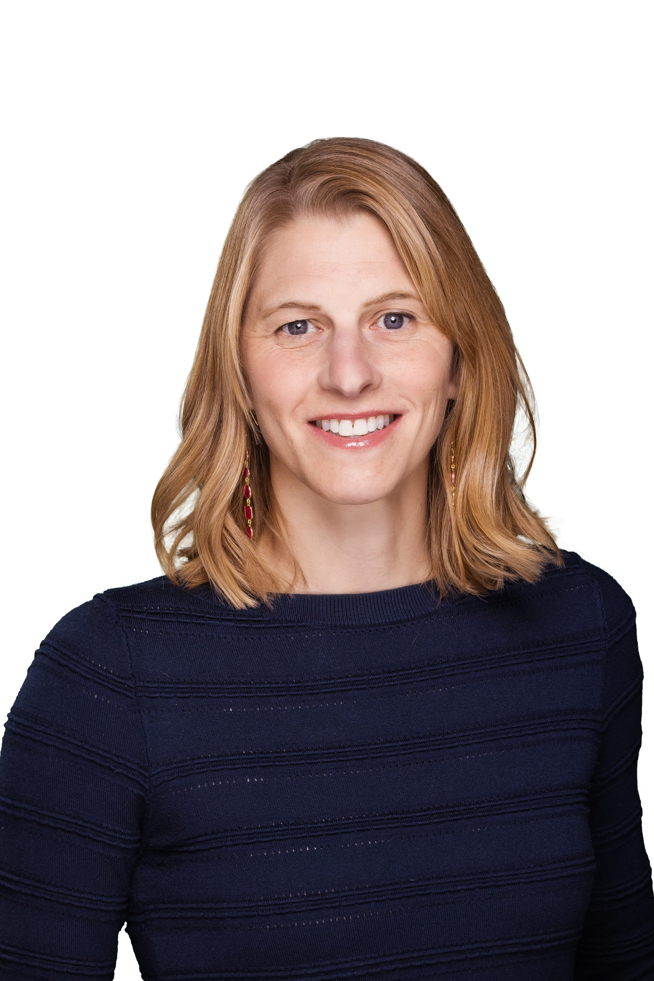
Patti Pileggi
Senior Account Executive
ppileggi@therichardsgrp.com
Marci Taks
Account Executive
mtaks@therichardsgrp.com
Katherine Pate
Senior Account Manager
kpate@therichardsgrp.com
Bethany Kelly
Senior Account Manager
bkelly@therichardsgrp.com
Lindsay Simpson
lsimpson@therichardsgrp.com
Contact Me Regarding:
Financials
Renewals
Plan Designs
Contact Me Regarding:
Financials
Renewals
Plan Designs
Contact Me Regarding:
Day to Day Questions
Reporting
Proposal Requests
Contact Me Regarding:
Benefits at a Glance (BAAG)
Employee Benefit Center (EBC)
Other Employee Facing Deliverables
Contact Me Regarding:
Wellness Initiatives

Slide 6
Patti Pileggi
Senior Account Executive
ppileggi@therichardsgrp.com
Katherine Pate
Senior Account Manager
kpate@therichardsgrp.com
Bethany Kelly
Senior Account Manager
bkelly@therichardsgrp.com
Contact Me Regarding:
Financials
Renewals
Plan Designs
Contact Me Regarding:
Day to Day Questions
Reporting
Proposal Requests
Contact Me Regarding:
Benefits at a Glance (BAAG)
Employee Benefit Center (EBC)
Other Employee Facing Deliverables

Slide 7
Patti Pileggi
Senior Account Executive
ppileggi@therichardsgrp.com
Katherine Pate
Senior Account Manager
kpate@therichardsgrp.com
Bethany Kelly
Senior Account Manager
bkelly@therichardsgrp.com
Mari Walsh
Director of Well-being
mwalsh@therichardsgrp.com
Contact Me Regarding:
Financials
Renewals
Plan Designs
Contact Me Regarding:
Day to Day Questions
Reporting
Proposal Requests
Contact Me Regarding:
Benefits at a Glance (BAAG)
Employee Benefit Center (EBC)
Other Employee Facing Deliverables
Contact Me Regarding:
Wellness Initiatives

Slide 8
Patti Pileggi
Senior Account Executive
ppileggi@therichardsgrp.com
Katherine Pate
Senior Account Manager
kpate@therichardsgrp.com
Bethany Kelly
Senior Account Manager
bkelly@therichardsgrp.com
Lindsay Simpson
Director of Well-being
lsimpson@therichardsgrp.com
Contact Me Regarding:
Financials
Renewals
Plan Designs
Contact Me Regarding:
Day to Day Questions
Reporting
Proposal Requests
Contact Me Regarding:
Benefits at a Glance (BAAG)
Employee Benefit Center (EBC)
Other Employee Facing Deliverables
Contact Me Regarding:
Wellness Initiatives

Slide 9
Patti Pileggi
Senior Account Executive
ppileggi@therichardsgrp.com
Katherine Pate
Senior Account Manager
kpate@therichardsgrp.com
Lindsay Simpson
Director of Well-being
lsimpson@therichardsgrp.com
Contact Me Regarding:
Financials
Renewals
Plan Designs
Contact Me Regarding:
Day to Day Questions
Reporting
Proposal Requests
Contact Me Regarding:
Wellness Initiatives

Slide 10
Patti Pileggi
Senior Account Executive
ppileggi@therichardsgrp.com
Katherine Pate
Senior Account Manager
kpate@therichardsgrp.com
Mari Walsh
Director of Well-being
mwalsh@therichardsgrp.com
Contact Me Regarding:
Financials
Renewals
Plan Designs
Contact Me Regarding:
Day to Day Questions
Reporting
Proposal Requests
Contact Me Regarding:
Wellness Initiatives

Slide 11
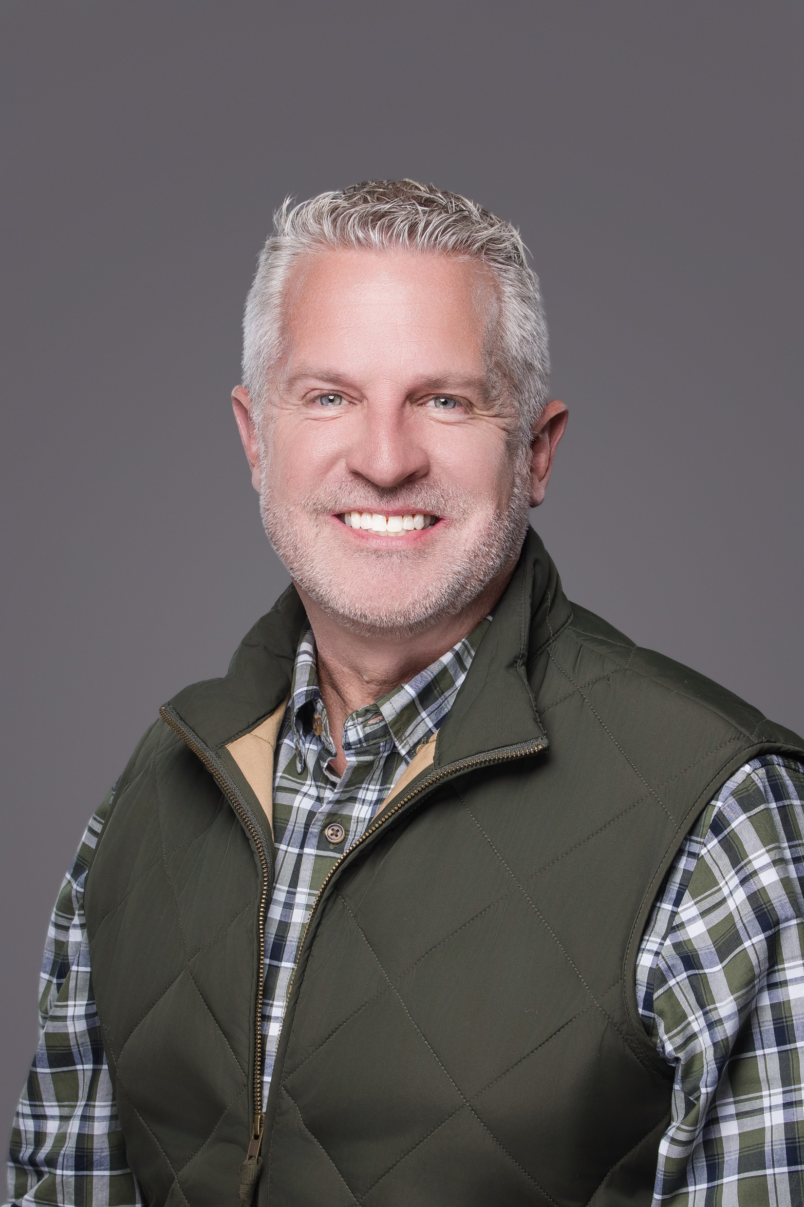
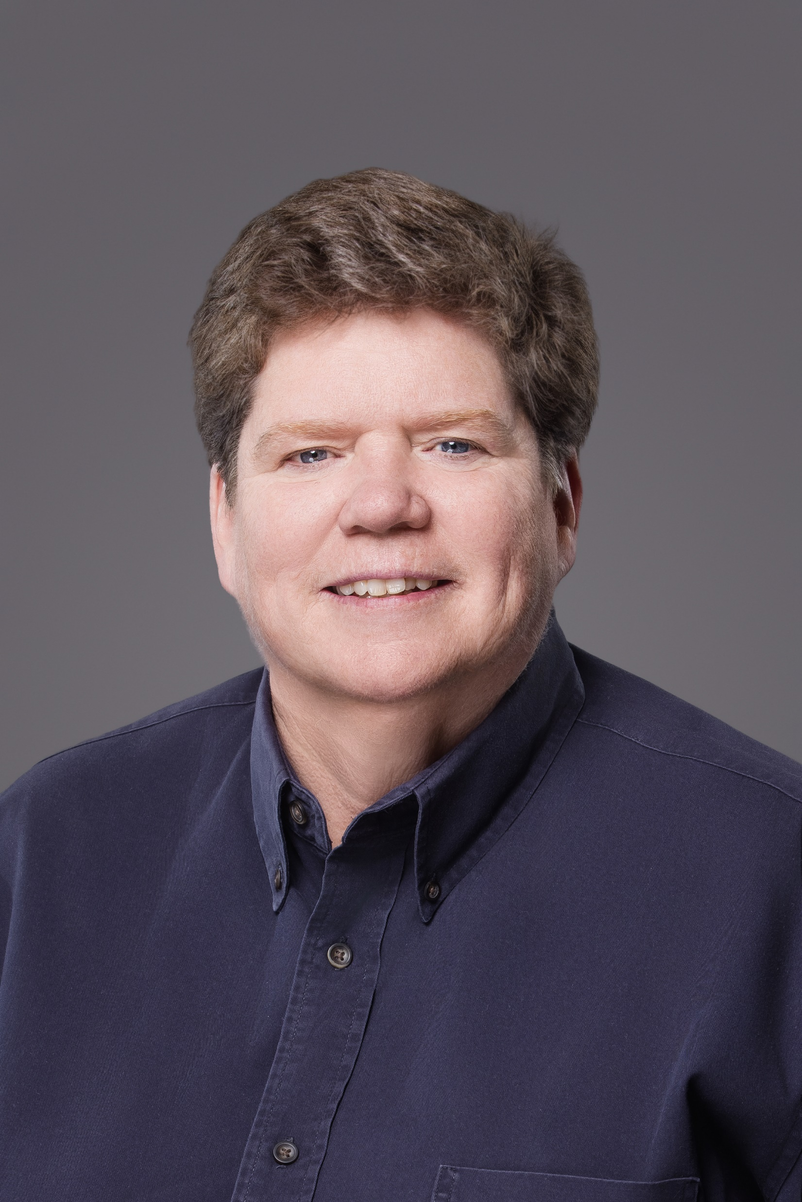
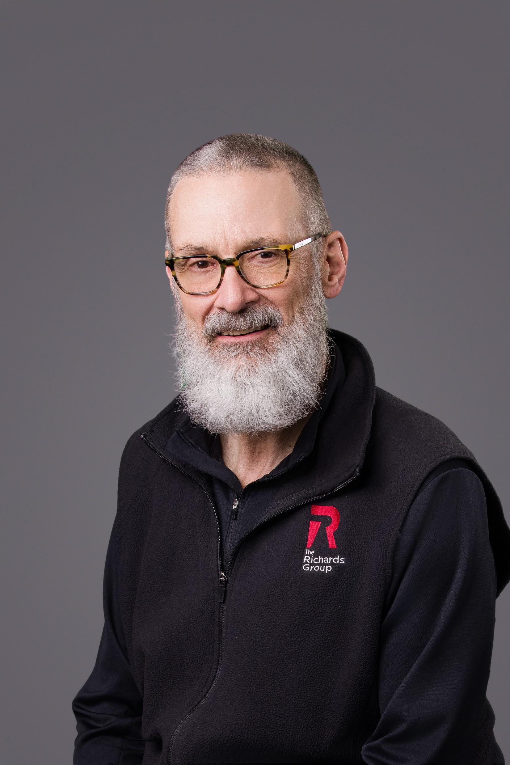
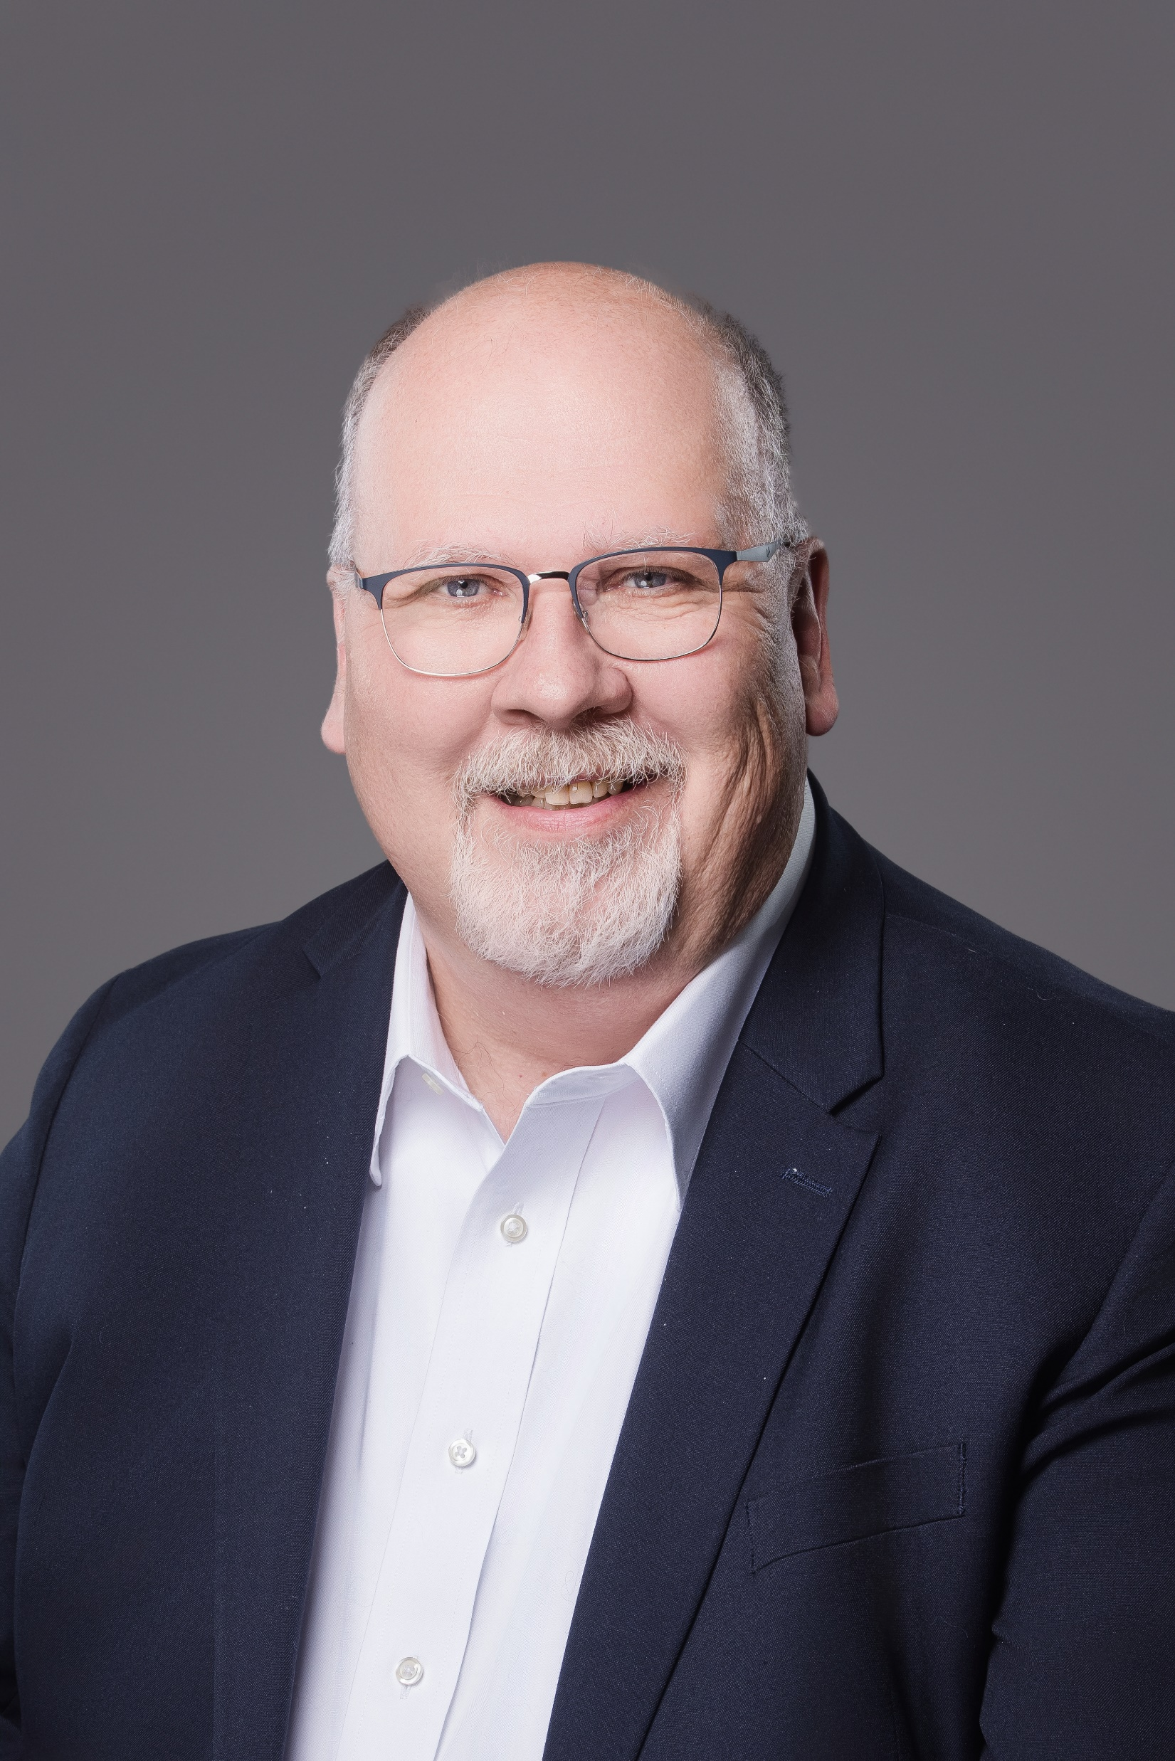
Dan Lyons
dlyons@therichardsgrp.com
Susan Loynd
sloynd@therichardsgrp.com
Ross Gibson
rgibson@therichardsgrp.com
Dave Twitchell
dtwichell@therichardsgrp.com
Managing Director, HR Service
Strategic HR Business Advisor
Comprehensive HR Consulting
Strategic HR Business Advisor
Leadership and Development
Strategic HR Business Advisor
Compensation

Slide 12
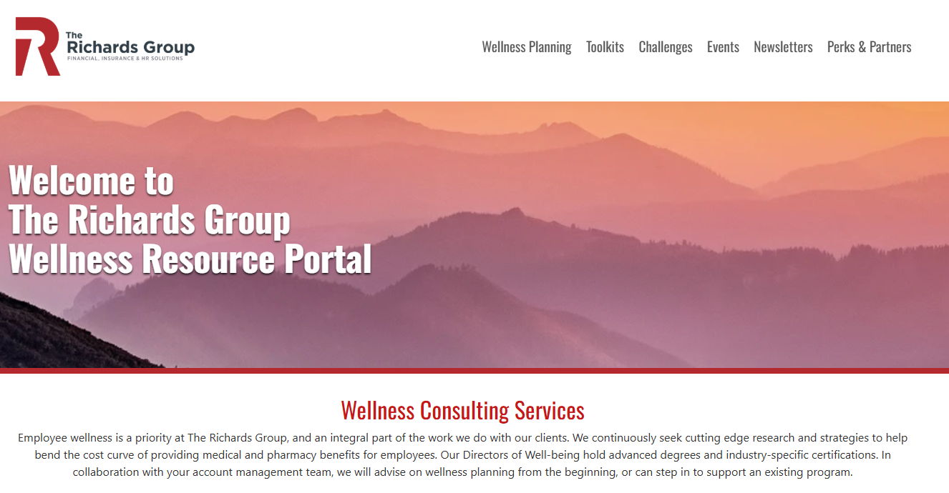
www.orgwellness.trgportal.com
Username: TRGClient Password: Wellness

