Slide 1

2022 Employee Benefits
Open Enrollment
2025 Open Enrollment

Slide 2

Agenda
Open Enrollment
Health Insurance
Dental Insurance
New! Vision Insurance
Life & Disability Insurance
EAP
Questions

Slide 3
Disclaimer
Information in this presentation and in the Employee Benefits Summary is being provided for your convenience. If there are any discrepancies between information summarized by TRG and information in carrier produced, or employer-provided documents, please rely on the latter.

Slide 4


What’s the Same?
Harvard Pilgrim
Health Equity HSA
Employer Provider Life & Disability through Anthem
Anthem Dental Plan – Design and Rates
EAP
401k

Slide 5


What’s Different?
Health Insurance
  Very challenging 12-months for health plan
  Deductibles
  Copays
  Premiums
New! Vision Plan through Anthem
Open Enrollment Moving to July 1 for 2023

Slide 6

2025
Open Enrollment
May 2 – May 9

Slide 7

Open Enrollment: Your opportunity to review benefit options and make changes as allowed.

Slide 8
Unless you experience a qualifying event…

Slide 9





Slide 10
Open Enrollment is the ONLY time to make changes to benefits

Slide 11
If you experience a QLE you have 30 days to notify HR and make changes

Slide 12

Health Insurance

Slide 13

Health Insurance
Three HMOs through Harvard Pilgrim

Slide 14

Choosing a health plan
When you have a choice of health insurance plans, there are three things to consider:

Slide 15

Choosing a health plan
When you have a choice of health insurance plans, there are three things to consider:
  Network

Slide 16
Choosing a health plan
When you have a choice of health insurance plans, there are three things to consider:
  Network
  Cost of using insurance

Slide 17
Choosing a health plan
When you have a choice of health insurance plans, there are three things to consider:
  Network
  Cost of using insurance
  Cost of owning insurance

Slide 18
Network
The “orange” plan provides access to a Broad Network of providers in New England
  Also, locally Maria Pattavina, Suzanne Coble, Jorge Crespo, Sojourns Community Health Clinic
The “purple” and “green” plans provide access to providers in 20 NH hospitals – including Cheshire Medical Center, Monadnock Community, Concord Memorial, Dartmouth-Hitchcock - Brattleboro Memorial, and Boston Children's for pediatric referral from Dartmouth Hitchcock on rare occasions

Slide 19

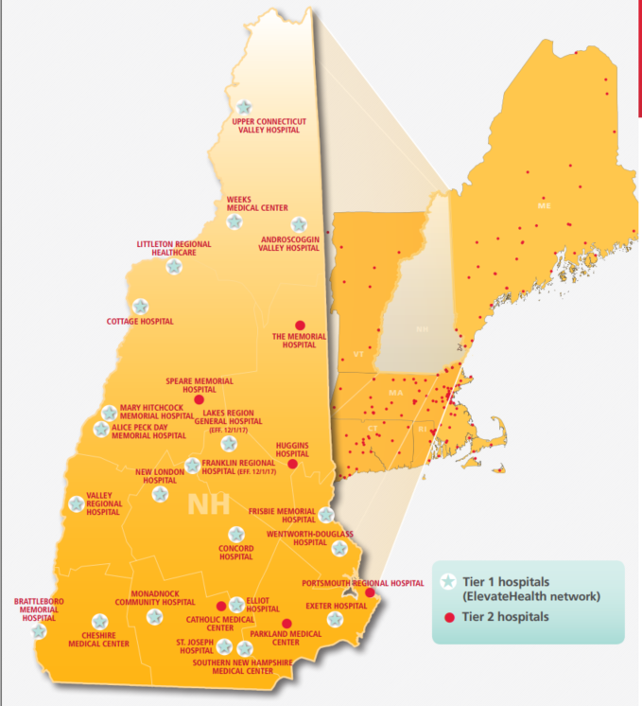


“Orange” plan includes facilities indicated with Blue Stars and Red Dots
“Purple” & “Green” plans include facilities indicated with Blue Stars

Slide 20

Network
If having access to providers in Massachusetts, Springfield VT, Catholic Medical Center or other providers outside of 20 NH hospitals and Brattleboro is necessary or desired, the HMO Tiered Copay LP plan is your choice
If you are comfortable using Cheshire Medical, Monadnock Community, Dartmouth Hitchcock, Brattleboro and 17 other NH hospitals, NH HMO ElevateHealth and NH HMO ElevateHealthHSA could be appropriate.

Slide 21
Decisions…
After you have determined which network is appropriate for you, the next consideration is the cost of use.

Slide 22

Cost Sharing Terms
Copay – a fixed amount you pay for office visit, medical service, Rx

Slide 23
Cost Sharing Terms
Copay – a fixed amount you pay for office visit, medical service, Rx
Deductible – an amount you pay for a “deductible-eligible” expense before plan pays all or a portion of future expenses (Plan Year)

Slide 24
Cost Sharing Terms
Copay – a fixed amount you pay for office visit, medical service, Rx
Deductible – an amount you pay for a “deductible-eligible” expense before plan pays all or a portion of future expenses (Plan Year)
Coinsurance – the amount you pay for future services after reaching the deductible

Slide 25
Cost Sharing Terms
Copay – a fixed amount you pay for office visit, medical service, Rx
Deductible – an amount you pay for a “deductible-eligible” expense before plan pays all or a portion of future expenses (Plan Year)
Coinsurance – the amount you pay for future services after reaching the deductible
Out-of-Pocket Max – the most you will pay for covered, in-network medical services & Rx

Slide 26

Cost Sharing Terms
Medical Copays
Deductible
Rx Copays
Coinsurance (DME Only)
Annual Out of Pocket Maximum
Best Buy LP: $6500/$13000
EH HMO: $6500/$13000
EH HSA: $5000/$10000

Slide 27
Plan Features: Cost of Use

Slide 28
Plan Features: Cost of Use

Slide 29

Plan Features: Cost of Use

Slide 30

Plan Features: Cost of Use
On the “Green” except for preventive services, everything is subject to the deductible.

Slide 31
Managing Costs
Urgent Care Centers (like Convenient MD) are generally less expensive than Emergency Rooms
Telemedicine/Dr on Demand generally less expensive than Urgent Care
Quest Diagnostics/Stand-alone labs, generally less expensive than labs at hospitals
Ambulatory Surgical Centers, lower cost alternatives to full-service hospitals for elective procedures
www.nhhealthcost.nh.gov
www.uspreventiveservicestaskforce.org
www.goodrx.com

Slide 32
Review
Orange plan offers access to Broad New England Network
Purple and Green plans operate on a limited Network of mostly NH providers
Preventive Care Services covered in full for all three plans
Orange and Purple apply copays for office visits and Rx, “Big Ticket” items subject to deductible
Green Plan, everything subject to the deductible (including Rx)
Final consideration: Cost to Own Insurance

Slide 33
Health Insurance
Employer contribution pegged to the “Green” HSA Eligible plan
The same $ amount applied to all three plans
You may choose to “buy up” to one of the other plans.

Slide 34



Plan Features: Cost to Own

Slide 35
Plan Features: Cost to Own
The only difference between the orange and purple plans is the Network (and labs at Quest CIF with orange plan)
  The Orange Plan costs more than the Purple Plan
The purple and green plans operate on the same limited network, but the cost of “using” the plans are different
  The Green Plan costs less Purple Plan

Slide 36

HSA-eligible plan
If you enroll in the “Green” HSA-eligible plan, and are eligible to make and receive contributions to a personal Health Savings Account, a portion of your payroll deduction will go into your HSA

Slide 37
Making a decision…
After reviewing your plan choices, and considering
  Network
  Cost to Use
  Cost to Own
decide which plan is most appropriate for you and your family,
Enroll via Paylocity’s Enterprise Benefits Portal

Slide 38

Health Savings Account

Slide 39

Health Savings Account (HSA)
If you enroll in the “Green” HSA-eligible HMO and are eligible to make contributions to an HSA, an account will be established for you at Health Equity

Slide 40

Health Savings Account Eligibility
In order to make or receive contributions to an HSA:
  An individual must be covered by a qualifying HDHP (the green plan)
  Must NOT have any other medical coverage including, but not limited to:
    Medicare/Medicaid
    Veteran’s Administration (VA)
    Spouse’s or parent’s plan
    Full Purpose FSA

Slide 41
Contributing to Health Savings Account
When you enroll in the Green Plan your payroll deductions is split between insurance and HSA
HSA contributions made pre-tax
You may choose to make additional contributions
  Up to $3650 (single coverage) $7300 (EE+)

Slide 42
What is a Health Savings Account / HSA?
An HSA is a triple tax-advantaged trust or custodial account that eligible individuals can use to pay for (or reimburse themselves for) qualifying medical expenses for themselves and tax dependents.
  Contributions are pre-tax
  Interest/earnings are tax-free
  Distributions for qualified medical, dental & vision expenses tax-free

Slide 43
Accessing your Health Savings Account
A debit card will be issued by Health Equity to be used at point of sale
Qualified medical, dental & vision expenses (for yourself and your qualified tax dependents) can be paid for with another form of payment and reimbursements requested from Health Equity

Slide 44

What happens to your HSA?
Each year any unused balances rollover and accumulate interest
If you leave your Co-op you keep the balance
If you enroll in another HSA-qualified health insurance plan, you may continue to make contributions
If you don’t enroll in another HSA-qualified plan, you may SPEND the funds, but NOT contribute

Slide 45

What happens to your HSA?
Because the HSA funds are yours, you may use at anytime for non-medical expenses HOWEVER
  Under age 65, 20% IRS penalty and taxed at your tax rate
  Over age 65, taxed at your tax rate (no penalty)

Slide 46
For more information: www.healthequity.com

Slide 47

Dental Insurance

Slide 48

Dental Insurance
Dental plan offered through Anthem
In-Network & Out-of-Network Benefits
  “In” pays applicable % of full negotiated rate
  “Out” pays applicable % of 95% of UC
Per Person CY benefit of $2000
Annual Deductible $50/$150 to Basic & Major
Orthodontic - $1000 lifetime Benefit - children

Slide 49
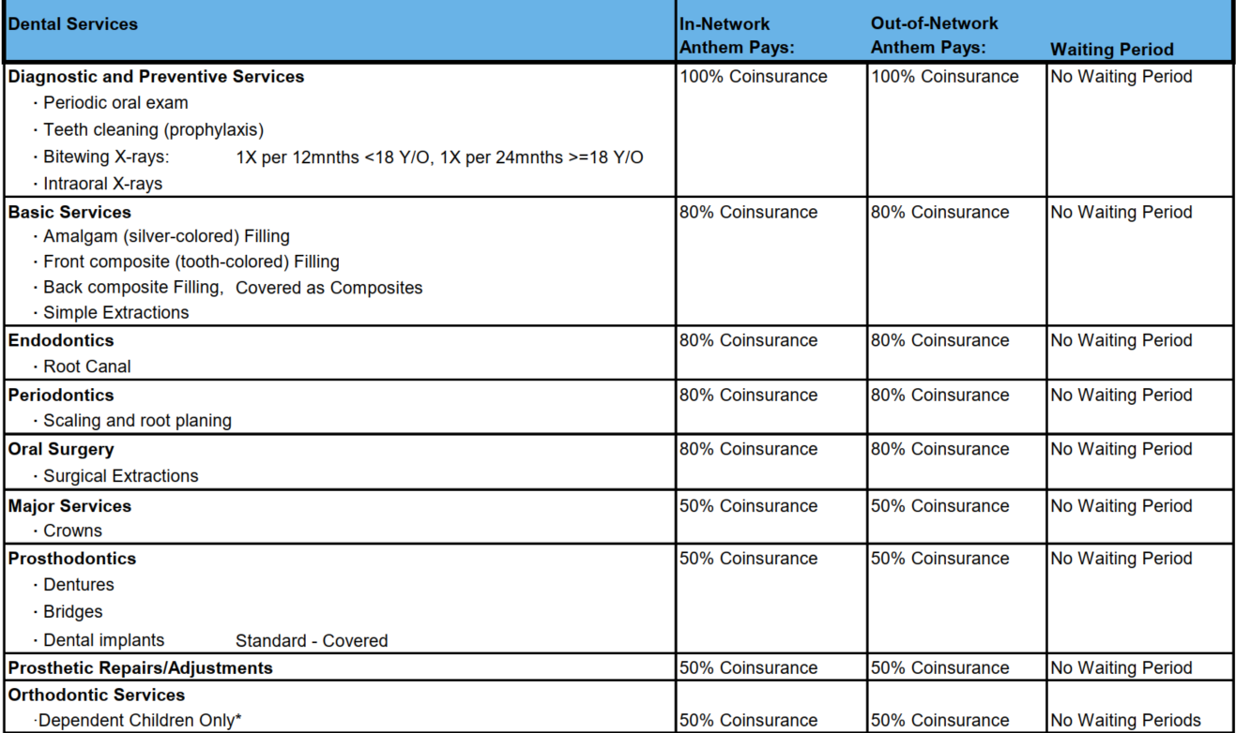
Dental Insurance

Slide 50
Provider Look Up
To determine if your dentist is in-network, or to locate a dentist that is:
Visit www.anthem.com/mydentalvision
Or call the toll free number on the back of your Anthem ID card

Slide 51
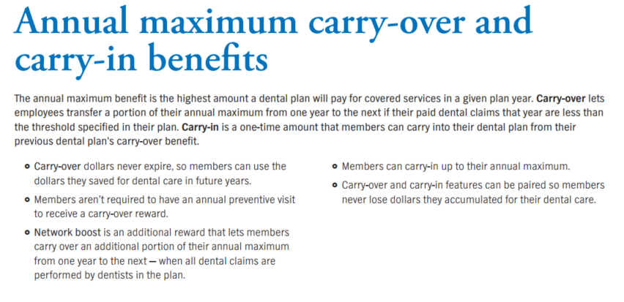
Dental Insurance

Slide 52
Dental Insurance - Cost

Slide 53

Vision Insurance

Slide 54
New! Vision Insurance
Vision plan offered through Anthem
Exam & Hardware Benefits
In-Network & Out-of-Network Benefits
In-Network Providers Limited

Slide 55

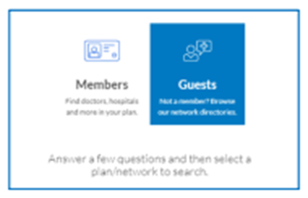
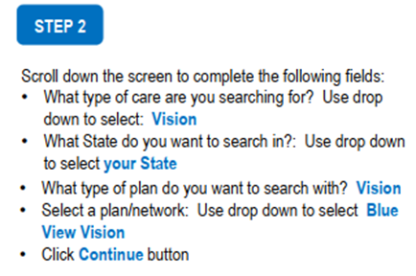
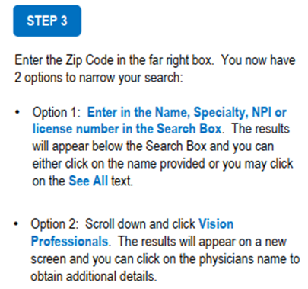

New! Vision Provider Look Up

Slide 56
New! Vision Insurance

Slide 57
New! Vision Insurance

Slide 58

Life & Disability Insurance

Slide 59


Life & Disability
Employer Paid Coverages – automatically enrolled when eligible
  Review Beneficiaries on file and update if necessary
  Life & AD&D, Employee & Dependents
    Employees working 20+ hours per week
    EE: $25,000 / Spouse: $10,000 / Child(ren): $5,000
  STD
    Employees working 35+ hours per week
    60% of pre-disability weekly earnings up to $1000/week
  LTD
    Employees working 35+ hours per week
    60% of pre-disability weekly earnings up to $6000/month

Slide 60

Employee Assistance Program

Slide 61


EAP
Available to Co-op employees and their loved ones, free of charge

Slide 62
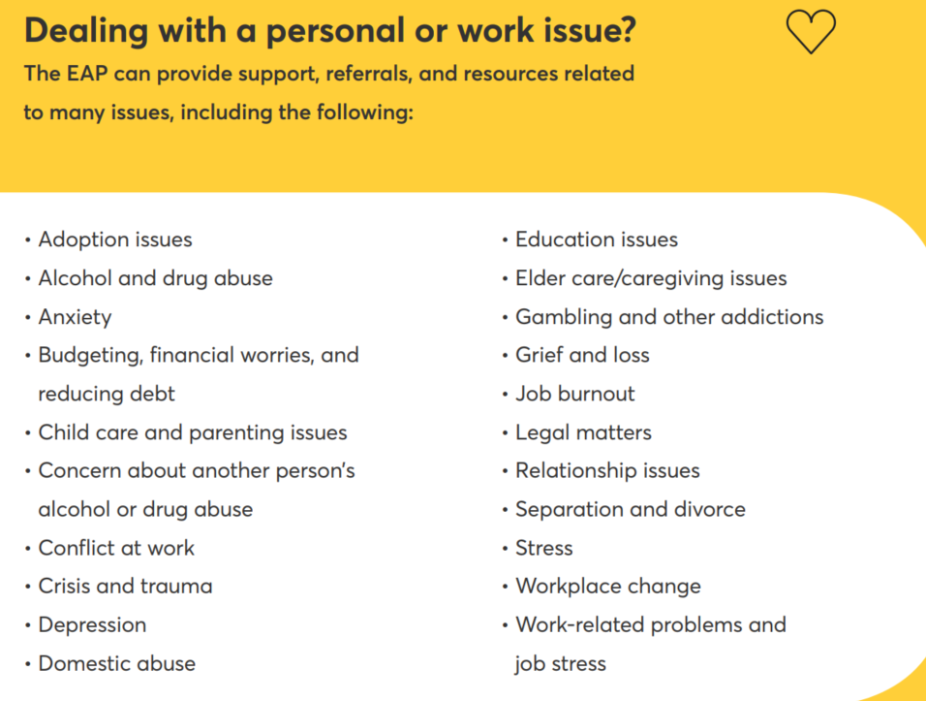
EAP

Slide 63
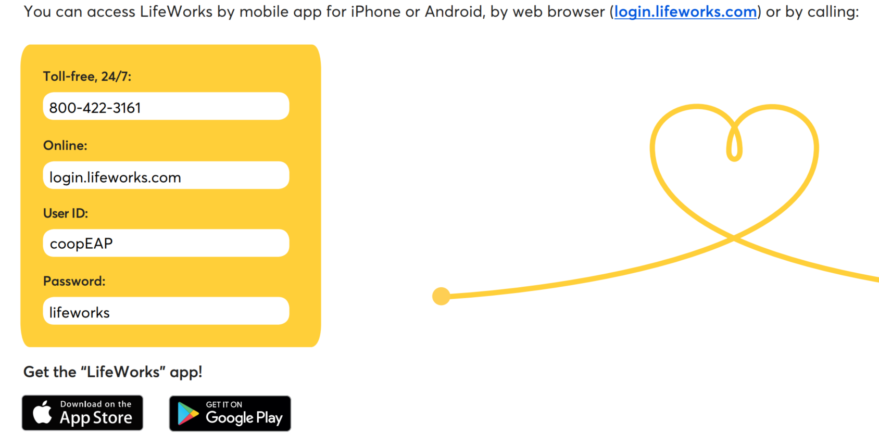
EAP

Slide 64



Benefits Enrollment Portal

Slide 65

Benefit Elections
All elections and changes are made through Paylocity’s Bswift
See Benefits Guide or HR for details

Slide 66

Questions

Slide 67

Liz Coppola lcoppola@therichardsgrp.com
603-313-6974

Slide 68

THANK YOU!!

