Slide 1



Opens: Monday, December 2nd, 2024, to Monday, December 16th, 2024

Slide 2


Open Enrollment for 2025
Agenda:
What is Open Enrollment
Resources
Benefits Review - overview of each plan
Next Steps for Open Enrollment
Wellness
Questions

Slide 3

What is Open Enrollment?
A dedicated time to educate yourself on the benefit package offered to you as part of your overall compensation
Your chance to enroll in plans
When you can add or drop family members from your plans
Coverage elected is effective for all of 2025
To make changes to your coverage after Open Enrollment is over you must have a Qualifying Event

Slide 4

Open Enrollment Resources
Employee Benefit Summary Booklet

Slide 5

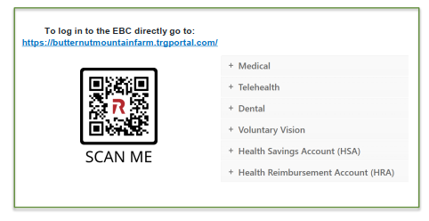
Open Enrollment Resources
Employee Benefit Center

Slide 6
Medical Plan Information
Ongoing and large claims significantly impact our plan's ability to be priced competitively and generate competitive renewals.
It's important for employees and covered dependents to obtain preventive care, such as physicals and age-appropriate cancer screens. These are covered at 100% and can play a significant role in identifying conditions much earlier, allowing for earlier interventions that result in lower overall costs.
Cigna provides BMF with an Onsite Health Improvement Program that includes wellness funds. This program allows us to take charge of our health and be rewarded with incentives for these preventive visits. We also receive a complete suite of wellness communications and programs.

Slide 7

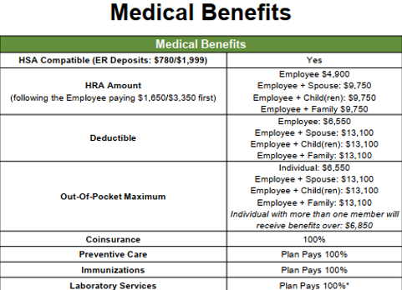
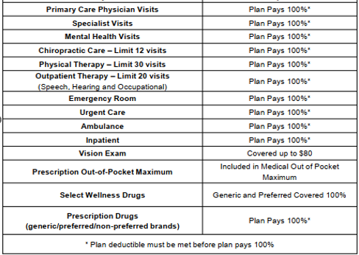
Cigna Medical Plan:

Slide 8
Out-of-Pocket Calculations
Perceived OOP Max
- Health Savings Account
- Health Reimbursement Account
+ Employee HRA contribution Requirements
____________
Actual OOP Max
SINGLE
OOP Max $6,550
HSA ($780)
HRA ($4,900
+ $1,650
________________
$2,520
FAMILY
$13,100
HSA ($1,999)
HRA ($9,750)
+ ($3,350)
____________
$4,701

Slide 9
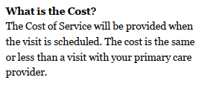

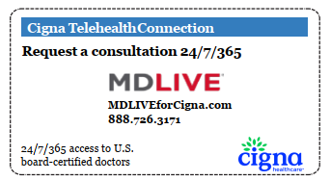
Telemedicine - Cigna
Available 24/7
Care for issues like:
Respiratory Infections
Bronchitis
Urinary Tract Infections
Pharyngitis
Rashes
Pink Eye
Cough
Flu
Stuffy Head
Allergies

Slide 10
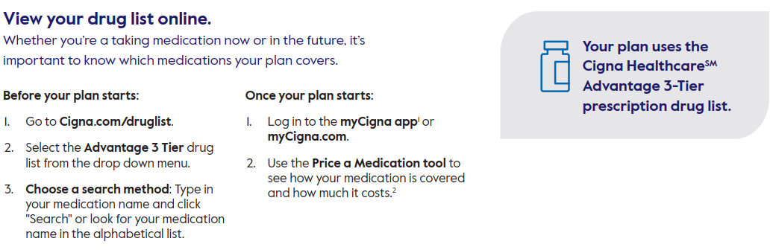
Pharmacy - Retail

Slide 11
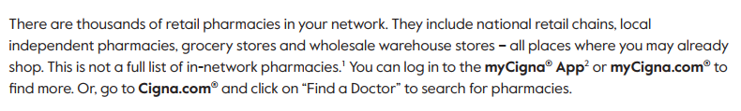
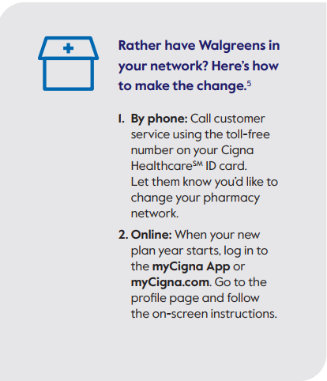
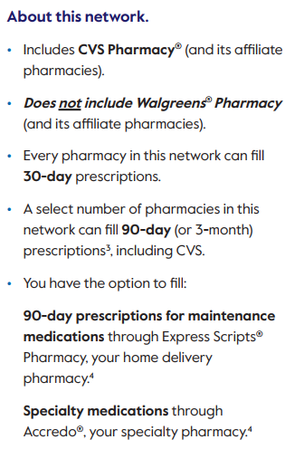
Pharmacy Change: Anchor Pharmacy/Member Choice

Slide 12

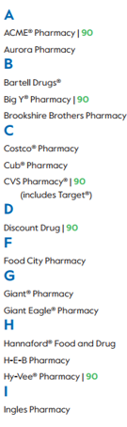
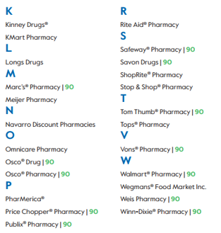
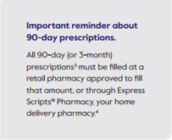
Pharmacy Change: Anchor Pharmacy/Member Choice

Slide 13
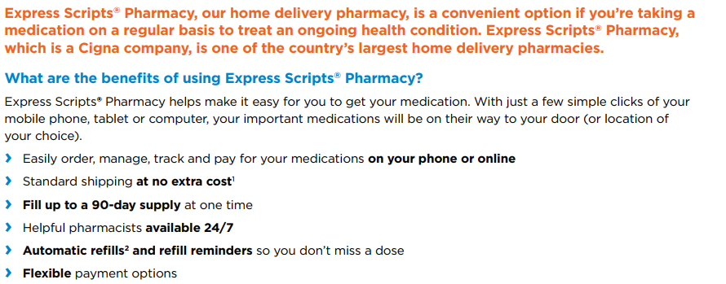

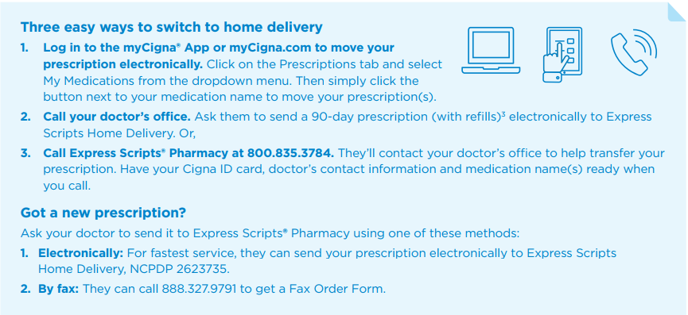
Pharmacy Mail Order

Slide 14
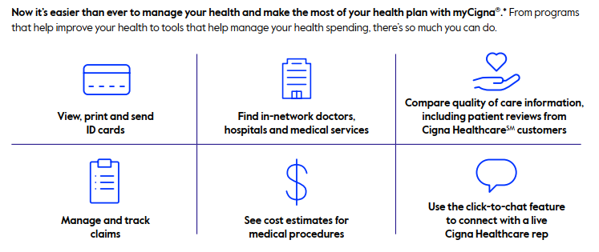
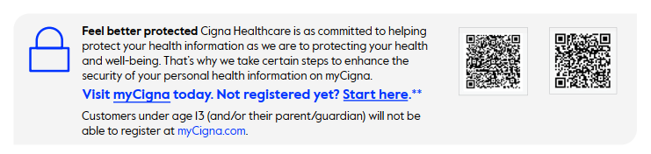
Cigna Value Adds
Please note that Cigna does not mail
ID Cards unless requested by calling
Cigna Customer Service.

Slide 15

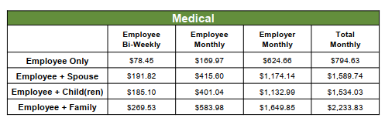
Medical Plan- EE Bi-Weekly Contributions

Slide 16

Dental Plan

Slide 17

Dental Plan continued

Slide 18
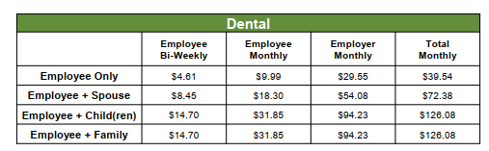
Dental Plan- EE Bi-Weekly Contributions

Slide 19
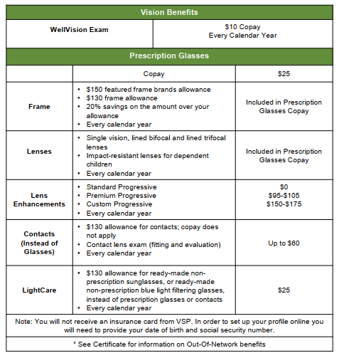
Vision Plan

Slide 20
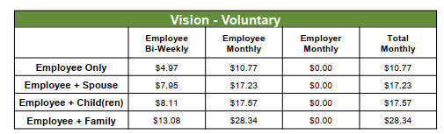
Vision Plan EE Biweekly Contributions

Slide 21




Vision plan Value Adds:

Slide 22

Ancillary Benefits
Employer Paid Group Life Insurance
  Flat $25,000
Voluntary Life & AD&D Insurance
  $10,000 increments up to 5X salary
  EOI (Evidence of Insurable ) is required for any amount over $100,000 or if you don’t enroll when initially eligible.
  Coverage for spouse and children can be purchased
  Spouse is a $5K to $50K Guarantee issue, and 50% of employee benefits up to $25K with no medical questions
  Children coverage is coverage from $2K from $5K to $10 to age 21 or 26 if full time student
  Include portability and conversion.
100% paid for by ER Short-Term Disability
  60% of weekly earnings up to $1,500
  Waiting period is 21 days for accident/illness
  Benefit Period: 10 weeks maximum
100% paid for by ER Long-Term Disability
  60% of monthly earnings up to $6,000 to age 65 or SSNRA
  90-day waiting period, dovetails with STD
REMINDER: Open Enrollment is a good time to update your beneficiary information.

Slide 23

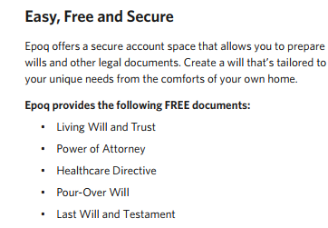
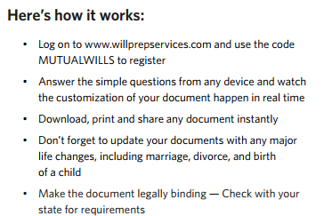

Ancillary Value Add Benefits: Will Prep Services

Slide 24
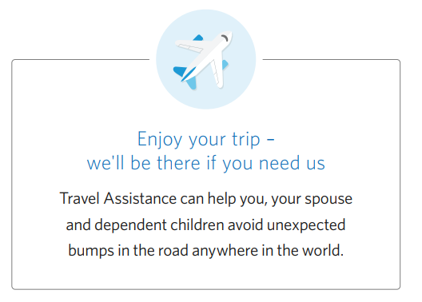
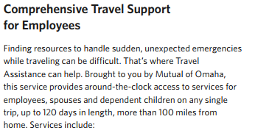
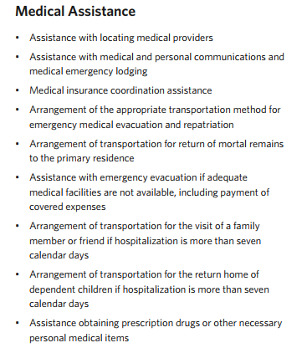
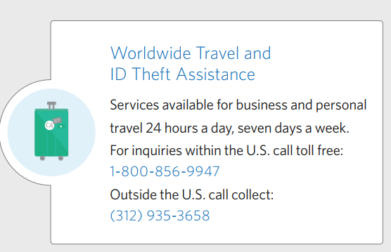
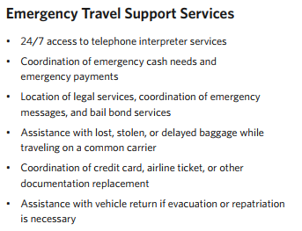
Ancillary Value Add Benefits: Worldwide Travel Assist

Slide 25



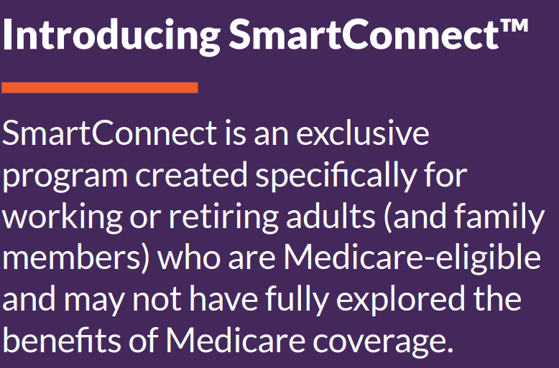
Medicare Education:
Savings Available for Employees & Spouses over age 65
Information on:
Medicare A & B
Medicare Advantage
Medicare Supplements
Medicare Part D

Slide 26

Nest Steps: Enroll with Employee Navigator
*NEW* Online Enrollment System for your Open Enrollment!

Slide 27
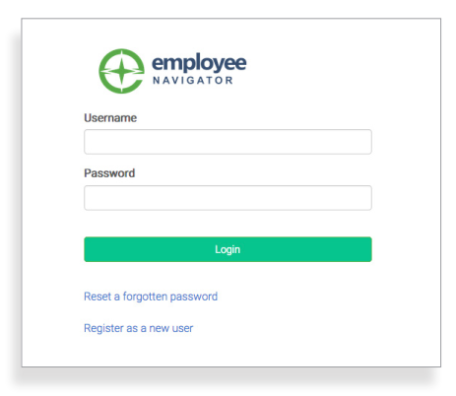

Employee Navigator Log In Screen
Step 1: Log In
Go to www.employeenavigator.com
First time users: click on the registration link sent to you by HR or click on “Register as a new user”. Create an account and create your won username and password
Returning users: Log in using your username & password you created or click Reset a forgotten password

Slide 28
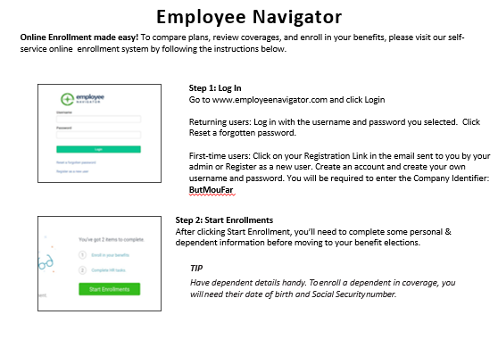
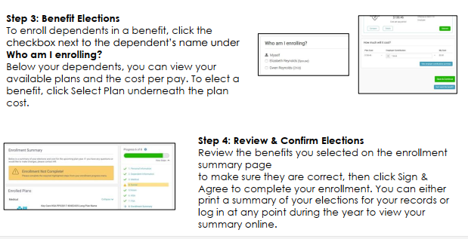
Employee Navigator Overview

Slide 29


Wellness at BMF
Wear Pink Day 2023
Healthy Harvest Lunch 2024

Slide 30

Employee Assistance Program (EAP)
100% confidential short-term counseling
5 sessions per issue per year
Available to you and your household members at no cost
Available 24/7 to help you address issues involving:
www.investeap.org
(866) 660 - 9533
Password is BMF
Relationships and family
Drugs and alcohol
Mental health
Grief and loss
Medical
Disability
Eldercare
Finding childcare and subsidies
Parenting techniques
Workplace conflict
Legal issues
Financial problems
If it causes you stress or worry, then Invest EAP’s local, experienced staff can help

Slide 31

Wellness Roadmap
New in 2024:
Wellness Reward Program
Biometric Screenings + Nutrition Visit
Wellness Fair
Harvest Lunch
On-site Dental Cleanings
Continued Offerings:
Wellness Committee
Well-being Challenges
Corporate Cup 5K
Flu Clinic
Wear Pink Day
Guided Stretch Breaks
Local & Healthy Food in Breakroom
On-site Physical Therapy
Employee Assistance Program
What’s Coming in 2025?
We’re excited to support your health and
well-being in 2025!
The Wellness Reward Program will return, allowing you to earn incentives for preventive care and participating in BMF wellness opportunities.
Got ideas for feedback?
Share with Kate, Kory, Sharon, Ira, or email us: wellness@butternutmountainfarm.com

Slide 32
Open Enrollment Reminders!
You will need dependent dates of birth and SSNs to enroll in benefits and add beneficiaries. Remember to have those handy!
Open Enrollment begins 12/02/24 and ends 12/16/24.
You will use Employee Navigator to enroll in each benefit.

Slide 33

Questions?

