Slide 1


YOUR BENEFITS FROM SUN LIFE
Discover new ways to protect what you love
North Country Smokehouse
Effective Date: 1/1/2022

Slide 2

Agenda
This year, North Country Smokehouse is making the following Voluntary benefits available to you:
Life and AD&D
Short-Term Disability
Long-Term Disability
Accident Insurance

Slide 3

LIFE INSURANCE
Provide the people you love with financial support when you can’t be there—and when they need it most.
Notes:
What is life insurance?
Life insurance can provide financial support to you or your loved ones if you, your spouse, or your child passes away.

Slide 4




Why do you need life insurance?
Household expenses
Financial support of others
Shared debt responsibility
Hired
help
Inheritance or philanthropic gift
Funeral or medical expenses
Notes:
What is life insurance?
Life insurance can provide financial support to you or your loved ones if you, your spouse, or your child passes away.
Why do you need life insurance?
Life insurance coverage is important if:
Your family needs your income to cover household expenses.
You support others financially or in other ways, such as providing time and help (e.g., child or elder care).
You share responsibility for significant debt (like a mortgage or student loans) with someone else. Did you know that Some types of debt do not disappear when you die, and the debt will become someone else’s responsibility?
Your family would need to hire someone to help if you were gone.
You would like to leave an inheritance for your loved ones or even for an organization you are passionate about.
Your family would benefit from financial help to cover your funeral expenses or medical bills.

Slide 5



How much Life and AD&D insurance can you buy?
YOU
YOUR SPOUSE
YOUR CHILDREN
Choose the benefit amounts that best meet your needs and your budget.
Up to $500,000 in $10,000 increments, not to exceed 5x your Basic Annual earnings. Guaranteed Issue of $100K when first eligible
Up to $150,000 in $5,000 increments; Guaranteed Issue of $30K when first eligible; cannot exceed 50% of your coverage
Up to $10,000 in $1,000 increments
Notes:
How much [additional] Life [and AD&D] insurance can you buy?
You can choose the benefit amounts that best meet your needs and your budget:
[For an incremental plan
For you. You may sign up for [$X,XXX] to [$XX,XXX] in [$X,XXX] increments.
For your spouse. If you elect coverage for yourself, you can sign up for [$X,XXX] to [$XX,XXX] in [$X,XXX] increments.
For your children. Choose a [$X,XXX] or [$X,XXX] benefit amount.]
[Your AD&D coverage pays an additional benefit—up to the amount of your Life benefit—if you suffer a covered loss due to an accidental injury.]

Slide 6
Short-Term Disability Insurance
PROTECTS YOUR INCOME
PROVIDES YOU WITH A WEEKLY CHECK.
HELPS YOU RETURN TO WORK.
Notes:
What is short-term disability insurance?
Short-term disability insurance provides you with a weekly cash benefit—after your claim is approved—if a covered disabling illness or injury prevents you from going to work and earning an income.

Slide 7



What does your short-term disability insurance cover?
Disabling
injury
Maternity
leave
Surgery recovery
Notes:
What does short-term disability insurance cover?
Short-term disability covers approved disabilities resulting from injuries, illness, maternity leaves, or recovering from some surgeries.

Slide 8



How much, how soon and for how long?
60% of
your weekly income to a maximum of $2,000 per week
1 days after injury
8 days after illness
Receive benefits for up to 26 weeks
Notes:
What is a pre-existing condition limitation?
You have a “pre-existing condition” if, during the [X] months prior to your effective date of coverage or the effective date of the increase of coverage, you:
received medical treatment, consultation, care, or services (including diagnostic measures) for the disabling condition, or
took prescribed drugs or medicines for the disabling condition.
The pre-existing-condition exclusion will not apply if your disability begins later than [XX] months after your effective date of coverage or increase in coverage.

Slide 9
Long-Term Disability Insurance
HELPS YOU KEEP YOUR
LIFE ON TRACK.
HELPS YOU PAY EVERYDAY EXPENSES.
HELPS YOU RETURN TO WORK.
Notes:
… to help pay for everyday expenses if a covered disabling illness or injury takes you away from work for an extended time.
What is long-term disability insurance?
Provides you with a monthly benefit if you are unable to work for a long period of time due to a covered disabling illness or injury (e.g. some back injuries and illnesses).
The monthly cash benefit is for [a portion of your monthly income] [a fixed amount].

Slide 10

How much, how soon and for how long?
60% of
your monthly income to a maximum of $10,000 per month
180 days/months
after injury or illness (Elimination Period)
Receive benefits for up to SSNRA years

Slide 11

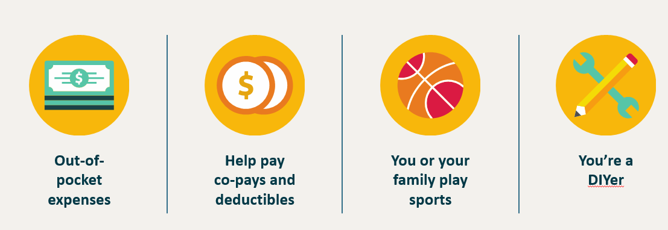
ACCIDENT INSURANCE
Help minimize the financial impact if you experience an off the job covered accident.
Coverage also available for your spouse, and your dependent children to age 26.
Notes:
What is accident insurance?
Accident insurance can provide financial support if you or a covered family member is hurt as a result of a covered accident.
Receive a check—after your claim is approved—and use the payment however you wish—to cover out-of-pocket medical costs or everyday expenses.

Slide 12

How accident insurance can help a family
ASSUMPTION
Your son or daughter breaks their leg while playing in a game for their high school basketball team. (High Plan example)
COVERED BENEFITS | BENEFIT SCHEDULE
Ambulance ride to hospital (by car) | $400
Emergency room visit | $200
X-ray | $100
Diagnosis of leg fracture (needing open surgery) | $3,000
Medical device (crutches) | $500
Follow-up visit (6 visits @ $100 each) | $600
Physical therapy (10 visits @$50 each) | $500
Total payments received from Sun Life Accident policy | $5300
CONCLUSION
You receive up to $5300 without having to rely solely on your savings.
Illustration is for hypothetical use only. Covered benefits shown represent hypothetical payments from the Accident insurance plan only. They do not represent payments from a health insurance plan.

Slide 13

Ready to Enroll?
Review Benefits Plans
Use Enrollment form for Personal and Dependent information
Select Benefits
Choose Beneficiaries
Return all forms to HR

Slide 14
Thank you!

