Slide 1
Health through Oral Wellness® (HOW®)
Notes:
Let’s learn about the Health through Oral Wellness Program that is available through your Northeast Delta Dental benefits.

Slide 2
Health through Oral Wellness® (HOW®)
Based on the concept of patient-centered oral health, HOW® provides additional preventive benefits to members who are at risk for oral disease, thereby helping them achieve better oral and overall health.
Notes:
The Health Through Oral Wellness Program, or HOW for short, is a patient centered oral health initiative. We believe oral health is an important part of your overall systemic health. HOW provides additional preventive benefits to members who are at risk of oral disease to help them achieve better oral and overall health.

Slide 3
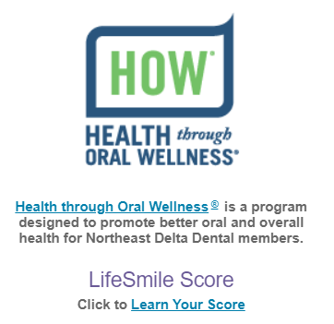
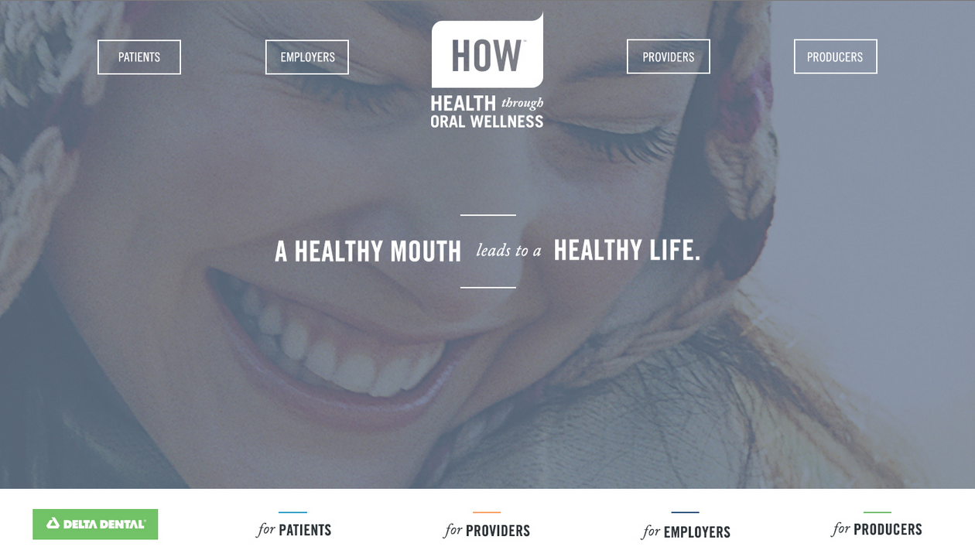
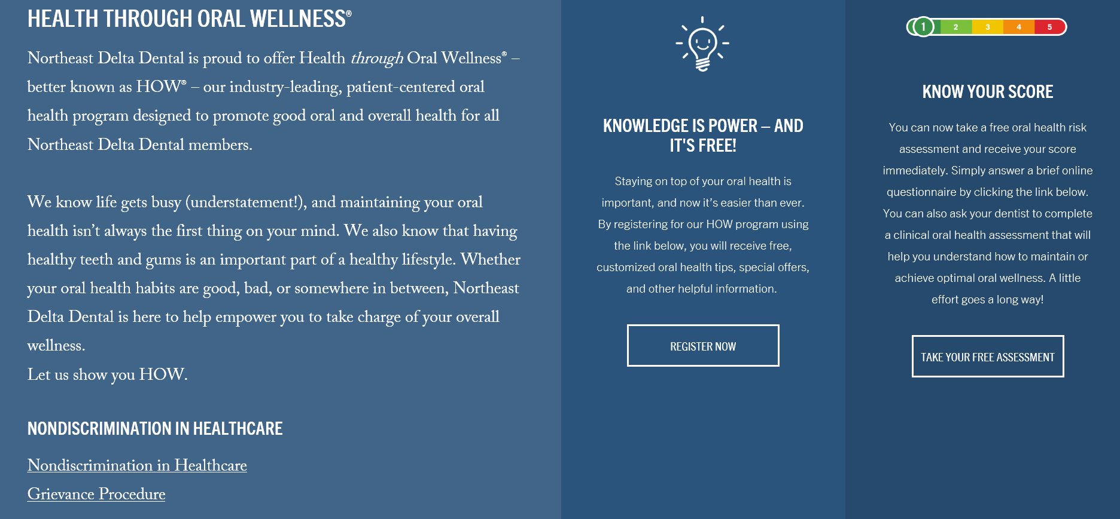
HealthThroughOralWellness.com
Register for the HOW® program to receive our Smile Coach Monthly e-newsletter
Take the Oral Health Self-Assessment to get a sense of your oral health status
Click through is on our website as well.
Notes:
Visit the Health Through Oral Wellness website to register for the program. Once registered you will receive our Smile Coach Monthly e-newsletter full of helpful oral health messages. You can take the oral health self assessment to get a sense of your oral health status. There is a click through to the site from our home page at nedelta.com as well.

Slide 4
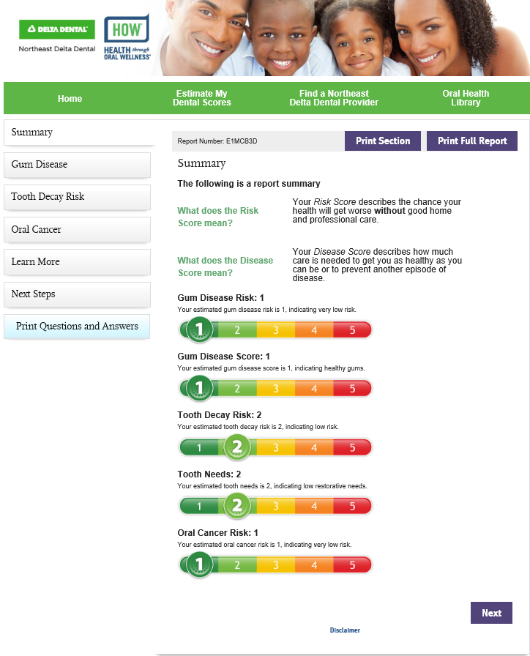
HOW® Oral Health Self-Assessment
Answer the questions online
Print out the report
Bring to your dentist
______________________
The dentist can then verify the results of the self-assessment with the Clinical Risk Assessment performed at the Dental Office.
Notes:
To take the oral health self assessment you’ll answer a few questions online. Review the report, print or download to your smart phone and bring to your next appointment with your dentist. The dentist will run their own clinical risk assessment and compare to you’re your self assessment and discuss any additional preventive services you qualify for.

Slide 5
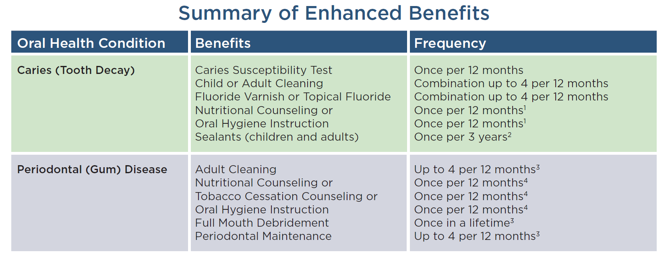
HOW® it Works
Dental office performs a clinical risk assessment, which is instantly submitted electronically to Northeast Delta Dental.
Patients that score a 3-5 on a 5-point risk scale for being at risk for oral disease qualify for additional preventive care benefits.
The additional preventive benefits can be applied immediately at that dental visit. (Ex: fluoride treatment for adults at-risk for tooth decay).
Any additional benefits that a member receives do apply toward annual maximum.
Notes:
Patients that score a 3-5 on a 5-point risk scale on the clinical risk assessment for being at-risk for oral disease qualify for additional preventive care benefits.
The additional preventive benefits can be applied immediately at that dental visit. For example: additional cleanings, fluoride treatment for adults at risk for tooth decay, or tobacco counseling for those at risk for gum disease).
The additional benefits that a member receives do apply toward their annual maximum.

Slide 6
Your continued oral health is important to us, so once you qualify to receive enhanced benefits you will have access to those benefits for as long as you are a Northeast Delta Dental subscriber. So if your oral health improves and you move from, for example, a risk score of 4 to 2, you will continue to receive the enhanced benefits you initially qualified for.
To view your qualified enhanced benefits please access your Benefit Lookup Portal at nedelta.com/patients
Questions on the HOW program please contact our customer service department at the number listed on the back of your card - 1-800-832-5700
Notes:
Your continued oral health is important to us, so once you qualify to receive enhanced benefits you will have access to those benefits for as long as you are a Northeast Delta Dental subscriber. So if your oral health improves and you move from, for example, a risk score of 4 to 2, you will continue to receive the enhanced benefits you initially qualified for.
To view your qualified enhanced benefits please access your Benefit Lookup Portal at nedelta.com/patients
Questions on the HOW program please contact our customer service department at the number listed on the back of your card - 1-800-832-5700

