Slide 1
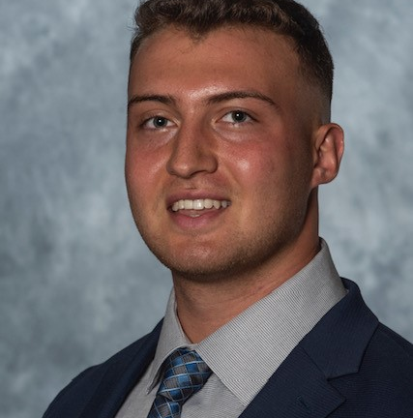
Your Client Service Team
Working with the right servicing team can make all the difference. We know who you
work with matters, which is why we’ve assigned the following experienced professionals
to manage your account:
Clark Andre
Amanda Matczak
Account Service Manager
A_Matczak@glic.com *
1 800 627 4200 *
Client Manager
Clark_Andre@glic.com
585-794-8206
Clark is your go-to strategic partner who oversees every aspect of your plan administration and service to ensure you are getting all the value Guardian has to offer.
Amanda can help you with…
Day to day service & admin questions/inquiries
Questions on operating systems and file feeds
Changes to your plan
Enrollment, Eligibility, Billing, Claims Status, Guardian Anytime
Engaging your Client Manager for escalations as needed
Clark can help you with…
Annual Renewals
Experience Reporting
Recommendations for
other benefit programs
Plan coverage reviews
Stewardship discussion
Industry trends
Legislative updates
Your overall service experience
To reach Amanda directly:
* Emails – Always include the 6-digit group plan number in the subject line
* Calls – 1-800-627-4200, enter 2, followed-by the 6-digit group plan number when prompted
Also, you can access Guardian Anytime for Self Service to quickly: View Enrollment, Billing Information, Run Reports, ID Cards, and Much More!

