Slide 1
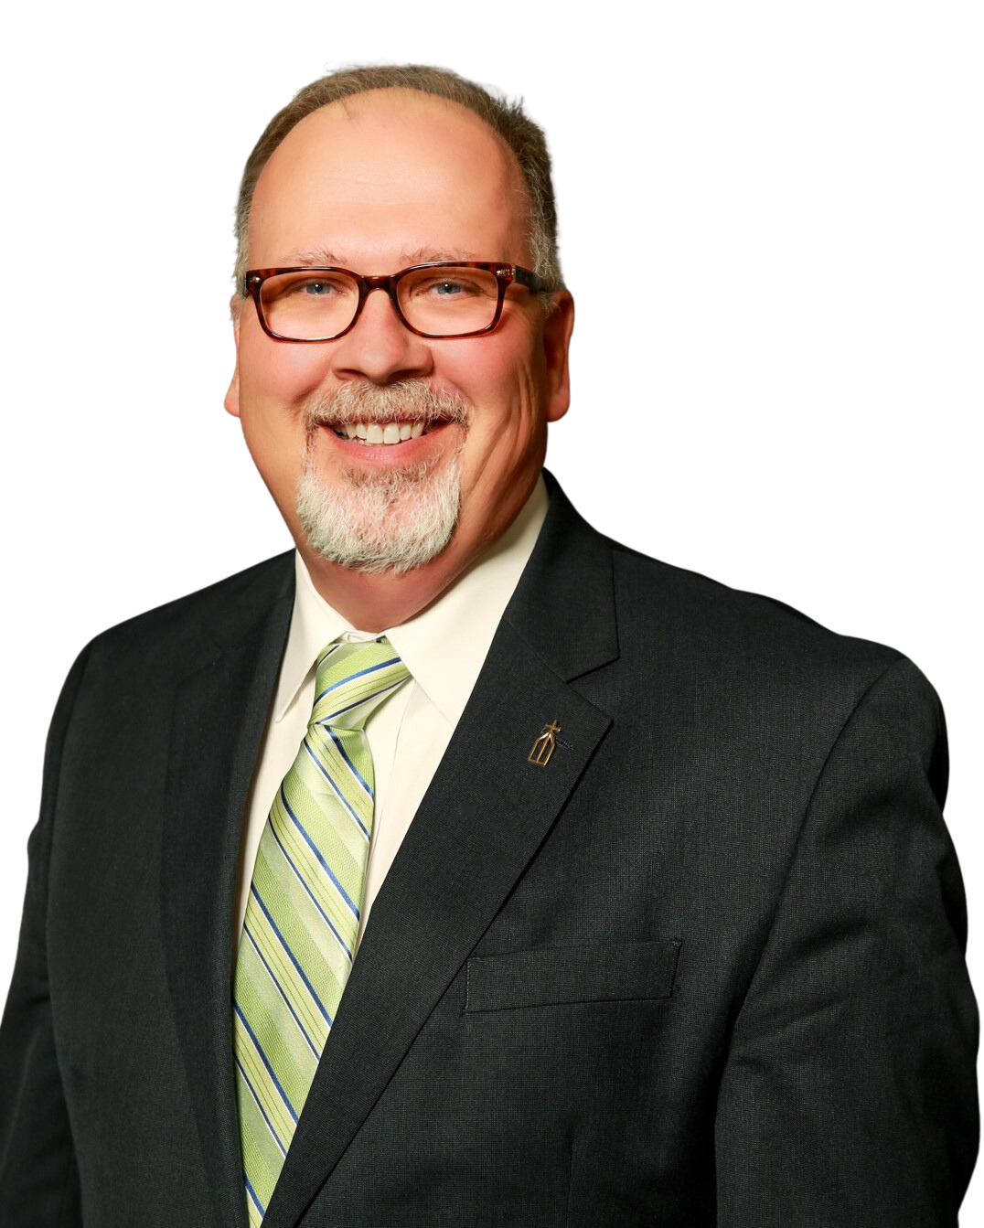
Compensation Services
More about Dave Dave Twitchell is a compensation, human resources and labor management consultant. Dave has had a distinguished 40+ year career as an HR executive and he shares his wealth of knowledge and experience with clients.
Regarding Compensation Services, Dave works with clients in providing compensation solutions by reviewing organizational strategy and establishing a compensation approach that will guide decision making, allow for long term planning and meet organizational objectives.
Dave is also a national volunteer leader with SHRM. Dave holds a Masters Degree in Human Service Administration from Southern New Hampshire University and a Bachelor of Science in Medical Technology from the University of New Hampshire.
For more information visit:
https://therichardsgrp.com/-compensation-services

