Slide 1


www.therichardsgrp.com
TRG Investment Advisors, LLC dba TRG Retirement Plan Consultants is a Registered Investment Adviser. Advisory services are only offered to clients or prospective clients where TRG Investment Advisors, LLC dba TRG Retirement Plan Consultants and its representatives are properly licensed or exempt from licensure. Past performance is no guarantee of future returns. Investing involves risk and possible loss of principal capital. No advice may be rendered by TRG Investment Advisors, LLC dba TRG Retirement Plan Consultants unless a client service agreement is in place.

Slide 2
ADMASTER-STAMP!MGR0425232799292
Key Things to Consider
Roth vs. Pre-Tax Contributions
Max the Match
The 1% Challenge-pick a day
Rollover Accounts
Household Finances
Try T. Rowe Price on-line/mobile app
Notes:
Today, I’ll review the following topics and then answer any questions you may have.
First, I’ll tell you about your retirement plan provider, John Hancock.
Then we’ll look at how you can save for retirement through your plan
Next, I’ll go over your plan’s highlights.
To give you a better understanding of investments, I’ll go over some investment concepts you should know.
If you’ve just become eligible to enroll, I’ll quickly take you through your options to enroll online.
And finally, I’ll give you a few tips to help get you off to a great start with your plan.

Slide 3

Employee contributions
2025 IRS standard contribution limit - $23,500
Additional catch-up contribution amount if over age 50 - $7,500
Bonus catch-up contribution amount if ages 60, 61, 62, 63 - $11,250
Pre-tax and Roth contribution options / deferral changes per pay period
Simple Energy makes an amazing match: Save 5%....get 4% = 9% into the plan
Vesting/Ownership – 100% vested your contributions & SH Match contributions.
Distributions
No Loans, Hardships are available for limited needs
Rollover and distribution options if you leave SE, roll to you new employer
Beneficiaries – remember to check and update your beneficiary information
Log-on and check or call T Rowe price to update: (800) 354-2351

Slide 4

Roth vs. Pre-Tax
When do you pay Uncle Sam for your deferral?
Employer Contributions are always Pre-tax
Matched on your % deferral regardless of Roth or Pre-Tax
What will tax rates be in 20-40 years when you are retired?
Roth: pay tax now
No tax on your contributions or your investment gains when you withdraw in retirement
Beneficial if retirement or spending the money is a long way off
Are you in a low tax bracket?
Pre-Tax: pay tax in retirement
Lowers your taxable income today. Pay tax on your contributions and your investment gains when you withdraw in retirement

Slide 5
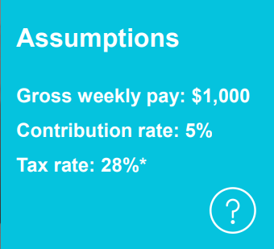
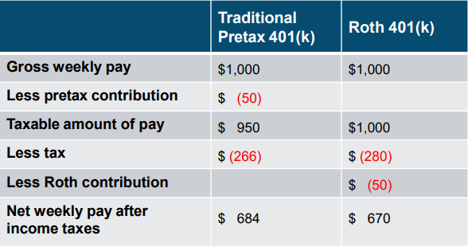
Roth vs. Pre-Tax
“Roth is the last money you spend on earth”
*For illustrative purposes only. The tax rate represents estimated federal and state taxes. Your results will vary. All investments involve risk, including possible loss of principal. For Roth contributions to be tax-free, you must satisfy the 5-year rule and be at least 59.5 when taking the distribution.

Slide 6
Max the Match: FREE MONEY!
This is an amazing benefit from Simple Energy
Simple Energy Matches your contributions:
Dollar for Dollar to 3%, save 3%....get 3%
Plus…..
50 cents on the dollar to 5%, save 5%....get 4%
For someone that makes $45,000 a year, 4% is:
$1,800 a year
(Free Money)
Don’t leave money on the table

Slide 7
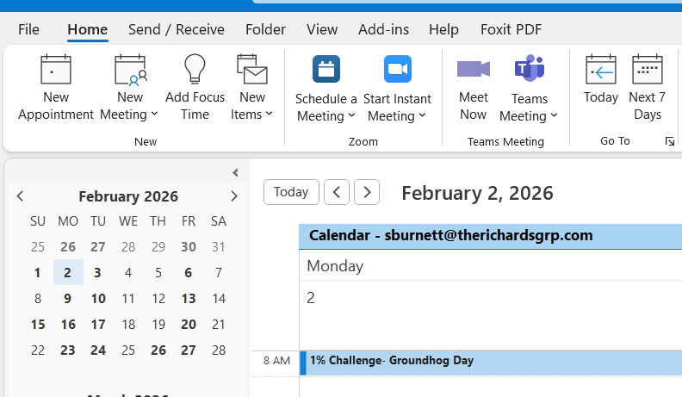
Try the 1% Challenge
Pick one day in the year
Mom’s Birthday, Veteran’s Day, Groundhog Day
Set an annual calendar reminder in Outlook/Google
Bump your deferral 1% on that day
Do it (or at least consider it) every year!
For someone that makes $45,000 a year, 1% is $8.65 a week
Contribution Increase | 10 Yrs | 20 Yrs | 30 Yrs | 40 Yrs
1% ($29.17 monthly) | $5,049 | $15,195 | $35,587 | $76,566
5% ($145.83 monthly) | $25,241 | $75,967 | $177,908 | $383,777
This example is hypothetical and for illustrative purposes only and is not indicative of the performance of any specific investment. Investments are subject to market risk and fluctuate in value. All contribution amounts are based on a $35,000 annual salary and assume a nominal rate of 7% per year compounded monthly.

Slide 8
Rollover your Accounts
Rollover a balance from prior employer:
Allocation easier with one account, monitored investments, low cost
Form or On-Line Request (Prior Plan: Withdrawal/Distribution Tab
Out of the Old…….Form Into the New
T. Rowe Price: Incoming Rollover Form required
Call 800 # on your statement for help
Leaving? Rollover your balance to a new employer
Take your account with you….please
You can initiate a withdrawal for rollover to a new employer/IRA online
New plan will likely require an “incoming rollover form”

Slide 9
Household Financial Wellness
Finances can be stressful……Where do I start???
Set up an emergency fund?
Set up a big purchase fund?
Pay down debt?
Create a spending plan by reviewing your income and expenses
Do you think you are spending too much?
Request your free annual credit report
Review your retirement accounts -consolidate
Review or set up beneficiaries for all accounts
Identify your protection needs regarding insurance, wills & documents
Home, auto, life

Slide 10

Household Financial Wellness
Monday Night Finance
Schedule it, put it on the calendar, stick to it
Do it solo or with your partner/spouse
Pull leftovers from the freezer/fridge for dinner
Determine how you are going to manage/track things
Laptop spreadsheet, app on your phone, or paper
Start with a pad, 3-ring binder or paper folder
Share passwords/permissions for on-line accounts
Make a list of all financial accounts for your household
Complete the Savology Assessment
Make “To Do” list of things to discuss, review, and tackle this year
Put a time limit on the session – aim for 30 to 60 minutes
MONDAY
NIGHT
FINANCE
$
“Household finances are not fixed in a day”

Slide 11
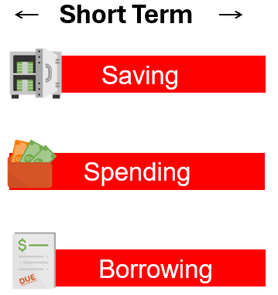
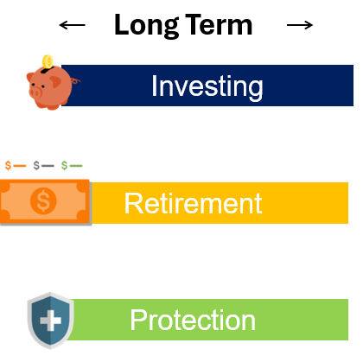
Building Blocks of Household Finances
Saving
Organize bank accounts: 1 bank, 3 dedicated named accounts
Emergency savings, big purchases or expenses
529s, Investment Account, Retirement
Spending
Identify regular bills, their frequency and timing: review them
Consider expected big expenses in the next 12 months
Borrowing
Assess debt, interest rates, repayment plan, HELOC
Check & monitor your credit score and report
Protection
Life, Home/Auto, Personal Umbrella, Benefits (ex: Health, Long and/or Short-Term Disability)
Will, Power of Attorney, Health Care directives, Estate planning (ex: Trusts)
Long Term Savings & Investment Accounts
401(k) / 403(b), consolidate old accounts, pensions, HSAs,
Social Security estimates ssa.gov

Slide 12

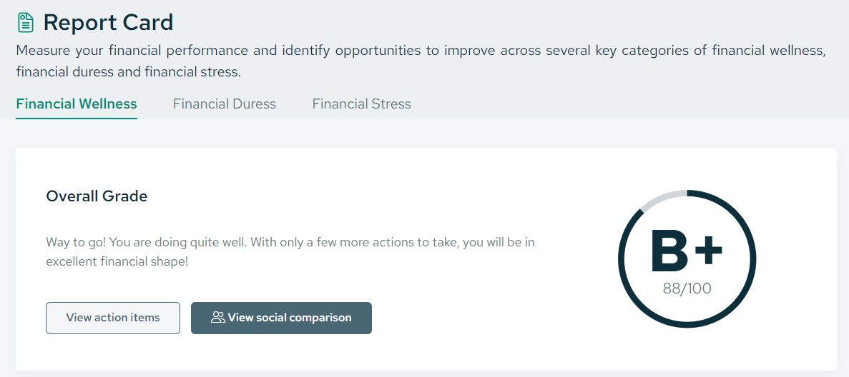
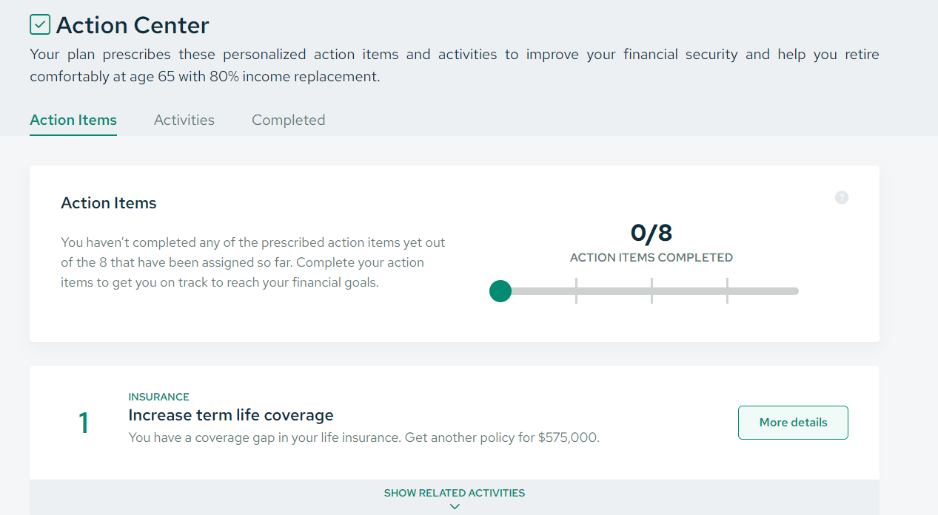
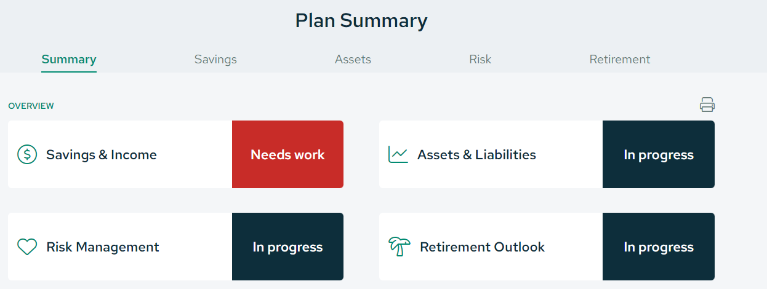
Savology
Employee experience:
Take a financial assessment that generates a financial “Report Card”
Initial Literacy Assessment – 10 minutes
Financial Stress Assessment
A checklist of actionable items/specific to-dos based on assessment results
A holistic financial plan that updates as tasks on your to-do list are completed
Planning Modules and short videos
Financial literacy courses
Tools to accomplish to-do list items (ex: budgeting)
No PII collected (Personally Identifiable Information)
Assessment Quiz
Report Card
To-Do List
Library of easy to review resources
https://app.savology.com/groups/rLMgGUAUJiNUFZJyDbmjzM
helpretire@therichardsgrp.com

Slide 13
How to Reduce Expenses / Spending
Make a list of all expenses…everything
Review your credit card statements and checking transactions
Review utilities, cable, cell phone – negotiate!!
Review subscriptions, especially streaming services
Seek to reduce food costs:
“We’re eating from the freezer this week!”
Take-out, coffee, eat leftovers, pack a lunch, dinner out
The 24-hour rule for purchases
Use cash in lieu of the card, weekly allocation
“where can we trim expenses?”

Slide 14
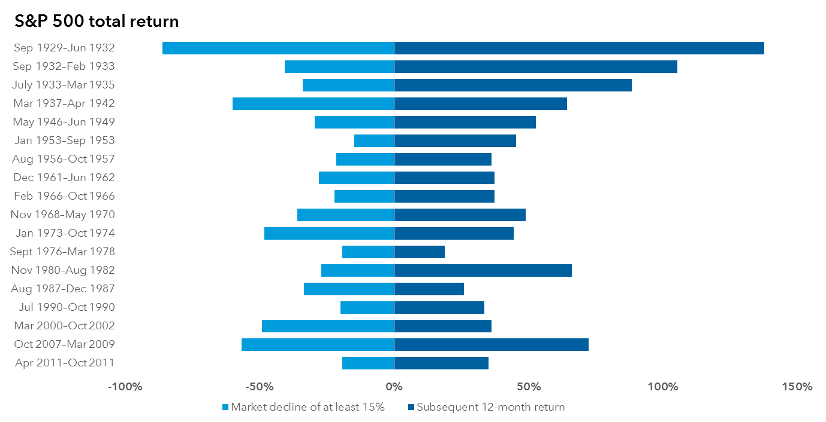
Market Volatility – keep emotions out of investing
Investors who sell early and miss out on potential gains when the market rebounds can be worse off than those who help through the entire decline.

Slide 15





Keep your account safe for you and your loved ones
ADMASTER-STAMP!MGR0425232799292
Common beneficiaries
Spouse
Children
Siblings
Common-law partner
If you don’t select a beneficiary, the courts could end up doing it for you.
Notes:
Let’s take a minute to talk about naming a beneficiary for all of your accounts, because you work hard to save.
Make sure you choose who will inherit your savings should something happen to you. If you don’t name your beneficiaries, the courts will do it for you, which will cost your estate money, and they may not give the money to the same people you would.

Slide 16
ADMASTER-STAMP!MGR0425232799292
Key Things to Consider
Roth vs. Pre-Tax Contributions
Max the Match
The 1% Challenge-pick a day
Rollover Accounts
Household Finances
Try Savology and Monday Night Finance
Try T. Rowe Price on-line/mobile app
Check & Update your beneficiaries
Notes:
Today, I’ll review the following topics and then answer any questions you may have.
First, I’ll tell you about your retirement plan provider, John Hancock.
Then we’ll look at how you can save for retirement through your plan
Next, I’ll go over your plan’s highlights.
To give you a better understanding of investments, I’ll go over some investment concepts you should know.
If you’ve just become eligible to enroll, I’ll quickly take you through your options to enroll online.
And finally, I’ll give you a few tips to help get you off to a great start with your plan.

Slide 17

More Questions? Need help?
Call (800) 354-2351 for representative assistance: Monday - Friday
(except certain NYSE Holidays)
Contact for all things transactional:
How to access your account online
Requesting a distribution
Requesting a rollover
Help with website tools
Advisor monitored e-mail box:
helpretire@therichardsgrp.com
Contact for guidance with things like:
How much to save, pre-tax vs. Roth
General investing questions
Retirement planning questions
Pros/cons of rollovers
Financial wellness topics (budgeting, debt, savings priorities)
helpretire@therichardsgrp.com
(800) 354-2351
https://www.troweprice.com/workplace/en/login.html
Please include your full name and
name of employer in your email!

Slide 19

T. Rowe Price Retirement
* Not
If you were born ​ | Target year​ | Approximate asset allocation​
1947 & earlier​ | 2010 Fund​ | 45% stock, 55% fixed income​
1948 to 1952​ | 2015 Fund​ | 49% stock, 51% fixed income​
1953 to 1957​ | 2020 Fund​ | 52% stock, 48% fixed income​
1958 to 1962​ | 2025 Fund​ | 57% stock, 43% fixed income​
1963 to 1967​ | 2030 Fund​ | 67% stock, 33% fixed income​
1968 to 1972​ | 2035 Fund​ | 79% stock, 21% fixed income​
1973 to 1977​ | 2040 Fund​ | 89% stock, 11% fixed income​
1978 to 1982​ | 2045 Fund​ | 96% stock, 4% fixed income​
1983 to 1987​ | 2050 Fund​ | 98% stock, 2% fixed income​
1988 to 1992​ | 2055 Fund​ | 98% stock, 2% fixed income​
1993 to 1997​ | 2060 Fund​ | 99% stock, 1% fixed income​
1998 and later​ | 2065 Fund​ | 99% stock, 1% fixed income​
https://www.troweprice.com/financial-intermediary/us/en/investments/retirement-solutions/retirement-fund-i.html#primary-asset-allocation - 03/31/2025

