Slide 1
Employee Benefits Summary
2025 – Field Staff

Slide 2
Insurance Terms
Cost sharing
All costs to the consumer beyond premiums—includes deductibles, co-pays, and coinsurance. Also called out-of-pocket costs.
Copay
A defined flat dollar amount that an individual must pay when s/he receives a covered medical service. For example, an individual may have to pay $25 for each covered primary care visit. The cost of the copay depends on the service and plan.
Coinsurance
A type of cost sharing where an individual pays a percentage of the cost of the medical services s/he receives. For example, health insurance may cover 80% of the charges for a covered hospitalization, leaving the individual responsible for the other 20%. The percentage covered depends on the service and the health plan. Coinsurance is typically stated as the percent of member responsibility (e.g., 20%).
Deductible
The amount an individual must pay for covered care before health insurance begins to pay for services. It is common for the deductible to be waived for preventive services.
OOPM (Out-of-Pocket Maximum)
The annual maximum amount an individual will have to pay out-of-pocket for covered services. Generally, this includes the deductible, co-insurance, and copays.
Embedded Deductible
Embedded deductible plans, also known as stacked deductibles, all individuals in a family contribute to the same family deductible, but if a person meets the plan’s individual deductible, they no longer pay toward the family deductible and cost sharing (copays and co-insurance) will be in effect.
Non-Embedded Deductible
Non-embedded deductible plans, also known as aggregate deductibles, do not begin to pay for medical expenses until the entire family deductible has been met. Furthermore, there are no individual deductible amounts for each family member.
This benefit summary booklet outlines the highlights of your benefit plans. For a complete list of covered and non-covered services, including benefits required by your state, see your employer’s insurance certificate or summary plan description—the official plan documents. If there are any differences between this summary and the plan documents, the information in the plan documents takes precedence.

Slide 3
Benefit Eligibility
Our benefit package is designed specifically with our employment classifications in mind. Please refer to each coverage section to determine your eligibility based upon your employment classification.
Benefit | Eligibility | Waiting Period
Medical | 30 hours/week | Date of Hire
Dental | 30 hours/week | Date of Hire
Member Services Information
Need additional information? Have a question about one of your benefits? Keep this booklet handy for a quick reference for all your benefit needs. If you still have questions, please contact your Human Resources Department.
Benefit | Administrator | Website | Phone Number
Medical – TPA | Loomis | www.loomisco.com | 800-346-1223
Medical – Network | Cigna | www.cigna.com | 800-244-6224
Prescription Program | RxFree4Me | www.RxFREE4Me.com | 844-794-3733
Dental | Delta Dental | www.nedelta.com | 800-832-5700
Telemedicine | UCM | www.ucmdigitalhealth.com | 844-484-7362
Benefits Website | The Richards Group | www.precisiontalent.trgportal.com | User: fieldstaff Pword: benefits

Slide 4
Welcome to the Precision Talent Group Employee Benefit Center (EBC)!
This is your online employee benefits manual. This site has been created to provide you with an efficient way to obtain information and answers to your questions regarding your employee benefit plans on a 24/7 basis.
To log in to the EBC visit the following link: https://precisiontalent.trgportal.com
Or scan the QR code using your smartphone camera:
Username:
fieldstaff
Password:
benefits

Slide 5
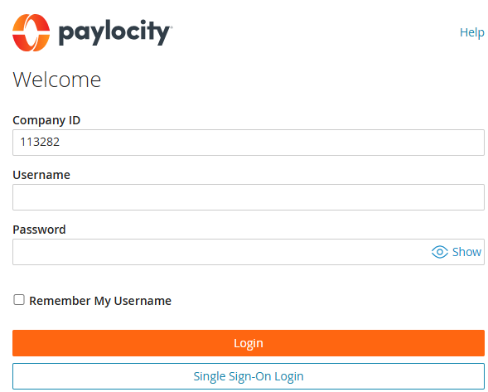
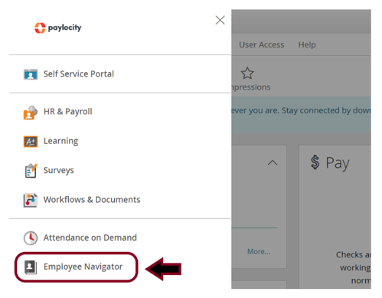
Online Enrollment
Step 1: Log In to Paylocity
Go to www.paylocity.com and click Login
The Company ID is 113282
Enter your Username and Password.
If you are a new user, click “Register New User” and follow the prompts.
Step 2: Access the SSO in Paylocity
After signing in to Paylocity, navigate to the mend on the left-hand side of your Paylocity Account (Self Service) and click “Employee Navigator”. This will open a new window and you will automatically be signed in to Employee Navigator. Continue onto the next page for further Enrollment instructions.

Slide 6
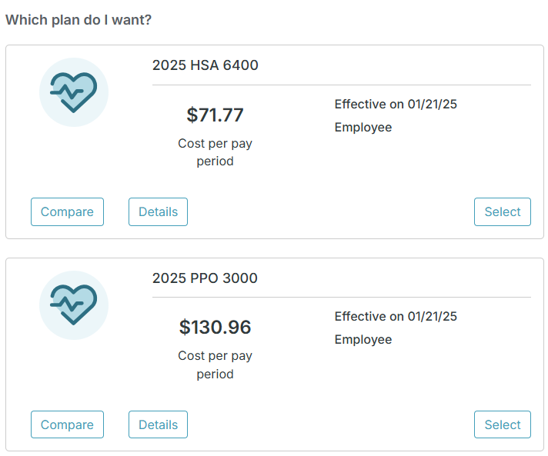
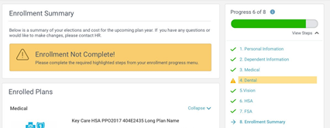
Online Enrollment (con’t)
Step 3: Start Enrollments
After clicking Start Enrollment, you’ll need to complete some personal & dependent information before moving to your benefit elections.
TIP
Have dependent details handy. To enroll a dependent in coverage you will need their date of birth and Social Security number.
Step 4: Benefit Elections
To enroll dependents in a benefit, click the checkbox next to the dependent’s name under Who am I enrolling?
Below your dependents you can view your available plans and the cost per pay. To elect a benefit, click Select Plan underneath the plan cost.
Step 5: Review & Confirm Elections
Review the benefits you selected on the enrollment summary page to make sure they are correct then click Sign & Agree to complete your enrollment. You can either print a summary of your elections for your records or login at any point during the year to view your summary online.

Slide 7
Medical Coverage
In-Network Plan Features | PPO 3000 | HSA 6400
Preventive Care | Covered in full | Covered in full
Calendar Year Deductible Individual / Family | $3,000 / $6,000 | $6,400 / $12,800
Calendar Year Out-of-Pocket Max Individual / Family | $6,500 / $13,000 | $7,050 / $14,100
Telemedicine Consultations Not through Loomis | $25, Deductible Waived | Not Covered
Primary Care Physician & Mental Health / Specialist Specialist includes Chiropractic Care – no limit | $25 / $50, Deductible Waived | Ded: $50 / $70
Outpatient Therapy Physical - 20 visits per CY Speech, Hearing, Occupational – 20 visits per CY combined | $25, Deductible Waived | Deductible, then 50%
Hospital Services Inpatient Facility Outpatient Surgery (Hospital) Outpatient Surgery (Free-Standing Facility) | Deductible, then 0% Deductible, then $300 $250 Copay, Deductible Waived | Deductible, then 50%
Diagnostic X-Ray Office & Outpatient Hospital Free-Standing Facility | Deductible, then 0% $150 Copay, Deductible Waived | Deductible, then 50% Deductible, then 50%
Laboratory Office & Free-Standing Facility Outpatient Hospital | Covered in Full Deductible, then 0% | Deductible, then 50% Deductible, then 50%
Advanced Imaging Outpatient Hospital Free-Standing Facility | Deductible, then 0% $250 Copay, Deductible Waived | Deductible, then 50% Deductible, then 50%
Urgent Care | $100 Copay, Deductible Waived | Deductible, then $100
Emergency Room | Ded / $350 Copay | Deductible, then $350
Prescriptions 30-day or 90-day Retail (90-day Retail & 90-day Mail is 2X) |  | Med Deductible 1st
Preventive Rx | Same as any other drug | Same as any other drug
Tier 1 – Generic | $25 | $25
Tier 2 – Preferred Brand | $80 | $80
Tier 3 – Non-Preferred Brand | 30% to $400 | 30% to $400
Tier 4 – Specialty (30 day only) | 40% to $550 | 40% to $550
DONE
For more details and prescription drug lists, please visit the EBC.

Slide 8
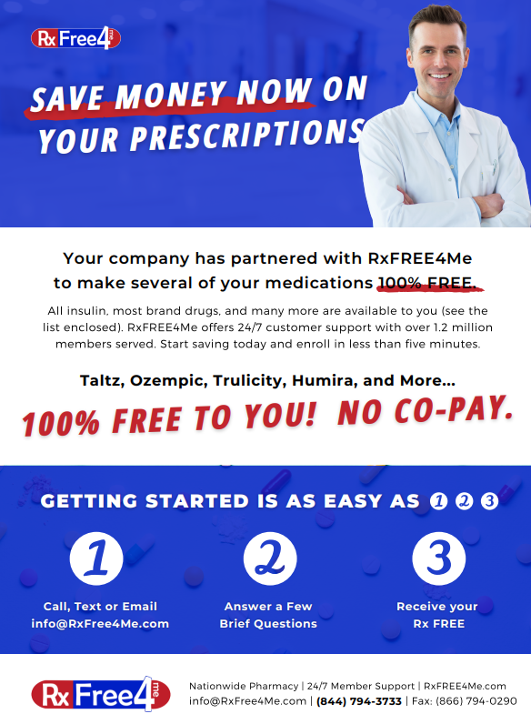
Prescription Program – New in 2025!

Slide 9
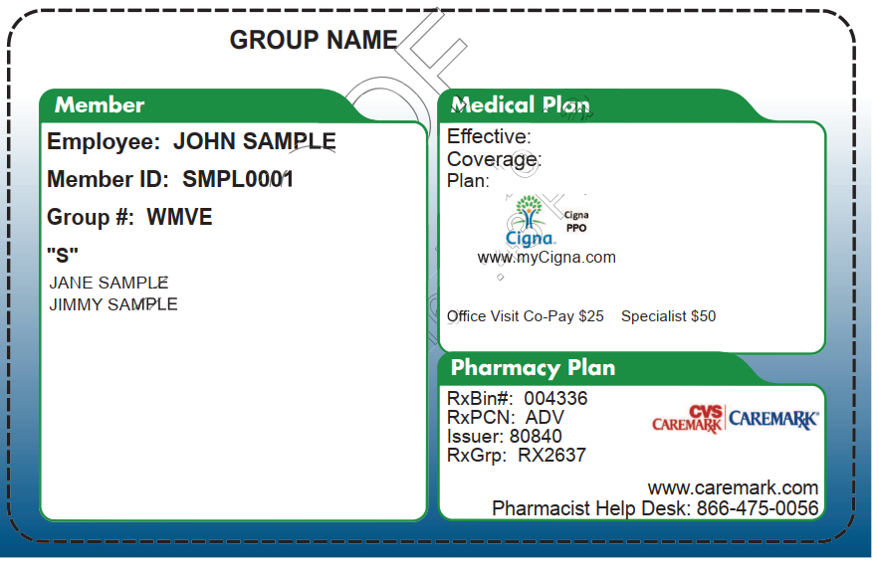
Medical Details
Vendor: | Roles / Responsibilities:
 | Members services, claim questions, eligibility, ID cards
 | Healthcare provider network
 | Pharmacy Benefit Manager (PBM), provide formulary
Vision Coverage
Eligibility
Employees who enroll in a Precision Talent Group company-sponsored medical plan will receive Vision Coverage.
How it Works
Here are the steps for submitting paid bills for reimbursement.
Visit any optician and/or vision center (there is no provider network).
Wait to receive a bill from the provider.
Pay the provider as billed.
Send a copy of the bill and payment to Loomis for reimbursement via email Damaris' email is: dsanchez@loomisco.com.
Eye Exam Reimbursement: $100 maximum benefit for one (1) exam every 24 months.
Supplies Reimbursement: $150 maximum benefit every 24 months.

Slide 10
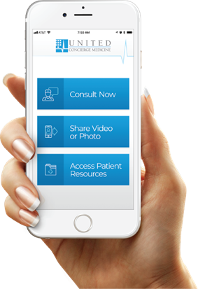
Telemedicine
Emergency Medicine Expertise at the touch of a button.
Many conditions can be treated virtually. Before visiting the ER, Urgent Care Clinic or your Primary Care Physician, call UCM to see if you can be treated virtually. If you take this step and still need to see a doctor in person, your copay is waived!
Simply Call UCM First and Save!
Your First Step to Care
Doctors at United Concierge Medicine
844-4-VIP DOC
(844-484-7362)
 | You Pay PPO 3000: | You Pay:
Emergency Room | Ded / $350 copay | $0
Urgent Care | $100 copay | $0
Primary Care Physician | $25 copay | $0
For 24/7/365 access to a healthcare provider!
Download the UCMnow App!
Notes:
HSA + Accident

Slide 11
Dental Coverage
Plan Features | PPO Plus Premier
Office Visit Copay | $0
Deductible – One Time (waived for Diagnostic & Preventive) | $100 / person $300 / family
*Annual Maximum Benefit - (Plan Year) | $2,000 per person each plan year
Diagnostic & Preventive Services (Exams, cleanings, x-rays and sealants) | Covered 100%
Basic Services (Fillings, routine extractions, endodontics (root canals), Periodontics (gum treatment), after 6 month waiting period) | 20% after deductible
Major Services After 6-month waiting period (Denture repair/rebase/reline, Crowns, inlays, Onlays, complex oral surgery, and cast restorations) | 50% after deductible
Orthodontic Benefits After 6-month waiting period | 50% up to $1,500
*Amount paid by Delta Dental until the Annual Maximum has been exhausted
Delta Dental Network Options
PPO Network – Visit a dentist in the PPO network to maximize your savings. These dentists have agreed to reduced fees, and you won’t get charged more than your expected share of the bill. You will also pay less out-of-pocket as you will have a lower deductible and coinsurance.
Premier Network – If you can’t find a PPO dentist, Delta Dental Premier dentists offer the next best opportunity to save. Unlike non-Delta Dental dentists, they have agreed to set fees, and you won’t get charged more than your expected share of the bill.
To find a participating provider visit nedelta.com
Notes:
Get richer left to right.

Slide 12
Delta Dental Perks
A healthy mouth is part of a healthy life and Northeast Delta Dental’s innovative HOW program works with your dental benefits to help you achieve and maintain better oral wellness. HOW is all about you because it’s based on your specific oral health risk and needs. Best of all, it’s secure and confidential.
Here’s how to get started:
1. Go to www.healththroughoralwellness.com and click on “Register Now”.
Know Your Score
After you register, please take the free oral health risk assessment by clicking on “Free Assessment”
in the Know Your Score section of the website.
Share Your Score With Your Dentist
The next step is to share your results with your dentist at your next dental visit. Your dentist can
discuss your results with you and perform a clinical version of the risk assessment.
The Northeast Delta Dental Plan allows you to double your calendar year maximum by earning an additional $250 per year for use in future benefit periods.
Here’s how it works:
To qualify for the carryover, you must have a claim paid for either an oral exam or a cleaning during a calendar year (a focus on prevention), and your total paid claims cannot exceed $500 during the same calendar year.
The carryover will accumulate for each year of qualification up to an amount equal to the plan’s original calendar year maximum. If, for example, the calendar year maximum is $2,000, enrollees can ultimately achieve an annual maximum of $4,000.
Great Savings—Up to 35% off eyewear
Choose from any available frame including quality name-brand products such as Brooks Brothers®, Ann Klein®, Vogue®, and more at provider locations. With EyeMed Vision Care, Northeast Delta Dental members have access to over 71,000 vision care providers nationwide at 27,000 locations, including optometrists, ophthalmologists, opticians, and the nation’s leading optical retailers.
It’s easy! To request your discount, simply present your Delta Dental member ID card or this ﬂyer when you arrive at the provider office or location. Your EyeMed provider will take care of the rest! To learn more about the EyeMed Vision Care Discount Plan, please visit our website at www.nedelta.com.
This is a discount program only and is separate from vision coverage.

Slide 13
2025 Employee Contributions
Medical Plan Weekly Contributions - PTG
Cigna | PPO 3000 | HSA 6400
Employee Only | $130.96 | $71.77
Employee + Spouse | $251.93 | $229.46
Employee + Child(ren) | $226.19 | $206.30
Employee + Family | $364.34 | $330.57
Dental Plan Weekly Contributions - PTG
Delta Dental | Premium Plus
Employee Only | $7.23
Employee + One | $19.86
Employee + Family | $34.84

Slide 14
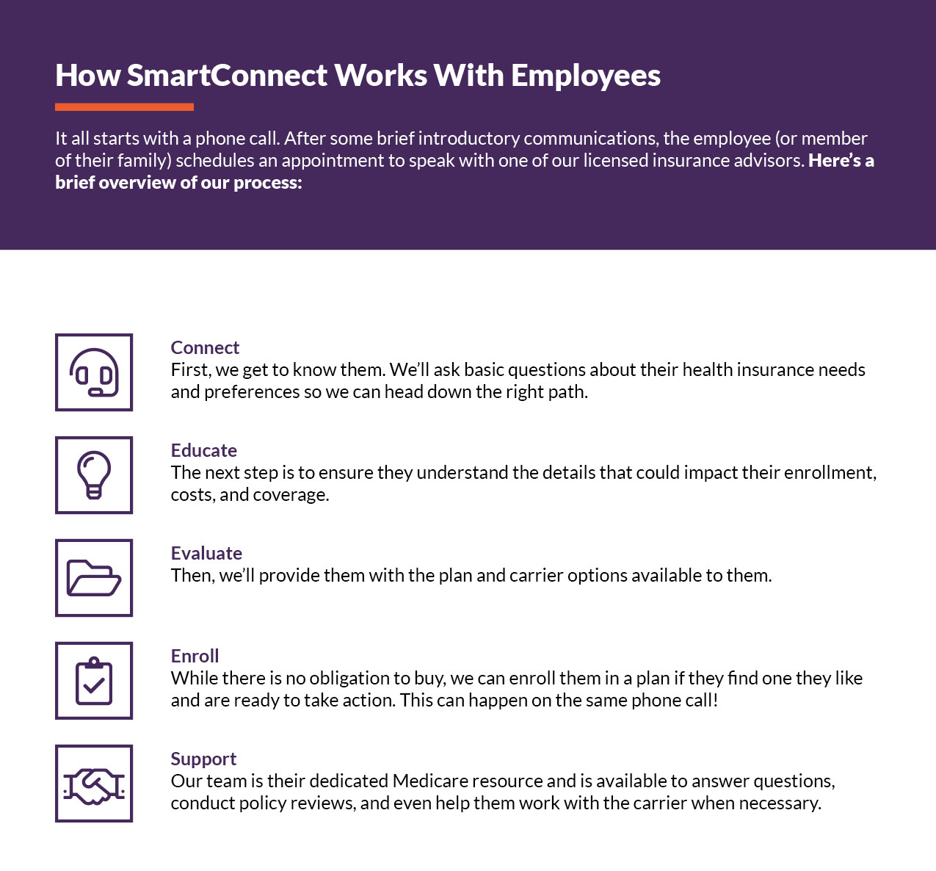
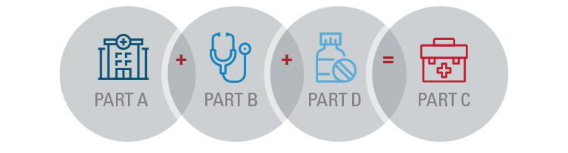
Additional Programs
Medicare Navigation (SmartConnect through The Richards Group)
Medicare is very complex, and it is important that you have an advocate who can provide you the proper Medicare education and guidance.
There are different paths you can choose in Medicare plans, and it can be very time consuming and difficult to filter through these options yourself. It is important that you find the appropriate plan in your area that best fits your medical needs and is within your financial budget.
The Richards Group has partnered with SmartConnect™, an exclusive, no-cost program created specifically to connect Medicare-eligible working adults to the world of Medicare benefits. Whether an employee plans to continue working or is transitioning to retirement, we tailor solutions designed around their needs. Our agents provide an unfiltered view of the entire range of options and prices available to the employee.
SmartConnect
1-833-502-2747 | TTY: 711
https://gps.smartmatch.com/therichardsgroup

Slide 15
Additional Information & Notices
COBRA Information:
COBRA continuation coverage is a temporary extension of coverage under the group health plan. The right to COBRA continuation coverage was created by a federal law, the Consolidated Omnibus Budget Reconciliation Act of 1985 (COBRA). COBRA continuation cover age can become available to you when you would otherwise lose your group health coverage. It can also become available to other members of your family who are covered under the Plan when they would otherwise lose their group health coverage. For additional information about your rights and obligations under the Plan and under federal law, you should review the Plan’s Summary Plan Description or contact the Benefits Coordinator in Human Resources.
Health Insurance Marketplace:
You may have other options available to you when you lose group health coverage. You may be eligible to buy an individual plan through the Health Insurance Marketplace (www.healthcare.gov). By enrolling in coverage through the Marketplace, you may qualify for lower costs on your monthly premiums and lower out-of-pocket costs. Additionally, you may qualify for a 30- day special enrollment period for another group health plan for which you are eligible (such as a spouse’s plan), even if that plan generally doesn’t accept late enrollees.
HIPAA Information:
Special Enrollment Right Mandated by the Health Insurance Portability and Accountability Act of 1996
Group health plans and health insurance insurers are required to provide special enrollment periods during which individuals who previously declined coverage for themselves and their dependents may be allowed to enroll without having to wait for the plan’s next open enrollment period. A special enrollment period can occur if a person with other health coverage loses that coverage or if a person becomes a new dependent through marriage, birth, adoption or placement for adoption. If you refuse enrollment for yourself or your dependents for medical coverage, you may later enroll within 30 days of a change in family status or loss of health coverage.
Individuals may not be denied eligibility or continued eligibility to enroll for benefits under the terms of the plan based on specified health factors. In addition, an individual may not be charged more for coverage than similarly situated individuals based on these specific health factors.
Effective April 1, 2009, the Children’s Health Insurance Reauthorization Act of 2009 (CHIPRA) created a new 60-day special enrollment peri od for eligible employees and dependents to immediately enroll in the plan if they become ineligible for Medicaid or any state’s Children’s Health Insurance Program (CHIP) and lose coverage or become eligible for that state’s premium assistance program. The employee must request coverage within 60 days after the termination of coverage or the determination of subsidy eligibility.
Women’s Health and Cancer Rights Act of 1998 (WHCRA):
WHCRA requires a group health plan to notify you, as a participant or a beneficiary, of your potential rights related to coverage in connection with a mastectomy. Your plan may provide medical and surgical benefits in connection with a mastectomy and reconstructive surgery. If it does, coverage will be provided in a manner determined in consultation with your attending physician and the patient for a) all stages of reconstruction on the breast on which the mastectomy was performed; b) surgery and reconstruction of the other breast to produce a symmetrical appearance; c) prostheses; and d) treatment of physical complications of the mastectomy, including lymphedema. The cover age, if available under your group health plan, is subject to the same deductible and coinsurance applicable to other medical and surgical benefits provided under the plan. For specific information, please refer to your summary plan description or benefits booklet, or contact Human Resources.
THIS IS ONLY A SUMMARY, NOT A CERTIFICATE OF INSURANCE
The information contained in this Employee Benefits Summary is presented for illustrative purposes only and is based on information provided by the employer and in certificates of insurance supplied by the insurance carrier. The Richards Group, your company’s insurance broker, has prepared this Summary to assist employees in understanding their company’s benefits plan. While every effort has been made to describe these benefits accurately, discrepancies or errors are possible. You should also read the actual plan documents in their entirety. If there is a discrepancy between the Employee Benefits Summary and the actual plan documents, the plan documents will prevail. If you have any questions about the Employee Benefits Summary, please contact Human Resources.

