Slide 1


Employee Benefit Summary
July 1, 2021 – December 31, 2021
Medical | Dental | Life | Disability |FSA | DCA | EAP

Slide 2
Who We Are, What We Believe
Monadnock Family Services (MFS) is a nonprofit Community Mental Health Center that has served Cheshire County and surrounding areas since 1905. Our mission is to be a source of health and hope for people and the communities in which they live. MFS fosters mental and emotional wellness for individuals of all ages. We create services that heal, education that transforms, and advocacy that brings a just society.
MFS is proud to offer a comprehensive benefits program to all eligible employees. Your benefits are an important part of your total compensation; therefore, we invite you to familiarize yourself with the details of these plans.
New this year, MFS will prepare to move open enrollment from June to December. This means that benefit elections you make during Open Enrollment in June 2021 will be in effect until December 31, 2021. In December 2021, eligible employees will have an opportunity to make new elections for January – December 2022. Outside of experiencing a qualified event, Open Enrollment is the only time you are can make changes to your benefit enrollments.
HRA = Health Reimbursement Account; MERP = Medical Expense Reimbursement Plan; FSA = Flexible Spending Account; DCA = Dependent Care Account; AD&D = Accidental Death & Dismemberment.
The information in this guide is provided for your convenience. If there are discrepancies between information found in carrier produced documents, or MFS produced documents, please rely on the latter.

Slide 3






Contact Information

Slide 4



Payroll Deductions
MFS contributes generously toward the cost of each eligible employee’s health and dental insurance. Your per paycheck deductions, 7/1/21 – 12/31/21 are shown below:
Health Insurance
Dental Insurance

Slide 5
Health Insurance
Beginning July 1, MFS employees will have access to one health insurance plan through Tufts Health Freedom Plan/United Healthcare, called Granite Advantage EPO. This plan replaces the three plans previously available through Harvard Pilgrim and offers greater coverage on most services. In the plan summary below, where the benefit/ feature is an improvement from current plans, the information is shown in green; same, black; disadvantage, red.

Slide 6
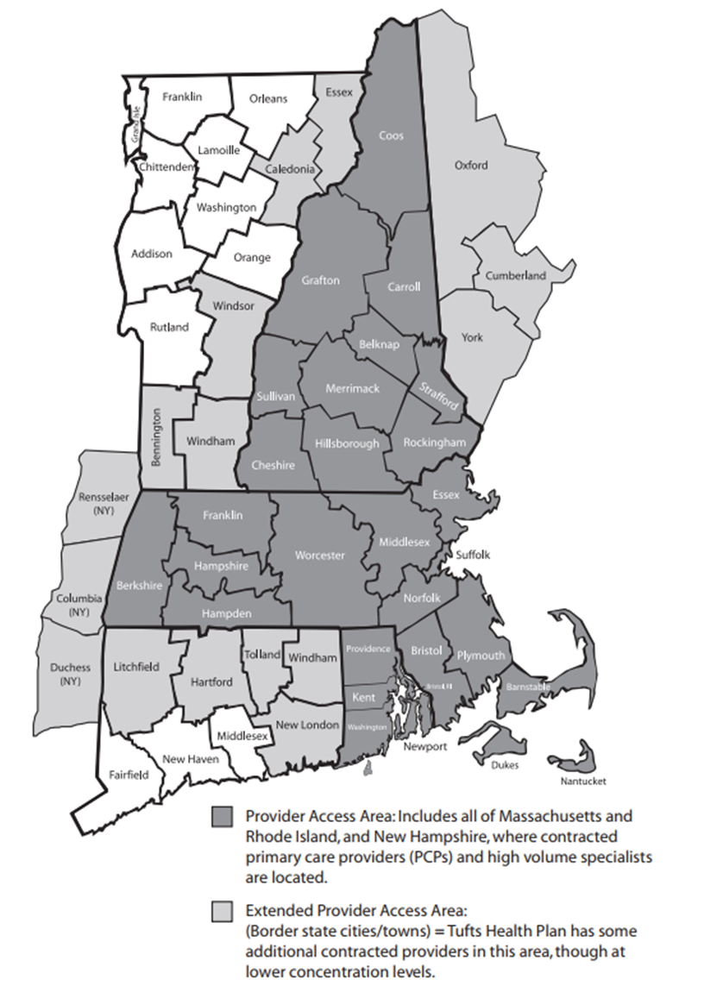
Tufts Provider Access
The Granite Advantage EPO plan contains an extensive network of providers across New England, including those associated with:
  Cheshire Medical Center, Brattleboro Memorial, Monadnock Community, Dartmouth Hitchcock Lebanon, Catholic Medical Center, Massachusetts General, Brigham & Women’s, Dana Farber, Boston Children’s and many more.

Slide 7


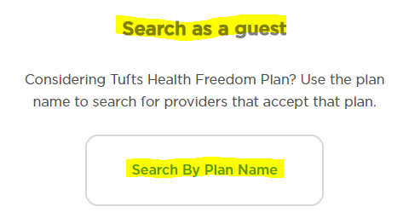
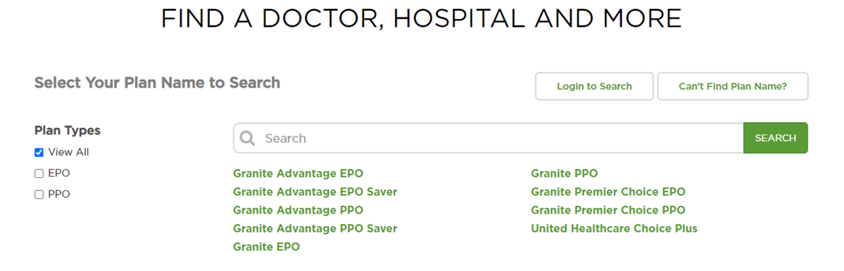


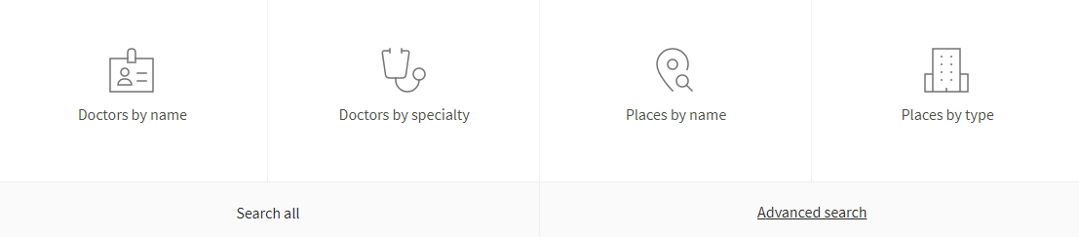
Locating your Providers
To determine if your providers are included in the Tufts Granite Advantage EPO, visit www.thfp.com and follow the steps below:
Step 1:
Step 2:
Step 3:
Step 4: Change to your provider’s location or your hometown
Step 5: Click the category by which you wish to search

Slide 8
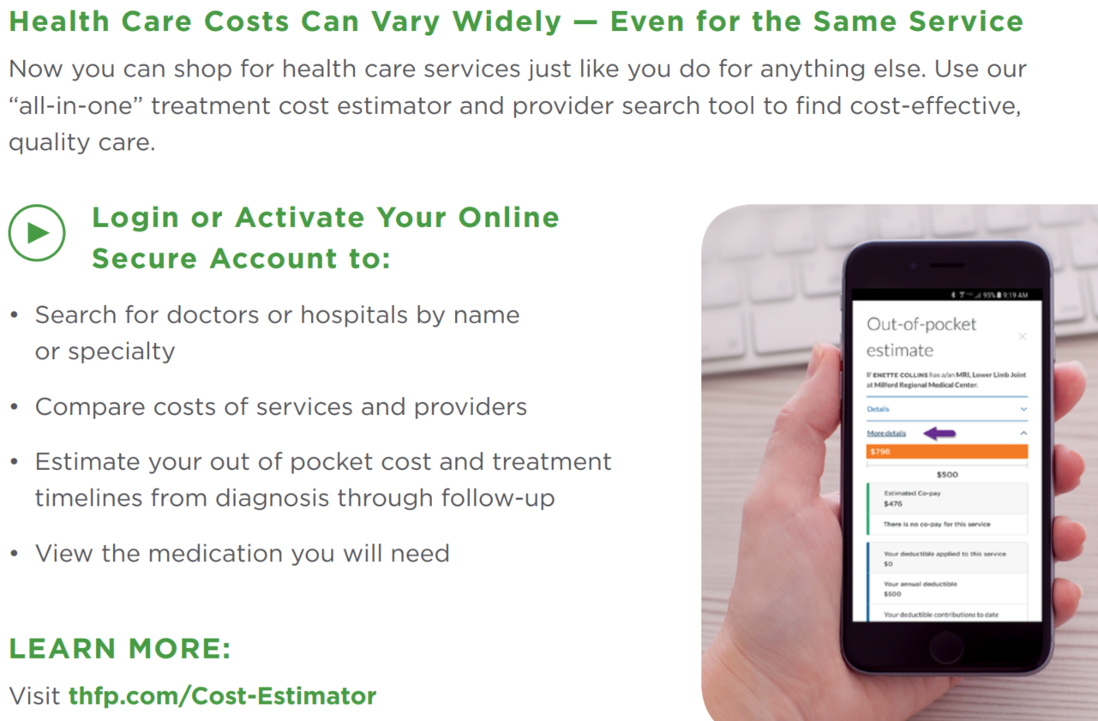
Cost of Use
The major cost sharing components of the Tufts Granite Advantage EPO are copays, deductibles, coinsurance, and Out-of-Pocket max amounts.
A copay is an amount set under the medical plan that the member pays for covered services - such as an office visit - or prescription drugs.
Deductible is the amount of deductible-eligible covered medical expenses (ie inpatient, outpatient, imaging, ER) the member pays before Tufts/UHC pays benefits. MFS’ plan has a $4,000 Individual and $8,000 Family deductible. If you are enrolled in one of MFS’ health plans through Harvard Pilgrim as of 6/30/2021, any covered health care expenses you have incurred in 2021 will be credited to your new Tufts plan. Please note: MFS’ MERP/HRA as explained on page 12 reduces the amount an employee ultimately pays for deductible-eligible services.
Coinsurance is the amount the member pays for deductible-eligible services after meeting the deductible. There is no coinsurance for medical services, but 25% coinsurance applies to Durable Medical Equipment after the deductible is met.
Out of Pocket Maximum refers to the most you will pay for covered expenses under the plan. Copays, Deductibles and Coinsurance all accumulate toward the OOP Max.

Slide 9
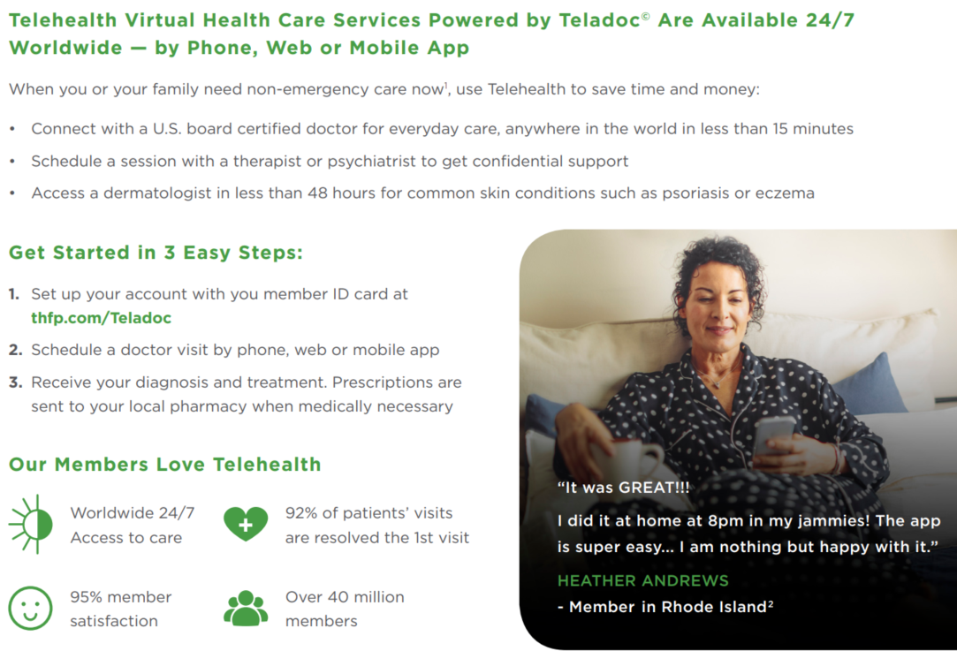
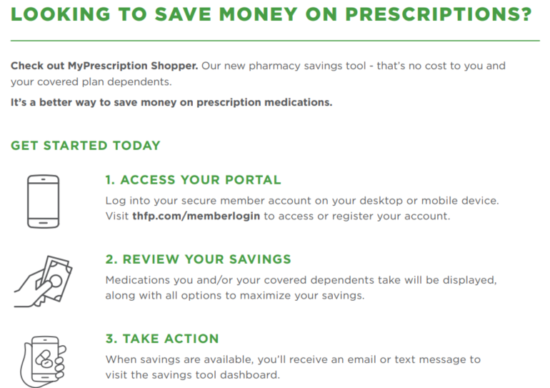
Telehealth & Rx Savings
Teledoc visits are covered in full.

Slide 10
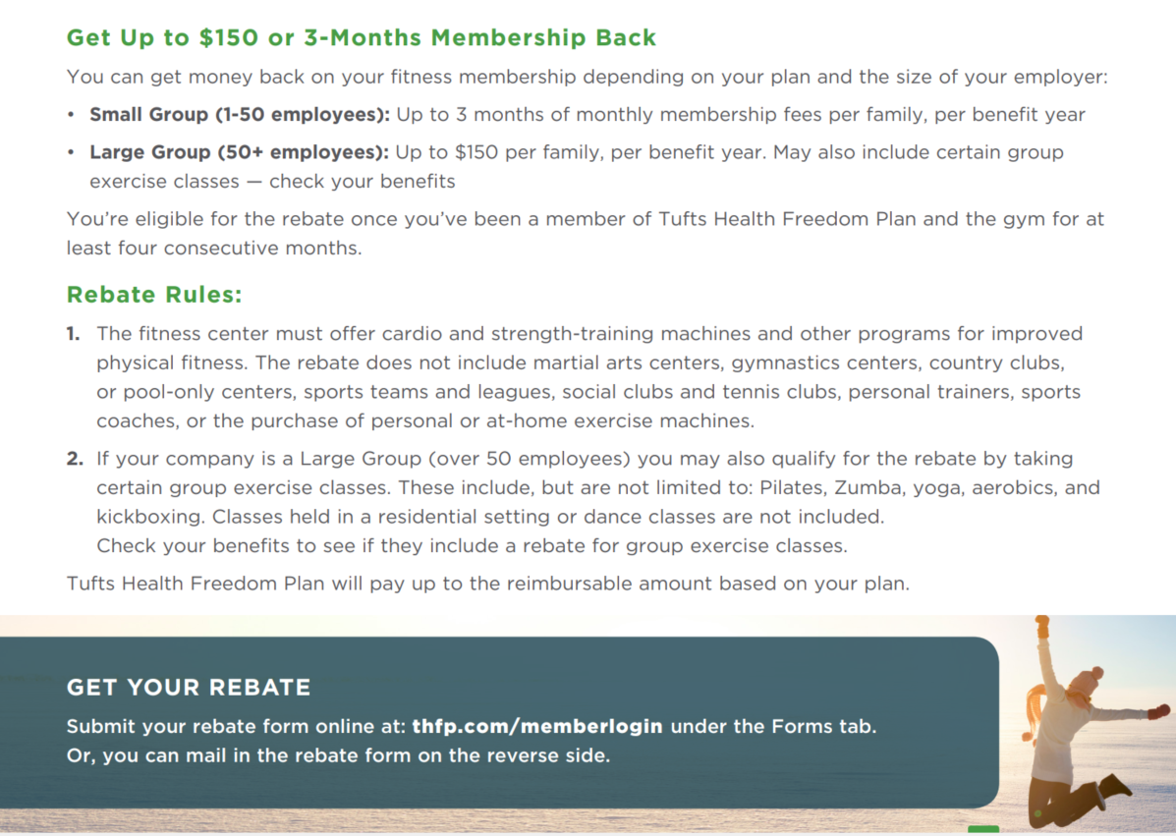
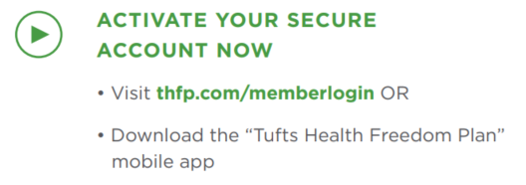
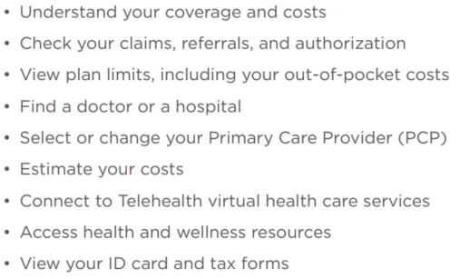
Fitness Reimbursement
Tufts Online Access

Slide 11

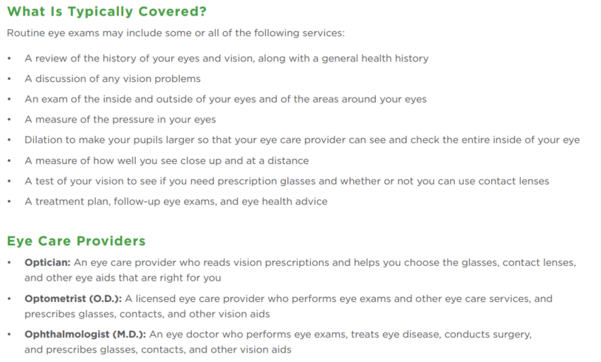
Vision

Slide 12

Health Reimbursement Account
MFS has generously established a Health Reimbursement Account HRA (MERP) to assist employees with a portion of coinsurance and deductible-eligible medical expenses. Enrollment in the HRA is automatic for you and your enrolled dependents when you enroll in MFS’ Tufts Granite Advantage EPO 4000.
How much is the HRA benefit?
You are eligible for a total reimbursement of medical services of up to $3000 if you have single coverage; $6000 for you and 1 or more dependents. In addition, 50% of coinsurance up to an additional $1000/$2000 is available when you have Tier 4 Rx and Durable Medical Equipment coinsurance expenses.
How does the reimbursement work?
You have a deductible-eligible service such as imaging, ER, inpatient hospitalization or outpatient surgery
You present your Tufts ID card to provider
Provider submits claim to Tufts
  Provider sends invoice to you
  You receive provider invoice and set aside
Tufts processes claim and sends Activity Summary/EOB to you, and places data on your Tufts member portal.
  You compare provider invoice to Tufts EOB to confirm accuracy.
You pay the provider, according to Tufts’ “Your responsibility” amount
Once you have passed $1000 in deductible expenses (or paid coinsurance on Tier 4 Rx), submit an HRA reimbursement request along with your Tufts EOB/Activity Summary to American Benefits Group for reimbursement
  Submit via www.amben.com/wealthcare using employer code ABGMFS
  Or, complete paper form and e-mail to claims@amben.com

Slide 13
Flexible Spending Accounts
MFS offers both health (FSA) and dependent care (DCA) flexible spending accounts. Employees may contribute pre-tax dollars into these accounts to help offset eligible medical expenses or dependent care expenses. These plans will be administered by American Benefits Group www.amben.com.
Open Enrollment for FSA occurs in December.
Health Care FSA
Funds from a health care FSA can be used for qualified expenses including medical, dental, vision, deductibles*, co-payments and coinsurance. For a full list of qualified expenses allowed by the IRS, see Publication 502 (www.irs.gov/publications/p502).
*You may NOT use FSA funds to pay for deductible expenses that are eligible for reimbursement under MFS’ HRA.
A debit card will be issued to all participants enrolled in the medical FSA. In 2021 the maximum allowable contribution amount is $2,750.
With an FSA, the entire elected amount is available on the first day of the health plan year.
Dependent Care FSA
A dependent care FSA allows employees to set aside pre-tax dollars to pay for qualified dependent care expenses. Funds can be used to pay for day care, preschool, elderly care or other dependent care. To qualify for a dependent care FSA, the IRS requires that the dependent care is necessary for you or your spouse to work, look for work or attend school full-time.
In 2021 the maximum amount you may contribute to the dependent care FSA is $5,000* (if single or married & filing jointly) or $2,500* (if married & filing separately)
Please note that the DCA is 100% employee funded and is only available to use as monetary contributions are made.
Visit www.amben.com for more information including tools to calculate your tax benefits and election amount estimators.
For enrollment forms, direct deposit forms, please contact MFS HR, visit www.amben.com, or call American Benefits Group at 855-294-7010.

Slide 14

Dental Insurance
Monadnock Family Services offers a dental plan administered by Northeast Delta Dental. Coverage summarized below.
The Delta Dental PPO plus Premier network arrangement offers access to the nation’s largest network of dental providers while simultaneously offering access to PPO providers who have agreed to accept lower fees for Delta Dental patients.

Slide 15

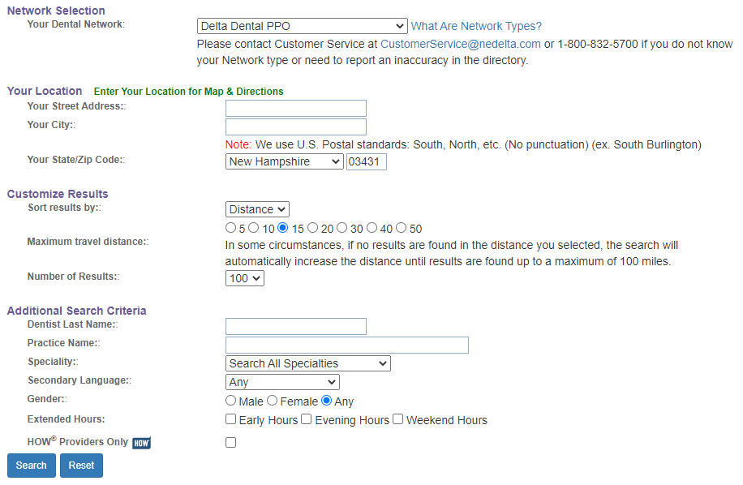
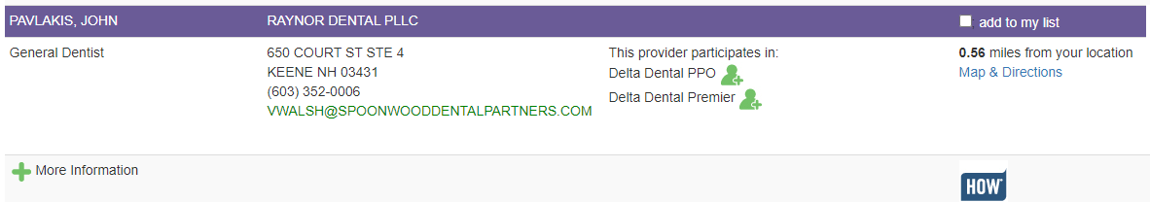
Find A Dentist
To find a dentist in your area, got to: www.nedelta.com
Click the “Find a Dentist” button from the homepage
Choose the Delta Dental PPO or Premier from the Network Selection
Select your location, by address (optional) or zip code
  You may then customize your search by selecting a distance range, dentist name, practice name and/or specialty.
  5. Click “Search” and view your results.

Slide 16
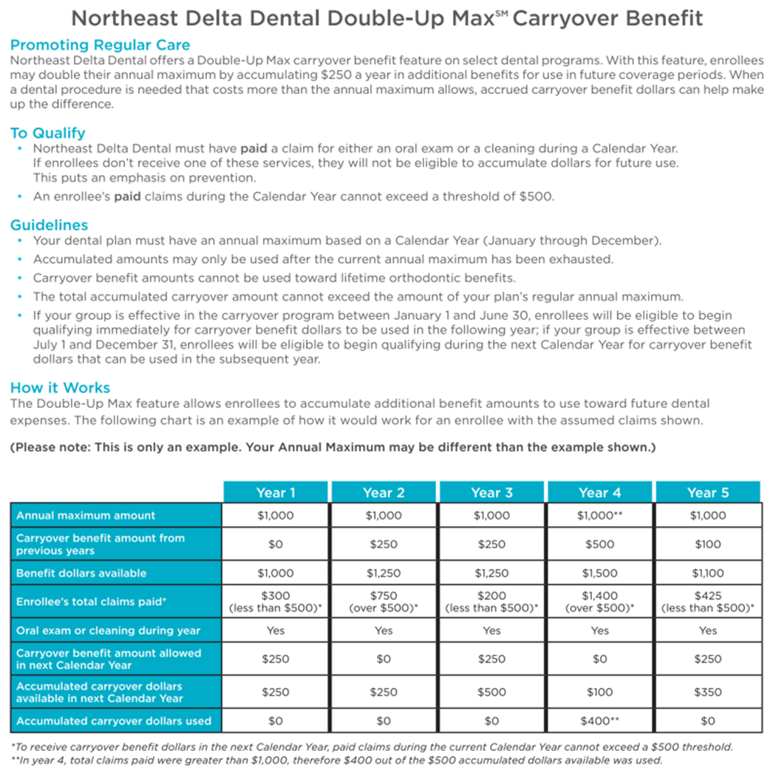
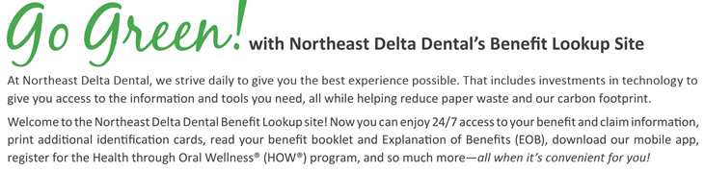
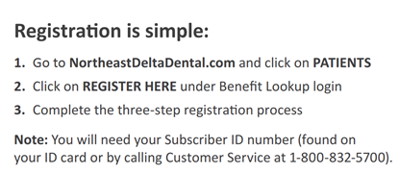
Dental Insurance

Slide 17

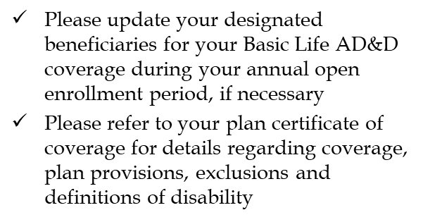

Life, AD&D Disability
MFS provides Life, AD&D & LTD insurance to eligible employees
Basic Life, Accidental Death & Dismemberment (AD&D)
100% Employer Paid
Eligible employees are automatically enrolled
Benefit is 1x annual earnings to a maximum $50,000
Terminally ill employees may receive a partial payment in advance
Coverage ends upon termination of employment or as specified
Please refer to Certificate of Coverage for details
Long Term Disability Insurance
100% Employer Paid
Eligible employees are automatically enrolled
Benefit is 60% of monthly pre-disability earnings, to a maximum of $8,000
Benefits begin 90 days following an accident or sickness
Benefits duration is up to your normal retirement age. If you become disabled at or after age 65, benefits are payable according to an age-based schedule.
Please refer to Certificate of Coverage for details

Slide 18



Financial/Legal EAP
Offered to all Monadnock Family Services employees and their immediate family members at no cost. Employees are automatically enrolled in the program on their date of hire. The EAP is a completely confidential counseling service that assists employees and family members with issues such as depression, grief & loss, substance abuse, dependent care, legal and more.

Slide 19

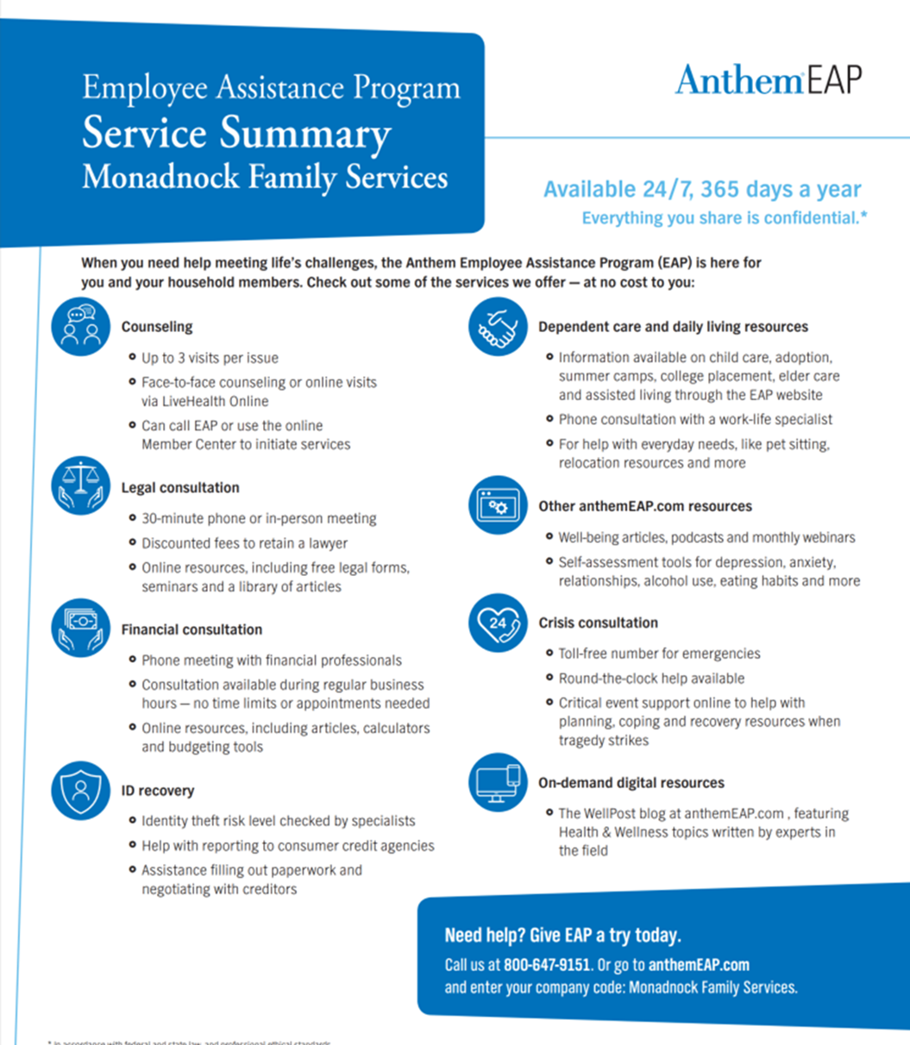
Comprehensive EAP
In addition to Prudential’s financial/legal-related EAP , the service below is offered to all Monadnock Family Services employees and their immediate family members at no cost. Employees are automatically enrolled in the program on their date of hire. The EAP is a completely confidential counseling service that assists employees and family members with issues such as depression, grief & loss, substance abuse, dependent care, legal and more.

Slide 20


64 Main Street Keene NH 03431
www.mfs.org
This Benefits Guide was produced by The Richards Group using information from carrier and MFS produced documents. It is provided for your convenience. Please refer to complete Schedules of Benefits and other official plan documents for details. If there are any discrepancies between information provided in this guide, and information provided in carrier or MFS-produced documents please rely on the latter.

