Slide 1


EastView at Middlebury
2022 Benefits at Glance

Slide 2

Memo
Dear Valued Employee:
You, our employee, are EastView at Middlebury’s most important asset. Our mission to provide a resident centered retirement community that fosters independence and freedom, promotes a high-quality life, and is respectful of and open to all persons depends on you each and every day. We continue to make every attempt to make our company a great place to work. To that end, we strive to provide you with benefits to keep you and your family healthy and safe. Please take the time to review your employee benefit plan, as it is an important part of your overall compensation package.
The following pages describe our package in broad terms. Please contact the Director of Human Resources Chris Donner at 802.989.7601 for more details.
Again, thank you for being a part of EastView at Middlebury.
Sincerely,
Connie Leach
Executive Director EastView at Middlebury
Reminder: Always notify Human Resources if you have a change of address, phone number or would like to update your emergency contacts.

Slide 3







Carrier Contact Information
MVP Health Care – Customer Care Center
1-888-687-6277
www.mvphealthcare.com
HSA Carrier – Customer Service
1-800-539-2968
www.key.com
Delta Dental – Customer Service
1-603-223-1000
www.nedelta.com
Vision Service Provider – Customer Service
1-800-877-7195
www.vsp.com
Mutual of Omaha– Customer Service
Life, Disability & Accident Insurance
1-800-775-6000
www.mutualofomaha.com
Mutual of Omaha– Customer Service
Employee Assistance Program
1-800-775-6000
www.mutualofomaha.com
Mutual of America – Customer Service
Retirement Simple IRA
1-800-468-3785
www.mutualofamerica.com
GradFin: Tuition Assistance
www.gradfin.com/trg.html

Slide 4
Employee Benefit Overview
Eligibility Wording:
Full-time - Employees who work a minimum of 30 hours per week are considered to be full-time. Such full-time employees are eligible for all benefits after applicable requirements for length of service have been met.
Part-time: Part-time employees are regularly scheduled to work less than 30 hours per week. Regular part-time employees are not eligible for EastView’s benefit programs, unless otherwise specified by law.
Per-Diem – These employees are scheduled to work less than 30 hours per week and do not have a set number of hours per pay period. However, Per Diem employees are required to work a minimum of one shift per month in order to qualify as an active employee. Per Diem workers are not eligible for EastView’s benefits.
On-call / Temporary / Seasonal - These individuals are employed by EastView and work either on a temporary or an intermittent basis. This can include interns, college or high school students on academic break looking for short-term work, and other finite direct engagement employment agreements. Temporary engagements generally do not require work more than 20 weeks in a calendar year and are not eligible for EastView’s benefits.
Every effort has been made to ensure the accuracy of the information in this Benefits at a Glance. Plan provisions summarized in this overview contain only highlights. If there is a discrepancy between this overview and the plan documents, the plan documents will govern.
Although EastView at Middlebury intends to continue all benefits in their present form, they reserve the right to amend, suspend, or terminate, in whole or in part, any or all of the plans at any time.
If any changes are made, you will be notified promptly.

Slide 5
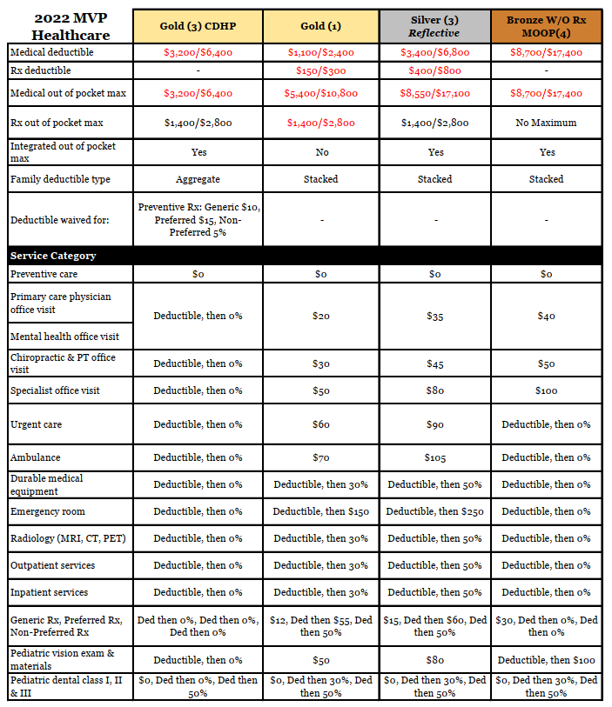
Medical Benefits

Slide 6
Medical Plans Employee Contributions
MVP HDHP Gold 3
Employee Bi-Weekly Cost | EastView Bi-Weekly Cost | Total Monthly Premium
$103.34 | $212.00 | $683.24
$418.68 | $212.00 | $1,366.48
$396.61 | $212.00 | $1,318.65
$674.12 | $212.00 | $1,919.90
Employee Only
Employee + Spouse
Employee + Child(ren)
Employee + Family
MVP COPAY Gold 1
Employee Only
Employee + Spouse
Employee + Child(ren)
Employee + Family
$95.64 | $212.00 | $666.54
$403.27 | $212.00 | $1,333.08
$381.73 | $212.00 | $1,286.42
$652.45 | $212.00 | $1,872.98
MVP COPAY Silver 3
Employee Only
Employee + Spouse
Employee + Child(ren)
Employee + Family
$67.80 | $212.00 | $606.23
$347.60 | $212.00 | $1,212.46
$328.01 | $212.00 | $1,170.02
$574.24 | $212.00 | $1,703.51
MVP COPAY Bronze 4
Employee Only
Employee + Spouse
Employee + Child(ren)
Employee + Family
$33.02 | $212.00 | $530.88
$278.04 | $212.00 | $1,061.76
$260.89 | $212.00 | $1,024.60
$476.51 | $212.00 | $1,491.77
Contributions are based on per pay period for employees who are eligible for benefits

Slide 7
Health Savings Account (HSA)
The Health Savings Account allows you to put aside up to $3,650 for an individual or $7,300 for a family per year tax free. You can use the account to pay for medical, dental and vision expenses not covered by an insurance plan. The expenses can be for you, your spouse, and/or your eligible dependents.
A reimbursement account is a way to put money aside tax free to be reimbursed to you when you have eligible healthcare and/or dependent expenses.
See below for a list of qualified HSA Expenses.
• Acupuncture
• Alcoholism treatment
• Ambulance
• Birth control
• Body scans
• Braille books and magazines
• Breast pumps and lactation supplies
• Chiropractor
• Co-insurance (medical, dental or vision)
• Copayments
• Crutches or canes
• Deductibles
• Diabetic supplies
• Diagnostic services
• Drug addiction treatment
• Fertility enhancements
• Guide dogs or other service animals
• Hearing aids and batteries
• Hospital services
• Insulin
• Insurance premiums for COBRA coverage
• Laboratory fees
• Learning disability treatments
• Mastectomy-related special bras
• Medical equipment and repairs
• Medical monitoring and testing devices
• Medical supplies
• OB/GYN
• Office visits
• Oxygen
• Physical exams
• Physical therapy
• Pregnancy tests (over-the-counter)
• Prescription drugs
• Prosthesis
• Psychiatric care
• Reconstructive surgery following
• mastectomy
• Smoking cessation (programs/drugs)
• Speech therapy
• Surgery
• Transportation, parking and related travel
expenses (essential to receive medical care; subject to IRS limits)
• Vaccinations
• Vasectomy
• Weight loss program and/or drugs (if
prescribed by a physician to treat a specific
medical condition)
• Wheelchair
• X-ray fees
• Braces
• Dentures
• Exams
• Extractions
• Fillings
• X-rays

Slide 8

Dental Coverage
Copay |  | $20 per Office Visit
Outline of Covered Services |  | In Network Benefits
Coverage A Diagnostic/Preventative | Diagnostic: Evaluations: 2 in a 12‐month period, Includes: periodic, limited, problem‐focused & comprehensive evaluations. X‐rays: complete series or panoramic film once in a 5‐year period, Bitewing X‐rays once in a 12 month period, X‐rays of individual teeth as needed Brush biopsy once in a 12‐month period Preventative: Cleanings: 2 in a 12‐month period under the Buy‐Down and Basic options; 4 in a 12‐month period under the Enhanced option Fluoride treatment: once in a 12‐month period to age 19 Space maintainers to age 16 Sealant application to permanent molars, once in a 3‐year period per tooth, for children to age 19 | 100% (No Deductible)
Coverage B Basic | Restorative: Amalgam (silver) fillings, Composite (white) fillings Oral Surgery: Surgical and routine extractions Endodontics: Root canal therapy Periodontics: Periodontal Maintenance (Cleaning) – 2 in a 12‐month period under the Buy‐Down and Basic options; 4 in a 12‐month period under the Enhanced option | 60% (Basic Plan) 70% (Preferred Plus Plan) No Waiting Period
Coverage C Major | Prosthodontics: Removable and fixed partial dentures (bridge); complete dentures, Rebase and reline (dentures) Crowns- Onlays- Implants | 50% (6 Month waiting period)
Coverage D | Orthodontics: Correction of crooked teeth for children & adults | 50% (6 month waiting period)
 | Orthodontic Lifetime Maximum (per person) | $1,000 per person (Basic Plan) $1,250 (Preferred Plus Plan)
Annual Max For Per Person |  | $1,000 (up to $2,000) person/calendar year (Basic Plan) $1,500 (up to $3,000) person/calendar year (Preferred Plus Plan)
One Time Deductible per Person/Family (Coverage B and C only) |  | $50/$150 (Basic Plan) $75/$225 (Preferred Plan Plus)

Slide 9

Dental Plan Contributions
Basic Plus Plan
Employee Bi-Weekly Cost | EastView Bi-Weekly Cost | Total Monthly Premium
$1.96 | $11.54 | $29.25
$13.19 | $11.54 | $53.58
$32.18 | $11.54 | $94.72
Employee Only
Employee + 1
Employee + Family
Preferred Plus Plan
Employee Bi-Weekly Cost | EastView Bi-Weekly Cost | Total Monthly Premium
$4.03 | $11.54 | $33.73
$16.97 | $11.54 | $61.77
$38.41 | $11.54 | $108.22
Employee Only
Employee + 1
Employee + Family
Contributions are based on per pay period for employees who are eligible for benefits

Slide 10

Vision Service Plan
Benefit | In Network | Out of Network | Frequency | Benefit Allowance
Annual Eye Exam | Covered in Full | Reimbursed up to $45 | Every 12 Months | N/A
Contact Exam | Up to $60 copay | NA | Every 12 months | N/A
Prescription Glasses | $25 copay |  | See frame & lenses | N/A
Lenses | Covered in Full
Single Vision | Covered in Full | Reimbursed up to $30 | Every 12 months | N/A
Bifocal | Covered in Full | Reimbursed up to $50 | Every 12 months | N/A
Frames | Included in Prescription Glasses copay | Reimbursed up to $70 | Every 12 months | $124 allowance $150 allowance for featured frame brand
Contacts | Elective – Covered in full up to Lens Allowance Necessary – Covered in full after Co-Pay | Reimbursed up to $105 | Every 12 months | $124 allowance
Employee BI-Weekly Cost | EastView Bi-Weekly Cost | Total Monthly Premium
$2.55 | $2.77 | $11.52
$5.74 | $2.77 | $18.43
$11.23 | $2.77 | $30.34
Employee Only
Employee + 1
Employee + Family
Contributions are based on per pay period for employees eligible for benefits

Slide 11

Short & Long Term Disability
EastView is pleased to announce that we have negotiated and moved our Lie & Disability Benefits to Mutual of Omaha for the 2022 year.
Short Term Disability
Benefit Information
Employee Contribution | NONE (Employer pays 100% of premium
Benefit Waiting Period | NA
Sickness | 14 days
Injury | 14 days
Weekly Benefit | 60%
Weekly Benefit Maximum | $1,000
Duration | 24 weeks
Long Term Disability
Benefit Information
Employee Contribution | NONE (Employer pays 100% of premium
Benefit Schedule | 60% of your pre-disability income Payments continue as long as you qualify as disabled under the terms of the policy, up to your retirement date or Social Security Normal retirement Age, whichever comes sooner
Benefit Monthly Maximum | $5,000
Waiting Period | 180 Days
Duration | 24 months

Slide 12
Life & AD&D Insurance
Basic Life & Accidental Death & Dismemberment
Employee Contribution | NONE (Employer pays 100% of premium)
Maximum Life Benefit | $100,000
Benefit | 1x your basic annual earning, rounded to the highest $1,000 Life Benefit reduces to: 35% at age 70; and Additional 15% at age 70
NEW!!! Accident Insurance
For 2022 EastView at Middlebury will be offering a 100% Voluntary Benefit with Mutual of Omaha for Accident Insurance.
Accident insurance pays a lump-sum cash benefit for covered injuries employees or an insured family member sustains as a result of an accident (as defined by the policy). Because accident insurance is supplemental, it works in addition to other insurance you may have.
The cash benefit from accident insurance can be used to:
Pay for out-of-pocket medical expenses
Supplement daily living expenses
Cover lost income from unpaid time off
Tier of Coverage | Employee Bi-Weekly Cost
Employee Only | $6.78
Employee + Spouse | $11.14
Employee + Child(ren) | $14.01
Employee + Family | $19.39
Employee Contribution | NONE (Employer pays 100% of premium)
Maximum Life Benefit | $100,000
Benefit | 1x your basic annual earning, rounded to the highest $1,000 Life Benefit reduces to: 35% at age 70; and Additional 15% at age 70

Slide 13

Retirement & Tuition Reimbursement
SIMPLE IRA (Mutual of America)
The SIMPLE IRA Plan is a particularly valuable supplement to our other employee benefits. Through payroll savings, you may set aside pre-tax dollars for savings and investment purpos­es.
When you join the SIMPLE IRA Plan, you will be participating in a Plan that combines varying portfolios with different goals and the freedom to change your investment selection as often as once per month.
When you enroll in the Plan, you will be given infor­mation explaining the plan and the investment portfolios. Review it carefully and direct any questions to the Plan Administrator or Human Resources.
Informational meetings are provided periodically throughout the year. We encourage employees to take advantage of these meetings.
Eligibility -You must be 18 years of age and have worked sixty (60) days prior to joining the Plan.
Employee Contributions - You may change the amount of your payroll deduction and choose to stop contributions at any time.
Company Contributions - EastView matches $1 for $1 of your contributions up to 3% of your annual salary. The company match is deposited with your contributions bi-weekly and is invested based on your investment choices.
Vesting - Deferrals made to the SIMPLE IRA Plan through the employee’s payroll deductions are always 100% vested. The Company’s match is also 100% vested. Any rollover contributions are also 100% vested.
GradFin
GradFIN will provide:
One-on-one education consultations with GradFin Consultation Experts to review your current loan status and discuss personalized payoff options to save on your loans.
GradFin will offer a competitive interest rate reduction when you refinance your loans.
GradFin will provide up to a $300 bonus to you when you refinance your loans with GradFin. The $300 bonus will be applied to the principal balance of the closed loan.
GradFin will offer the lowest interest rates in the industry through their lending platform which is made up of ten lenders to maximize the chances that you will be approved for a new loan.
For more information or to schedule a one-on-one consultation visit:
www.gradfin.com/trg.html

Slide 14


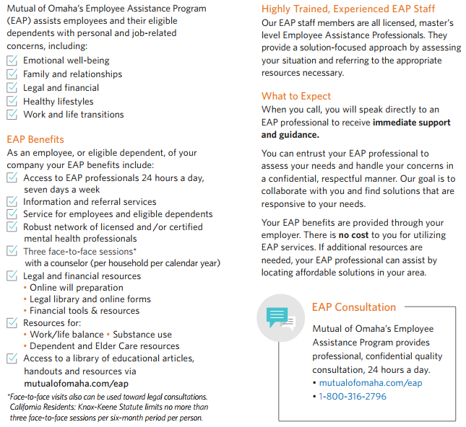
Employee Assistance Program

Slide 15
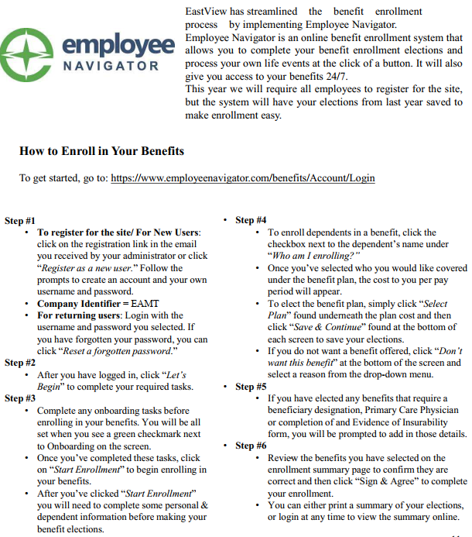

Employee Navigator
Employee Benefits Center (EBC)
The EBC is your online employee benefits center. The EBC is a one-stop resource which provides you with up to date benefit information, benefit summary plan documents, forms and contact information for each carrier.
To log into the EBC directly go to: http://eastview.trgportal.com/

Slide 16


