Slide 1
2022 Open Enrollment
Aspire Living & Learning

Slide 2
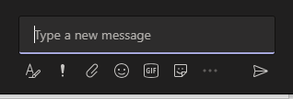
About today’s technology
We are using
Microsoft Teams
To raise your hand virtually and alert the presenter you have a question
To make the ‘chat box’ appear in the lower right corner to type a question or comment
To mute or unmute your audio
To show yourself on by camera

Slide 3
Today we will cover
Open Enrollment
Online Enrollment
What’s not changing for 2022?
Employee Benefit Center
Questions?
*NEW* Pet Insurance

Slide 4
Open Enrollment
Open enrollment is your opportunity to make changes to your benefit elections:
Enroll, drop, or change plans
Enroll or drop dependents
Update beneficiary information
Determine Flex Spending amounts
Outside of open enrollment, you must have a qualified event to make changes to your coverage.

Slide 5
Online Enrollment
This year plan elections will be made in
November 1st to November 16th
Open enrollment will be ACTIVE, meaning you MUST make plan elections in Ultipro for:
MEDICAL
DENTAL
FLEXIBLE SPENDING
*NEW* PET INSURANCE
The ONLY coverage that will roll to 2022 is Voluntary Life, Accident and Critical Illness.
If you do not make elections in Ultipro you will not have coverage in 2022.
Getting started: log into UltiPro and select Menu >> Myself >> Open Enrollment

Slide 6
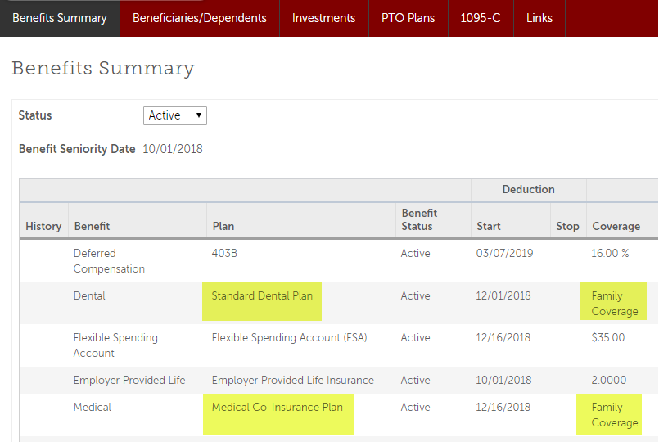
What’s my current coverage?
Navigate to Myself >> Benefits >> Benefits Summary
Check both Plan and Coverage options. In this example, the Standard Dental and Medical Co-Insurance plans are active – both with Family Coverage

Slide 7
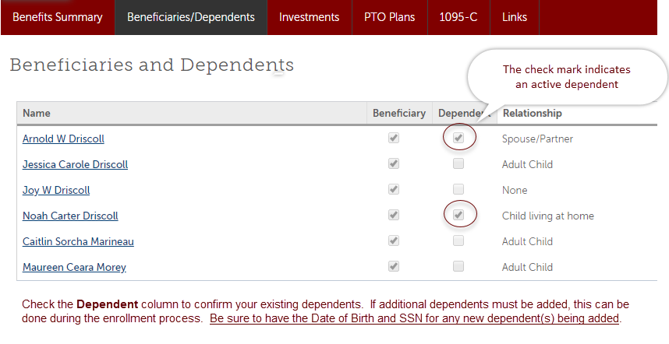
Who are my active dependents?
Navigate to Myself >> Benefits >> Beneficiaries/Dependents
Check the Dependent column to confirm your existing dependents. If additional dependents must be added, this can be done during the enrollment process. Date of Birth and SSN are required when adding new dependents.

Slide 8
What’s not changing??
Vision still part of your Cigna medical plan coverage.
Dental plans and rates not changing
Cigna plan designs not changing
Voluntary Life, Accident, Critical Illness plans and rates not changing

Slide 9
Nationwide Pet Insurance
Coverage available on Dogs ~ Cats ~Birds ~ Exotic Pets
Two Plan Options
Rates determined by
Breed
Age
Species
Plan Selected
State of residence
Premiums paid through payroll deduction.
Use your own veterinarian.
Enroll in Ultipro.
See Employee Benefit Center for more details or contact Nationwide at 877-738-7874 or at https://benefits.petinsurance.com/allinc .
NEW!
Dogs Cats Amphibians Birds Chameleons Chinchillas Ferrets Geckos Gerbils Guinea pigs Hamsters Iguanas Lizards Mice Rats Rabbits Snakes Tortoises Turtles

Slide 10
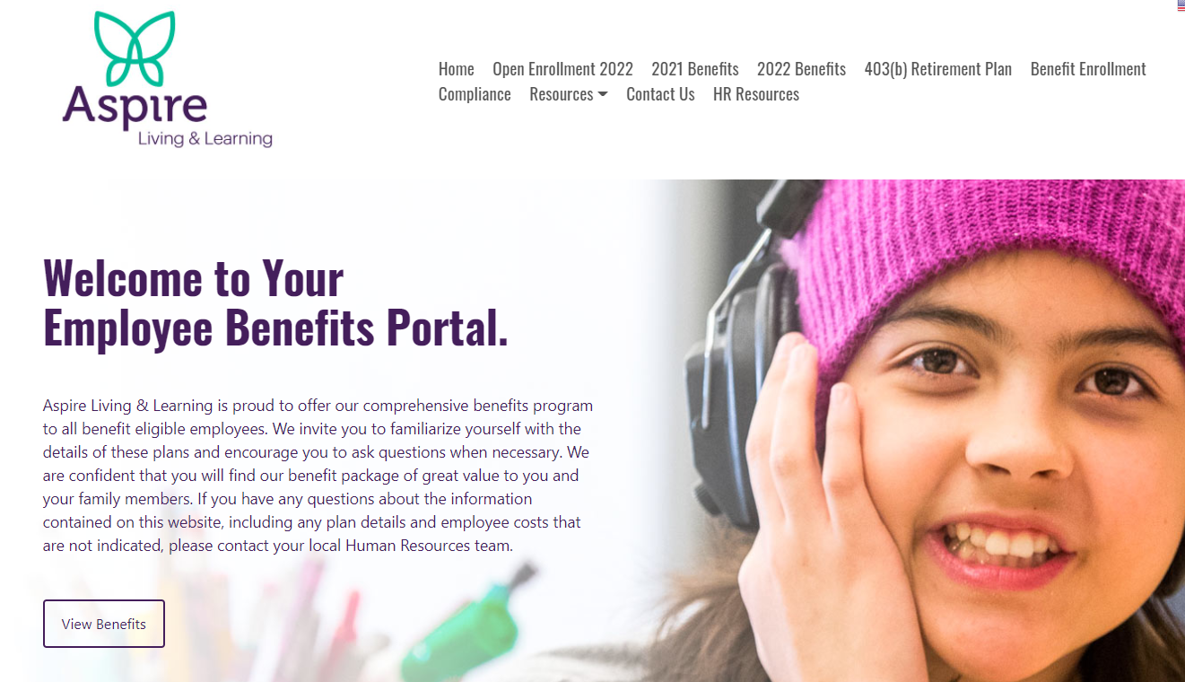
Employee Benefit Center (EBC)
A look at the EBC!
The EBC is your online source for Aspire Living & Learning’s benefit information.
Visit the EBC for information about plan designs, rates, forms and plan documents:
Electronic version of Benefits at a Glance booklet
Links to carrier websites and tools
Link to the Ultipro enrollment site
View current (2021) and new (2022) information
Visit the Employee Benefit Center at www.aspirebenefits.trgportal.com

Slide 11
Remember!
“How to Enroll in Your 2022 Benefits” video on the Employee Benefit Center!
Open Enrollment is in
Elections can be made between November 1st and November 16th
Open Enrollment is ACTIVE, meaning you MUST make plan elections to have coverage in 2022
Visit the Employee Benefit Center at www.aspirebenefits.trgportal.com

Slide 12
Questions?

