Slide 1

2021 Review &
Planning Meeting
May 5, 2021

Slide 2

Agenda
Navigate to Virtual Binder tab
YTD Plan Report- March last data on file
2020 Financial Analysis
Open Enrollment & Demographics
Strategy & Benefits Climate
Business Associate Agreement (BAA) & 2021 Advisory Agreement
Discussion
This Photo by Unknown Author is licensed under CC BY-SA

Slide 3





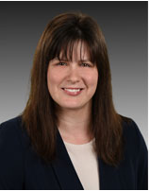


Your Account Management Team
Tom Scull
Vice President
tscull@therichardsgrp.com
P: (802) 251-3839
C: (802) 233-2071
John Round
Principal
jround@therichardsgrp.com
P: (603) 357-2707
Caitlin Caulfield
Sr. Account Manager
ccaulfield@therichardsgrp.com
P: (802) 251-3775
C: (603) 209-5859
Amanda Normand
Account Manager
anormand@therichardsgrp.com
(802) 251-1863
Jackie Brady
Sr. Account Executive
jbrady@therichardsgrp.com
P: (802) 251-3814
C: (802) 451-9559
Your Special Operations Team
Ross Gibson
Chief of Operations
Leadership & Organizational Dev. Facilitator
rgibson@therichardsgrp.com
P: (802) 451-6445
Lindsay Simpson
Organizational Wellness Lead
lsimpson@therichardsgrp.com
P: (802) 251-3803

Slide 4
Financial Analysis
Total Aspire Cost
Year to Year Cost Change
Per Employee Per Year Cost History
High-Cost Claimant Analysis
Stop Loss
2020 Financials

Slide 5
T
Financial Analysis
Total $7,421,419
Net employee contributions
Total: $7,147,691
Total: $7,421,419
Overall increase +3.8% 2019 to 2020; increase medical, decline vision, dental

Slide 6
Financial Analysis
T
Total $7,811,591
Pre-employee contributions
(true utilization, not cost to Aspire)
Total $7,299,091
Total $7,811,591
7% increase in medical plan but both 2019 and 2020 below expected

Slide 7
kk
Financial Analysis
Total Gross Claims= $7,227,950
Total: $6,747,159

Slide 8
Financial Analysis
kk
Good value from stop loss premium paid in 2020
Dividend Calculation
Experience refund is 25% of net profit. Net Profit= 60% of premium minus specific claims paid:
Premium $1,119,946
60% $618,000
Reimbursements: $816,456
Refund: -$144,488
No 2020 stop loss dividend

Slide 9
Financial Analysis
*
*July 2017 to Dec. 2017 annualized
2020 slightly below 2016/2017

Slide 10
Financial Analysis
2017: short plan year
2018: transitional year, CBA runout and up-front termination admin costs
*claims net stop loss
2020 Where is Covid decline? Masked by high-cost claimant activity.

Slide 11
Financial Analysis
Costs are gross medical claims only; no Rx and pre- stop loss reimbursements
2018 data is immature for both plans

Slide 12
Financial Analysis
High Cost Claimant Analysis | July 2018 to June 2019 | July 2019 to Dec 2019 (6 mo.) | 2020
Claimants with over $50,000 in claims | 15 | 9 | 30
Employee # | 8 | 8 | 19
Dependent # | 7 | 1 | 11
Total Cost of claimants over $50K | $1,603,240 | $929,024 | $3,171,194
Employee $ | $634,994 | $872,427 | $2,120,115
Dependent $ | $968,246 | $56,597 | $1,051,079
Top 5 | 1. $297,733 | 1. $281,877 | 1. $613,966
 | 2. $161,696 | 2. $129,783 | 2. $206,759
 | 3. $126,820 | 3. $110,745 | 3. $177,455
 | 4. $124,122 | 4. $98,734 | 4. $151,904
 | 5. $123,269 | 5. $69,682 | 5. $125,390
Total $ over $25,000 | $2,889,582 (51) | $1,409,810 (28) | $4,102,180(72)
2020= Extremely high frequency
2020: 8 claimants over $100,000 specific

Slide 13
Cigna Virtual Care - Medical
Utilization not huge, but double last year!
Aspire Virtual Care
Top ICD visits per 1,000
Member user information
User
Non-user
16
Percent Unique Users
2.4%
97.6%
Average Age
40.1
34.2
12
% User with a primary care office visit
56.1%
53.1%
8
4
Gender Distribution
% Male
19.9%
43.0%
0
Skin
Infectious/ Parasitic
Ear, Nose, Throat
General Medical
Other
Male Average Age
35.9
33.8
Male Average Enrollment (member mths)
10.5
10.3
Base
2
2
4
1
10
% Female
80.1%
57.0%
Current
9
6
4
4
15
Female Average Age
41.1
34.5
Female Average Enrollment (member mths)
10.6
9.9
Virtual Care- Medical Visit detail
Office visit opportunities and savings
Base
Current
1 Visit
2 Visits
3+ Visits
1 Visit
2 Visits
3+ Visits
Cost per visit
Current
MDLive
Employees
10
0
0
19
5
2
Average Office visit cost
$176
Spouses
1
0
0
2
0
0
Average ER Steerable visit cost
$773
Dependents
0
0
0
1
0
0
Virtual Care- Medical cost per visit
$55
AmWell
Employees
1
0
1
0
1
0
Opportunity Redirect Savings
Current
Spouses
2
0
0
0
0
0
Number of Office Visits Eligible for Virtual Care- Medical
1,042
Dependents
1
1
0
1
0
0
10% Redirect to Virtual Care- Medical
$12,608
Total
Employees
11
0
1
19
6
2
25% Redirect to Virtual Care- Medical
$31,521
2019:
20
$2,580
Spouses
3
0
0
2
0
0
Savings from Virtual Care- Medical vs. Office Visit
Current
Dependents
1
1
0
2
0
0
Number of Virtual Care- Medical Visits instead of Office Visits
42
Total Unique Members
14
1
1
23
6
2
Savings from Virtual Care- Medical Visits vs Office Visits
$5,082
* Cost per visit represents the average cost of both vendors providing service in Cigna’s standard offering
Current Period reflects claims incurred between Jan. 2020 and Dec. 2020, paid through Mar. 2021
Base Period reflects claims incurred between Jan. 2019 and Dec. 2019, paid through Mar. 2021
ASPIRE LIVING & LEARNING, INC.-Request 1150070-View 1492594-RPT_ID 241_BCN-Tier 3
PAGE 1

Slide 14
Open Enrollment
Medical Counts and Trends
Medical Enrollment by Salary
Dental Counts and Trends
FSA/DCA and Reliance Standard Voluntary
Aspire Demographic Profile
1 1 2021 Benefit Changes and Final Increases
1 1 2021 Open Enrollment Results

Slide 15
Open Enrollment
1 1 2021 Benefit Changes and Final Increases
Medical
Projected increase for 2021 -1.42%; +1.46% with conservative assumptions adopted
  Cigna admin fee +3% with rate guarantee to 1 1 2023
  Cigna wellness pledge $20,000
  Included projected Omada costs of $27,300
  Used claims data to March 2020
No plan design changes; added Omada
Rounded payroll contribution increases:
  Coinsurance +$5.50/$10.50/$15.00
  Copay +$5.00/$9.50/$14.00
Stop Loss
Renewed with Optum; negotiated from +16% to +13%
No change to $100,000 specific insurance level
Had budgeted +10% (+$114,500); actual +$148,500
Dental
Projected increase 1.8%
No admin change
No plan design changes; rounded payroll contribution charges +$. 50/$.50/$1.00
Life & Disability- renewed with no increase; rate guarantee to 1 1 2023
Vision- 2 cent pepm admin fee increase

Slide 16

Open Enrollment
Expect more movement to copay plan, closer to benchmark
Both current plans are high value (one platinum, one gold).
Introducing a qualified high deductible health plan would be an opportunity for all income groups: low premium for healthy low wage earners; tax advantaged for high wage earners.
Recalculate design and cost spread between Coinsurance/Copay to encourage movement?
Protected by defined contribution but need to slow access to plan dollars?

Slide 17

Dental:
Self funded w/Delta Dental
Projected 2018 plan costs:
  Using 36 months of data: +9.6%
  No increase in Cigna admin fee (GMHEC rate guarantee)
  Assumed +6.1% trend and +2.5% margin
First full year with Cigna and plan choice
No plan changes; left premium equivalents and employer defined contribution unchanged, no employee rate change
Open Enrollment
Employees still evaluating and choosing
Dental Enrollment Results
4th year self funded with Delta
3rd year of plan choice
“Premium Plan” enrollment increased even with contribution changes
Notes:
2016 – EE contributions = $37,784.24
2017 – EE contributions = $66,066
2016 – NU cost = $319,800
2017 – NU cost = $77,300.76

Slide 18
Open Enrollment
VSP
7.1%Vision:
VSP
7.1% increase
2 y rate guarantee (1/1/2018 thru 12/31/20)
:
VSP
7.1% increase
2 rate guarantee (1/1/2018 thru 12/31/20)
FSA increase unusual; most groups had decline in flex due to COVID uncertainty

Slide 19
Open Enrollment
VSP
7.1%Vision:
VSP
7.1% increase
2 y rate guarantee (1/1/2018 thru 12/31/20)
:
VSP
7.1% increase
2 rate guarantee (1/1/2018 thru 12/31/20)
Move to Reliance Standard
Increase in critical illness common across groups

Slide 20








Demographic profile
Up from $29,252 in 2020
#929
benefits-eligible Employees
0
$30,160
median annual income
2.5 years
median tenure
38
median age
69% Female
gender
INCOME BREAKDOWN
TENURE BREAKDOWN
Very little change
In 2020:
4%
50.8%
29.5%
15.5%
.2%
AGE BREAKDOWN
8.7% GEN z
46.3% MILLENNIALS
30.1% GEN X
14.7% BOOMERS
0.1% Traditionalists

Slide 21
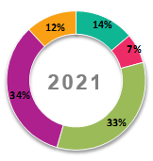
2021 Segmenting your employees cluster preferences
130
Employees
Just Starting
Ages 18 – 26
<2 years of service
Benefits are not a major factor in employment decisions
Typically choose the lowest cost plan to maximize take home pay
Especially value flexibility and choice
67
Employees
Future Loyals
Ages 18 – 26
>2 years of service
Benefits are becoming increasingly important in employment decisions
Typically choose the lowest cost plan to maximize take home pay
Especially value flexibility and choice, as part of a total rewards lens
313
Employees
New Career
Path
Ages 27 – 49
<5 years of service
Benefits can impact employment decisions
Typically choose the plan that best fits the needs of the family
Have disposable income, but need to save where possible
314
Employees
Long-Term Loyals
Age 27+
5+ years of service
Benefits play a role in decision to stay or leave
Typically choose the plan that can help maintain health and minimize disruption
Often can manage short-term risk, but have lots of competing expenses
105
Employees
Late Career Transitions
Age 50+
<5 years of service
Looking to protect/maximize benefits to help bridge time to retirement
Not sure how to pay for healthcare in retirement or what supplemental coverage is needed
Want to know how to make the most of savings
Identify “natural groups” or “segments” or “clusters” in the workforce that can be targeted in customized, tailored ways to improve the experience and increase engagement

Slide 22
Strategy & Planning
Vendor Contact Terms
2021 RFPs
2021 Initiatives
Compliance Update
COVID-19
Strategy & Planning

Slide 23

Political Update
ALE’s are here to stay!
An Applicable Large Employer (ALE) is defined as: any company or organization that has an average of at least 50 full-time employees or "full-time equivalents" or "FTE." For the purposes of the Affordable Care Act, a full-time employee is someone who works at least 30 hours a week.
ALEs will still be offering health care to employees under the Biden Administration.
Coverage will still need to be deemed “affordable” and “minimal essential coverage” going forward.
Benefits will also continue to be a main asset to employers as a way to attract and retain employees.
Small employers may see some relief from the Public Option, but it is still too early to tell what will happen.
President Biden's Health Care Agenda
Expanded ACA
Offering a Public Option to Private Markets
Expanding Medicare eligibility
Expand Medicaid at the state level
Larger Tax Credits on the Exchange w/expanded eligibility
Reducing Drug Pricing
Increasing pricing transparency
Expanding mental health care access
This Photo by Unknown Author is licensed under CC BY-SA

Slide 24
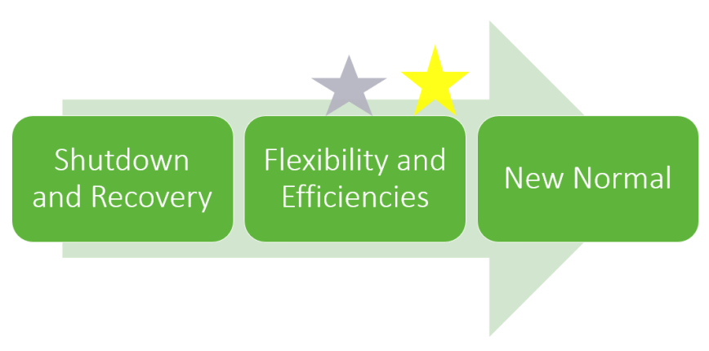
COVID 19
TRG COVID-19 Vaccine Information Page
https://therichardsgrp.com/covid19-vaccinations
  NH Rollout Plan for COVID Vaccines
  VT Rollout Plan for COVID Vaccines
  Vaccine Tracker
TRG Webinar (recording available): “Legal Updates and Considerations for Employee Wellness and COVID Management in the Workplace”

Slide 25

COVID 19
5 HR Trends to Watch in 2021
Employee well-being
  COVID-19 has changed the perception of what qualifies as a ‘safe & healthy’ work environment.
Greater inclusivity
  2020 also aimed the spotlight at racial inequity, prompting many businesses to commit to more diverse representation in their employee population.
Expanded remote work
  Large numbers of employers will likely continue to offer remote work opportunities, allowing for greater hiring flexibility and expanded talent pools..
Increased employee monitoring
  As work goes remote long-term, employers will need to weigh the need to manage workers against the consequences of infringing on employee privacy
Reimagined onboarding
  This critical process of hiring, training and welcoming new employees into an organization is one of the most important functions of HR. What was once a series of carefully outlined in-person meetings will likely continue to adapt.
COVID-19 affected nearly every workplace function last year, and that influence will linger into 2021 and beyond. Entire functions are being reimagined and reevaluated. Employers will need to adapt quickly if they want to compete in this innovative landscape.

Slide 26

COVID 19
EEOC issues FAQ’s on Mandatory Vaccinations for COVID-19
The Equal Employment Opportunity Commission (EEOC) recently added nine new answers to frequently asked questions (FAQs) to its existing guidance on how employers should comply with the Americans with Disabilities Act (ADA) and other fair employment laws while also observing all applicable emergency workplace safety guidelines during the coronavirus (COVID-19) pandemic.
Guidance for Employers
The new FAQs address mandatory workplace vaccination programs and the restrictions that federal fair employment laws place on them. In general, employers may require employees to receive COVID-19 vaccinations as long as they provide reasonable accommodations for employees who refuse to take the vaccine for medical or religious reasons.
The EEOC’s new FAQs generally clarify, among other things, that:
Employers may require employees to receive COVID-19 vaccinations;
Employers that require vaccinations may need to provide accommodations, or show that an unvaccinated employee would pose a direct threat;
Vaccination-related questions from employers must be job-related and consistent with business necessity; and
Any medical information obtained in the course of a vaccination program must be kept confidential.
Employers with 15 or more employees should become familiar with and follow the guidance provided in all of the EEOC’s FAQs about ADA compliance, and employers should ensure that they comply with state and local anti-discrimination laws as well.
While the COVID-19 vaccine is not yet available to the general public, employers should begin to plan for when there is broader access.

Slide 27
COVID 19
Consolidated Appropriations Act (CAA)
December 2020
On Dec. 27, 2020, President Trump signed the Consolidated Appropriations Act of 2021 into law. The Act provides temporary special rules for health and dependent care flexible spending accounts (FSAs) that give employees additional time to use these funds.
Extended Periods
Because of the COVID-19 pandemic, employees may be more likely to have unused amounts in health or dependent care FSAs. For plan years ending in 2020 and 2021, the Act allows employers to:
Permit employees to carry over unused amounts remaining in these FSAs to the next plan year.
Extend the grace period to 12 months after the end of such plan year.
Permit employees who cease plan participation during 2020 or 2021 to continue to receive reimbursements from unused amounts through the end of the plan year in which their participation ended.
The Act also includes a special carry forward rule for dependent care FSAs where the dependent aged out during the pandemic. For purposes of determining dependent care assistance that may be paid or reimbursed, the maximum age is increased from 13 to 14 years of age.
Change in Election Amounts
Employees are also able to elect to prospectively modify the amount of their FSA contributions for plan years ending in 2021, even if they have not experienced a change in status. However, the applicable dollar limitations will continue to apply.

Slide 28
COVID 19
American Rescue Plan Act (ARPA)
March 2021
President Biden capped the first major legislative victory of his administration by signing off on a sweeping $1.9 trillion COVID package meant to infuse a host of economic relief measures into the economy. But the American Rescue Plan (Public law 117-2) is more than stimulus payments and jobless benefits, it also includes a litany of provisions with direct implications for employee benefit plan sponsors. The enactment – which comes exactly twelve months after the virus was a declared a health emergency – brings the total price tag of pandemic related spending to about $5.4 trillion since last March.
Key employee benefit policy provisions include:
Dependent Care Account increases
COBRA subsidies
Paid Sick and Family Leave
Emergency Paid Sick Leave

Slide 29
Strategy & Planning
Line of Coverage | Vendor | Funding | Next Renewal Date | Last RFP Performed | RFP for 2020?
Medical | Cigna | Self Funded | 1/1/2022 | Fall 2017 | N
Rx | Cigna | Self Funded | 1/1/2022 | 2019 | N
Stop Loss | Optum | Insured | 1/1/2022 | 2020 | every year
Dental | Delta Dental | Self Funded | 1/1/2022 | 2017 | N
Vision | Cigna | Self Funded | 1/1/2023 | 2017 | N
Life & Disability | Reliance Standard | Insured; STD self | 1/1/2023 | 2017 | N
Critical Illness & Accident | Reliance Standard | Insured | ongoing | 2017 | N
FSA/DCA | Streamline | N/A | 1/1/2022 | 2017 | N

Slide 30
Strategy & Planning
2021 Goals & Open Items
Your needs and priorities?
Revisit adding High Deductible Health Plan as third plan
Increase plan value spread between Copay and Coinsurance plans & contributions
Index plan out-of-pocket maximums
Medicare Seminar
Total Compensation Statements
Ross Gibson Leadership & management Development- 8 hours included in consulting arrangement
Wellness engagement
  Cigna Wellness $20,000
  Keep promoting Omada – great results so far
  Activities informed by claims data
  Explore wellness platform?
Data Warehouse analytics and identify informed plan changes
Ongoing:
  Budgeting, modeling for 2022 w/review of benchmarks
  Updates & planning for Health Care Reform/ACA developments/Covid
  Ongoing compliance (5500’s, SPD wrap, ACA, Non-Discrimination Testing)

Slide 31
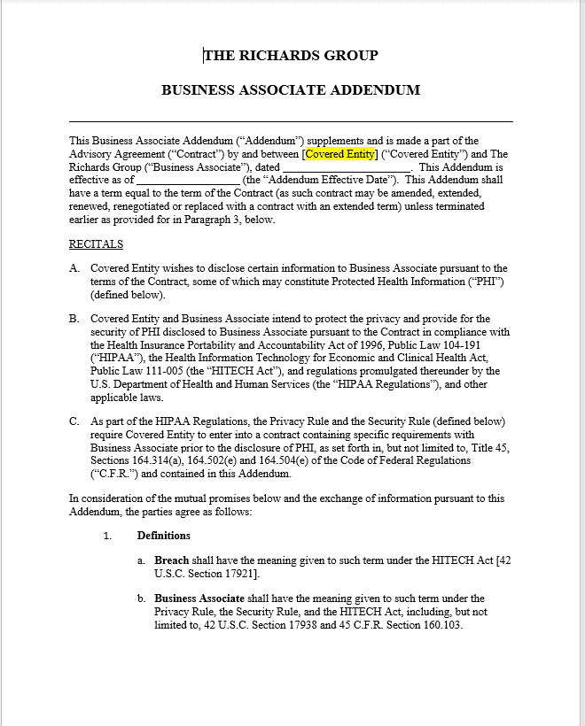
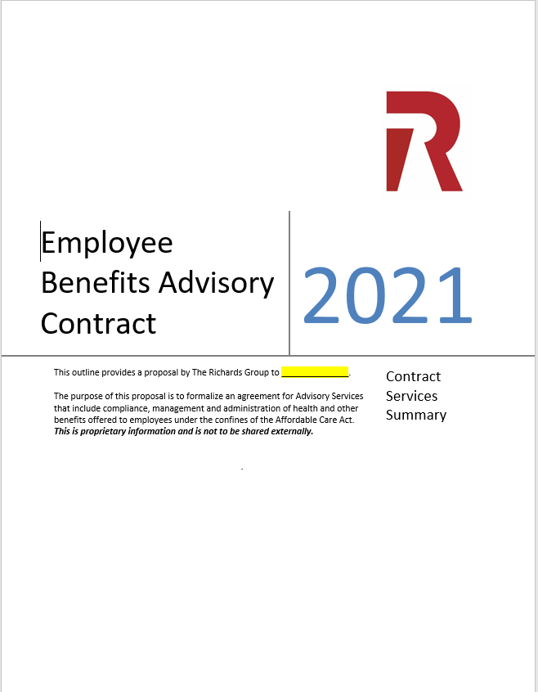
Compliance
* Not
HIPAA Privacy Officers:
Who is the current Brattleboro Retreat Privacy officer?
Notes:
Annually we update our Business Associate Agreement – can send that over after the call
Updated Consulting Agreement will also be sent over for review and signature

Slide 32

Your Account Management Team:
Tom Scull, Managing Principal/ tscull@therichardsgrp.com
Jackie Brady, Sr. Account Executive/ jbrady@therichardsgrp.com
Caitlin Caulfield, Sr. Account Manager/ ccaulfield@therichardsgrp.com
Amanda Normand, Account Manager/ anormand@therichardsgrp.com
Questions/ Comments?

