Slide 1


2020 - 2021
Employee Health & Wellness Guide
Medical | Dental | Life | Disability | FSA | DCA | EAP
768 Route 10 Gilsum NH 03448
www.badgerbalm.com

Slide 2
Health & Wellness Benefits
Nothing is more important to you and your loved ones than good health. That’s why at W.S. Badger we are committed to a comprehensive employee benefit program that helps our employees stay healthy & feel secure.
Stay Healthy
Health Insurance
Health Reimbursement Arrangement (HRA)
Health Savings Account (HSA)
Pre-Tax Flexible Spending Account (FSA)
Dental Insurance
Wellness Fund
Feel Secure
Life Insurance
Short Term Disability
Long Term Disability
Employee Assistance Program
Benefit Plan Overview

Slide 3







Contact Information
Contact Information

Slide 4

Health Insurance
Health Insurance Oct 1, 2020 – Sept 30, 2021
Cigna HRA Open Access Plus Plan
Health Insurance

Slide 5
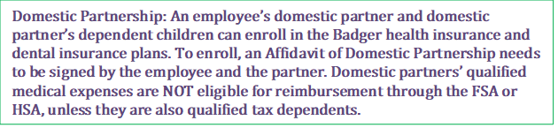
Health Insurance
Who is Eligible and When?
All regular full-time employees working 30+ hours a week are eligible to enroll in health insurance. Eligibility for newly hired employees is the 1st of the month following 30 days of full-time employment. Current, eligible employees who have elected to waive coverage are able to enroll during Open Enrollment. Only if they experience a qualifying event (including losing coverage elsewhere, getting married, having a baby) are they able to enroll outside of the open enrollment period.
Waiving or Declining Health Insurance
If you are eligible for health insurance and will not be enrolling because of alternative coverage, or choose not to have insurance, a waiver form must be signed during the enrollment period. If you elect not to enroll, you may not join the plan until the next enrollment period, October 1, 2021, unless there is a “qualifying event.” See W.S. Badger HR for more information about qualifying events.
Health Insurance

Slide 6
Health Insurance
All employees should be aware of possible Federal tax penalties for declining Badger’s health insurance plan enrollment, as well as alternatives for health insurance available through the Health Insurance Exchange. For more information about declining health insurance, see: https://www.healthcare.gov/get-coverage/ and http://www.valuepenguin.com/ppaca/exchanges/nh.
What happens if I leave Badger?
Under certain circumstances, you and your dependents may continue to participate in health coverage, dental insurance, and the Medical Flexible Spending Account through the Consolidated Omnibus Budget Reconciliation Act. COBRA is a federal guarantee of the continuation of health insurance plan coverage after employment ends, which allows you to remain on medical and dental coverage, at the employee’s expense, for up to 18 or 36 months, depending on the circumstances. Former employees who enroll via COBRA will be responsible for the full cost of the monthly premiums.
Health Insurance
How do I enroll?
During Open Enrollment, September 2020, your health insurance enrollment must be completed through your ADP password-protected webpage.
Newly hired, regular full-time employees will enroll for health insurance benefits during the new employee orientation period. Eligibility begins the 1st day of the month, following the 30th day of employment.

Slide 7
Preventive Care
With W. S. Badger’s health insurance plan, Preventive Care services should be covered in full.
Preventive Care is care you receive when you are healthy and symptom-free, such as routine check-ups, screenings and immunizations.
Diagnosis & treatment are different from preventive care. They involve testing or treatment for a symptom or health issue you already have, such as an existing illness or injury. When a health care provider takes steps to diagnose or treat your health condition, the charges will be subject to you will be responsible for the Member Cost Sharing as stated in your plan.
For a list of services that should be considered based on your age and gender see: https://www.healthcare.gov/what-are-my-preventive-care-benefits
In addition to coverage for Preventive Services, your plan includes coverage for certain Preventive Rx and supplies.
Generally speaking, preventive medications are used to prevent conditions like high blood pressure, high cholesterol, diabetes, asthma, osteoporosis, heart attack, stroke and prenatal nutrient deficiency. For a sample list, please see page 6.
Health Insurance

Slide 8

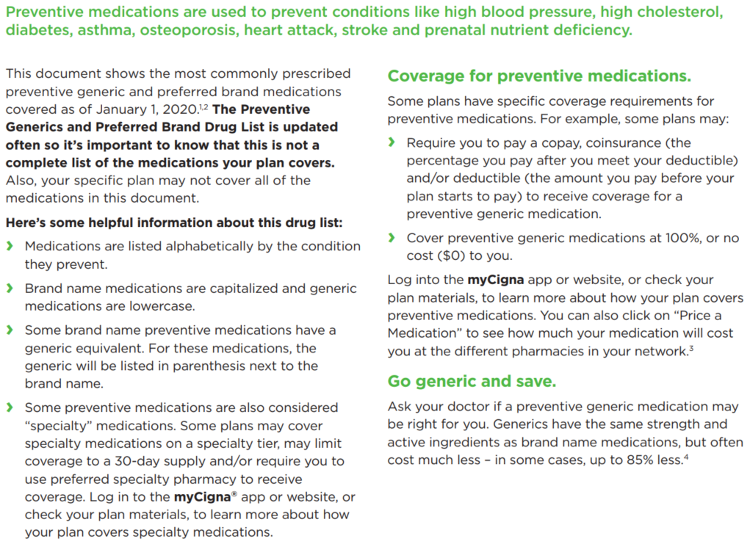
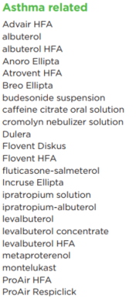
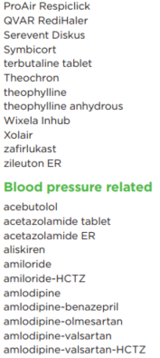
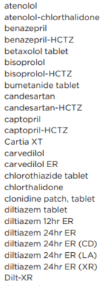
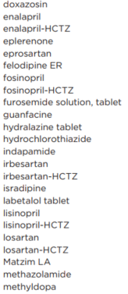
Rx Benefits
Health Insurance

Slide 9
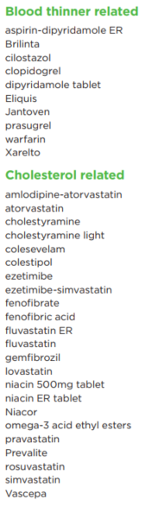
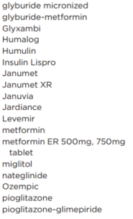
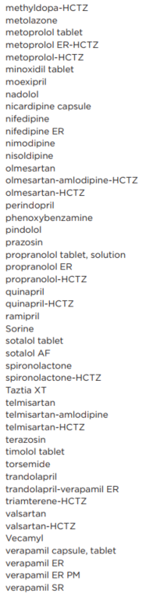
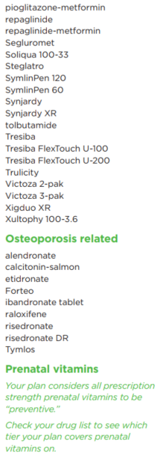
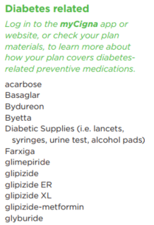
Rx Benefits
continued
Telemedicine

Slide 10
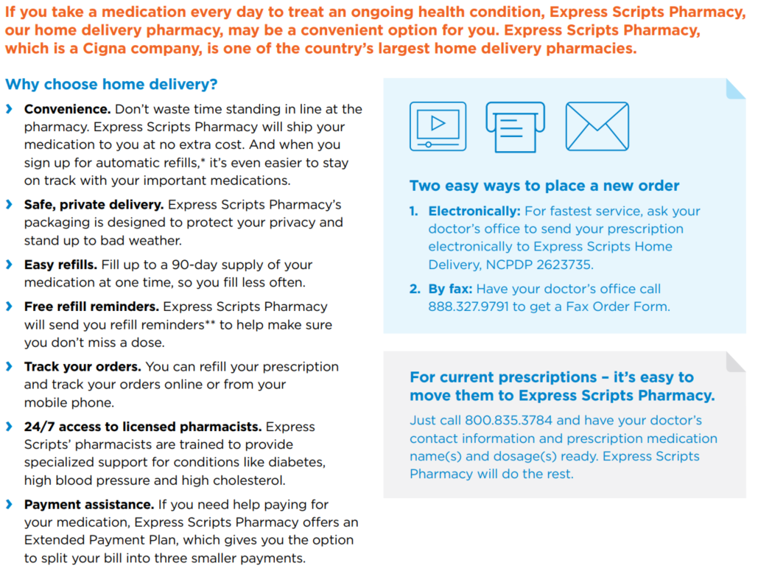
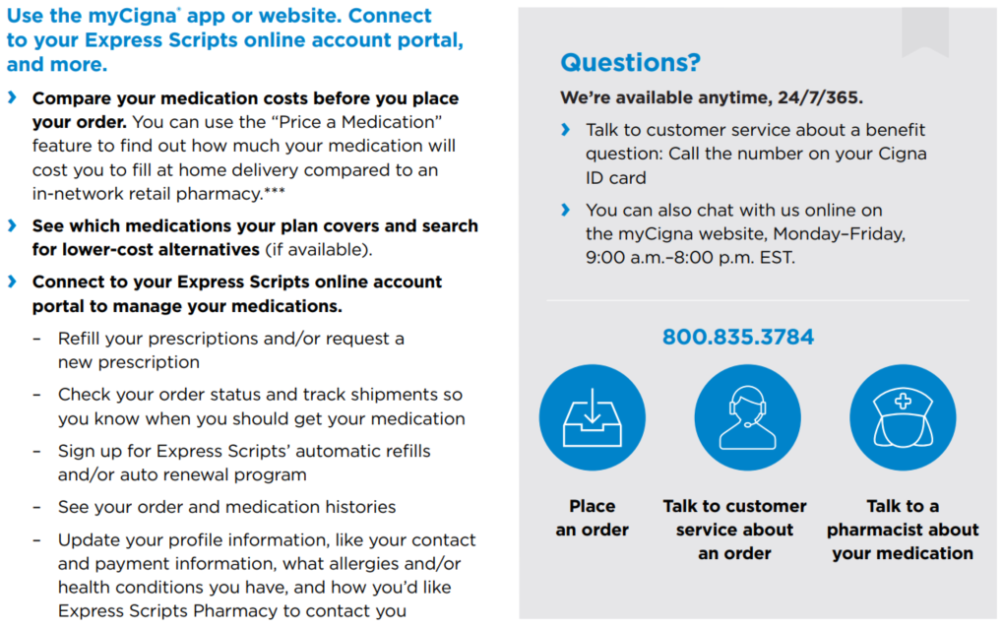
Express Scripts Pharmacy
Health Insurance

Slide 11

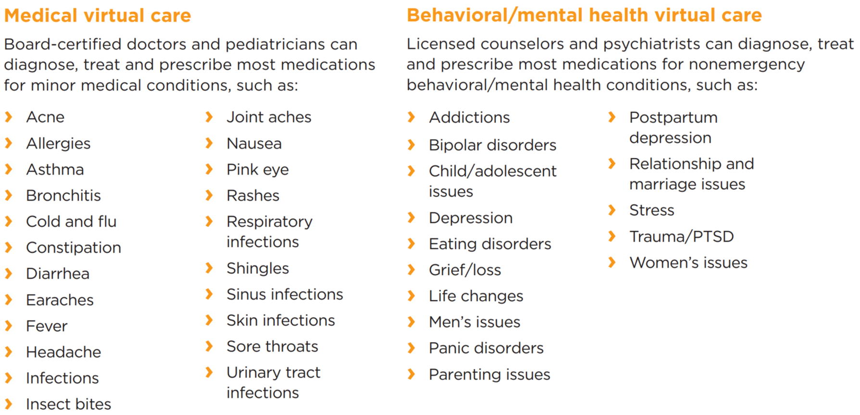
Telemedicine v Telehealth
Telemedicine
Accessed through app MD Live
Medical & Behavioral Mental Health Virtual Care
With a licensed NH provider
Under Cigna plan should cost $55 Copay
866-726-3171 or www.mycigna.com
Telehealth
Virtual care with your (local?) provider(s)
Has gained popularity during the Covid-19 pandemic
Charges subject to normal cost sharing – under your Cigna plan, that means charges are subject to your deductible
Telemedicine

Slide 12
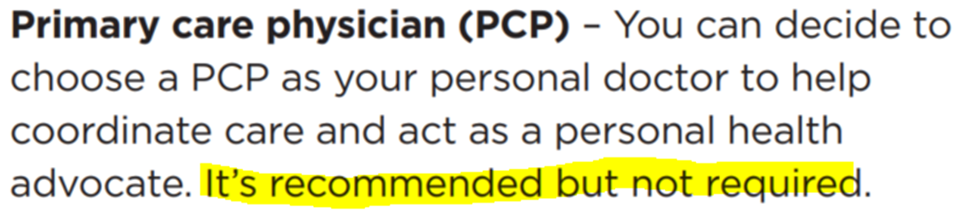
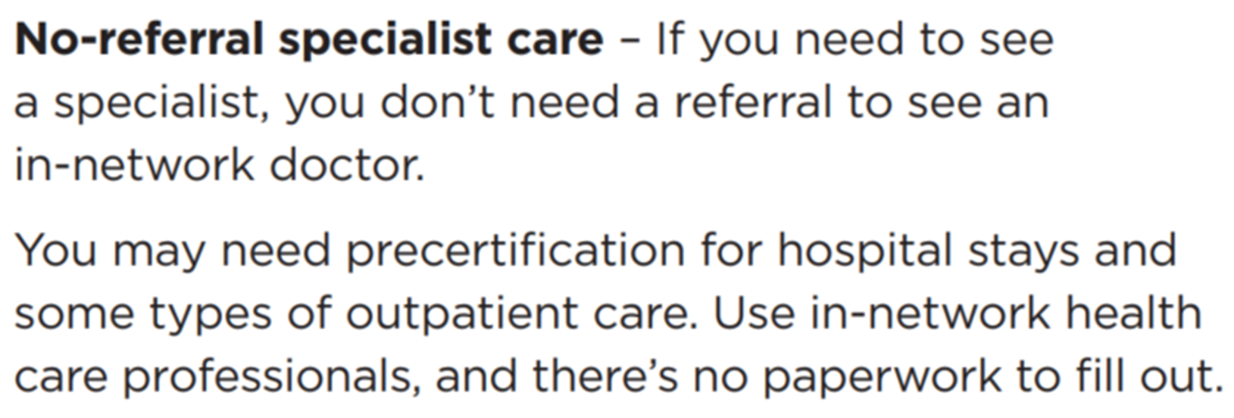
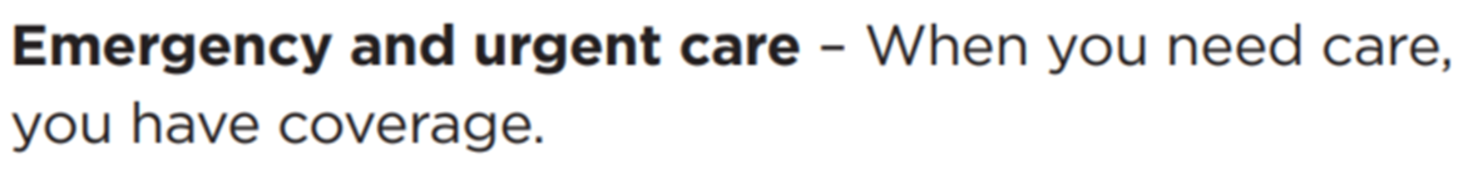
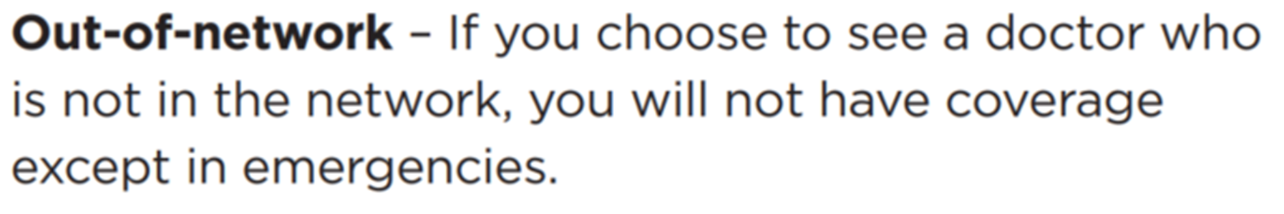



Cigna Providers
W.S. Badger’s health insurance plan operates on Cigna’s Open Access Plus network
Health Insurance
To find your providers: https://www.cigna.com

Slide 13
Health Reimbursement Account
W.S. Badger has generously established a Health Reimbursement Account (HRA) to minimize your exposure to the costs of using your insurance. Beginning 10/1/20, Cigna will manage the HRA.
If you are enrolled in a Badger Harvard Pilgrim plan through 9/30/20 and have incurred deductible expenses since January 2020, Cigna will give you deductible credit for those expenses.
When you have medical services that are subject to the deductible you will pay the first $1,400 (or $2,800 if you have dependents on your plan). Once you incur $1,401/$2,801 in deductible expenses, the HRA* will pay until you’ve reached $5,001/$10,001, when Cigna will cover in-network eligible services in full.
*NEW beginning 10/1/20, the HRA will pay providers directly for services. You will no longer pay providers for amounts $1401-$5000.
For Rx Reimbursements:
You will pay for all prescription drugs with personal funds/credit card
Once you have reached $1400 in medical services & Rx you can submit for reimbursement through the HRA
  Through Portal: Mycigna.com
  Fax: 303-729-7437
  Mail to: Cigna, PO Box 188061, Chattanooga TN 37422
Telemedicine

Slide 14

Health Insurance Employee Cost
W.S. Badger will pay 70% of the cost of health insurance coverage for employees and their dependents.
For coverage 10/1/20 – 9/30/21 your bi-weekly payroll deductions will be:
Health Insurance

Slide 15

Health Savings Account
Cigna’s plan is HSA-eligible, which means you might be able to establish and fund a Health Savings Account (HSA).
HSAs are tripled tax-advantaged personally owned savings accounts where contributions are tax deductible, growth is tax free, and distributions to pay for qualified medical expenses (including vision and dental) for yourself and your tax dependents*, are tax-free.
In order to make or receive HSA contributions, you may NOT have “first dollar coverage” for medical services up to $1400 or $2800. This means you may NOT be enrolled in Medicare, a partner’s plan, full purpose FSA, VA plan, etc.
*Most domestic partners are NOT tax dependents, and therefore while they can be enrolled in your health insurance plan, you may NOT use your HSA funds for their expenses.
Mascoma Bank allows Badgers to establish fee-free HSA accounts.
Ways to contribute to your HSA:
Badger Wellness Fund
Payroll Deduction
Direct contributions from personal savings, checking, etc
As gifts from others on your behalf
Telemedicine

Slide 16

Flexible Spending Accounts
W.S. Badger offers both health (FSA) and dependent care (DCA) flexible spending accounts. Employees may contribute pre-tax dollars into these accounts to help offset eligible medical expenses or dependent care expenses. Beginning in 2020, these plans will be administered by American Benefits Group www.amben.com .
The Health Care FSA is available to all regular full-time or part-time employees, whether or not they participate in Badger’s health insurance plan.
Health Care FSA
Funds from a health care FSA can be used for qualified expenses including medical, dental, vision, deductibles*, co-payments and coinsurance. For a full list of qualified expenses allowed by the IRS, see Publication 502 (www.irs.gov/publications/p502).
If you fund an HSA account, you will be eligible for a Limited Purpose FSA which you can use for vision and dental services only.
A debit card will be issued to all participants enrolled in the medical FSA. In 2020 the maximum allowable contribution amount is $2,750.
With an FSA, the entire elected amount is available on the first day of the health plan year. Plan Year 10/1/20 – 9/30/21
Dependent Care FSA
A dependent care FSA allows employees to set aside pre-tax dollars to pay for qualified dependent care expenses. Funds can be used to pay for day care, preschool, elderly care or other dependent care. To qualify for a dependent care FSA, the IRS requires that the dependent care is necessary for you or your spouse to work, look for work or attend school full-time.
In 2020 the maximum amount you may contribute to the dependent care FSA is $5,000* (if single or married & filing jointly) or $2,500* (if married & filing separately)
Please note that the DCA is 100% employee funded and is only available to use as monetary contributions are made. Plan year 1/1/21-12/31/21
Visit www.amben.com for more information including tools to calculate your tax benefits and election amount estimators.
For enrollment forms, direct deposit forms, please contact Human Resources, visit www.amben.com, or call American Benefits Group at 855-294-7010.
Flexible Spending Accounts

Slide 17
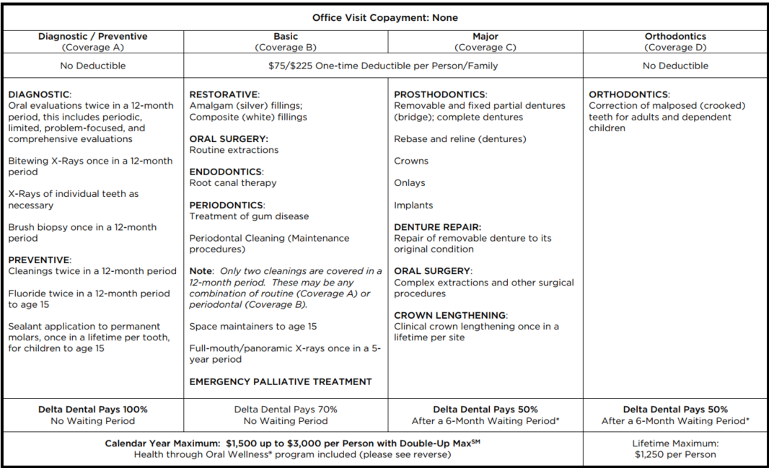
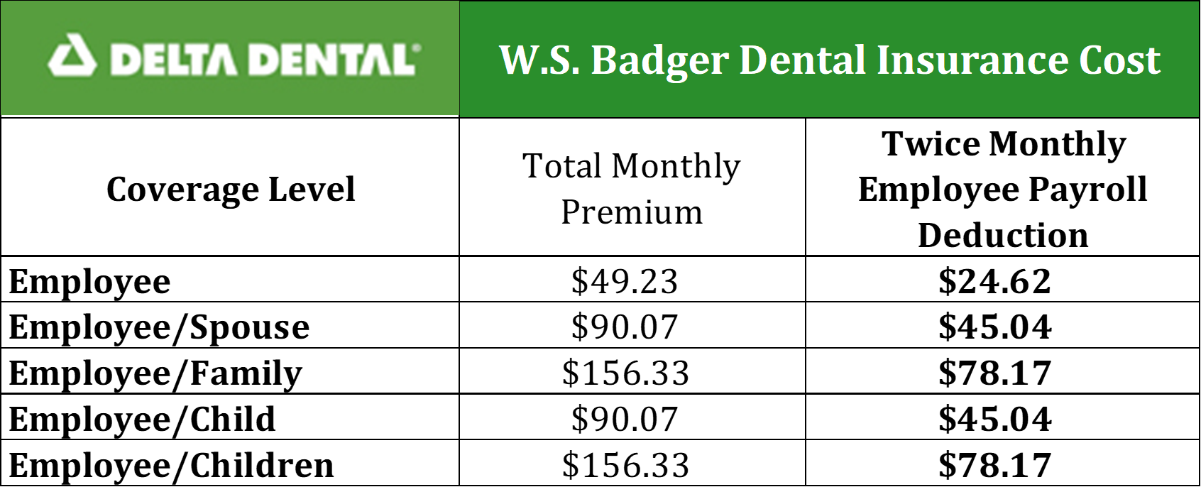
Dental Insurance
W. S. Badger offers one dental plan through Delta Dental. Summary of Benefits:
Dental Insurance
Delta Dental Provider Lookup: https://nedelta.com/Providers

Slide 18

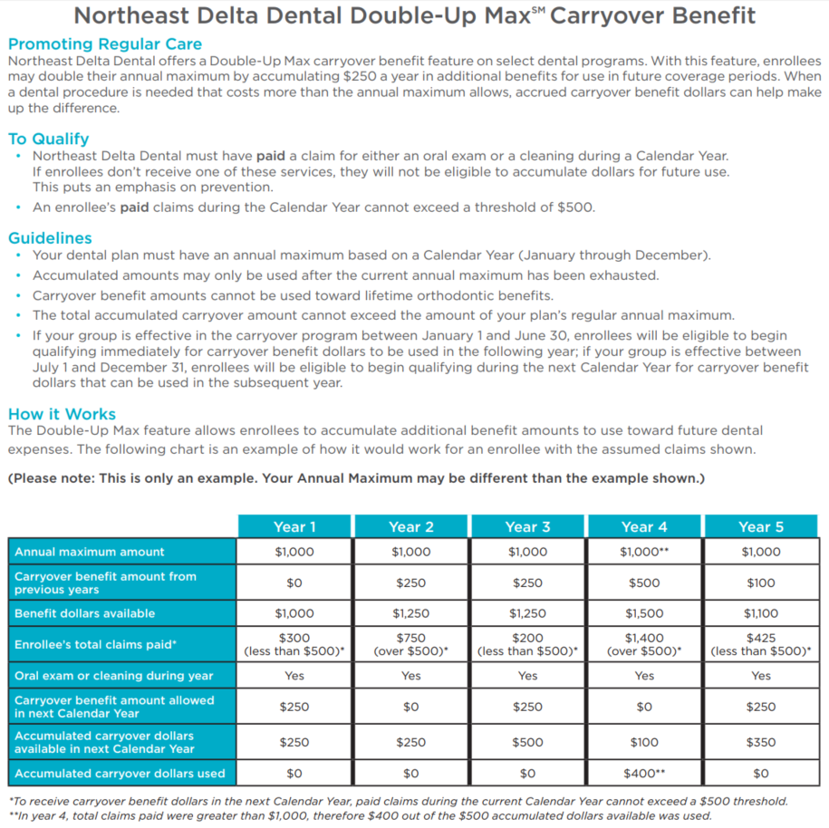
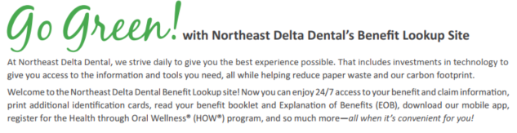
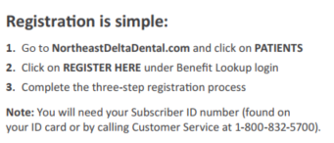
Dental Insurance
Dental Insurance

Slide 19
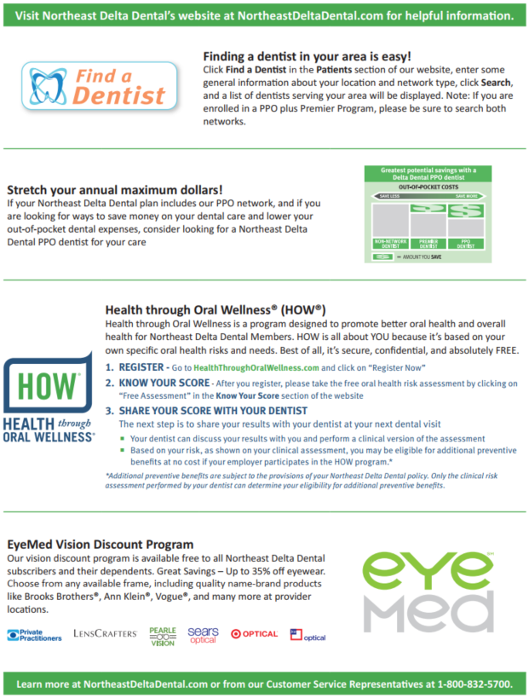
Dental Insurance
Dental Insurance

Slide 20

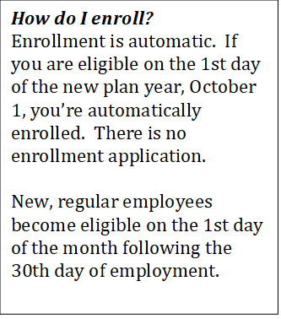
Badger Wellness Fund
W.S. Badger funds and administers our own general health and wellness reimbursement plan. The Badger Wellness Fund reimburses for both qualified and specific non-qualified expenses used to maintain good health.
Total available Wellness Fund dollars for full-time, regular employees for the October 1, 2020 – September 30, 2021 plan year is $1,000. Part-time employees receive a prorated amount.
Once a year, at open enrollment, employees may choose to contribute money from their Wellness Funds into their H.S.A. Employees may elect to contribute any portion of their wellness funds (up to $1,000) but are unable to change their decision throughout the year. This one-time lump sum employer funding is tax benefited.
With money not contributed to a Health Savings Account:
Reimbursement is a taxable benefit, paid to you in your biweekly payroll check. Your balance is prorated if you become eligible after October 1.
Funds not spent in 2019-20 do not roll over to the plan next year.
Expenses incurred by dependent family members are eligible for reimbursement.
You can use your Wellness Fund reimbursement for items such as athletic equipment (ie, a bicycle or skis), a fitness center membership or dance classes for your child. If you are enrolled in a medical plan other than Badger’s, you could use Wellness Funds to reimburse yourself for out-of-pocket medical expenses like co-pays and deductibles, or for vision or dental care.
Additional information about the Badger Wellness Fund and reimbursement forms are available from Human Resources or in Badger share drive at: S:\Administration\Human Resources\1. HR Public\3. EMPLOYEE BENEFITS INFO.
Badger Wellness Fund

Slide 21
Life, AD&D and Disability
Life, AD&D and Disability Insurance can plan an important role in reducing financial stress when a family is faced with the pre-mature death or disability of a wage-earner. To help employees during critical times of need, through Lincoln Financial Group, Badger provides employer paid Life Insurance, Short Term Disability and Long Term Disability Insurance.
Basic Life AD&D Insurance
(100% Employer Paid)
Eligibility is the first of the month following 30 days of employment for employees who work 20 hours or more per week.
Eligible employees are automatically enrolled in Basic Life AD&D Insurance
Coverage is 1x annual earnings to a maximum of $150,000
Benefits are reduced by 65% at age 65; 50% at age 70; 35% at age 75
Short Term Disability Insurance (STD)
(100% Employer Paid)
Eligibility is the first of the month following 30 days of employment for employees who work 20 hours or more per week
Eligible employees are automatically enrolled in Short Term Disability Insurance
Coverage is 60% of pre-disability weekly earnings to a maximum of $2,000 per week
Benefits begin on the 1st day of a disabling injury/accident and on the 8th day of a disabling illness
The maximum benefit period is up to 13 weeks
Long Term Disability Insurance (LTD)
(100% Employer Paid)
Eligibility is the first of the month following 30 days of employment for employees who work 20 hours or more per week
Eligible employees are automatically enrolled in Long Term Disability Insurance
Coverage is 60% of pre-disability weekly earnings to a maximum of $2,000 per week
Benefits begin on the 1st day of a disabling injury/accident and on the 8th day of a disabling illness
The maximum benefit period is up to 13 weeks
Life, AD&D and Disability
Review your beneficiaries and visit lfg.com or see HR to update if needed.

Slide 22
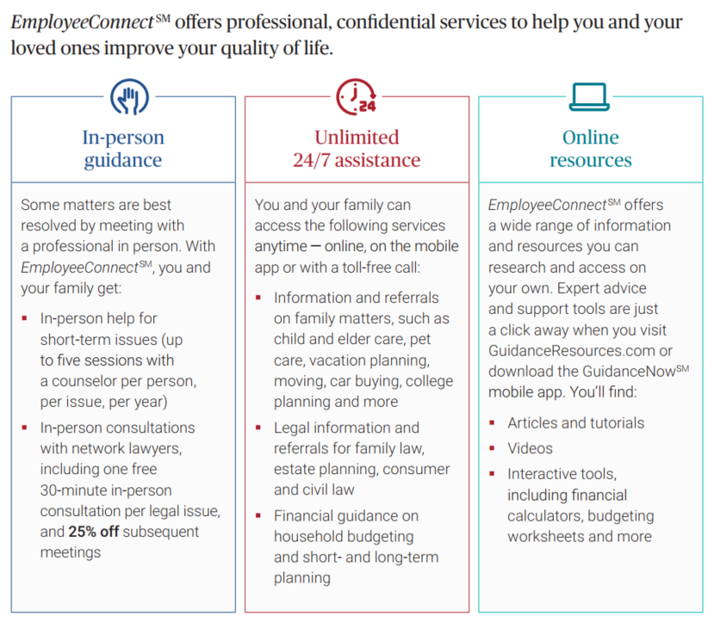
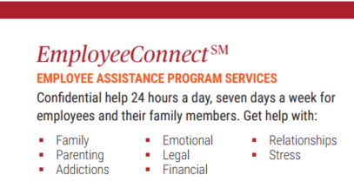
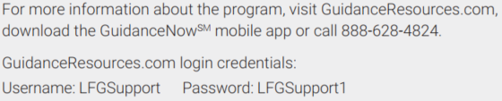
Employee Assistance Program
Employee Assistance Program

Slide 23

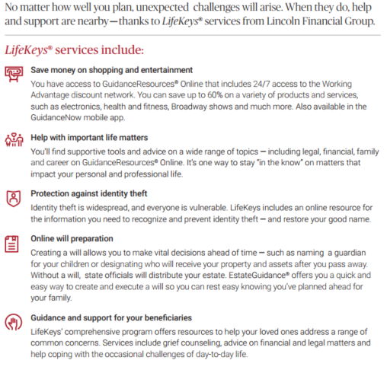
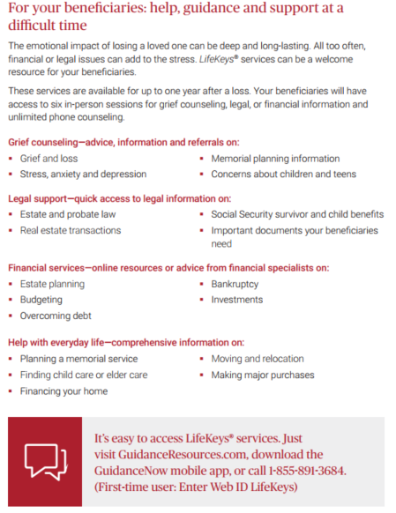

LifeKeys
LifeKeys

Slide 24
2020
Employee Benefit Summary
Medical | Dental | Life | Disability |FSA | DCA | EAP |Retirement
768 Route 10 Gilsum, NH 03448
www.badgerbalm.com

