Slide 1
Benefit Summary
January 1, 2023
Medical / HRA
Vision
Dental
Life/AD&D
Optional Life
Founded over thirty years ago, Silver Forest started selling its distinctive jewelry at Craft Shows throughout the Northeast. We are widely credited with developing the first casual earring line. Today, Silver Forest jewelry can be found in Retailers throughout the United States and Canada. Silver Forest jewelry is hand crafted in Bellows Falls, Vermont.
Optional Short- Term Disability
Natural elements, ancient cultures and a subtle sense of humor influence our designs. Our artistic use of stones, textured metals and color has always set us apart from our competition. Denim friendly and casual, Silver Forest is not a trend it is a lifestyle, which is why we continue to be a top selling jewelry brand.
The benefits outlined in the following pages are designed to support your health and well-being and enable you to achieve maximum peace of mind with a minimum of financial anxiety. Our goal is to provide Silver Forest employees with high quality and affordable insurance coverage, and we ask that in return, you become a wise healthcare consumer.
401(k) Plan
Paid Time Off (PTO)
We encourage you to contact Carlene Hellus for additional information on any of the benefits that we offer.
Employee Assistance Program
Our Mission:
Our mission at Silver Forest is to create wearable art that is as timeless and unique as you.
Silver Forest, 40 Industrial Drive, Bellows Falls, VT 05101, 800-922-9946

Slide 2
Contact Information ⎯
Refer to this list when you need to contact one of your benefit vendors. For general information contact Carlene Hellus at 802-463-3996.
M E D I C A L :
Provider Name
Provider CS Phone Number Provider Pharmacy Info Provider Web Address
MVP Health Care 800-348-8515
800-378-9295
www.mvphealthcare.com
H E A L T H R E I M B U R S E M E N T A R R A N G E M E N T ( H R A ) :
Provider Name
MVP Health Care
My Spending Accounts Team 888-222-9931
315-234-6146
www.mywealthcareonline.com/mvphealthcare MySpendingAccounts@mvphealthcare.com
Provider CS Phone Number Provider CS Fax Number Provider Web Address Provider Email Address
V I S I O N :
Provider Name
Provider MS Phone Number Provider Web Address
Vision Service Plan (VSP) 800-877-7195
www.vsp.com
D E N T A L : _ _ _ _ _ _ _ _ _ _ _ _ _ _ _ _ _ _ _ _ _ _ _ _ _ _ _ _ _ _ _ _ _ _ _ _ _ _ _ _ _ _ _ _
Provider Name
Provider Phone Number Provider Web Address
Northeast Delta Dental 800-832-5700
www.nedelta.com
R E T I R E M E N T P L A N : _ _ _ _ _ _ _ _ _ _ _ _ _ _ _ _ _ _ _ _ _ _ _ _ _ _ _ _ _ _ _ _ _ _
Provider Name
Provider Phone Number Provider Web Address
Empower Retirement 855-756-4738
www.participant.empower-retirement.com
L I F E , A D & D , S H O R T - T E R M D I S A B I L I T Y : _ _ _ _ _ _
Provider Name
For Any Questions
Lincoln Financial Group See Carlene Hellus
E M P L O Y E E A S S I S T A N C E P R O G R A M : _ _ _ _ _ _ _ _ _ _ _ _ _ _ _ _ _ _ _ _
Provider Name
Provider Phone Number Provider Web Address
Invest EAP 866-660-9533
www.investeap.com

Slide 3
Eligibility:
All full time employees working a minimum of 30 hours per week. Insurance Benefits begin the first of the month following 2 months of continuous employment in regular full-time status. See 401(k) retirement section for that benefit eligibility.
Medical Insurance ⎯
MVP Health Care
For 2023 we will continue to offer the MVP Gold high deductible plan with and without the accompanying Health Reimbursement Account (HRA). Choosing the plan without the HRA allows for a much lower employee payroll deduction which may appeal to those employees who have minimal maintenance claims and are looking for a lower premium.
Plan Option 1:
High Deductible Health Plan—HRA Medical Service Category: | MVP Health Care (High deductible medical plan) | MVP Administrators (Silver Forest funded HRA)
Preventive and Well Care Services Well baby, child care, immunizations Adult Annual Physical Mammography Screening Prostate Cancer Screening Annual Pap Test & Ob/Gyn Exam Immunizations for Adults Colonoscopy, Sigmoidoscopy for Adults Bone Density Tests | Covered in Full, No Deductible | No Funding Necessary; Paid by MVP Health Care
Deductible | $3,200 individual; $6,400 family
Co-Insurance | Covered at 100% of allowed charges after deductible is met | All eligible medical and
 |  | prescription services and
General Out-of-Pocket Maximum Prescription Out-of-Pocket Maximum | $3,200 individual; $6,400 family $1,400 individual; $2,800 family | supplies subject to the
 |  | deductible are paid 100% from
 |  | first dollar, up to the maximum
 |  | HRA benefits for Individual or
Lifetime Maximum Benefit Payable | Unlimited
 |  | Family shown below.
Hospital: Hospital Inpatient Hospital Outpatient Surgery Hospital Outpatient Other Physician Office Visits Physician Inpatient Care Second Surgical Opinion (optional) Diagnostic Lab and Other Testing Maternity Physician and Hospital Services Physical/Occupational/Speech Therapy Ambulance Home Health Care Emergency Room (ER) Visit Urgent Care Center Mental Health Inpatient and Outpatient Substance Abuse Inpatient and Outpatient Chiropractic Benefit Durable Medical Equipment/Ostemy Supplies | Covered at 100% of allowed charges, after the deductible is met | The SF HRA Plan Pays:
 |  | 100% of the Individual
 |  | Deductible to a maximum
 |  | benefit of $3,200
 |  | 100% of the Family Deductible
 |  | to a maximum benefit of $6,400
 |  | Participant Pays:
 |  | 0% of the Individual Deductible;
 |  | 0% of the Family Deductible

Slide 4
High Deductible Health Plan—HRA Medical Service Category: | MVP Health Care (High deductible medical plan) | MVP Administrators (Silver Forest funded HRA)
Prescription Drug Benefit Tier 1 (mostly generics) Tier 2 (mostly preferred brands) Tier 3 (mostly non preferred brands) | $0 copay after deductible is met $0 copay after deductible is met $0 copay after deductible is met Wellness prescriptions are not subject to the deductible and are paid subject to: $10 (Tier 1), $15 (Tier 2), and 5% (Tier 3) | Eligible prescriptions are funded by the HRA
Notes: If you have dependents covered on your plan, the entire $6,400 deductible must be met by any combination of family members before MVP pays benefits Some services are subject to notification requirement – see your certificate for details A network provider must deliver all care Use your HRA debit card for Prescription Drugs only; MVP will pay medical claims directly to the provider when HRA funds are available This summary chart is intended to provide a general outline of coverage. In the event of any conflict between this document and your certificate of coverage, your certificate will be controlling. Children to age 26 are eligible for coverage
Premiums: Silver Forest funds 100% of the Health Reimbursement Account (HRA) on behalf of our participants. The medical premium cost is shared between Silver Forest and the Employee Participant. The deductions include the VSP vision plan of benefits.
Employee Premiums: | Employee Only | Employee/Spouse; Employee/Child(ren) | Family
Weekly Premium Deduction | $109.25 | $241.50 | $326.60
Plan Option 2:
Plan Option 2 is exactly the same as Plan Option 1, but without access to the Health Reimbursement Account (HRA). You will be responsible for paying all plan out-of-pocket expenses during 2023 but your payroll deduction is significantly lower than Plan Option 1.
Employee Premiums: | Employee Only | Employee/Spouse; Employee/Child(ren) | Family
Weekly Premium Deduction | $60.50 | $143.75 | $200.00
Health Reimbursement Account ⎯
Silver Forest / MVP Administrators
Silver Forest will fund expenses that are covered under Plan Option 1’s medical deductible 100% up to a maximum benefit of $3,200 for individuals and $6,400 for families; participants pay no plan out of pocket.
Eligible expenses must be incurred between January 1, 2023 and December 31, 2023 and processed by MVP Administrators for reimbursement by June 30, 2024
MVP Administrators uploads claims from the MVP medical claim system directly so few claims should need substantiation from the participant; however, the participant should keep receipts if MVP has a question.
MVP will pay the provider directly and send you an explanation of benefits (EOB); you will not need to pay your provider but make sure the HRA payment matches what your EOB indicates it should be. You will have a debit card to pay for eligible Rx. Do no pay your medical provider for services with your debit card.

Slide 5
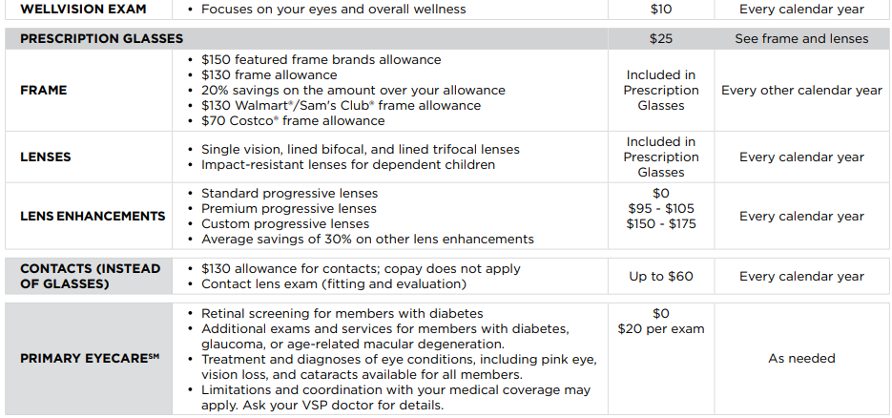
Vision Plan ⎯
Vision Service Plan (VSP)
A vision plan is offered through Vision Service Plan (VSP) when you are covered on the Silver Forest medical plan through MVP. VSP is the largest vision benefit administrator in the country with many providers in our region.
VSP (Vision Service Plan) offers benefits through a network of participating providers
$10 copay on eye exams every 12 months
$25 copay for lenses every 12 months, covered in full
Frames are covered every 24 months, limited to $130 plus 20% off any out-of-pocket charges
Elective contact lenses and the associated exam are covered up to $130 instead of glasses
Necessary contact lenses are paid in full at participating providers for those with a specific condition; up to
$210 allowance at affiliate providers
Out of Network provider services have limited reimbursements based on a schedule (see contract for details)
Voluntary Vision Plan ⎯
Vision Service Plan (VSP)
A VOLUNTARY vision plan is offered through Vision Service Plan (VSP) for those who choose not to enroll in the Medical Plan through MVP. VSP is the largest vision benefit administrator in the country with many providers in our region.
The Voluntary Vision Plan is the same plan and provides the same benefits as the Vision Plan automatically provided to those employees who enroll in the Medical Plan.
Employee Premiums: | Employee Only | Employee/Spouse; Employee/Child(ren) | Family
Weekly Premium Deduction | $1.83 | $2.99 | $4.82

Slide 6
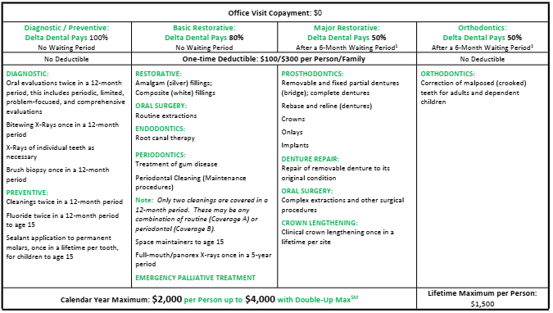
Dental Insurance ⎯
Northeast Delta Dental
Plan PPO Premier
Premiums: Silver Forest funds 50% of the dental premium with Delta Dental on behalf of our participants. The deductions for 2023 have decreased!
Employee Contribution: | Single | 2 Person | Family
52 Deductions per year | $5.12 | $9.37 | $16.37
Life & AD&D Insurance ⎯
Lincoln Financial Group
Basic Life and AD&D Insurance (100% Silver Forest funded)
A flat benefit of $20,000
Includes accidental death and dismemberment benefits
Benefits reduce by 50% upon reaching age 70
Optional Life Insurance (100% employee funded)
5 times average annual salary to a maximum of $500,000, in $10,000 increments
The guarantee issue for an employee is $100,000, a spouse is $25,000 and a child is $10,000 during your initial eligibility; medical evidence will be required if you apply for benefits after your initial eligibility
This plan is portable for up to 3 years upon terminating current employment
Some restrictions apply – see the policy for details

Slide 7
Short-Term Disability ⎯
Lincoln Financial Group
Voluntary Short-Term Disability Insurance (100% employee funded)
Benefit begin after a waiting period of 0 days for accidents and 7 days for sicknesses
Benefit is up to 70% of current base rate of pay to a maximum of $750/week
The maximum benefit period is 26 weeks per eligible disability
Benefits are available for part time earnings
There is a pre-existing condition limitation for conditions you have seen a medical provider or taken medication in the 6 months prior to your coverage effective date and will not be covered until you have been on the plan continuously for 12 months
Paid Time Off (PTO) ⎯
Silver Forest
In-House Employees
Benefits begin accruing your first day of employment and are available for use when employment status is permanent, full-time.
Paid time off is based on accumulated hours worked per week. Silver Forest will provide you with up to 15 days of paid time off for a full year of employment.
Employees are eligible for an additional 5 days of paid time off after 5 years of service. And another 5 days of paid time off after 15 years of service.
Employees with less than 5 years of service can carry forward up to 120 hours of accrued paid time off from one year to the next. Those employees with more than 5 years but less than 15 years of service can carry forward up to 160 hours. And employees with more than 15 years can carry forward 200 hours.
See Carlene Hellus for details
Pieceworkers
Benefits begin accruing your first day of employment and are available for use when employment status is permanent, full-time.
Paid time off is based on accumulated hours worked per week. Silver Forest will provide you with up to 5 days of paid time off for a full year of employment.
Employees are eligible for an additional 5 days of paid time off after 10 years of service. And another 5 days of paid time off after 20 years of service.
Employees with less than 5 years of service can carry forward up to 40 hours of accrued paid time off from one year to the next. Those employees with more than 5 years but less than 10 years of service can carry forward up to 80 hours. And employees with more than 20 years can carry forward 120 hours.
See Carlene Hellus for details

Slide 8
Employee Assistance Program ⎯
Invest EAP
Everyone experiences difficulties in their personal and working lives at some point. The invest EAP plan is available to provide free, easy access to confidential short-term counseling and advisory services to assist in coping with a broad range of potential problems.
Services cover:
Workplace and relationship issues
Personal issues such as anxiety, depression and stress
Legal and Financial matters
Child and Eldercare assistance
Online Web Password is SILVER
All employees and their household members, including civil union partners, may use this program
⎯ 401(k) Plan ⎯
Empower Retirement
Benefits are available with regular full time status and begin after 1 year of employment at regular full time and has worked a minimum of 1,000 hours
Annual contribution limits set by the federal government; new 2023 limits are $20,500; a catch up amount of $6,500 is available to participants 50 and older
Forms to be completed if making changes:
Enrollment/Change Form for new enrollees or to make changes to your MVP medical or Delta Dental plans
2023 Employee Election form to indicate benefit plan choices and deductions
Voluntary Life and Short-term Disability insurance enrollment form if adding or changing coverage
Life Insurance Beneficiary form if changing your beneficiary designation
Contact the Carlene Hellus in the Finance Office at 802-463-3996 with any questions or to return forms.
Note: See plan booklets for detailed description of benefits as well as plan limitations
The text contained i n this Guide was taken f rom various summary plan descriptions and benefit i nformation. While every effort was taken to accurately report your benefits, discrepancies or errors are always pos s i ble. I n case of a discrepancy between the Guide and the actual plan documents, the actual plan documents will prevail. All i nformation i s confidential, pursuant to the Health Insurance Portability and Accountability Act ( HIPAA) of 1996 . I f you have any questions about your Guide, see Carlene Hellus.

