Slide 1

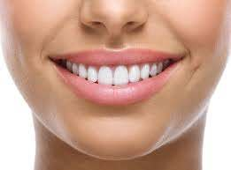
Promoting Regular Care
Northeast Delta Dental offers a Double-Up Max carryover benefit feature on your plan. With this feature, enrollees in the Northeast Delta Dental Plan may double their annual maximum by accumulating $250 a year in additional benefits for use in future coverage periods. This carryover amount can be used in subsequent years for dental procedures that costs more than the annual maximum allows. Accrued carryover benefit dollars can help make up the difference and keep costs down for the member.
How to Qualify – it’s simple!
Receive preventive care, an oral exam or cleaning during the Calendar Year.
Your total paid claims during that Calendar Year do not exceed $500.
If you meet both these requirements then Northeast Delta Dental will automatically carryover $250 for future benefits.
Notes:
Northeast

Slide 2
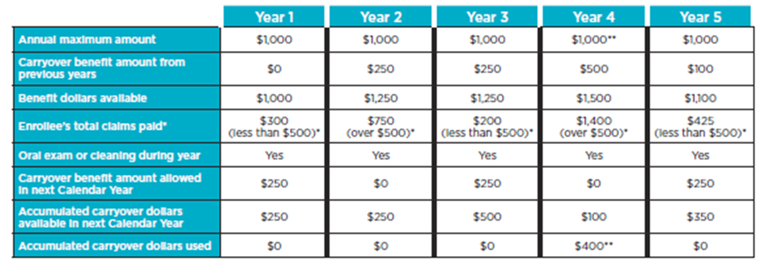
How it works!
Let’s look at an example of how the carryover maximum helps for future dental costs.
(Please note: This is only an example. Your Annual Maximum may be different than the example shown.)
* To receive carryover benefit dollars for future use, paid claims during the current Calendar Year cannot exceed a $500 threshold.
** In Year 4, total claims paid were greater than $1,000, therefore $400 out of the $500 accumulated dollars that were available were used.
Carryover dollars remain available to you until you use them and for as long as you are on the plan.
To view your Carryover dollars available to you, please visit our secure Patient Benefit Lookup Portal at nedelta.com/patients. Register or login to view your benefits and carryover dollars.
Notes:
Let’s look at an example of how the carryover maximum helps for future dental costs. In this particular example, the member’s annual maximum per year is $1,000. In year 1, the first year of coverage there is no carryover benefit from previous years, Total claims paid for the calendar year are $300, less than the $500 annual threshold and the member had at least one exam or cleaning during the calendar year so they qualified for the carryover benefit of $250.
In year 2, the benefit dollars available is $1,250, $1,000 annual maximum and $250 in Carryover dollars. Total claims paid in year 2 were $750, over the $500 threshold so although the member has an exam or cleaning they were not eligible for additional carryover dollars due to the total claims paid of $750.
Year 3, the benefit dollars available are again $1,250. Total claims paid was under the $500 threshold and at least one exam or cleaning occurred, qualifying the member for $250 carryover benefit for a total of $500 in accumulated carryover benefit.
Using the carryover benefits is shown in year 4. The total benefit dollars available is $1,500, $1,000 is the annual maximum and $500 is carryover from years 1 & 3. Total claims for that year was $1,400 of which $1,000 was used from the annual maximum and $400 was used from the accumulated carryover, leaving a balance of $100 of carryover available.
In year 5, the members available benefit dollars is $1,100. Their total claims paid was less than $500 and they had a least an exam or cleaning qualifying them for the $250 carryover benefit. When added to the $100 previously carried over gives them a total of $350 in available carryover.
Carryover dollars remain available to you until you use them or for as long as you are enrolled in the plan. To view the carryover dollars available to you please visit our secure Patient Benefit Lookup portal at nedelta.com. Register or login to view your benefits and carryover dollars. You may also call our customer service department at 1-800-832-5700.

