Slide 1
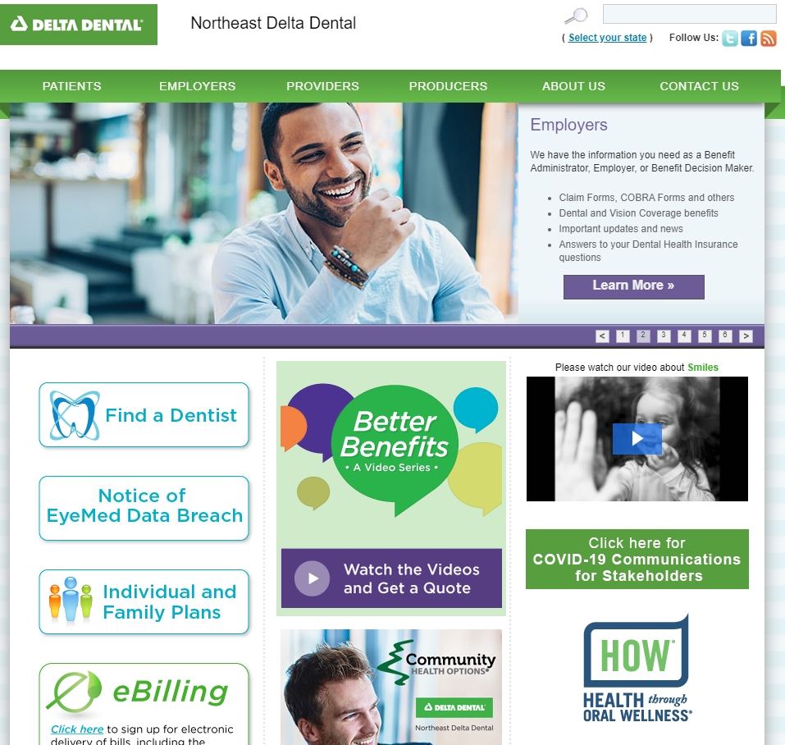
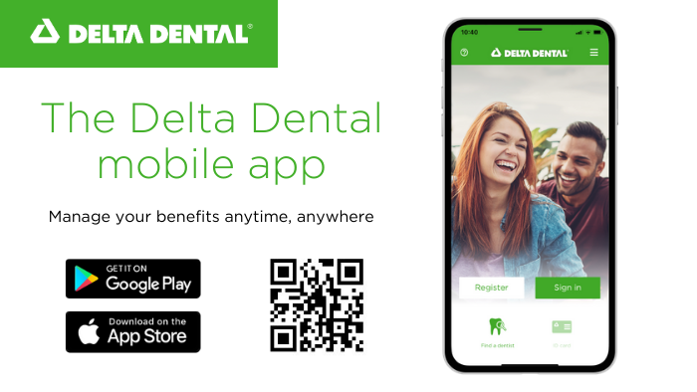
Northeast Delta Dental
Patient Portal & Mobile App
Notes:
Welcome to Northeast Delta Dentals review of the Patient Benefit Portal and Mobile app.

Slide 2
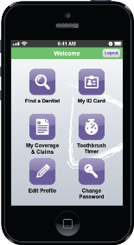
Online Tools at NEDelta.com
Find Claim and Benefit Information
View and Print EOBs
Access Dental Plan Documents
Print Additional ID Cards
Search for a network dentist
Register for Health through Oral Wellness (HOW) program
Download helpful forms and information
Delta Dental Mobile App
Notes:
Northeast Delta Dental provides all the access to your benefits paper-free whether it be online at nedelta.com or through the mobile app. The Patient Benefit Lookup portion of nedelta.com is where you will find claim and benefit information, view and print your Explanation of Benefits, access your plan documents, or print any additional or replacement cards you need. Right from our home page, you can search for an in-network dentist by clinking on the Find a Dentist button. Also on the home page, you’ll see the HOW logo where you can click to register for the Health Through Oral Wellness program. Additional oral health information and useful forms can be found on our website as well. Or download the Delta Dental Mobile app from the app or google play store for your digital ID card, benefit information and to search for an in-network provider.

Slide 3
nedelta.com
Notes:
This is an image of the home page on our website, nedelta.com. This is where you can see the Find a Dentist tool, as well as the HOW logo to link to our HOW website. Click on Patients at the top to access the Patient Benefit Lookup portion of our site.

Slide 4
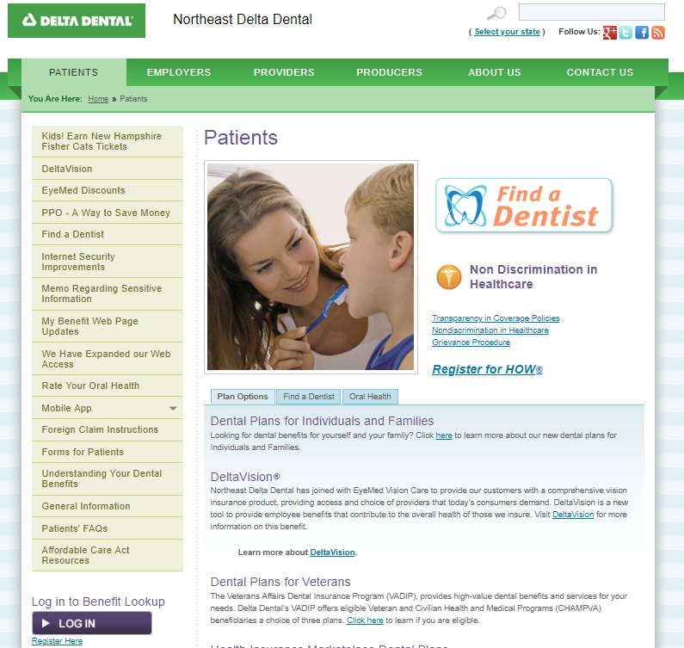
Benefit Lookup nedelta.com/patients
Register/Log In to access your Benefits
Notes:
Under the Patients tab, you can look up your benefits and claims, print ID cards and access useful tools and information. Register and login today.

Slide 5
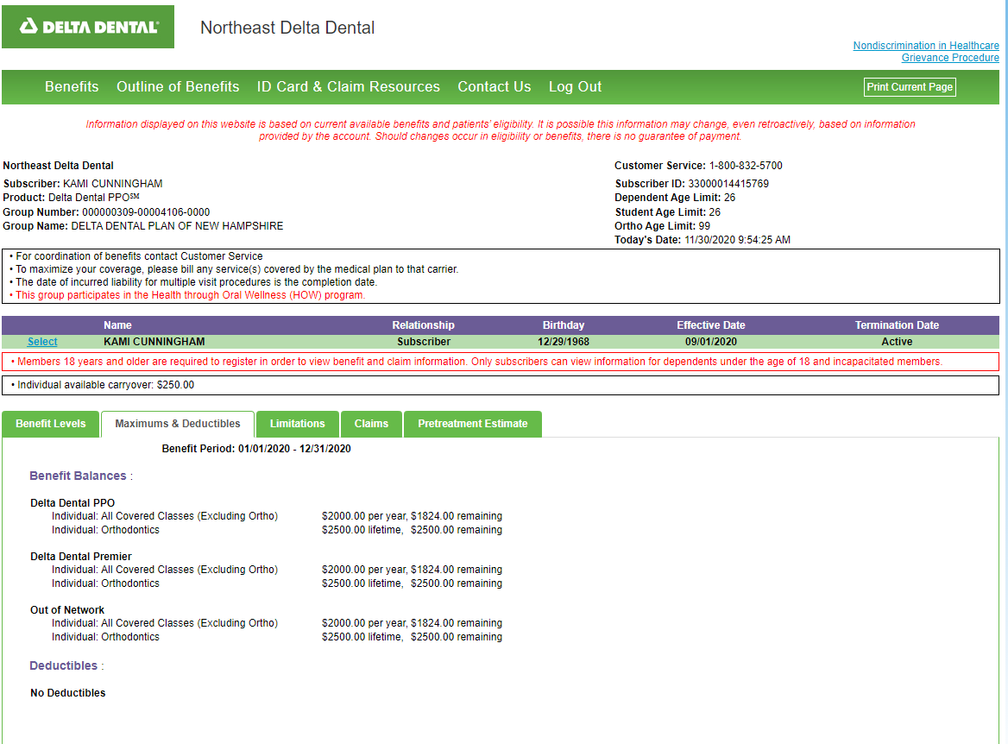
Benefit Lookup
Notes:
Once you log in you can view details of your benefits under the Benefits tab. Where you are with your annual maximum and if you’ve had the Oral Health Risk Assessment and qualified for extra preventive benefits you’ll see those added benefits here. You’ll also find your claims and any pretreatment estimates, which are recommended for services with cost share.

Slide 6
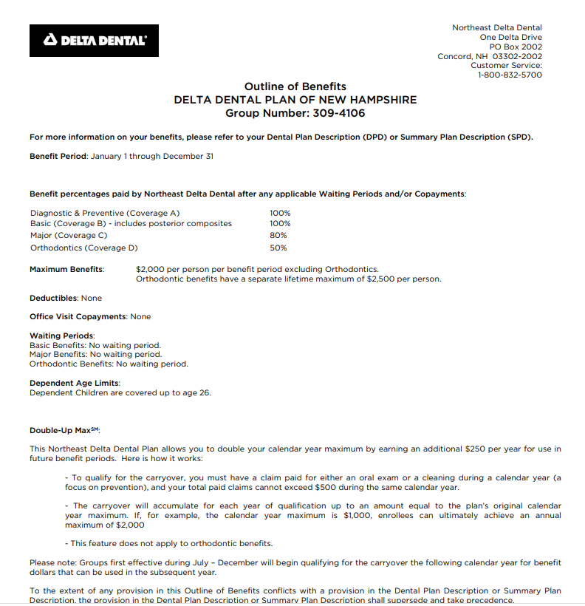
Notes:
You can view your Outline of Benefits under the Outline of Benefits tab. The Outline of Benefits will provide a high level overview of your benefits.

Slide 7
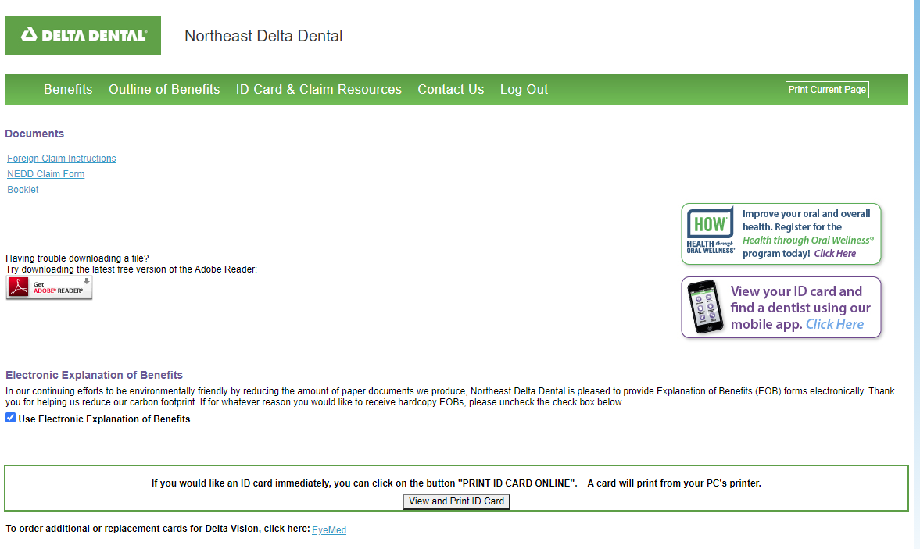
For Claim Resources or to print a new ID Card go to the ID Card & Claims Resources Tab
Notes:
You can print additional or replacement ID cards, review your plan booklet and claim’s information under the ID Card and Claim Resources tab.

Slide 8
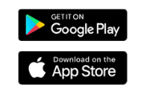
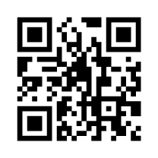
Download the Delta Dental Mobile App for your benefits & ID Card at your fingertips
Notes:
And if you prefer to have your benefits at your fingertips you can download the Delta Dental Mobile app. You’re ID card will be visible as well as all your coverage and claims information. You can also search for a dentist on the mobile app which is convenient if you’re looking for a provider in your area or when being referred to a specialist from your providers office.

Slide 9
Questions: Contact Northeast Delta Dental Customer Service at 1-800-832-5700 or customerservice@nedelta.com Website: www.nedelta.com
Notes:
So whether you use the secure benefit lookup portal, the mobile app or both you’ll find all your plan benefits easily and paperless.
If you have questions on your dental benefits please contact your Human Resources or Benefit Department or refer to your Outline of Coverage and/or certificate of insurance, access your patient portal, or contact our customer service department.

