Slide 1
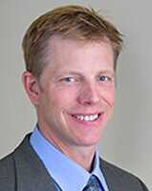
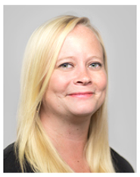
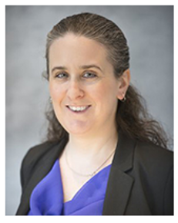
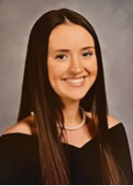
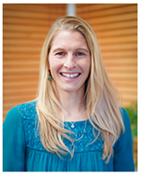
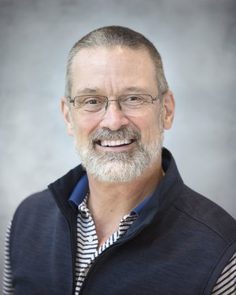
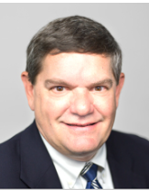
2022 Employee Benefits
TRG Team
Name | Title | Phone | Email | Resource
Tom Scull | Vice President | O: (802) 251-3839 C: (802) 233-2071 | tscull@therichardsgrp.com | Strategy & Underwriting
Johanna Keefe | Senior Account Executive | O: (802) 747-6650 C: (802) 342-6656 | jkeefe@therichardsgrp.com | Overall Account Management
Betsy Ploof | Senior Account Manager | O: (802) 251-3847 C: (802) 738-5399 | bploof@therichardsgrp.com | Day to Day Service
Shannon Watelet | Account Manager | O: (802) 747-6650 | swatelet@therichardsgrp.com | TRG Deliverables
Lindsay Simpson | Organizational Wellness Lead | O: (802) 251-3803 | lsimpson@therichardsgrp.com | Wellness Guidance
Ross Gibson | COO, Employee Benefits | O: (802) 251-3793 | rgibson@therichardsgrp.com | Human Resource Management
Steve Burnett | Investment Advisor Rep. | O: (802) 251-3818 | sburnett@therichardsgrp.com | Retirement Plan Advisory

